Slide 1

Data Visualization in R for Data Science
Universitas Airlangga, 4 September 2018
Nanda Prasetya Pamungkas

Slide 2
Overview
Basic Plot
Dot Plot
Boxplot
Bar Chart
Histogram

Slide 3
Basic Plot
library("datasets")
data("pressure") #data(pressure)works,too
plot(pressure)
#alternative
with(pressure,plot(temperature,pressure))

Slide 4
Basic Plot
plot(pressure, type = "p", main="pressuredata")
Type :
p : point
l : line
b : both
h : histogram
Main : Judul Gambar

Slide 5
Dot Plot
data(iris) #loadirisdata
pch.vec<-c(16 ,2 ,3)[iris$Species]
col.vec<-c(16 ,2 ,3)[iris$Species]
plot(iris$Sepal.Length,iris$Sepal.Width,
col=col.vec,pch=pch.vec)

Slide 6
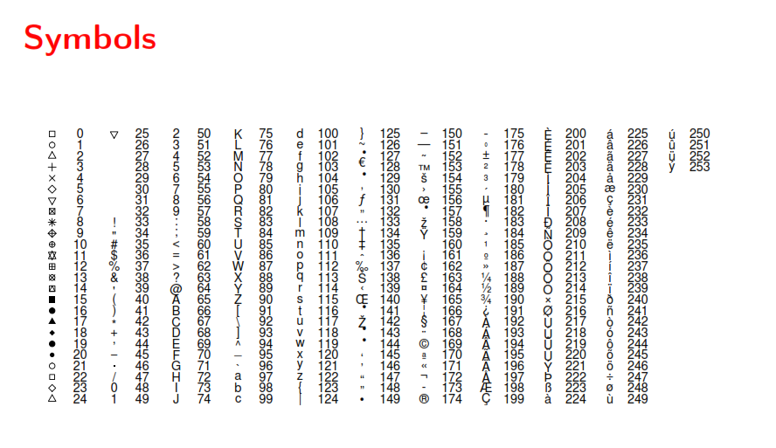

Slide 7
Boxplot
Simple
boxplot(InsectSprays$count)
Multiple
boxplot(InsectSprays)

Slide 8
Boxplot
Separated by Factor
boxplot(count ~ spray, data = InsectSprays)

Slide 9
Barchart
barplot(VADeaths)

Slide 10
Histogram
hist(iris$Sepal.Length)

Slide 11
Do Like This

