Slide 1

Programming in R for Data Science
Universitas Airlangga, 18 September 2018
Nanda Prasetya Pamungkas

Slide 2
Overview
Loops
Conditions
Functions

Slide 3
Loops and Conditions - IF
#simpleif
x<-1
if(x==2){print("x=2") }
#if-else
x<-1
if(x==2){
print("x=2")
} else {
print("x!=2")}

Slide 4
Loops and Conditions - FOR
for(i in 1:4) {print(i) }
for(i in letters[1:4]) {print(i) }
a<-numeric(400)
#generate empty a of length 400
for(i in 1:400) {a[i]=i} #fill a with 1:400 #takes much longer than a <- 1:400

Slide 5
Loops and Conditionds - While, Repeat
i<-0
while(i<4){
i<-i+1
print(i)
}
i<-0 ;
repeat{
i<-i+1 ;
print(i) ;
if(i==4)break
}

Slide 6
Loops and Conditionds - IFELSE
x<-c(6:-4)
sqrt(x) #gives warning
sqrt(ifelse(x>=0,x,NA)) #no warning

Slide 7
Loops and Conditionds - Measures
x<-c(1:50000)
system.time(for(i in 1:50000) {x[i]<-rnorm(1) })
system.time(x<-rnorm(50000) )

Slide 8
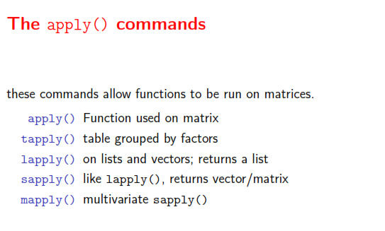

Slide 9
apply()
matrix(1:10 ,nrow=2) ->a
apply(a,1,mean)
apply(a,2,mean)

Slide 10
lapply(), sapply(), mapply()
matrix(2:11 ,nrow=2) ->a
matrix(1:10 ,nrow=2) ->b
c=list(a,b)
lapply(c,mean)
sapply(c,mean)
mapply(rep,pi, 3:1)

Slide 11
tapply()
data(iris)
attach(iris)
tapply(Sepal.Width,Species,mean)

Slide 12
Functions
myfun<-function(x){
return(x*x)
}
myfun(2)
myfun<-function(x){
x*x
}
myfun(2)

Slide 13
Functions
myfun<-function(x, a){
r<-a*sin(x)
return(r)
}
myfun(pi/2 ,2)
myfun1<-function(x, a){a*sin(x) } #short version
myfun1(pi/2 ,2)

Slide 14
Function
How to make a default?
If not default, what else?
How to make two list result in one function?
myfun(pi/2)
[[1]] [1] 1
[[2]] [1] 6.123032e-17

Slide 15
Functions - SWITCH
rootsquare<-function(x, type) {
switch(type,
square=x*x,
root=sqrt(x))
}
rootsquare(10 ,1)
rootsquare(10 ,2)

Slide 16
Functions - SWITCH
Make Random Cauchy distribution and determine mean, median, and trimmed mean 0,1 with function!

