Slide 1
E2E TESTING WITH TESTCAFE AND CUCUMBER.JS
Renato Ćurić | DevOps Engineer

Slide 2

TALK AGENDA
Introduction
What is TestCafe?
What is Cucumber?
How does it work?
Demo
Questions

Slide 3
INTRODUCTION

Slide 4

End-to-end testing is where you test your whole application from start to finish. It involves assuring that all the integrated pieces of an application function and work together as expected.

Slide 5
WHAT IS TESTCAFE?

Slide 6

TESTCAFE IS
A Node.js tool to automate end-to-end web that is:
Free and open source
Easy to set up
Working on all popular environments
With TestCafe we can:
Run test on multiple browsers on multiple platforms
Write stable tests in latest JS and TS versions
Integrate our tests with CI
Notes:
Uses web proxy to run tests – URL rewrite
If you use Selenium you need web drivers for platforms and for that platform for each browser – hassle
Run test on remote browsers including mobile
Isolated testing – each time a browser is opened by testCafe it is like a incognito window
Automatic waiting for page loads
Write test in the language you write you application – JS TS
Waits for page loads
Speedy setup
Browser support

Slide 7
WHAT IS CUCUMBER.JS?

Slide 8

CUCUMBER.JS IS
What does Cucumber actually provide for us:
A single point of truth
Living documentation
Focus on the customer
Less rework
a JavaScript implementation of Cucumber and it is used for running automated tests written in plain language

Slide 9
HOW DOES IT WORK?

Slide 10
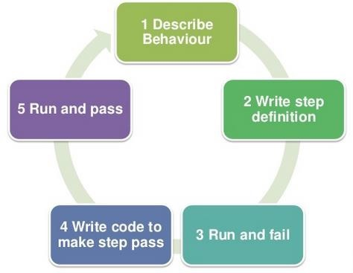
HOW DOES IT WORK?
THE CONCEPT ON WHICH WE BASE OUR WORKFLOW
WITH THIS CONCEPT WE PUT EMPHASIS ON
COLLABORATION AND AUTOMATION

Slide 11
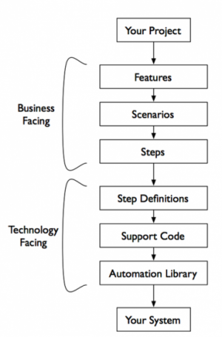
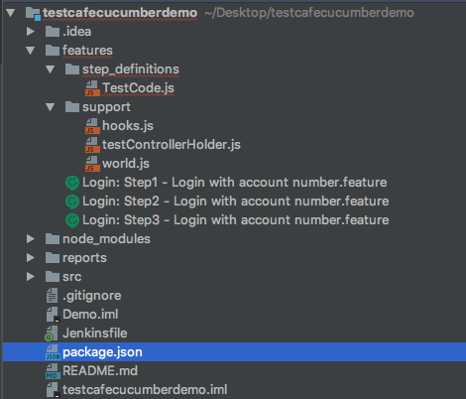
CUCUMBER TECH STACK

Slide 12
DEMO

Slide 13
QUESTIONS

Slide 14
THANK YOU
www.reply.com

Slide 15



