Slide 1
Statistical Analysis of Economic Data
Data Visualization ISM 6419.001
Ninad Mehta

Slide 2
About the Dataset
From United States government census official website (https://www.census.gov/)
Economic characteristics
Employment
Occupation
How did people commute to work?
Income
Industries
Technology Used: Power BI

Slide 3
Main idea for the presentation
Economic development of states
Which industries are blooming
How did people commute to work?
How much they are earning?
Government Vs Private sectors

Slide 4
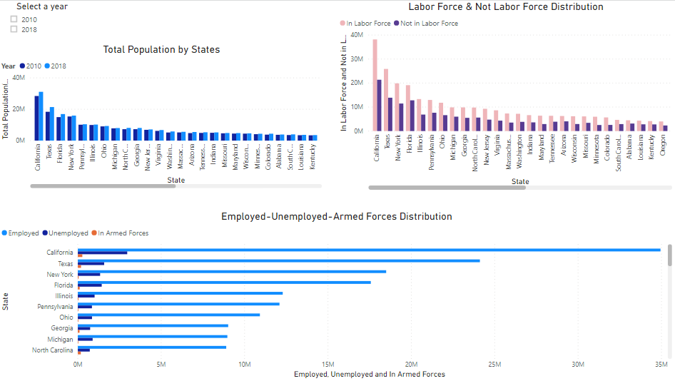
Report 1

Slide 5
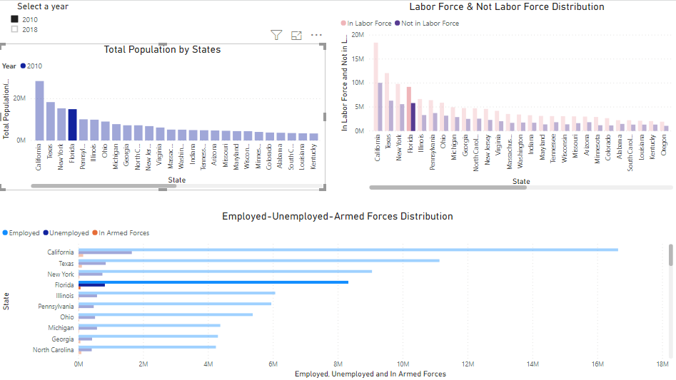
Report 1

Slide 6
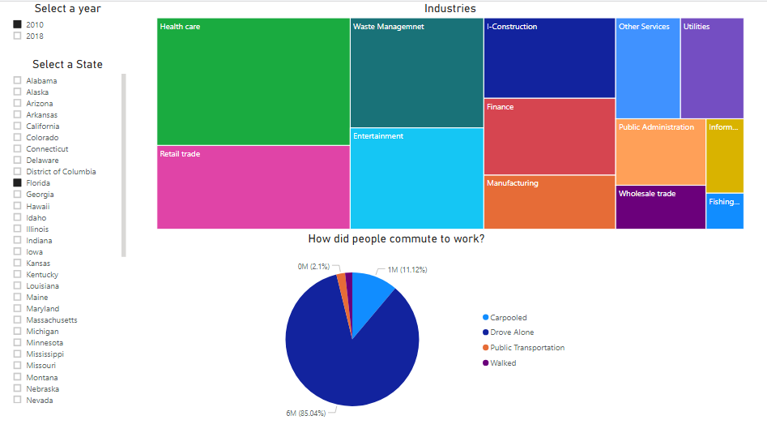
Report 2

Slide 7
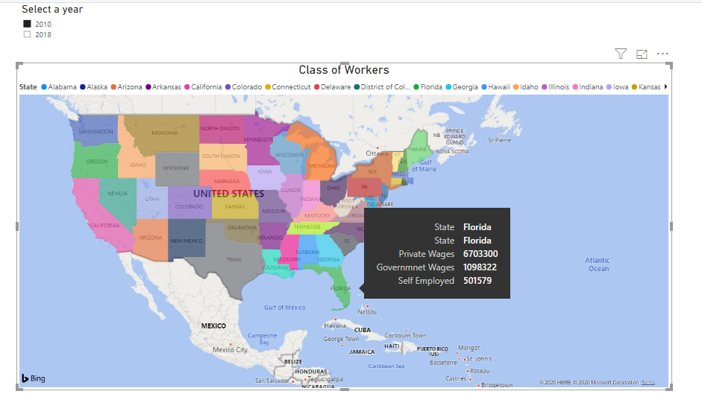
Report 3

Slide 8
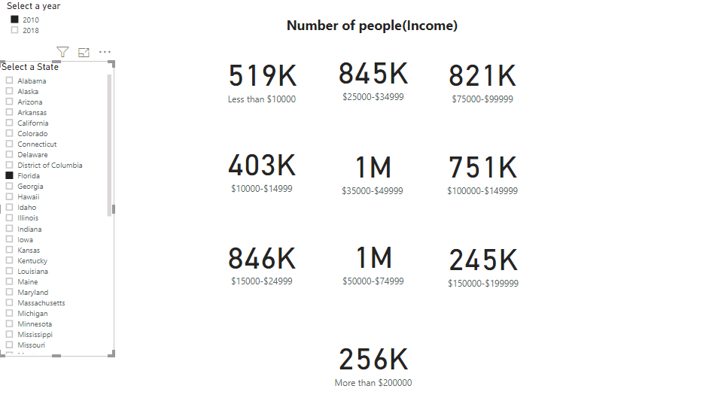
Report 4

Slide 9
Business Value
Useful for all the states governments
People who are applying for jobs

Slide 10
Thank you!

