Slide 1
TweetNERD
End to End Entity Linking Benchmark for Tweets
Shubhanshu Mishra, Aman Saini, Raheleh Makki, Sneha Mehta, Aria Haghighi, Ali Mollahosseini
Twitter, Inc.
ArXiv: https://arxiv.org/abs/2210.08129
Dataset: https://doi.org/10.5281/zenodo.6617192
Code: https://github.com/twitter-research/TweetNERD
NeurIPS 2022 Datasets and Benchmarks
Notes:
Hi everyone,
I am Shubhanshu from Twitter.
We present TweetNERD, an End to End Entity Linking Benchmark for Tweets.

Slide 2

Named Entity Recognition and Disambiguation (NERD)
Knowledge Base (Wikidata)
NeurIPS is the biggest ML conference. In 2022, it will be held in NOLA.
Malayalam (Q36236)
Mali (Q912)
ML …
(8454 other entities)
Malayalam (Q36236)
Mali (Q912)
ML …
(8454 other entities)
ML prog. lang (Q860654)
machine learning (Q2539)
millilitre (Q2332346)
ML prog. lang (Q860654)
machine learning (Q2539)
millilitre (Q2332346)
NeurIPS is the biggest ML conference. In 2022, it will be held in NOLA.
NeurIPS is the biggest ML conference. In 2022, it will be held in NOLA.
NeurIPS is the biggest ML conference. In 2022, it will be held in NOLA.
NER - Named Entity Recognition
Candidate Generation
Entity Disambiguation
Notes:
Named Entity Recognition and Disambiguation or NERD aims at (click)
Identifying Named Entities in a Given Text (click)
And then among all the possible candidates for that entity in a Knowledge Base (click)
Linking it to the most likely one give the context.

Slide 3
Challenges for NERD on Tweets
Finding the correct entity could require context around the Tweet
Users can use creative spellings
Tweets are very short (max 280 chars)
Small existing publicly available benchmarks for NERD on Tweets
Notes:
However, NERD when applied to Tweet has a few challenges.
These include lack of context, creative spellings, short texts, and the availability of small publicly available benchmarks for Tweets.

Slide 4
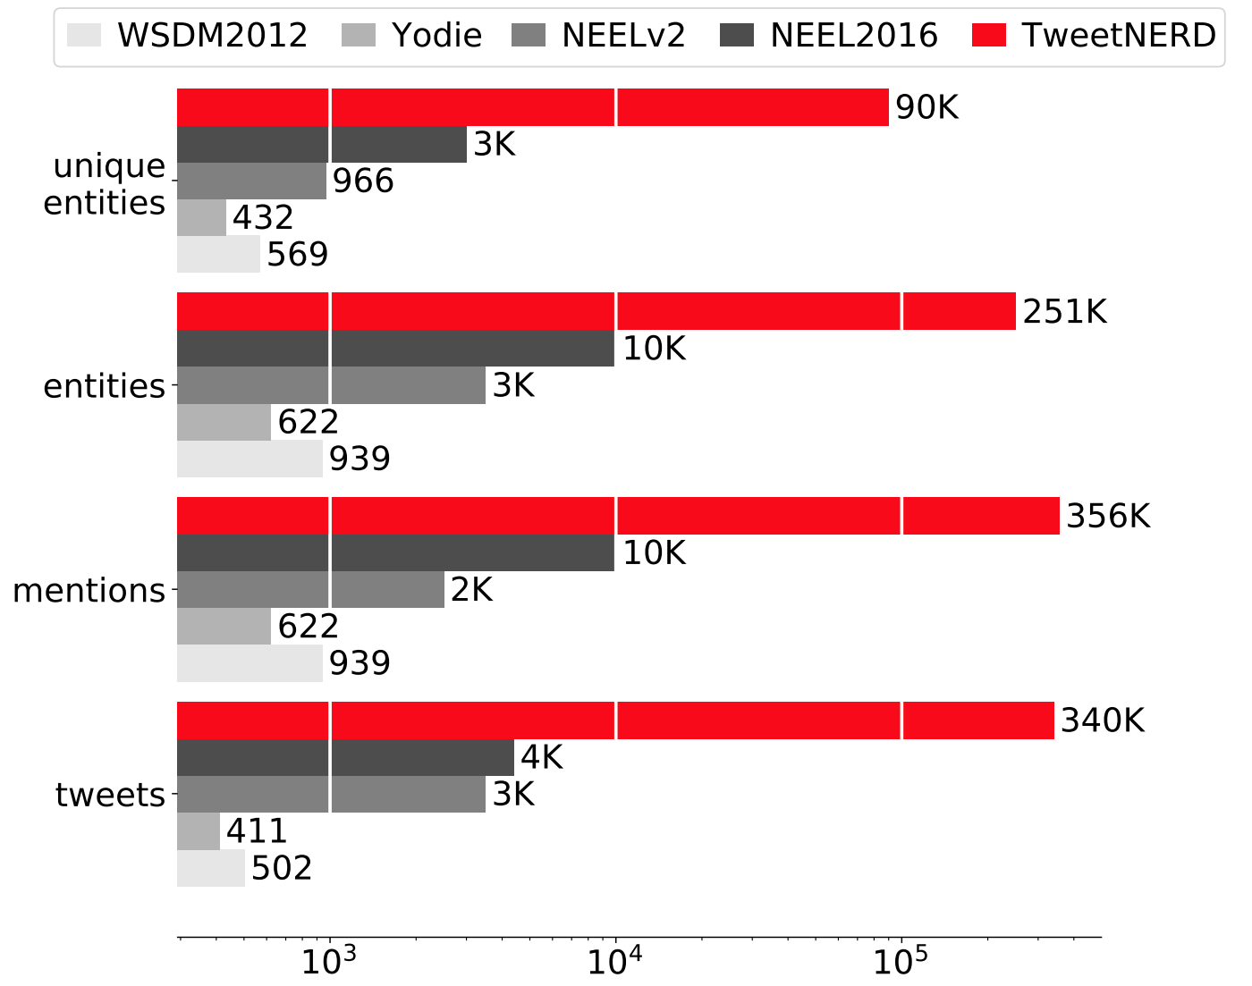
Existing NERD datasets for Tweets
Notes:
The research community has previously shared a few benchmarks for NERD on Tweets.
However, these are often small, with largest ones having around 10K Tweet samples.

Slide 5
TweetNERD - Largest NERD dataset for Tweets
Notes:
We release TweetNERD which is the largest and temporally most diverse dataset of NERD on Tweets. (click)
It consists of 340K+ Tweets with more than 90K entities.

Slide 6
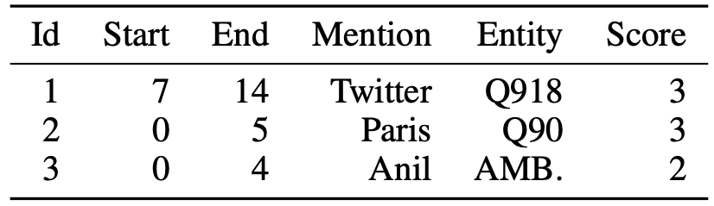
TweetNERD: Overview
Available at: https://doi.org/10.5281/zenodo.6617192 under Creative Commons Attribution 4.0 International (CC BY 4.0) license.
Scripts for processing TweetNERD can be found at: https://github.com/twitter-research/TweetNERD
Entities linked to Wikidata via QID: Multilingual Public Knowledge Base.
Released Data Format.
Should be hydrated via Public Twitter API.
Notes:
TweetNERD is distributed publicly as Tweet IDs, span offset, and linked Entities.
We link each entity to Wikidata which is a public multilingual knowledge base.
It must be reconstructed using the Public Twitter API.

Slide 7
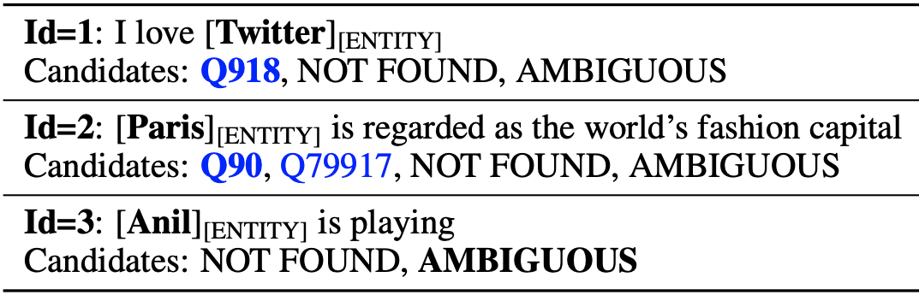
TweetNERD: Annotation
Each Tweet annotated by 3 annotators. Majority is marked as gold.
Annotators asked to use Tweet context, media, and time in making decision.
Annotators select named entity span in Tweet and link it to Wikidata QID or AMBIGUOUS or NOT_FOUND.
Entities Types: Person, Place, Organization, Products, Works of Art, Scientific Concepts
Entities can be Hashtags, or words or phrases in Tweet.
Notes:
Each Tweet is annotated by 3 annotators with majority marked as gold.
Annotated used context around the Tweet to make their annotation decision.
We also include Hashtags as possible annotation spans.

Slide 8
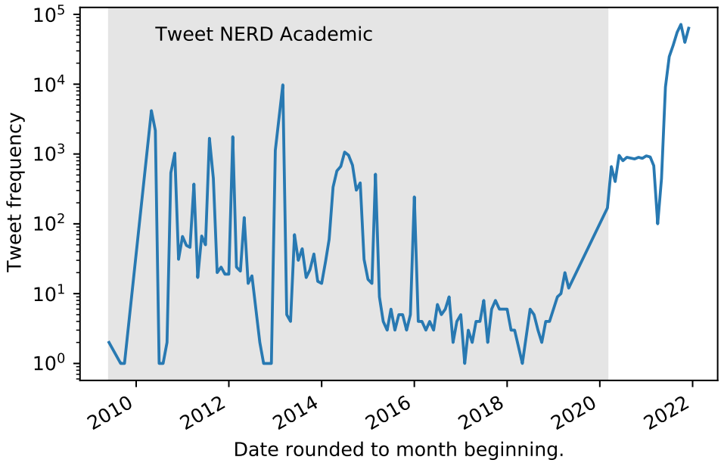
TweetNERD: Data Sampling
Random sampling gives low hit rate for Tweets with Entities.
Sample Tweets which have NER, phrase match with Wikidata
Use phrase entropy to select Tweets with easy and difficult phrases.
340K Tweets collected in rounds of 25K Tweets.
Tweets from 2010 to 2022.
Notes:
Sampling Tweets for NERD is challenging as Random Sampling will return few Tweets with Entities.
Instead we use a mix of strategies based on existing NER system and phrase matches from Wikidata for sampling Tweets.
Furthermore, in order to ensure a wide variety of Entities we use phrase entropy to select phrases with varying difficulty.
We conduct annotation in multiple rounds each with 25K Tweets.
Finally, TweetNERD consists of around 340K Tweets from 2010-2022 making it the largest and temporally most diverse NERD benchmarks for Tweets.

Slide 9
TweetNERD Test Splits: TweetNERD-OOD
25K Tweets used for evaluating existing named entity recognition and linking models.
TweetNERD-OOD is sampled in equal proportion based on the entropy of the contained NER mentions.
Notes:
While we do not impose any Train/Dev/Test split on TweetNERD we do suggest evaluation on Two main splits of the dataset.
First, TweetNERD-OOD which consists of Tweets from one of the 25K rounds aimed at identifying Tweets more difficult for NER systems.

Slide 10
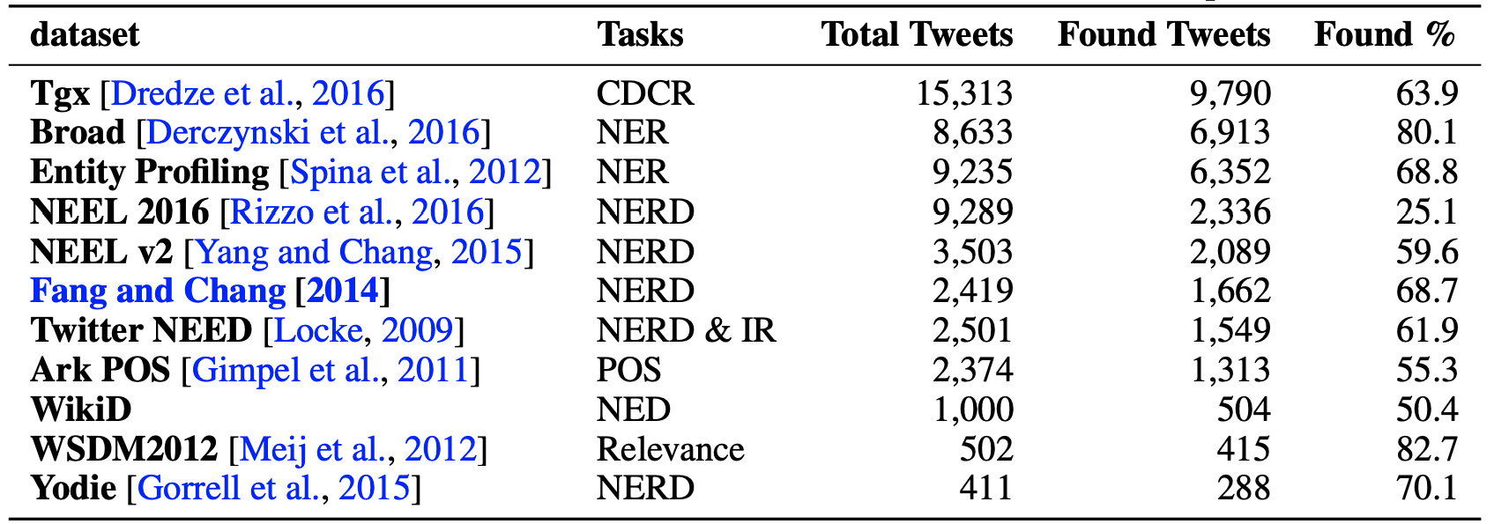
TweetNERD Data Splits: TweetNERD-Academic
Includes 30K Tweet IDs used in existing Tweet based NERD benchmarks, re-annotated using TweetNERD guidelines.
Many Tweets from existing benchmarks are now deleted (Found rate ~60%)
Good for temporal generalization evaluation.
Notes:
Next, we suggest evaluation on TweetNERD-Academic which consists of Tweet IDs re-annotated via TweetNERD annotation scheme.
This standardizes existing benchmarks into a common format increases our temporal range.
Around 40% of Tweets in existing academic benchmarks cannot be found anymore, which makes the remaining Tweets in the benchmark to be stable. These are the ones included in TweetNERD.

Slide 11
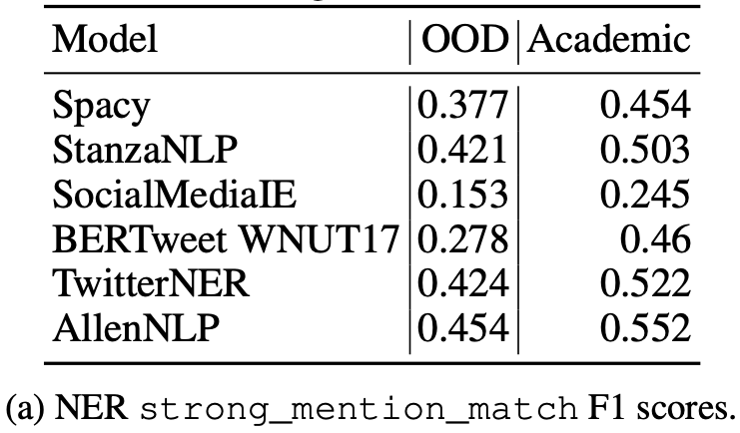
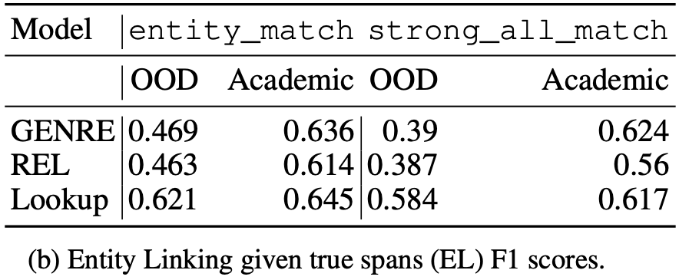
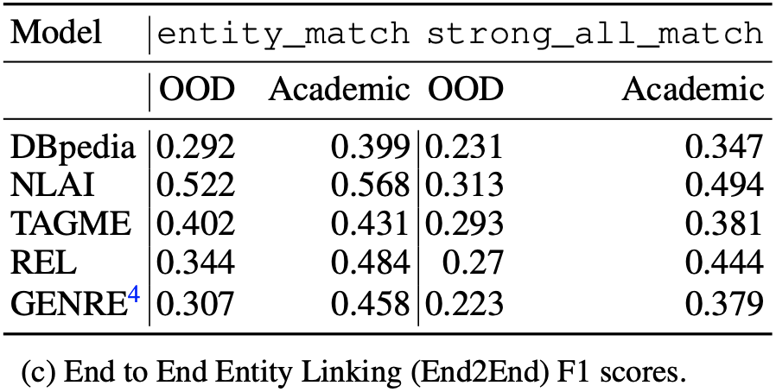
Performance of existing NERD systems
Evaluate popular systems for NER, Linking given True Spans, and End to End Linking.
Evaluations are tokenizer independent
Performed using neleval software
Notes:
We evaluate TweetNERD splits via popular systems.
We focus on the task of NER, Linking given True Spans, and End to End linking.
Our evaluations are tokenizer independent as we use text offset based evaluation.

Slide 12
Suggested applications
Suggested tasks:
NER,
Candidate Generation,
Linking given Gold Spans, and
End to End Entity Linking.
Evaluate NERD systems for Tweet using standard Train/Dev/Test split
Assess Temporal Generalization of NERD models
Notes:
Finally, we encourage the research community to use TweetNERD for evaluation of various NERD tasks, as well as extend it to assess Temporal Generalization of NERD models.

Slide 13
Thank You
Mishra, Shubhanshu, Aman, Saini, Raheleh, Makki, Sneha, Mehta, Aria, Haghighi, and Ali, Mollahosseini. "TweetNERD - End to End Entity Linking Benchmark for Tweets.". In Proceedings of the Neural Information Processing Systems Track on Datasets and Benchmarks. 2022.
ArXiv: https://arxiv.org/abs/2210.08129
Dataset: https://doi.org/10.5281/zenodo.6617192
Code: https://github.com/twitter-research/TweetNERD
Wikidata page: https://www.wikidata.org/wiki/Q114825474
Questions: @TheShubhanshu
Notes:
Thank you.
More details about TweetNERD can be found at the following links.
Please reach out to me on Twitter for any questions.

