Slide 1
Social Network Analysis
Shubhanshu Mishra
And you all

Slide 2
Learning objectives
What is a (social) network?
How to create one?
Important questions which can be answered using social network analysis:
Identifying important people
Finding communities
How do these networks form?

Slide 3
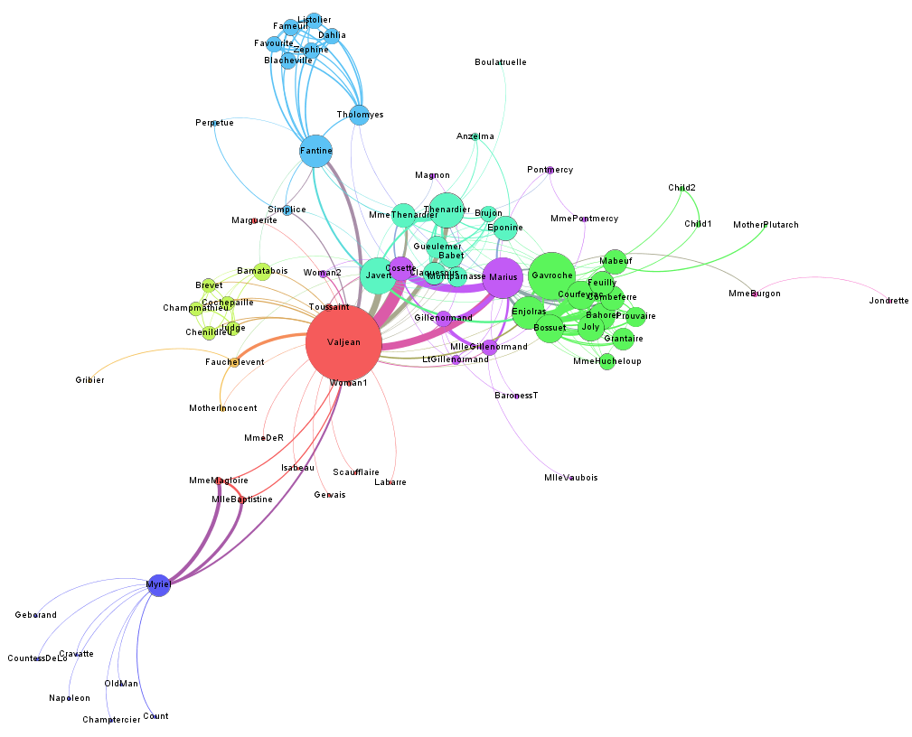
By the end of the course you will be able to make sense of this figure.

Slide 4
What is a Network?

Slide 5
Nodes
Actors
Entities

Slide 6
Edges
Connections
Relations

Slide 7
(Nodes, Edges) = Network

Slide 8
What is a Social Network?
Nodes are individuals (people)
Edges are some kind of interaction or relationship between people

Slide 9
What are examples of social networks around us?

Slide 10
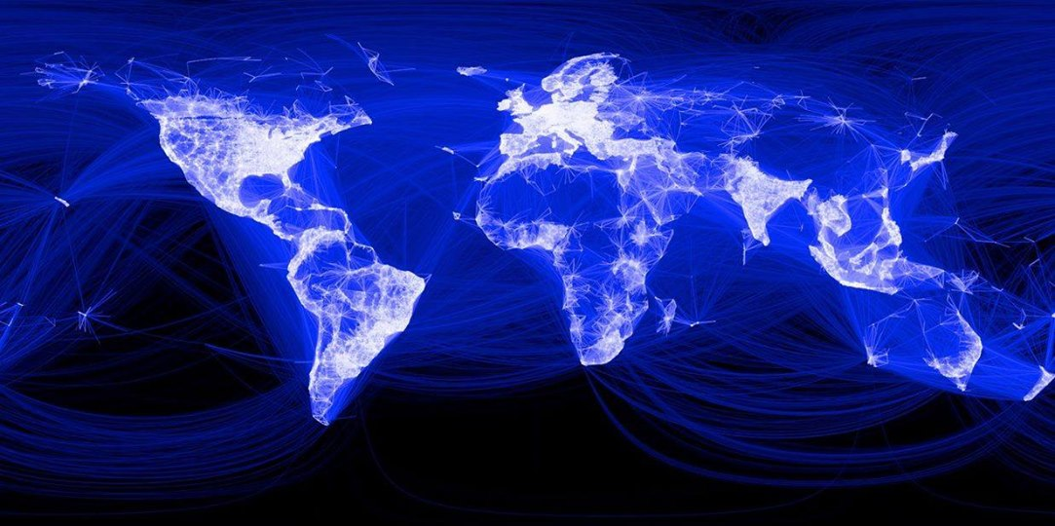
Source: https://www.facebook.com/notes/facebook-security/facebook-invites-submissions-for-secure-the-internet-grants/10155036231140766/

Slide 11
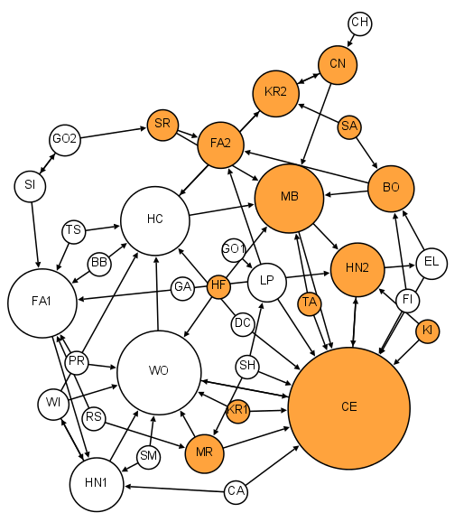
1st Grade
Who Shall Survive: A New Approach to the Problem of Human Interrelations – J. L. Moreno (1934)
Source: http://www.martingrandjean.ch/social-network-analysis-visualization-morenos-sociograms-revisited/

Slide 12
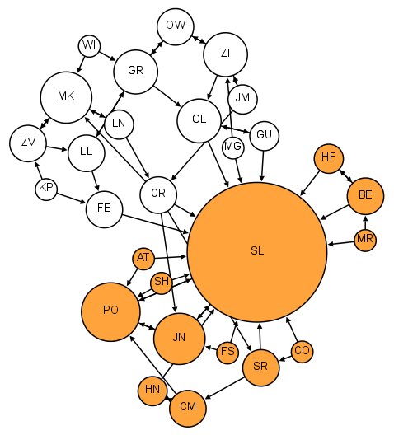
2nd Grade
Source: http://www.martingrandjean.ch/social-network-analysis-visualization-morenos-sociograms-revisited/

Slide 13
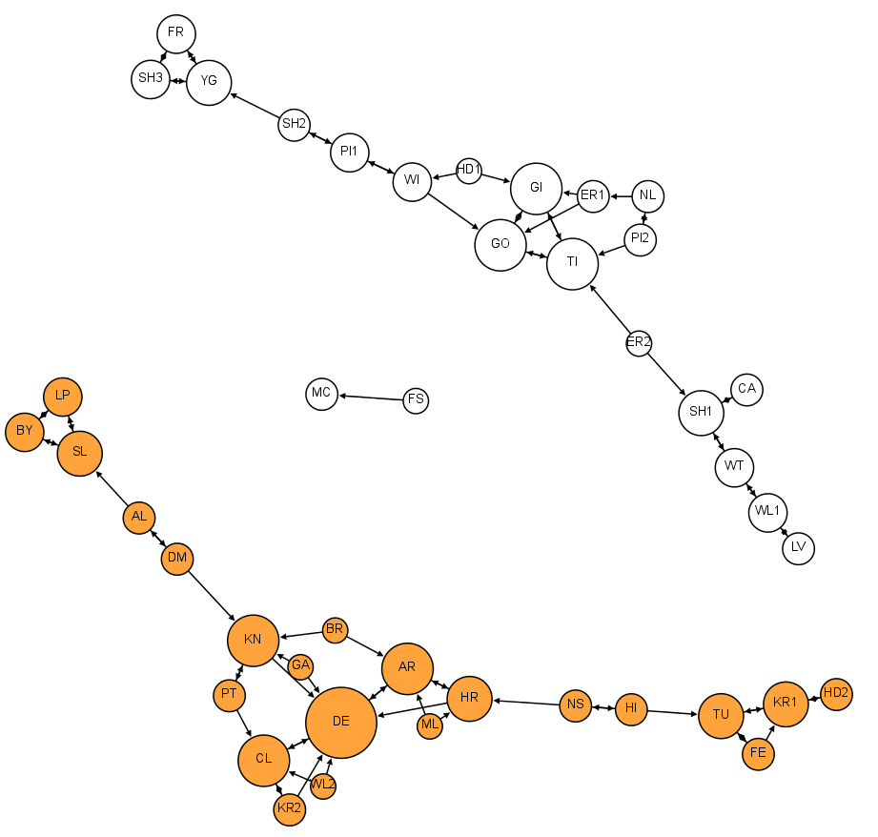
6th Grade
Source: http://www.martingrandjean.ch/social-network-analysis-visualization-morenos-sociograms-revisited/

Slide 14
What is analysis?
Finding patterns in data
Answering questions based on data

Slide 15
What questions can be answered by Social Network Analysis?

Slide 16
Which nodes are important? (centrality measures)
Who is connected to most people? - Degree centrality
Who is acting as a most popular bridge of information in the network? – Betweenness centrality
Who is closest to everyone else in the network? – Closeness centrality
Who is connected to the most important people (recursive definition)? – Eigenvector centrality (also known as PageRank)
Notes:
Importance defined differently

Slide 17
Demo using Gephi

Slide 18
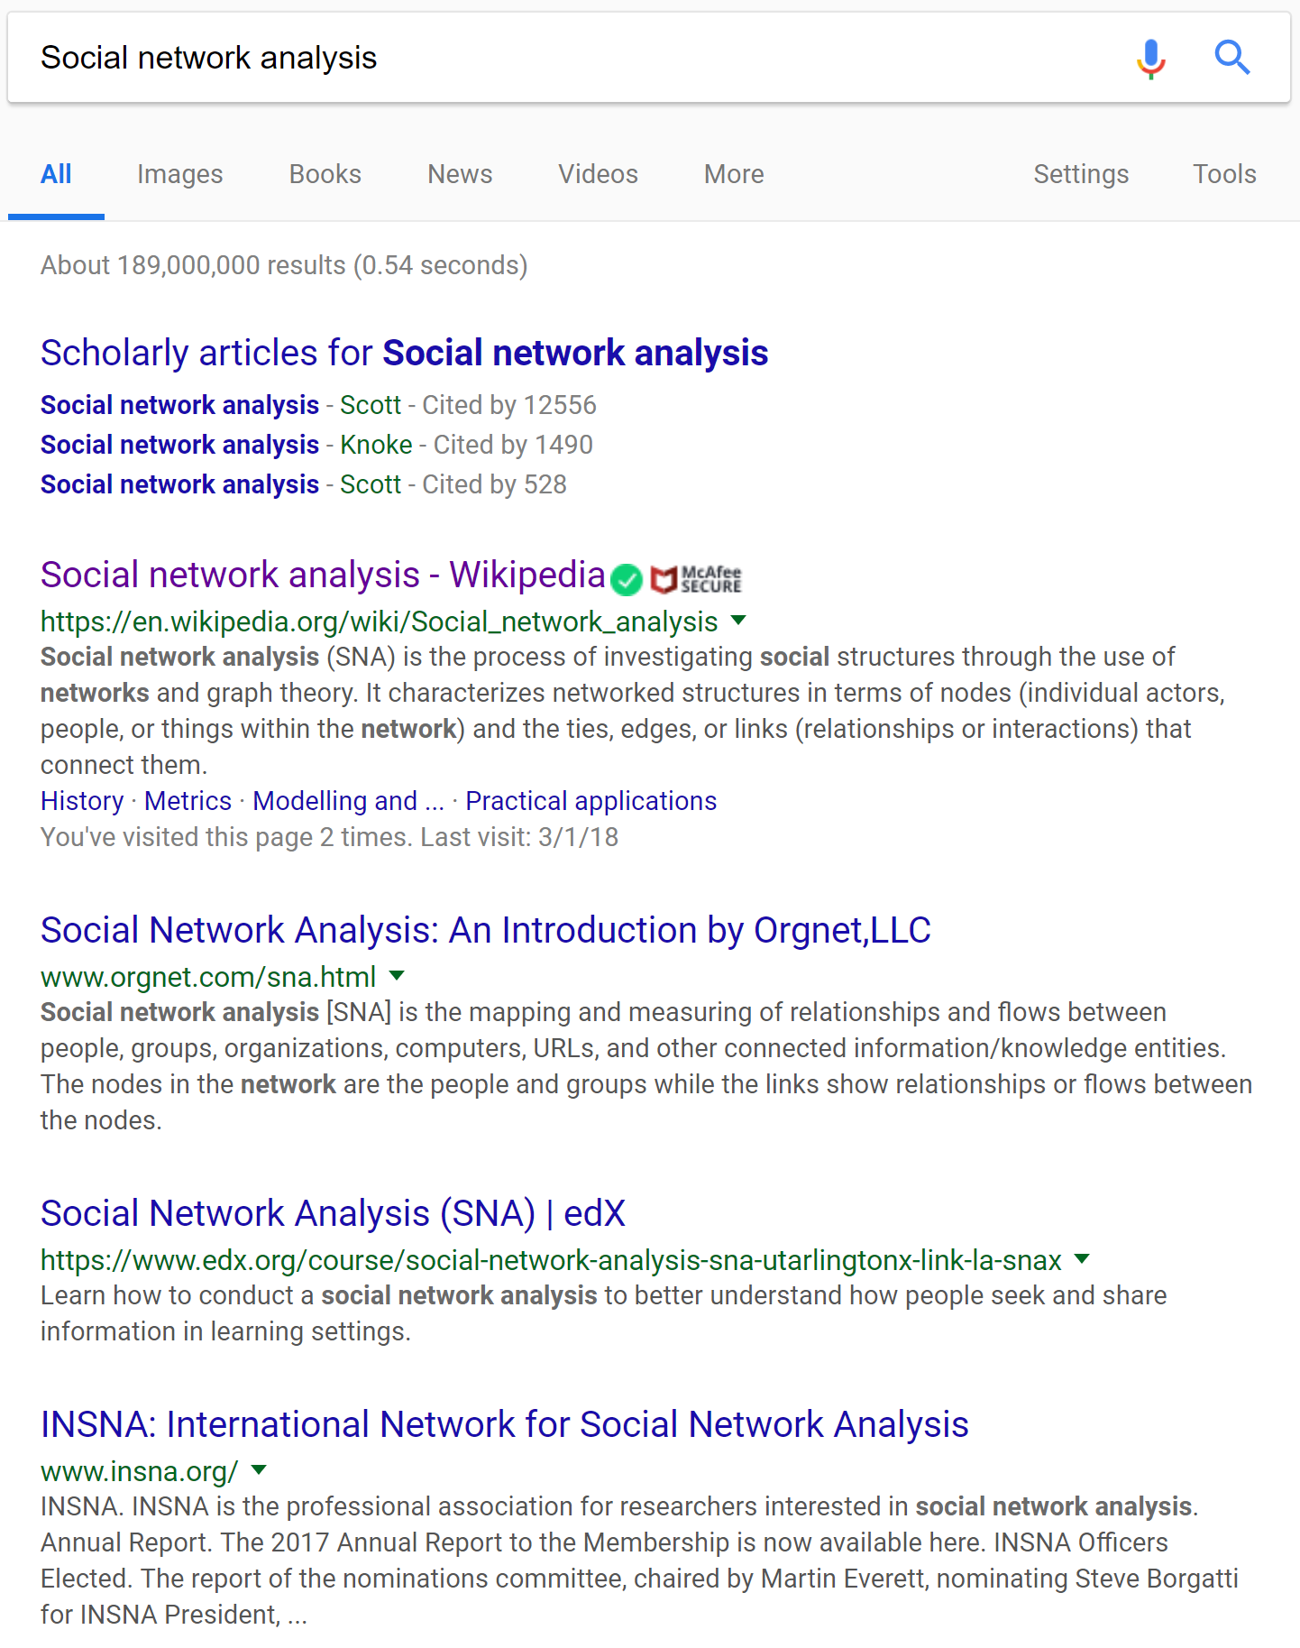
Where do you see PageRank centrality?

Slide 19
What are communities in the network?
Many ways of identifying communities
One popular way is connections within community should be more than connections across communities
Demo using Gephi

Slide 20
How do these networks form?
Many explanations

Slide 21
Random linking between nodes
Also called Random graph model
Gives rise to a large connected network
# of connections of each node are normally distributed
Demo: http://www.netlogoweb.org/launch#http://www.netlogoweb.org/assets/modelslib/Sample%20Models/Networks/Giant%20Component.nlogo

Slide 22
New people more likely to link to popular people
Also called Preferential attachment models
Few people have majority of the connections in the network
These people act as hubs of information
Demo: http://www.netlogoweb.org/launch#http://www.netlogoweb.org/assets/modelslib/Sample%20Models/Networks/Preferential%20Attachment.nlogo

Slide 23
Most links between neighbors but some links to farther people
Also called Small world phenomenon
Small average distance between people
High percentage of friends of a person know each other
Demo: http://www.netlogoweb.org/launch#http://www.netlogoweb.org/assets/modelslib/Sample%20Models/Networks/Small%20Worlds.nlogo

Slide 24
What we learnt?
Network – nodes and edges
Social network – nodes = people, edges = social connections
Examples: Facebook, school networks
Answering questions using social networks
Identifying important people – many measures of importance
How to find communities in networks
How do these networks form
Using Gephi for network analysis and NetLogo for network simulation

Slide 25
Questions
Shubhanshu Mishra
http://shubhanshu.com/
https://twitter.com/TheShubhanshu

