Slide 1
Q5
Why does key-finding matter? Give examples of questions one could ask of a symbolic corpus that require key identification

Slide 2
What is key finding?
We refer to key-finding as the process of determining the key of a musical piece, for example, the key that is written on the title of the piece
Furthermore, a key-finding model is an algorithm that allows us to determine that key automatically given a digital representation of the piece of music (see Question 4 for a more extensive review of digital representations of music)

Slide 3
Applications of global key finding
Some of the utilities of key-finding algorithms are music classification, music cataloguing, and harmonic mixing for DJs
These applications appear frequently across the literature of key-finding models

Slide 4
Applications of local key finding
Although not as frequently mentioned as the applications of global keys, researchers have also found useful applications for local key-finding models across the field of Music Information Retrieval
Structural segmentation of the music
Roman numeral analysis
Pitch-spelling algorithms
Chord labelling
Visualizing music
Local key-finding models and their applications are, nevertheless, less common. Mainly, because local key-finding models are very difficult to evaluate. On the other hand, global key-finding models are relatively easier to evaluate quantitatively, and have become more popular over the years

Slide 5
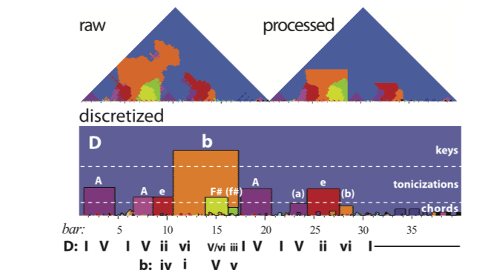
Going further into new research questions
Sapp studied tonality through the computation of a key-finding model at different window lengths of a piece of music
From the tonal regions obtained, he categorized different regions as either chords, tonicizations, and modulations
How do we know this is true?

Slide 6
Concrete questions we can ask in a corpus
How many changes of key (modulations) happen in a given piece?
How many tonicizations happen in a given piece?
How many of those were annotated by a human annotator?
How many of those overlapped or mismatched between annotators?
How many of those were found by local key estimation algorithms?
How many of those end in a Perfect Authentic Cadence or confirm other structural cues mentioned in music theory?
How many times does the local key mismatch the global key of the beginning of the piece?
How many times does the local key mismatch the global key of the end of the piece?

Slide 7
Why is key-finding actually useful?
It is maybe as complex as harmonic analysis, but in certain aspects it is simpler
Simpler to annotate
Simpler to evaluate
At least for tonal music, there is usually a common ground (major-minor paradigm) whereas in harmony, there are multiple systems of annotation and subsystems within those systems
Because it allows us to challenge music theoretical assumptions about tonality
Because when we want to apply music-theoretical frameworks to large volumes of data and quantify their generalization, they fail
Key-finding is a debugging tool for music theory
Visualizing the tonal structure of a piece
Wait, is that the real "tonal structure of the piece"? How do we know?
Let's make some studies, let's ask people to write down the modulations within a piece
Then, it forces us to create ground truth for that phenomenon
To study it, to understand it, and test it with our debugging tools

Slide 8
What else can be done?
Krumhansl and Kessler made a landmark when they introduced the probe-tone technique
A landmark not because of their results, which are good, but because of the criticism they generated
The distributional approach challenges our notions of music theory and how music works
And that is good, we need to test it, we need to be skeptical of rooted concepts like "tonicization", "modulation", and "functional harmony" even if they have been there for a while
We had to be skeptical of Newton's laws if we wanted to move forward
Music theory is the development of the best generalization, not the truth, and we always aim for the truth
The best generalization is our most useful tool in the quest for the truth, until it is not, and we find a better generalization
Just like machine learning models do
We need to think more of ourselves like machines that are training themselves for centuries, except that we are smarter than machines, we can always depart in the quest of a better local minima!

