Slide 1

MINOR PROJECT PRESENTATION ON VIRTUAL MAKEUP TRY-ON BACHELOR OF TECHNOLOGY Submitted by: Naqeeb Ahmed (F4-046) Sakshi (F5-064) Under Guidance of : Dr. SURENDER DHIMAN ASSISTANT PROFESSOR ECE department Dr. AKHILESH DAS GUPTA INSTITUTE OF TECHNOLOGY & MANAGEMENT (A Unit of BBD Group) Approved by AICTE and Affiliated with GGSIP University FC-26, Shastri Park, New Delhi-110 053

Slide 2
CONTENT
INTRODUCTION
PROBLEM STATEMENT
OBJECTIVES
LITERATURE REVIEW
METHODOLOGY
TECHNOLOGY USED
RESULTS ANALYSIS
FUTURE SCOPE
REFERENCES

Slide 3
INTRODUCTION
ENCAPTURE BEAUTY - A VIRTUAL MAKEUP TOOL lets you try on different makeup styles without actually wearing any!
Makeup transfer is one of the applications of image style transfer, which refers to transferring the reference makeup to the face without makeup and maintaining the original appearance of the plain face and the makeup style of the reference face.
It seamlessly adorns your face with the chosen makeup while preserving your natural beauty. Say goodbye to the makeup aisle and hello to endless virtual makeovers!"

Slide 4
PROBLEM STATEMENT
→With our web app, you can try eye makeup, different hair color styles, and more. With the help of it, it will be so easy to simulate a fresh new look in seconds.
It works by applying the effects of the selected items to the user's image.
→Along with that our virtual makeup tool will also have the functionality to recommend products to the users as per their preferences. We are also working on Skincare Services which will look after skin and cure methods like Acne Detection and its Cures.

Slide 5
OBJECTIVES
The objective of virtual makeup is to simulate the application of makeup on a person's face using computer vision and image processing techniques. This can be used in various applications, such as:
→ Online or mobile app-based virtual try-on of makeup products, allowing consumers to see how they would look with different makeup products before making a purchase.
→ Virtual makeup tutorials, where users can see step-by-step instructions on how to apply makeup on their own face.
The main objective is to provide realistic and user-friendly experience of makeup application, enabling users to experiment with different makeup products and looks, and providing a way for brands to showcase their products.

Slide 6
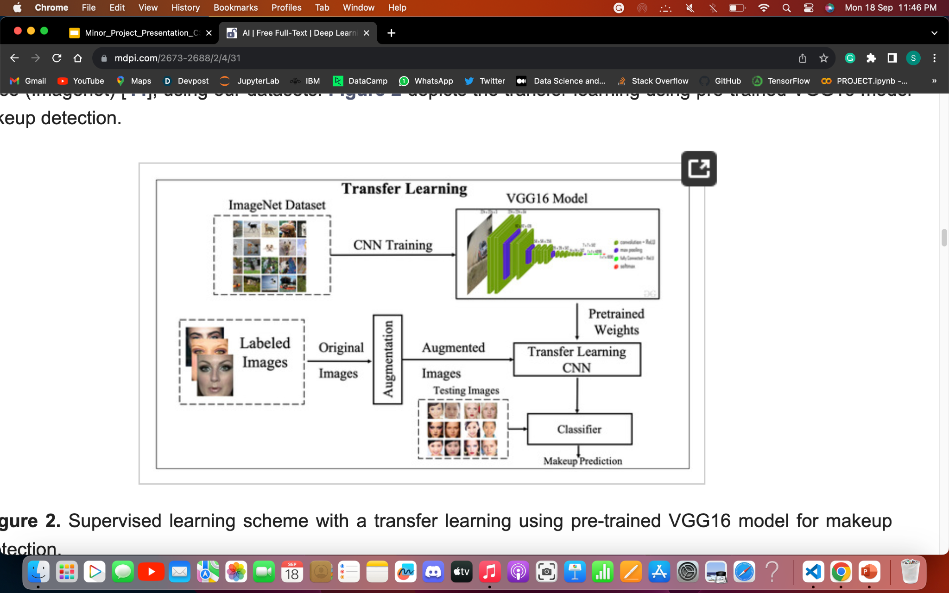

Slide 7
LITERATURE REVIEW
CUMTGAN: An instance-level controllable U-Net GAN for facial makeup transfer
CUMTGAN Makeup Transfer: CUMTGAN is an advanced GAN for precise facial makeup transfer.
Controlled Makeup Styles: It allows users to control makeup shades and styles.
New Evaluation Method: The paper introduces a novel evaluation method for assessing makeup transfer quality.
Key Contributions: CUMTGAN's key strengths include convergence, generalization, and a unique Superimposed Module.
Effective Makeup Transfer: The study demonstrates effective makeup transfer across different skin tones with favorable user study results.
Paired CycleGAN: Asymmetric Style Transfer for Applying and Removing Makeup
Paired CycleGAN for Makeup: This study explores loss terms' importance in makeup transfer networks and finds that removing specific losses affects eyeshadow placement, identity preservation, saturation, and color vividness.
Effective Architecture: The DRN architecture outperforms the Unet architecture in faithfully reproducing makeup properties on lips and eyes, including color and shine, without the need for explicit facial feature alignment.
Skin Tone Adaptation: The network successfully transfers makeup styles across various skin tones while preserving identity details, as evidenced by a favorable user study. However, extreme makeup styles not seen during training present challenges.

Slide 8
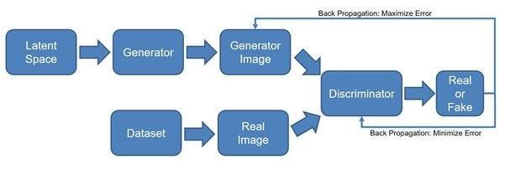
METHODOLOGY
→ Disentangled Makeup Transfer with GAN is a technique that aims to separate the makeup style from other facial attributes and transfer it onto facial images in a realistic and controllable manner.
→ The methodology involves several key steps, including dataset preparation, makeup encoding, makeup decoding, GAN architecture design, training procedure, and evaluation metrics. A total of 1,04,000 images were used, taken from kaggle as well as scraped from the internet .

Slide 9
METHODOLOGY
Dataset Preparation:
Collect and prepare diverse facial image dataset with labeled and annotated makeup styles, lighting conditions, and poses to facilitate training. The images were compressed using python opencv library into 256 x 256 pixels to easily fit the training model and to reduce the training time as well.
Makeup Encoding:
Extract and represent makeup style from facial images in a latent space to separate it from other facial attributes. Use techniques like feature extraction algorithms or deep learning models for makeup encoding.
Makeup Decoding:
Reconstruct makeup style from latent representation to generate realistic and visually appealing makeup that can be applied to new facial images. Use techniques like generative models or image synthesis algorithms for makeup decoding.
GAN Architecture for Makeup Transfer:
GAN architecture is vital for makeup transfer. It includes a generator and discriminator network. The generator uses makeup-encoded representation to synthesize images with desired makeup. The discriminator evaluates realism and improves generator performance.
Training Procedure:
Training optimizes GAN architecture for makeup transfer. It includes adversarial training where generator and discriminator networks compete. Training uses prepared dataset with forward and backward passes to update parameters. Yields benchmarks like Cityscapes, PASCAL VOC, and ADE20K.

Slide 10
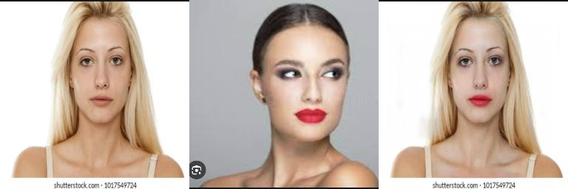
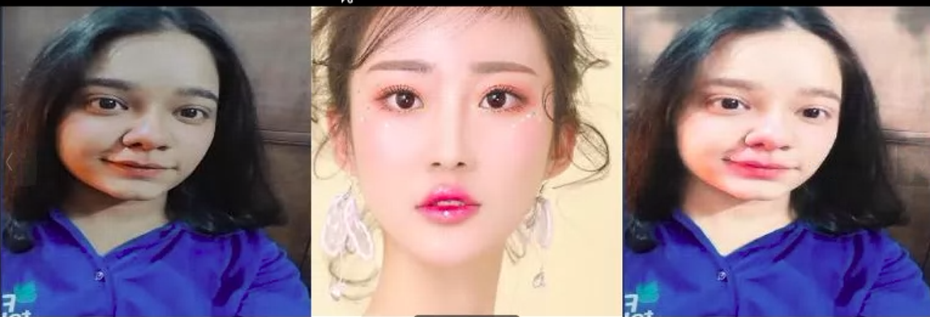
RESULT ANALYSIS

Slide 11
TECHNOLOGY USED
Our app specializes in Deep Learning utilizing Convolution Neural Networks and OpenCV. We will be using the latest technologies used in the industry. For making the Virtual Try-on System we will use Python and its various libraries such as NumPy, Pandas, OpenCV, PyTorch, etc. For deploying the web app, we will make our User Interface using ReactJs, fetching data from ML APIs created in Flask.

Slide 12
FUTURE SCOPE
Virtual Try-On is faster, customers can try different products in mere minutes, which may take hours to try in the store. It gives customers a more comprehensive view of products and possibilities.
It creates sustainability by eliminating what is arguably the biggest downside of online shopping, i.e. returns. Reducing returns with VTO would save the customer (and the brand) time and increase their satisfaction with the shopping experience while helping companies move away from unsustainable business models.

Slide 13
REFERENCES
[1] Miao Hao, Guanghua Gu, Hao Fu, Chang Liu, Dong Cui.: CUMTGAN: An instance-level controllable U-Net GAN for facial makeup transfer. In: ACM MM, 2022
[2] Chang, H., Lu, J., Yu, F., Finkelstein, A.: Pairedcyclegan: Asymmetric style transfer for applying and removing makeup. In: 10.1109/CVPR.2018.00012, 2018
[3] Chen, H.J., Hui, K.M., Wang, S.Y., Tsao, L.W., Shuai, H.H., Cheng, W.H.: Beautyglow: On-demand makeup transfer framework with reversible generative network. In: 10.1109/CVPR.2019.01028, 2019

