Slide 1
Urban Diversity Within Seattle’s Neighborhoods
Natalia Quintero
March 2019

Slide 2
Data Sources
Seattle department of neighborhoods Neighborhood Snapshots
Findwell neighborhood guide for zoning
Google Maps for coordinates

Slide 3
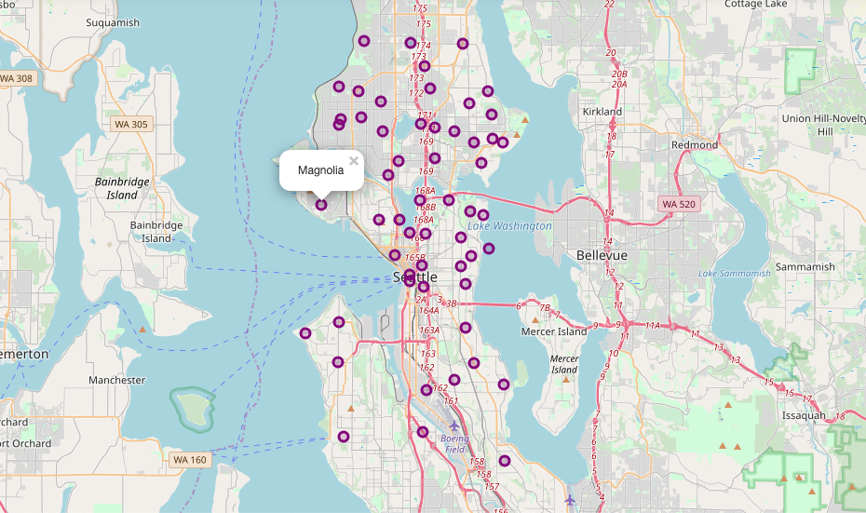
Seattle Neighborhood Map

Slide 4
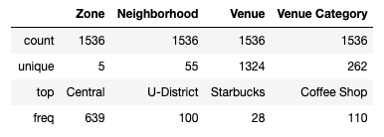
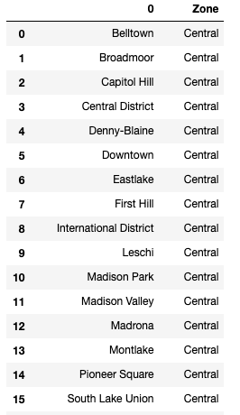
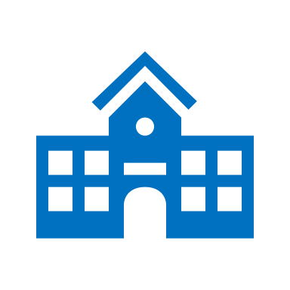

Most popular venues are concentrated in the central zone
which includes popular areas like Downtown and Capitol Hill.
Starbucks appears to be the most popular place overall.

Slide 5



















Neighborhood Recommendation by Venues *Refer to notebook for a full list
Ballard
U District
Alki
Beacon Hill

Slide 6
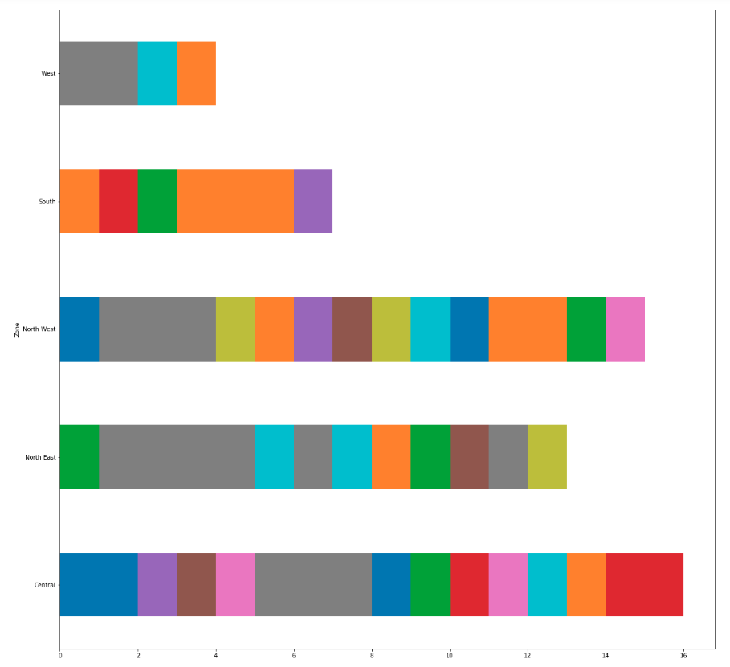
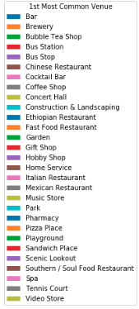
Most Common Venue by Zone

Slide 7
Thanks

