Slide 1
House Sales in King County, WA
By Natalia Quintero

Slide 2
Data Source
King County is one of the most populous county in WA state with 2/3 of its population living in Seattle’s suburbs .
This study collected information from about 21,000 homes including square footage, zip-code, condition and views.
All data was collected and provided by Learn.
Accuracy of the study: 64%

Slide 3

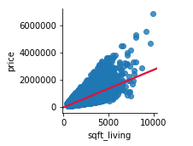

Living area

Slide 4
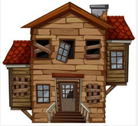
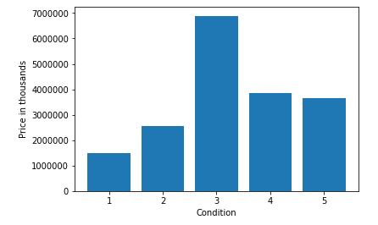
Condition
Poor/worn out.
Fair/badly worn.
Average.
Good.
Very Good

Slide 5
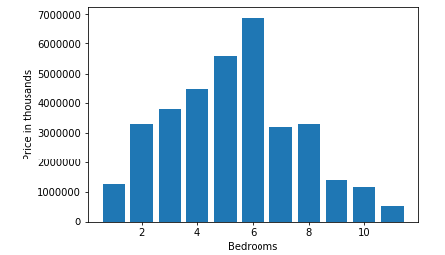
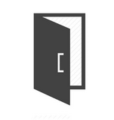
Number of Rooms

Slide 6
Recommendations
New Houses
Ample living space
Average of 5 rooms
Use high quality materials and fixtures
Old Houses
Keep house in average condition, make sure all components are functional
If renovating, add more rooms and use good quality fixtures.
Create more living space if possible

Slide 7
Thanks for your time.

