Slide 1
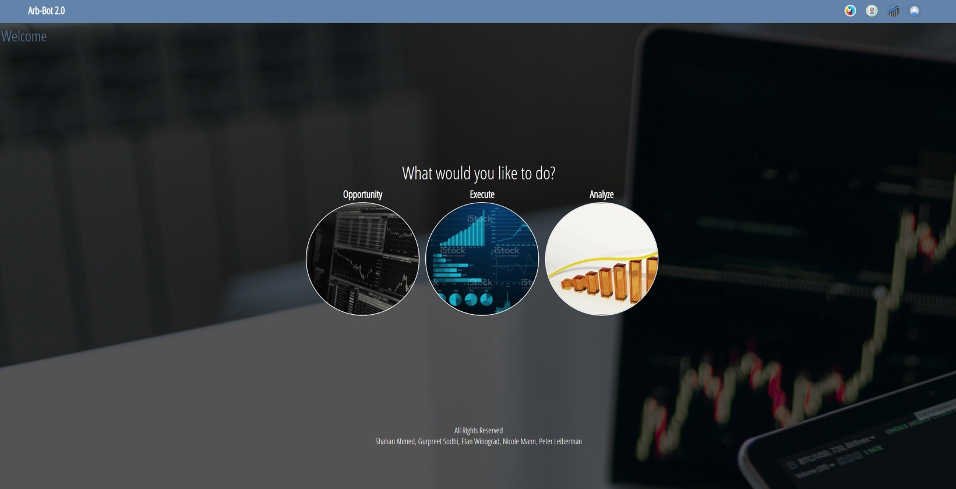
Arb-bot 2.0 Algo Trading
Team #4 – Project 2
Gurpreet Sodhi, Shahan Ahmed, Nicole Mann, Etan Winograd, Peter Leiberman

Slide 2
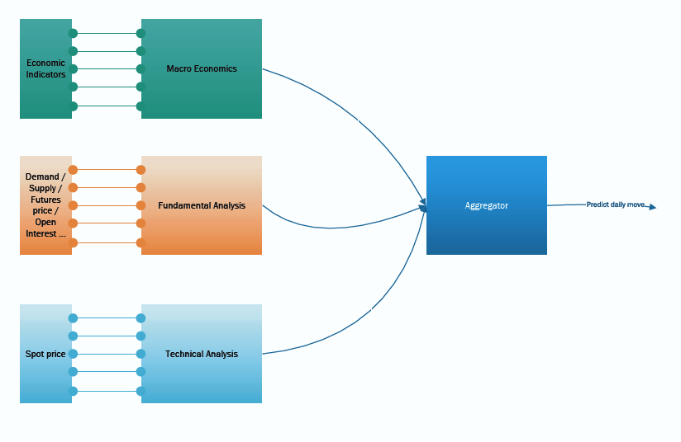
Logic Flow

Slide 3

Technology Breakdown
Python – ML libraries, data processing , and calculations.
HTML – Markup language used for graphical Interface.
JavaScript – Processes the user interactions.
PHP – Server side communication.

Slide 4
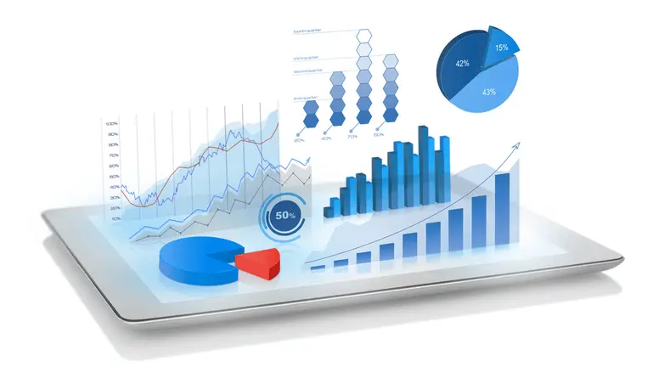
Data Preparation
10 years of crude and gold price data (spot and future) from Bloomberg terminal.
10 years of economic data from Bloomberg.
Convert data for appropriate machine learning models.
Enhance data by creating square terms, cross terms, and filling in missing data.

Slide 5
Demonstration

Slide 6
Arb-Bot 2.0 Core Models
Macro
Aggregator
Data preparation: train test split, oversampling, standard scalar
Technical
Classification models
Fundamental
Spot and future price
Demand/supply indicators
HLOCV data
Technical indicators
Modeling: logistic regression, random forests, SVM
Multi class classification
Data preparation
Deep learning neural networks
Classifier models

Slide 7

Future Enhancements Predict the future, NOW!
Horizontal enhancement – more asset coverage.
Vertical enhancement
Data optimization
Fine-tune ML models

Slide 8

Conclusion Aggregate is better than the sum of individuals
We brought together three streams of finance (Macro, Fundamental, Technical) on the same platform.
Each stream leveraged the best possible ML model.

Slide 9
Appendix
Gurpreet – Fundamental analysis
Peter – Aggregate analysis
Nicole – Macro analysis
Etan – Technical analysis
Shahan – Code integration & front end

