Slide 1

Campus Campaigns
Syed Naqvi, Josh Platt, Caleb Swanson, Grant Levene

Slide 2
Overview
Platform for users to find and get involved in university campaigns
Users can collaborate, vote, and even donate towards causes / ideas important to them
At certain intervals, the website will take the top voted campaigns and lobby the respective college organizations on behalf of the author of the campaign
“Our mission is your mission”

Slide 3
Campaign author (vignette #1)
Jim is concerned about the quality of the local drinking water
He goes to campuscampaigns, registers an account with university email, and creates a campaign to raise awareness about water quality

Slide 4
Campaign supporter (vignette #2)
Billy is an eager freshman at MSU that wants to get involved
He goes to campauscampaigns, creates an account with his university email, and browses through his schools currently active causes
He pledges his support for a clean water drinking initiative, and even donates some money.

Slide 5
Application admin (vignette #3)
Tim is a web admin for the site
He logs into his web admin account and manually deletes some offensive comments via an admin interface

Slide 6
Outsider (vignette #4)
Joe works for his school’s paper and wants to get some more info about a local movement
He goes to campuscampaigns and browses the public campaigns for his school

Slide 7
Wireframes
https://gomockingbird.com/projects/sc6qbt1

Slide 8
Campaign interaction
Organize campaigns by college
Individual institution pages / resources
Individual campaign info pages

Slide 9
Campaign creation
Creation / edit form
‘My Campaigns’
Edit / update current campaign
Appeal rejected campaigns

Slide 10
Campaign administration
Campaign Rejection / deletion
Disputed Campaigns

Slide 11
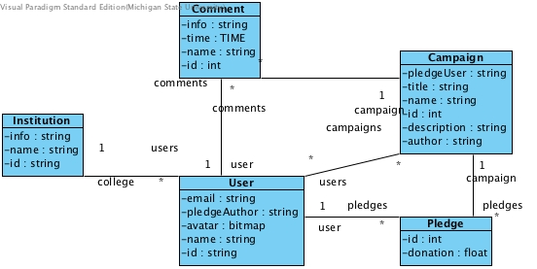

Slide 12
ESTIMATED TIME UNTIL COMPLETION
Things needed to be completed:
Campaign administration
Campaign views
Donations class
User avatars
Estimated time left: A week and a half

