Slide 1
Automatic Generation Image Captions based on Deep Learning and Neural Network
Durga Sai Teja Thota - 700741029 Rushitha Mudigonda - 700745857
Anjali Nara - 700745071 Sowmya Nalini Koppolu - 700757410

Slide 2
MOTIVATION
A diverse array of image sources, ranging from television broadcasts to online platforms and news sources, collectively form an extensive repository of visual content. Despite a notable portion of these images lacking accompanying descriptions, humans demonstrate an innate capability to decipher them autonomously.
Conversely, machines encounter significant hurdles when attempting to grasp images devoid of explanatory details. Therefore, the necessity for accompanying descriptions becomes paramount in facilitating machine comprehension of visual content.
In the field of artificial intelligence, there is a growing emphasis on the development of techniques for captioning natural scenes, which has become a pivotal research endeavor. This area is dedicated to furnishing comprehensive descriptions for images, thereby tackling the challenge of bridging the gap in machine.

Slide 3
PROBLEM STATEMENT AND SOLUTION
In the training phase of the CNN-RNN framework-based image captioning technique, two notable drawbacks arise. Firstly, every caption is treated with equal significance, disregarding potential variations in their individual importance. Secondly, there's a risk that during caption generation, objects might not be accurately recognized.
In this paper we have also suggested called Reference based long short term memory (R-LSTM) that main aim is by implementing reference information to give more descriptive caption for a query image.

Slide 4
Contributions
Anjali: Led the conceptualization and development of the R-LSTM framework for automatic image captioning. Contributed to the design and implementation of the attention mechanisms for enhancing caption quality. Played a key role in conducting experiments and analyzing results to validate the effectiveness of the proposed approach.
Durga Sai Teja : Specialized in preprocessing image data and extracting essential features using Convolutional Neural Networks (CNNs). Implemented and optimized the CNN component of the framework to efficiently capture image features. Collaborated with other team members to integrate the CNN with the R-LSTM architecture seamlessly.
Sowmya: Led the evaluation and benchmarking efforts of the R-LSTM model against existing techniques using a recognized benchmark dataset. Conducted thorough tests and analyses to assess the model's performance in generating high-quality captions. Contributed to the interpretation of results and the comparison of performance metrics to demonstrate the superiority of the R-LSTM approach.
Rushitha: Designed and implemented the R-LSTM architecture, focusing on its ability to capture long-term dependencies in data sequences. Explored various configurations of the R-LSTM model and fine-tuned its parameters to achieve optimal performance. Integrated attention mechanisms into the R-LSTM framework to improve the generation of detailed and contextually relevant captions.

Slide 5
OBJECTIVES
Should implement a CNN-RNN model by building an image caption generator.
The primary objective is to enhance the descriptive quality of a caption for a query image through the integration of reference information using Long Short-Term Memory (LSTM).
This system is developing in the high-level languages and uses advanced technologies .The response time on the client system should be very less.

Slide 6
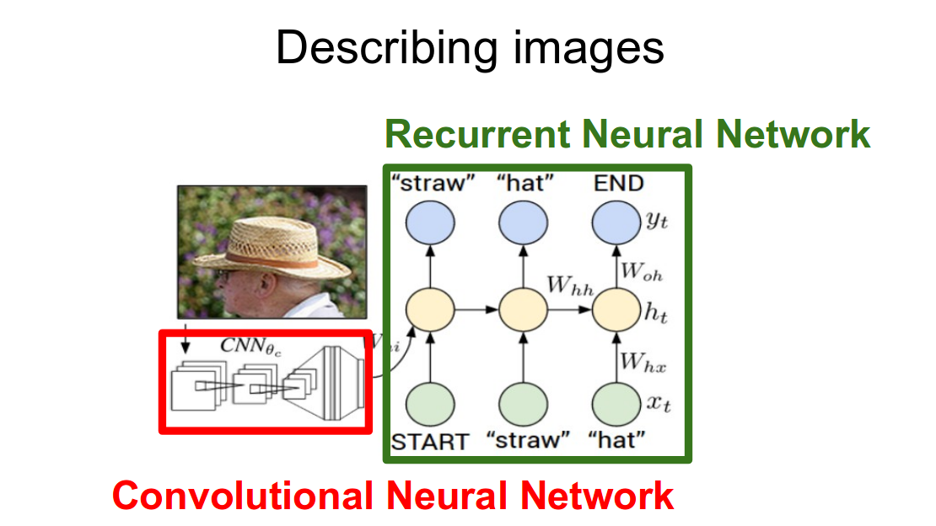
METHODOLOGY
The process of image captioning can be logically divided into two modules: an image-based model responsible for extracting features from the image, and a language-based model that translates these features into a coherent natural sentence.
The image-based model, also known as the encoder, typically utilizes a Convolutional Neural Network (CNN) to extract relevant features and nuances from the input image. On the other hand, the language-based model, or decoder, relies on a Recurrent Neural Network (RNN) to convert the extracted features and objects into a descriptive natural language sentence. The outlined approach is summarized in the accompanying image

Slide 7
PAPER 1 CONTRIBUTION:
Paper Title: Refining object detection in video with Recurrent neural network
core content: RNN(Recurrent Neural Network)
Contribution:
A Recurrent Neural Network reads in a sequence of provisionally labeled frames using the contextual information to output refined predictions.
Recurrent model, we demonstrate an efficient and effective training strategy that simultaneously employs localization-level strong supervision, category-level weak supervision, and a penalty encouraging smoothness of predictions across adjacent frames
On a video dataset with sparse object-level annotation, our framework proves effective, as validated by extensive experiments.

Slide 8
PAPER 2 CONTRIBUTION:
Paper Title: An Approach for Rainfall Prediction Using Long Short Term Memory Neural Network
Core Content:
Long Short-Term Memory
Contribution:
LSTM network is an extended special network architecture of Recurrent Neural Network (RNN)
LSTM was designed to overcome the shortcomings of RNN such as vanishing gradient because of having short term memory.
Long Short-Term Memory can solve the long-range dependency issue of RNN as it can retain the findings for a long-range of time.

Slide 9
PAPER 3 CONTRIBUTION:
Paper Title: Face Mask Detection using deep neural networks
Core Content: CNN (Convolutional Neural Network)
Contribution:
CNN is a type of artificial neural network which widely used for image /object recognition and classification
It is a neural network that has one or more convolutional neural network and are used for image processing/classification and also for other auto corrected data.

Slide 10
PAPER 4 CONTRIBUTION:
Paper Title: Convolutional Neural Networks for image classification
Core Content: CNN(Convolutional Neural Networks)
Contribution:
Convolutional Neural Networks (CNNs) and their use in image classification tasks. The authors provide a comprehensive explanation of how CNNs work, including their architecture, components, and mathematical operation.
Main contribution is to provide a detailed understanding of CNNs and their application to image classification, along with experimental evidence of their effectiveness.

Slide 11
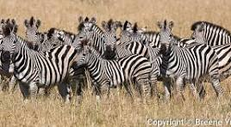

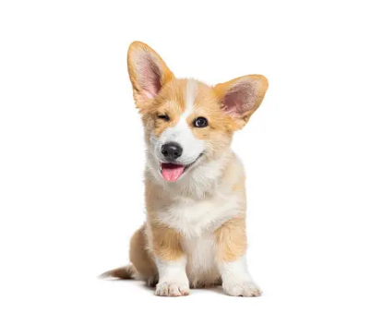
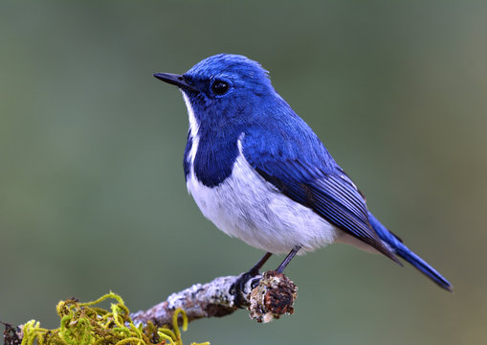
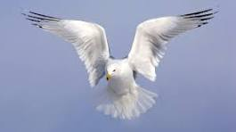
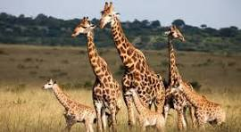
RESULTS
Gathered the Required information and resources required to complete the project
FIG1: <start> a group of zebras are standing in a field . <end>
FIG2: <start> a group of people standing around a table with a remote . <end>
FIG3: <start> a brown and white dog with a red collar . <end>
FIG4: <start> a bird standing on branch. <end>
FIG5: <start> a large white bird flying in the sky . <end>
FIG6: <start> a group of giraffes are standing in the grass . <end>

Slide 12
REFERENCES: 1.Graves, A.; Liwicki, M.; Fernández, S.; Bertolami, R.; Bunke, H.; Schmidhuber, J. (May 2009). "A Novel Connectionist System for Unconstrained Handwriting Recognition". IEEE Transactions on Pattern Analysis and Machine Intelligence. 2. Li, Xiangang; Wu, Xihong (2014-10-15). "Constructing Long Short-Term Memory based Deep Recurrent Neural Networks for Large Vocabulary Speech Recognition 3. Wu, Yonghui; Schuster, Mike; Chen, Zhifeng; Le, Quoc V.; Norouzi, Mohammad; Macherey, Wolfgang; Krikun, Maxim; Cao, Yuan; Gao, Qin (2016-09-26). "Google's Neural Machine Translation System: Bridging the Gap between Human and Machine Translation 4. Mayer, H.; Gomez, F.; Wierstra, D.; Nagy, I.; Knoll, A.; Schmidhuber, J. (October 2006). A System for Robotic Heart Surgery that Learns to Tie Knots Using Recurrent Neural Networks. 2006 IEEE/RSJ International Conference on Intelligent Robots and Systems. pp. 543–548. 5. Rodriguez, Jesus (July 2, 2018). "The Science Behind OpenAI Five that just Produced One of the Greatest Breakthrough in the History of AI". Towards Data Science. Archived from the original on 2019-12-26. Retrieved 2019-01-15.

Slide 13
6. Li, Xiangang; Wu, Xihong (2014-10-15). "Constructing Long Short-Term Memory based Deep Recurrent Neural Networks for Large Vocabulary Speech Recognition 7. K. Cho, B. Van Merriënboer, Ç. Gülçehre, D. Bahdanau, F. Bougares, H. Schwenk, Y. Bengio, Learning phrase representations using rnn encoder–decoder for statistical machine translation, in: Proceedings of the 2014 Conference on Empir-ical Methods in Natural Language Processing (EMNLP), Association for Computational Linguistics, Doha, Qatar, 2014. 8. Rashtchian C, Young P, Hodosh M, Hockenmaier J. (2010) Collecting image annotations using Amazon’s Mechanical Turk. In: Proceedings of the NAACL HLT 2010 workshop on creating speech and language data with Amazon’s Mechanical Turk. Association for Computational Linguistics. 9. D. Lin, An information-theoretic definition of similarity, in: Proceedings of the Fifteenth International Conference on Machine Learning 10. Dewa Made Sri Arsa, I.P.A. Bayupati & Kadek Sastrawan ,” Detection of fake news using deep learning CNN–RNN based methods” 11. Anjali Samad,Bhagyanidhi and Vaibhav Gautam, "An Approach for Rainfall Prediction Using Long Short Term Memory Neural Network"
13

Slide 14
THANK YOU

