Slide 1
Calling the right patients first
PINECREST HEALTH · QUALITY & CARE MANAGEMENT
A readmission worklist that ranks every discharge by predicted risk, explains why, and records what the care team did about it.
Narasimha Kamathardi · November 2026
Pinecrest Health is fictional. All data is synthetic.
Notes:
Pinecrest Health is a fictional three-hospital system and every record in this build is synthetic. The worklist ranks every discharge by predicted 30-day readmission risk, explains why, and records the action the care team approved. Source: evidence/07_deck_figures.md

Slide 2
One in seven patients comes back within 30 days. Three executives feel it differently.
SPONSOR
FUNDS IT
RUNS IT
Chief Quality Officer
CFO
VP of Care Management
Owns the 30-day readmission rate and the CMS HRRP penalty that follows it, and reports both to the board.
Carries the HRRP penalty as budget risk (up to 3% of Medicare reimbursement) and absorbs about $15K for every avoidable second stay.
Runs a fixed coordinator team that can call only a fraction of each day's discharges, and works the list without a ranking.
14.7%
$15K
6,013
readmission rate today
per avoidable readmission
discharges in the data
The CQO answers for the number. The CFO funds the fix. The VP of Care Management runs it.
Notes:
Three executives, three different pressures on the same number: the CQO is the sponsor and reports the rate to the board, the CFO funds the work, and the VP of Care Management runs the coordinator team. $15K per readmission and the 3% HRRP cap are industry figures, not from the data. Source: evidence/07_deck_figures.md

Slide 3
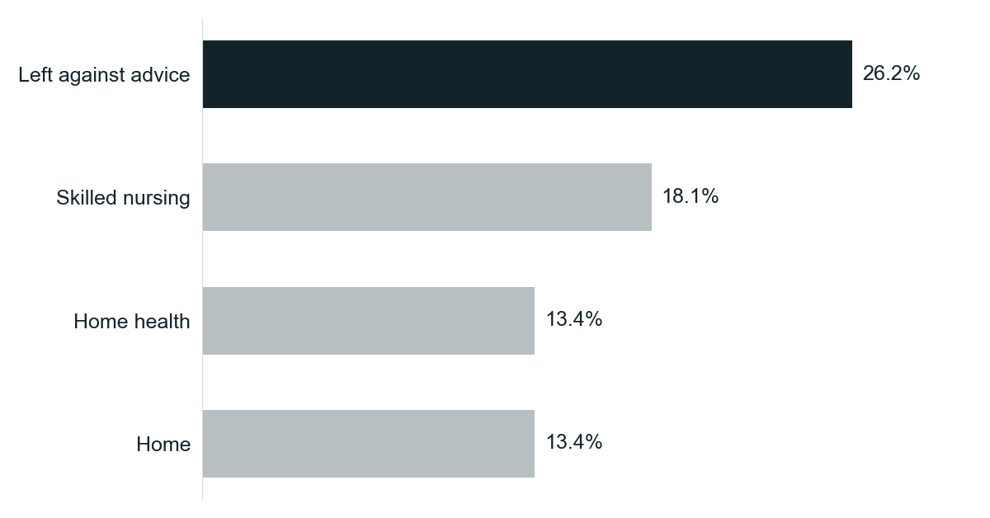
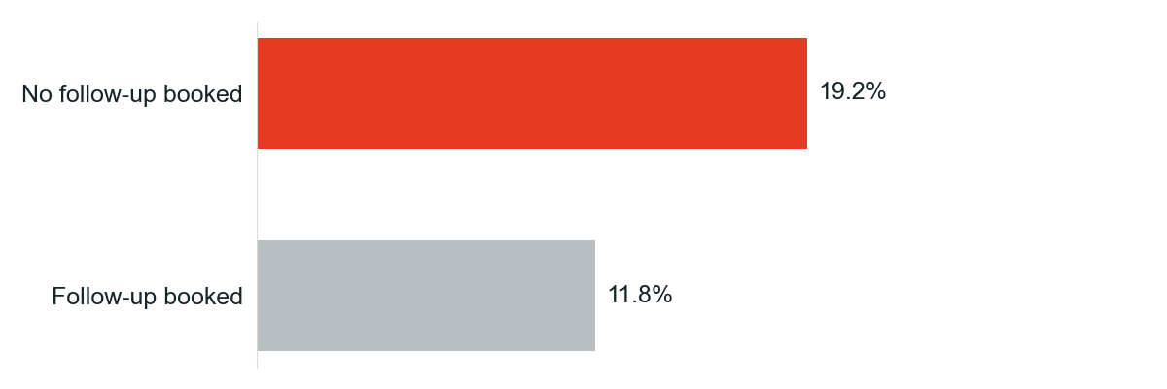
A missed follow-up visit is the gap the care team can close.
30-DAY READMISSION RATE BY DISCHARGE DISPOSITION
BY FOLLOW-UP STATUS
2,324
discharges left without a follow-up; their readmission rate is 1.6× higher.
Disposition is decided at discharge. Booking the follow-up is something a coordinator can still do the next morning.
Notes:
Left-against-advice discharges readmit most at 26.2%, but disposition is fixed once the patient leaves. Discharges with no follow-up booked readmit at 19.2% against 11.8% with one, a 1.6x gap across 2,324 discharges, and that is the gap a coordinator can still close. Source: evidence/07_deck_figures.md

Slide 4
Same team, same morning. A different first call.
 | TODAY | WITH THE WORKLIST
Who to call first | Alphabetical discharge list | Ranked by predicted 30-day risk
Why this patient | Coordinator reads the chart | Short explanation from the patient's own notes
What to do | Decided from experience | Recommended action per patient, editable
Record of the call | Free text, if anything | Approved action saved with approver and time
Notes:
The team size and the morning routine do not change; only the order of calls and the record of each call do. The worklist ranks by predicted risk, explains each ranking from the patient's own notes, and saves the approved action with the approver and time. Source: evidence/06_app_execution.md

Slide 5
Six Databricks stages over one dataset, each reading the previous stage's output.
1
2
3
4
5
6
INGEST
GOVERN
PREDICT
SERVE
ASK
ACT
Lakeflow
Unity Catalog
ML
Lakebase
Genie
Databricks App
pc_bronze_*
→ pc_silver_*
→ pc_gold_*
PHI tags, column masks, lineage
pc_readmission_
risk_model
@champion
(batch-scores every patient)
synced pc_risk_worklist + writable care_actions
“Pinecrest Readmission Insights” space
pinecrest-care-
coordinator
Raw files land in a Unity Catalog volume; one permission model covers every stage.
Notes:
Walk left to right: the same records flow through all six stages, and each stage reads the output of the one before it. Raw files land in a Unity Catalog volume and one permission model governs the volume, the tables, the model, the served rows and the app. Source: evidence/01_lakeflow, evidence/02_unity_catalog, evidence/03_ml_training_run_output.md, evidence/05_genie_conversations.md, evidence/06_app_execution.md

Slide 6
Bad rows stop at the pipeline. Patient identity stays masked.
6,038
raw discharges
SAME ROW, TWO READERS
CARE TEAM SEES
PC-00001 · Mateo Chen · 555-656-8462
−25
rejected for invalid length of stay, planted on purpose and caught by a Lakeflow expectation
EVERYONE ELSE SEES
PC-00001 · ***MASKED*** · ***MASKED***
6,013
clean discharges in gold
Name, phone and ZIP are tagged phi. Lineage is captured automatically.
Notes:
I planted 25 invalid discharges in the raw data and the Lakeflow expectation on length of stay dropped exactly those 25, leaving 6,013 clean rows in gold. Name, phone and ZIP are tagged phi, name and phone are masked for anyone outside the care team, and lineage was captured without extra work. Source: evidence/01_lakeflow and evidence/02_unity_catalog

Slide 7
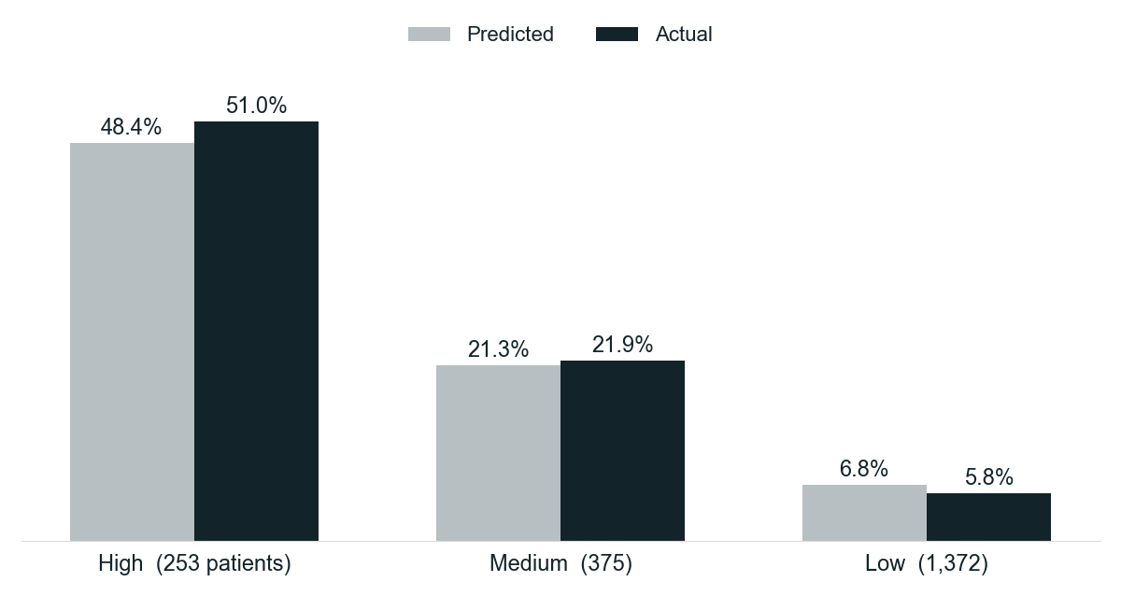
Half of the High-risk group was readmitted. One in seventeen of the Low group was.
3.34×
top-decile lift (held-out)
0.779
test AUC (held-out 25%)
v1
registered in Unity Catalog as @champion, scores all 2,000 patients
Latest discharge per patient; includes rows used in training.
Notes:
Of the 253 High-risk patients, 51.0% were readmitted; of the 1,372 Low-risk patients, 5.8% were, about one in seventeen. The chart uses each patient's latest discharge and includes rows seen in training, so the held-out numbers on the right are the fair test: 3.34x top-decile lift and 0.779 AUC. Source: evidence/03_ml_training_run_output.md

Slide 8
The quality team asks in plain English and gets the answer from the governed tables.
QUESTION
ANSWER
How many high-risk patients does each facility have?
→
Main 91 · North 89 · Valley 73
Which facility had the highest COPD readmission rate?
→
Pinecrest North, 20.8% (58 of 279)
Which high-risk patients have no follow-up visit scheduled?
→
PC-01684 first, 0.91 predicted risk
Average predicted risk by discharge disposition?
→
Left against advice 0.29 · Home 0.13
Asked through the Genie Conversation API; Genie wrote the SQL against the governed gold tables.
Notes:
These four questions were asked through the Genie Conversation API, and the evidence file shows the SQL Genie wrote and the rows it returned. Business users get answers without writing SQL, on the same governed tables the model and the app read. Source: evidence/05_genie_conversations.md

Slide 9
PC-01684: heart failure, sent to skilled nursing, no follow-up booked.
Ingested
Governed
Scored
Surfaced
Served
Approved
Raw file → gold
Name, phone masked
0.91 → High
Genie lists first
~4 ms from Lakebase
Written to care_actions
WHAT THE COORDINATOR SAW (APP LOG, VERBATIM EXCERPT)
“Barriers to follow-up: transportation to a follow-up visit isn't arranged yet (per the daughter), and the patient reports that the cost of the inhaler and copays is a barrier. First action: schedule the follow-up visit within 7 days and book it together with transportation. Coordinate with the daughter and the skilled nursing facility, and flag the cost concerns for financial or medication assistance.”
Approved by the coordinator · saved as action c3c92782 · read back from Lakebase
Notes:
This is the integration proof: one patient through all six stages, from the raw file to an approved action. The excerpt is the app log word for word, and the approved action c3c92782 was read back from the Lakebase care_actions table. Source: evidence/06_app_execution.md

Slide 10
For the CQO and CFO: each point of readmission rate is about $3M a year.
20,000
×
1 pt
=
200
×
$15K
=
$3M
discharges a year
lower rate
readmissions avoided
per second stay
avoided cost per year
Illustrative figures for a mid-size system, not from the synthetic data. HRRP penalty relief, the CFO's other exposure, comes on top.
90-DAY PILOT
CQO SCORECARD
KEEP IT CURRENT
CHF and COPD discharges at all three hospitals, the two highest-rate conditions in the data (COPD 17.6%, CHF 17.4%).
Weekly readmission rate on the pilot cohort, and the share of High-risk patients with a follow-up booked within 7 days.
Retrain monthly from the same pipeline; promote a new version only if it beats @champion.
github.com/naradbx-dsa-blaze/pinecrest-readmission-journey
Notes:
One point of readmission rate at 20,000 discharges a year is 200 readmissions; at about $15K per second stay that is roughly $3M a year, and HRRP penalty relief for the CFO comes on top. These are illustrative industry figures, not from the synthetic data. The ask is a 90-day pilot on CHF and COPD, scored by the CQO's weekly scorecard. Source: evidence/07_deck_figures.md

