Slide 1
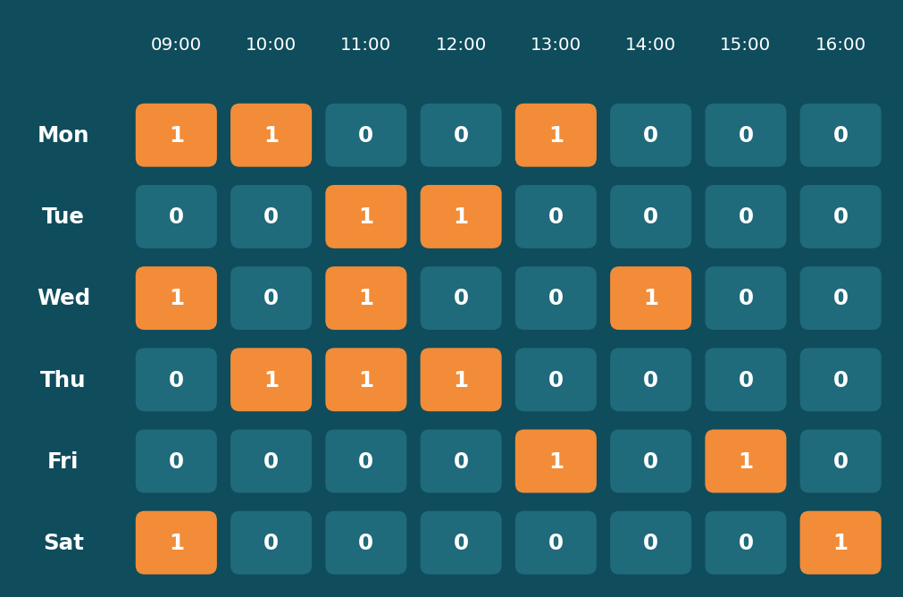
ClinicAppointmentManager
A Java console application that books clinic appointments, blocks double bookings and saves records to files
Weekly timetable of one doctor: orange = booked
Programming in Java | Project Viva
Notes:
Introduce the project: a console app for a small clinic. Mention it is built only from the syllabus topics.

Slide 2



The problem we solve
Double bookings
Our solution
Two patients get the same doctor at the same time
Register patients
Book and cancel appointments
Block slot conflicts
Track confirmed / paid / follow-up
Save to files and print a report
Lost paper records
Patient details are hard to search or recover
No status tracking
Nobody knows who is confirmed or has paid
Notes:
Paper registers cause double bookings. Our app prevents them in code: the doctor's grid refuses a slot that is already 1.

Slide 3
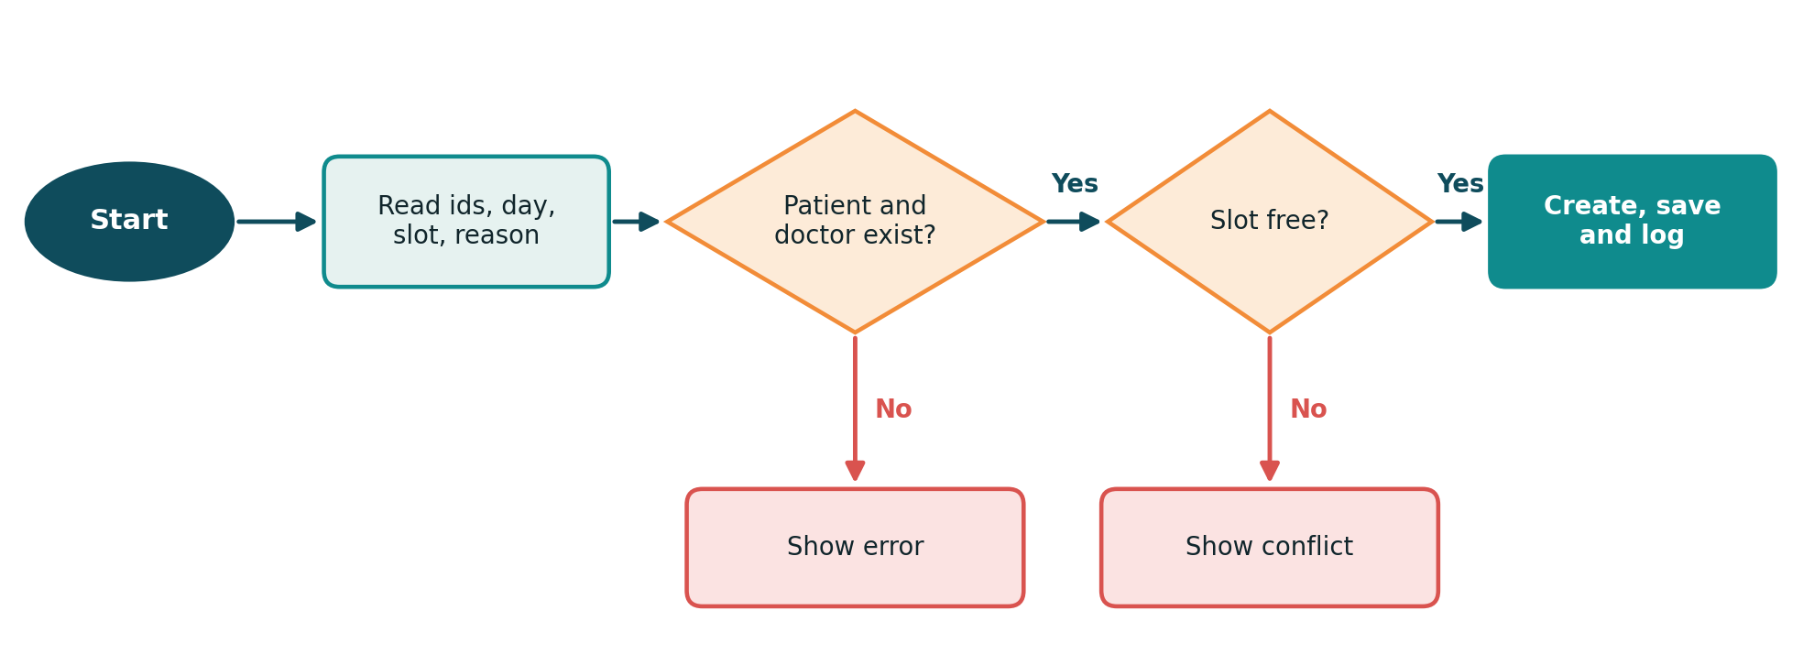
Plan first: algorithm and flowchart
Booking an appointment: two checks, then save. Planned on paper before any Java was written.
Notes:
Why: planning the logic first avoids mistakes. Walk through the flowchart: validate ids, check slot, then create, save and log.

Slide 4
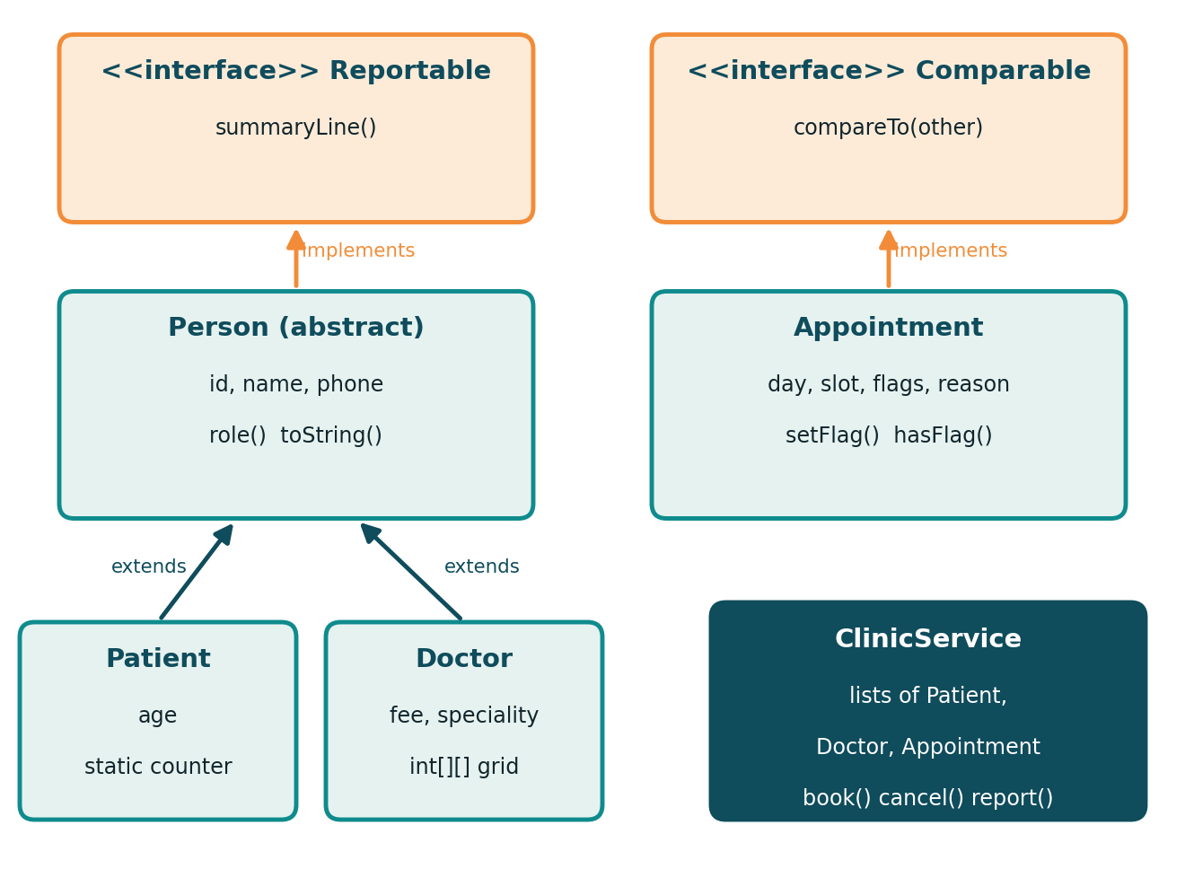
Program design
Main: menu, Scanner, printf
ClinicService: rules and report
FileStore: reading and writing files
Person to Patient and Doctor: is-a
Reportable: one print method for all
Notes:
Three layers: Main handles input/output, ClinicService holds the logic, FileStore handles files. Person is abstract; Patient and Doctor extend it. Reportable lets one print method serve all.

Slide 5
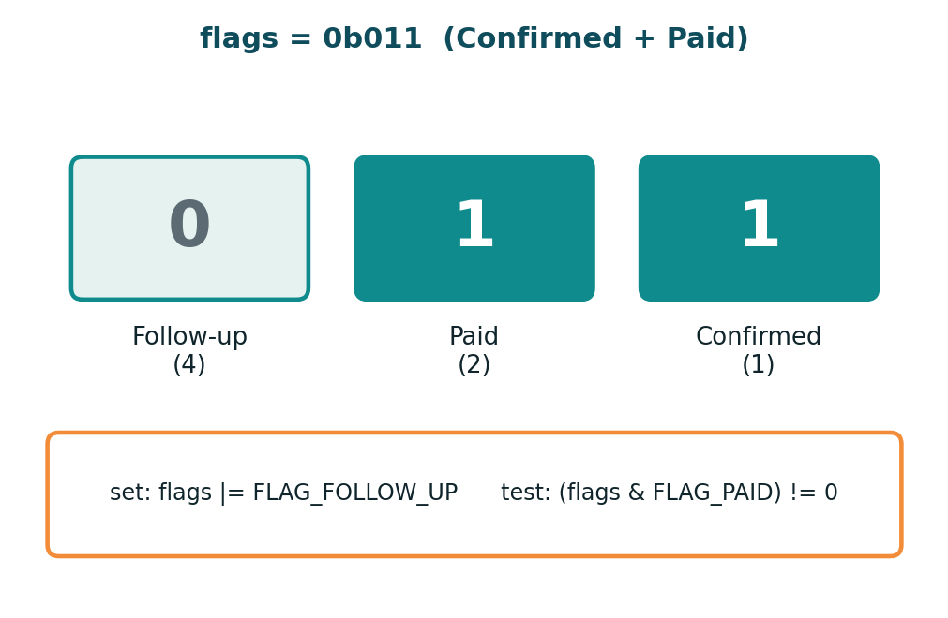
Java foundations in use
Primitive types
int for ids and slots, double for fees
Constants
final static values in one file
Operators
arithmetic, relational, logical, ternary
Typecasting
(double) paid * 100 / total
Bitwise flags: one int stores three statuses
Notes:
Why bitwise: three yes/no statuses fit in one int. Why cast: without (double), int division gives 0 for the paid percentage.

Slide 6
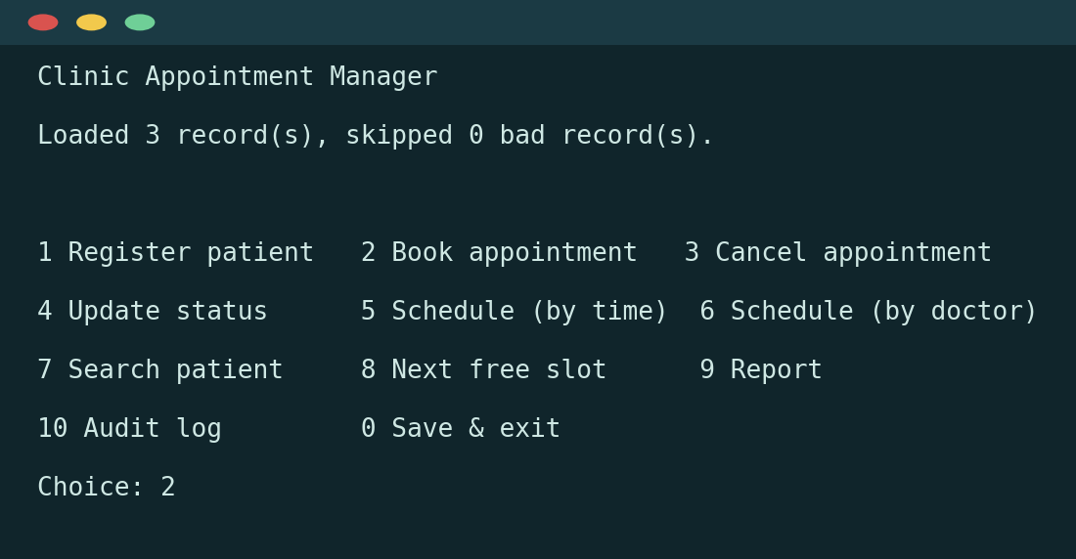
Control flow: menu and loops
do-while: menu shows at least once
switch: 11 fixed menu options
if-else ladder: picks the status flag
for and for-each: walk the day x slot grid
while: read a file until it ends
The menu loop, as the user sees it
Notes:
do-while because the menu must show at least once. switch because the menu has many fixed options. while reads a file until readLine returns null.

Slide 7
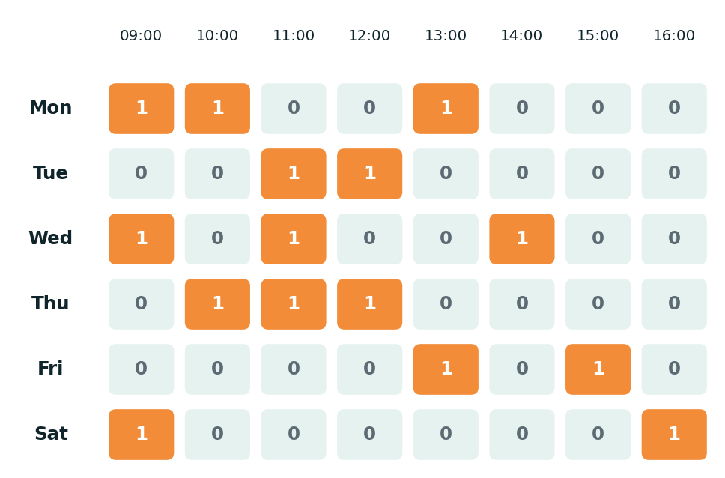
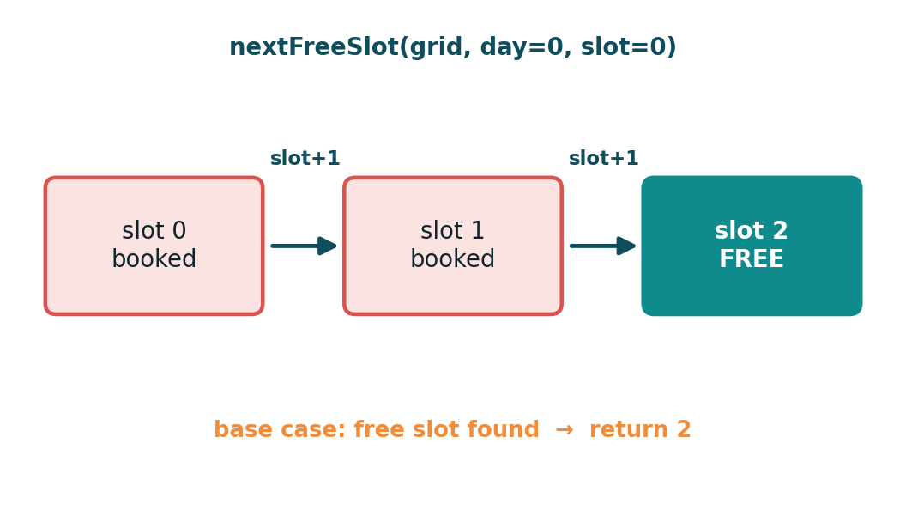
Arrays and recursion
2D array: one 6 x 8 matrix per doctor; adding matrices gives the clinic load
Recursion: finds the next free slot; base case is a free slot or the end of the day
Notes:
2D array: each doctor has a days x slots matrix. Adding all doctors' matrices gives the clinic load. Recursion: base cases are past the last slot, or a free slot found.

Slide 8




Object-oriented design
Encapsulation
Inheritance
Private fields; Doctor returns a copy of its grid
Patient and Doctor extend abstract Person
Interface
Static and this()
Reportable gives one print method for all
Shared id counter; overloaded constructors
Notes:
Encapsulation: getGridCopy returns a copy so nobody can change bookings without going through book(). Static counter gives each patient a unique id.

Slide 9
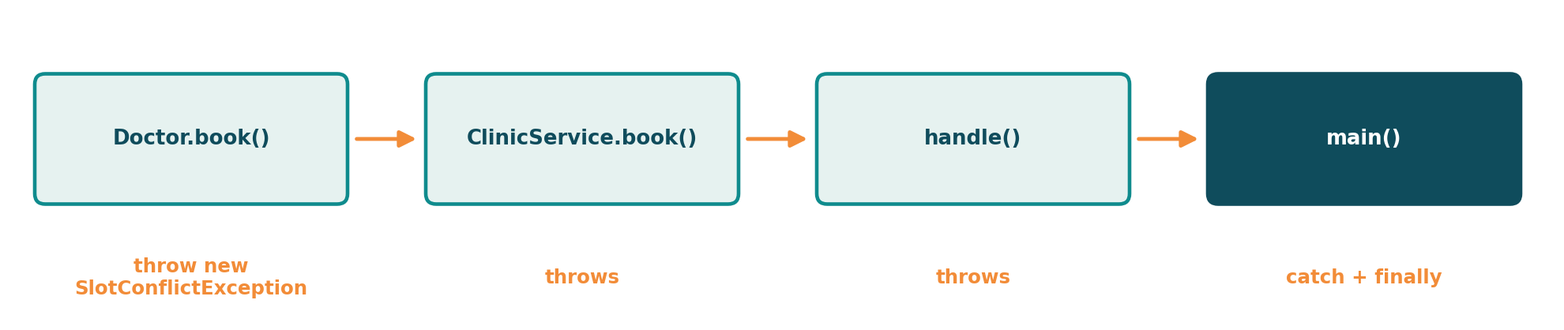
Exception handling
Checked
InvalidInputException and SlotConflictException must be handled
Unchecked
NumberFormatException is caught and converted
finally
Saves data and says goodbye even if saving fails
Notes:
Checked exceptions: expected situations the caller must handle. NumberFormatException is unchecked and is converted to our checked exception. finally always runs.

Slide 10
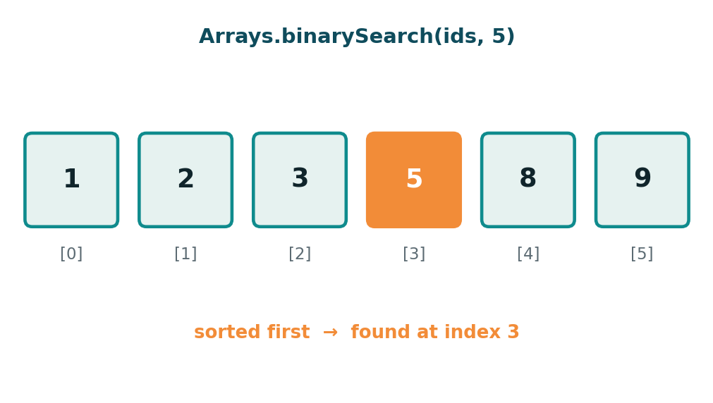
Strings, sorting and searching
String: trim, split, join, contains
equals() compares content, == compares references
StringBuilder builds the report
Comparable: day, then slot
Comparator: by id, by doctor
binarySearch after sorting
Sort first, then binary search
Notes:
Binary search needs sorted data, so we sort by id first. Comparable gives one natural order; Comparator gives extra orders. StringBuilder avoids many temporary String objects.

Slide 11
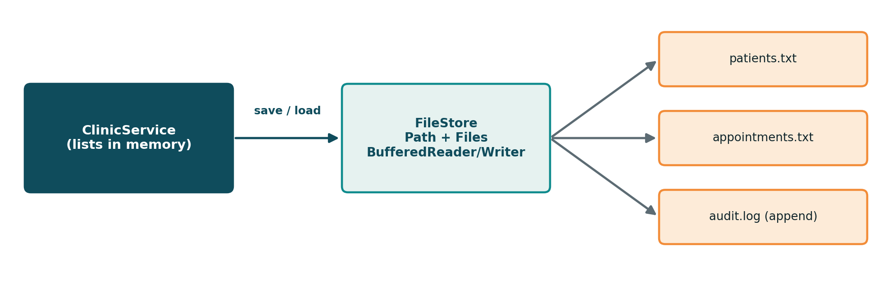
File input and output
try-with-resources
Files close automatically
Missing file
Treated as no data yet
Bad records
Skipped and counted
Notes:
try-with-resources closes readers and writers automatically. A missing file is treated as no data yet. Malformed lines are skipped and counted so the app never crashes on bad data.

Slide 12
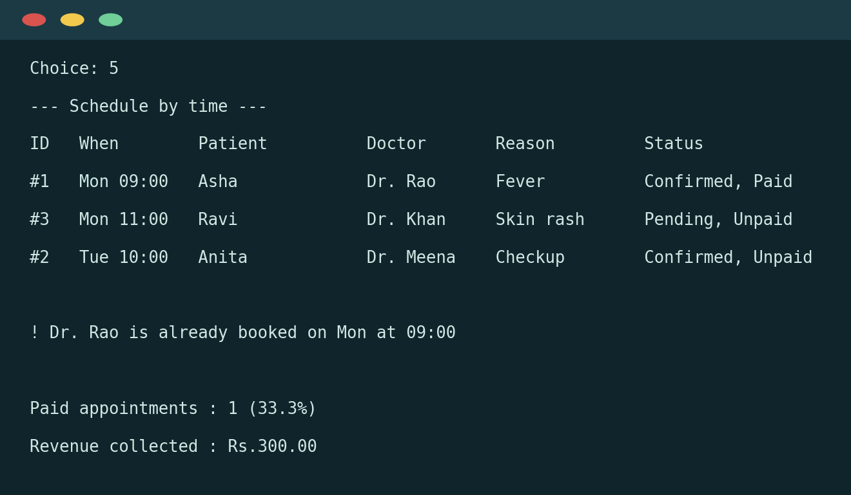
The app in action
Report shows
Appointments per doctor
Busiest doctor
Revenue and average fee
Clinic load grid
Illustrative output
Notes:
Sample output showing schedule sorted by time, a rejected double booking and report figures. Replace with a real screenshot from your own run before the viva.

Slide 13
Every topic has a reason
14
30+
1
Java files
syllabus topics
working app
Thank you. Questions?

