Slide 1

MALLA REDDY COLLEGE OF ENGINEERING
(Approved by AICTE-Permanently Affiliated to JNTU-Hyderabad)Accredited by NBA & NAAC, Recognized section 2(f) & 12(B) of UGC New Delhi ISO 9001:2015 certified Institution
Department of Electronics and Communication Engineering
A Technical Seminar on
BIO CHIP TECHNOLOGY
Presented By:
N . Srikanth
19Q91A04A0
ECE-4B

Slide 2
OVERVIEW
INTRODUCTION
HISTORY
COMPONENTS OF BIOCHIP
WORKING OF BIOCHIPS
WORKING IMPLANT
APPLICATIONS
DISADVANTAGES
FUTURE
CONCLUSION

Slide 3
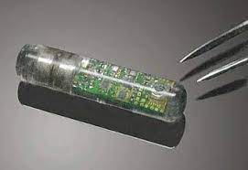
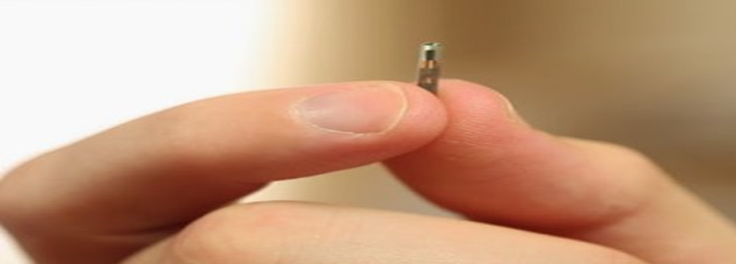
INTRODUCTION
Biochip=Bio + Chip
Bio : stands for any biological entity like protein, DNA etc,..
Chip : A computer chip
Permits many tests to be performed at the same time
Performs thousands of biological reactions in a few seconds

Slide 4
HISTORY
Developed in 1983 for monitoring fisheries
Large scale of development of biochips in the 1990s
In 1980 Fred sanger and Walter gilbert were awarded Nobel price for the pioneering DNA sequencing approach

Slide 5
TYPES OF BIOCHIPS
DNA Microarray: A DNA microarray is set of tiny DNA spots fixed to a strong surface
Microfluidic Chip: Microfluid chip is known as lab on a chip
Protein Microarray : A protein chip method is use to follow the actions as well as connections of proteins and to find out their function on a large scale.

Slide 6
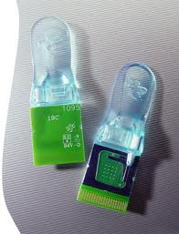
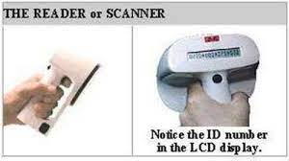
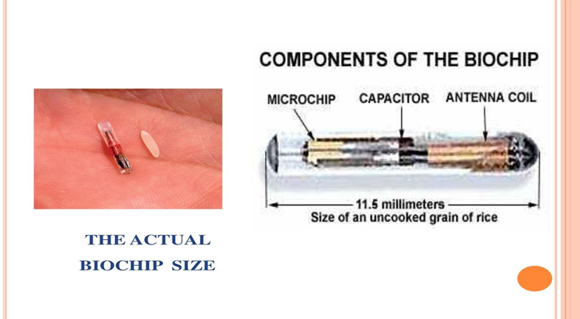
COMPONENTS
Biochip implant system consist of two components :
Transponder
Reader or scanner

Slide 7
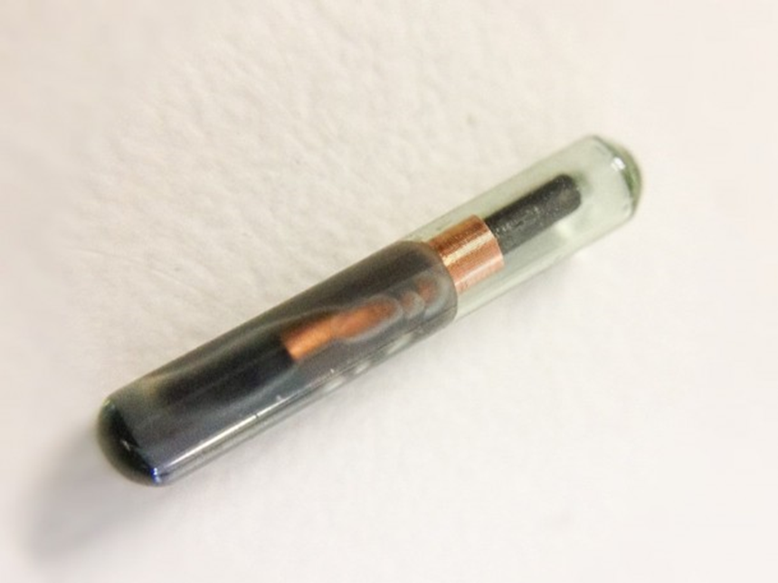
TRANSPONDER
Two types of transponder – passive or active.
Communication between biochip and reader is via low-frequency radio waves
Transponder consists of four parts:
Computer microchip
Antenna coil
Tuning capacitor
Glass capsule

Slide 8
Computer microchip: The microchip stores a unique identification number from 10 to 15 digits long.
Antenna coil : This tiny ,primitive , radio antenna “receives and sends” signals from the reader.
Tunning capacitors :The capacitor is charged by the small (1 – 1000) signal sent by the reader.
Glass capsule: “Houses” the microchip, antenna coil and capacitor.
It is made of bio compataible material such as a soda lime glass.

Slide 9
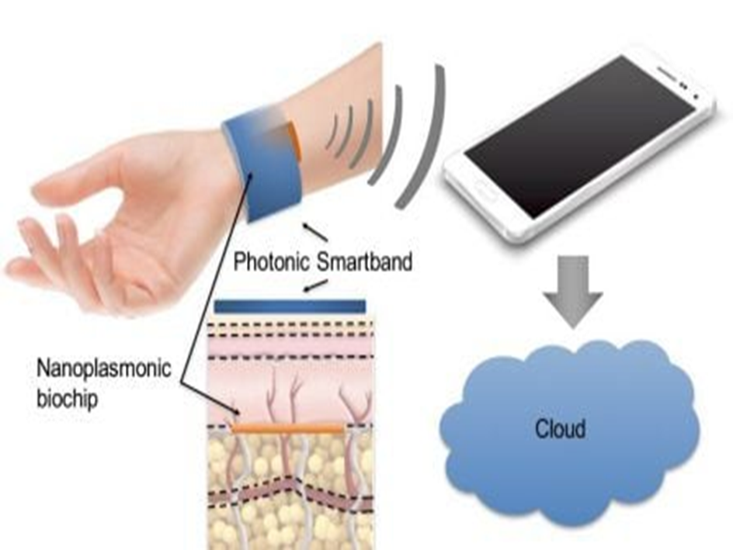
READER OR SCANNER
Consists of an “exciter” coil which creates electromagnetic field.
Provide energy to “activate” the implanted biochip.
Also carriers a receiving coil to receive ID number.
Contains the software and components to decode the receive code and display the result in an LCD display

Slide 10
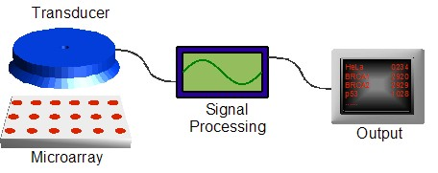
WORKING
The operating generates a low power electromagnetic field through radio signals
The fixed biochip gets turned ON.
The activated chip transmits the idenfication code reverse to the operator through the radio signals.
Reader strengthens the received code to change to change it into digital form and finally exhibits it on LCD.

Slide 11
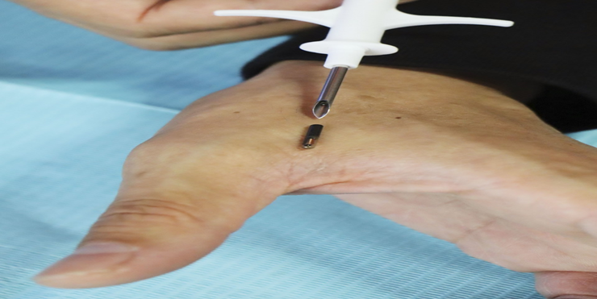
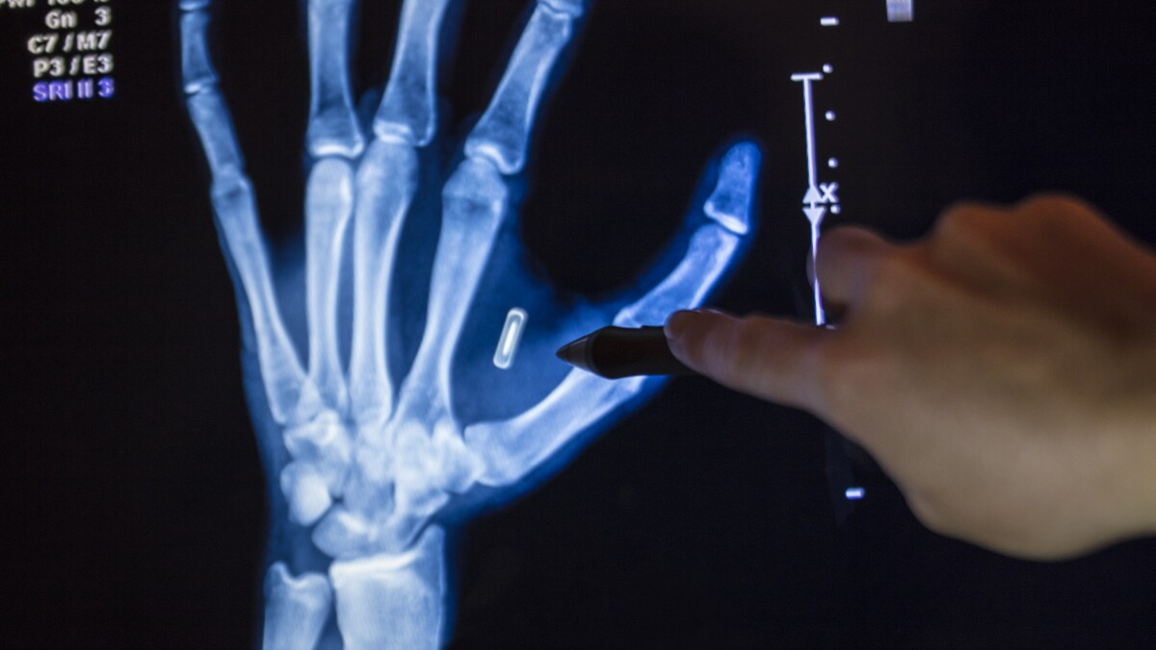
BIOCHIP IMPLANT
Injected by a hypodermic syringe beneath the skin.
Injection Is safe and simple.
Anesthesia is not required.
Usually injected behind the neck in animals.

Slide 12
APPLICATIONS
With a biochip tracing of a person ,anywhere in the world is possible.
A biochip can store and update financial , medical, basically everything about a person.
Medical implementation of biochips-as glucose detector; as oxygen sensor ; as an blood pressure sensor.
Biochips are really potent in replacing passports ,cash ,medical records.

Slide 13
ADVANTAGES
To secure the sick.
To find the lost people.
To identity person uniquely.
In monitoring health conditions of individuals in which they are specially employed.
Ability to detect multiple viral agents in parallel.
They can perform thousands of biological reactions in a few seconds.

Slide 14
DISADVANTAGES
They raise the critical issues of personal privacy.
They mark the end of human freedom and dignity.
There is a danger of turning human being into a controlled slave.
They can implemented into ones body without their without their knowledge.

Slide 15
FUTURE
A chip implanted somewhere in human bodies might serve as a combination of credit card ,passport, driver’s license, personal diary.
No longer would it be needed to worry about losing the credits cards while travelling.
A chip inserted into human bodies might also give us extra mental power.

Slide 16
CONCLUSION
Biochips are:
Fast
Accurate
Miniaturized
Expected to become economically advantageous attributes that make them analogous to computer chip.

Slide 17
THANK YOU
FOR YOUR ATTENTION

