Slide 1
Telecom Customer Churn Analysis
A guide by Gautam Narang

Slide 2

Overview
Goal: Analyze telecommunication company customer data to predict whether or not a customer is likely to leave the platform (churn)
Data from 7043 customers (21 features):
Churn (Yes or No)
Customer account information (tenure, contract, payments, etc.)
Demographic Information (Partner, Gender, Age, etc.)
Add-on services provided by the platform

Slide 3



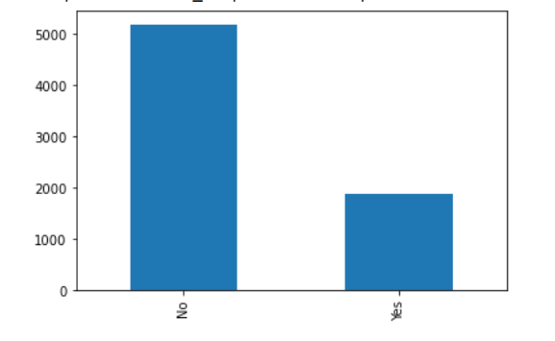
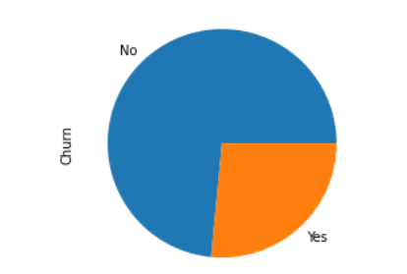
Target - Customer Churn

Slide 4
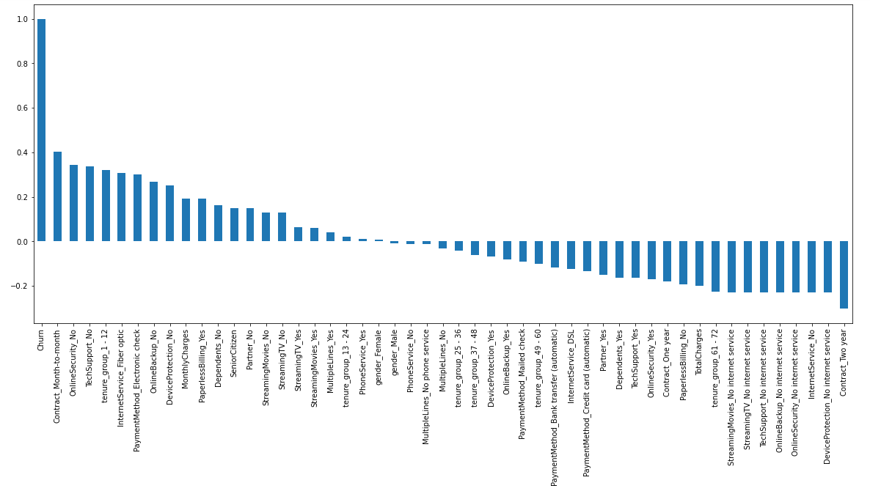
Feature Correlation to Churn

Slide 5
HIGH Churn seen in case of month to month contracts, no online security, no tech support, first year of subscription and fibre optics internet
LOW Churn is seens in case of long term contracts, subscriptions without internet service and customers engaged for 5+ years
Factors like gender, availability of phone service and number of multiple lines have almost no impact on churn.
Derived Insight

Slide 6
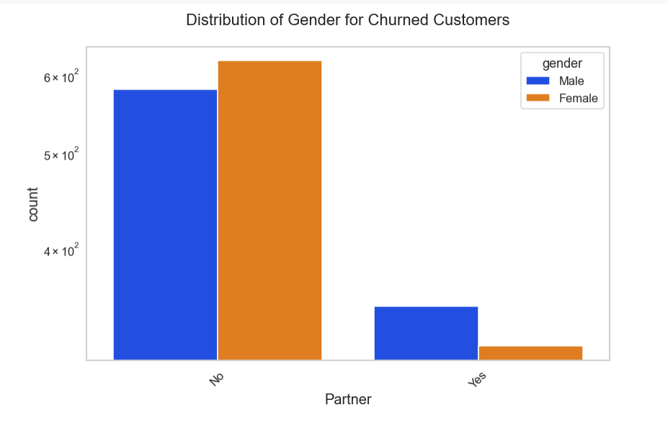
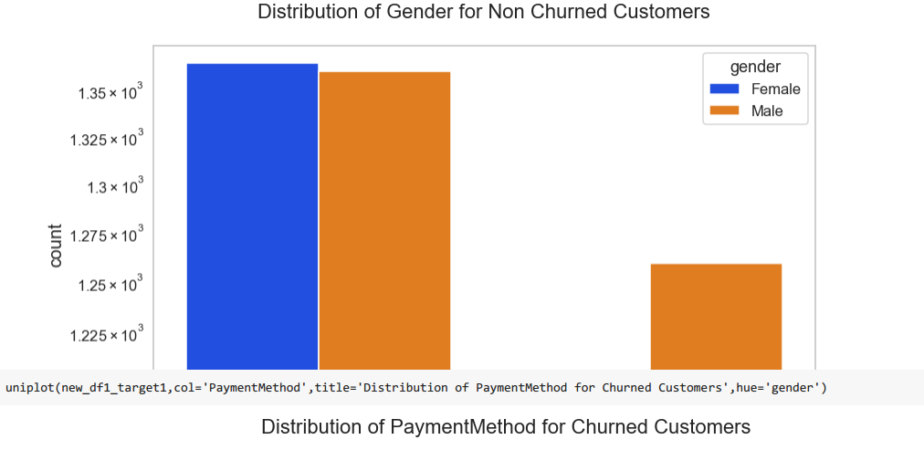

Slide 7
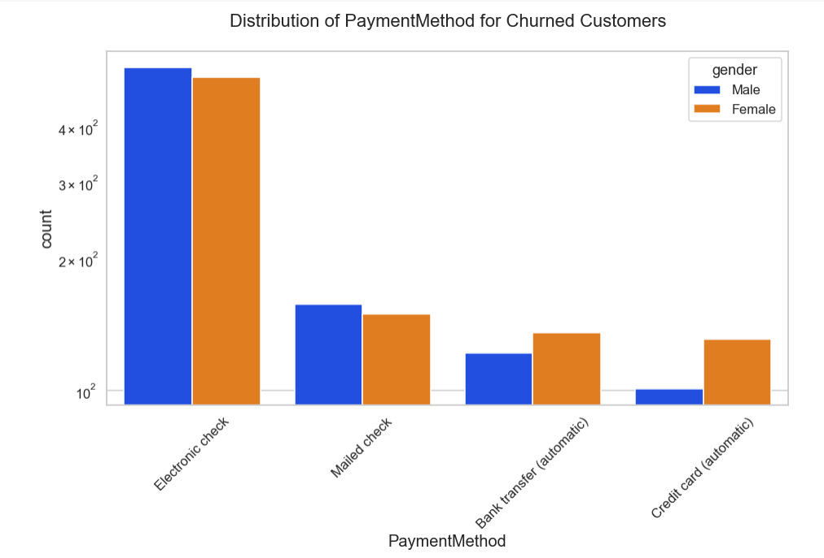
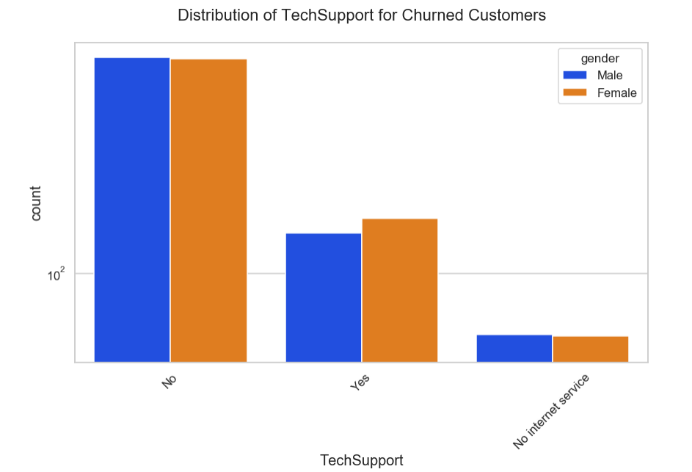

Slide 8
Conclusion
High churn seen in the case of month to month contracts, no online security, no tech support, first year of subscription and fibre optics internet.
Low churn seen in case of long term contracts, subscriptions without internet service and customers engaged for 5 plus years.
Factors like gender, availability of phone service and number of lines have almost no impact on churn.
Electronic check medium are highest churners with a churn rate of 44 %
Customers who are not senior citizens are high churners witha churn rate of 42 %
Pre paid customers are more likely to churn with a curn rate of 41 %
Single customers with no partners are more likely to churn with a churn rate of 35 %
Higher monthly charge, lower tenure and lower total charge are linked to high churn.
Females who don't have partners are more likely to churn compared to their male counterparts.
Females making payment through pre authorised credit card are more likely to churn as compared to their male counterparts.

Slide 9
Thank you

