Slide 1
A heatwave nearly doubles the share of urgent patients seen late
PULSEOPS — ED SURGE SIMULATOR · THE PROBLEM
Urgent patients (triage levels 1–3) not seen within their target time
13.8%
26.7%
Normal day
Heatwave day
Left without being seen 1.9% → 6.8%
Peak bed occupancy 87.1% → 96.0%
Simulated reference ED (60 beds, 4 doctors, 3 triage nurses), 50 simulated days per scenario. Patient patterns from NHAMCS 2022 (CDC); heatwave size +6% to +13% from a published study, as cited by the team.
Notes:
Every summer, emergency departments plan for an ordinary day, and then a heatwave arrives. In our simulated reference department, built from the CDC's NHAMCS 2022 survey, a normal day sees 13.8 percent of urgent patients late. On a heatwave day that nearly doubles, to 26.7 percent. Patients who give up and leave unseen rise from 1.9 to 6.8 percent, and beds peak at 96 percent. Hospitals rarely know in advance where they will break first. PulseOps is built to answer that question before the surge arrives.

Slide 2
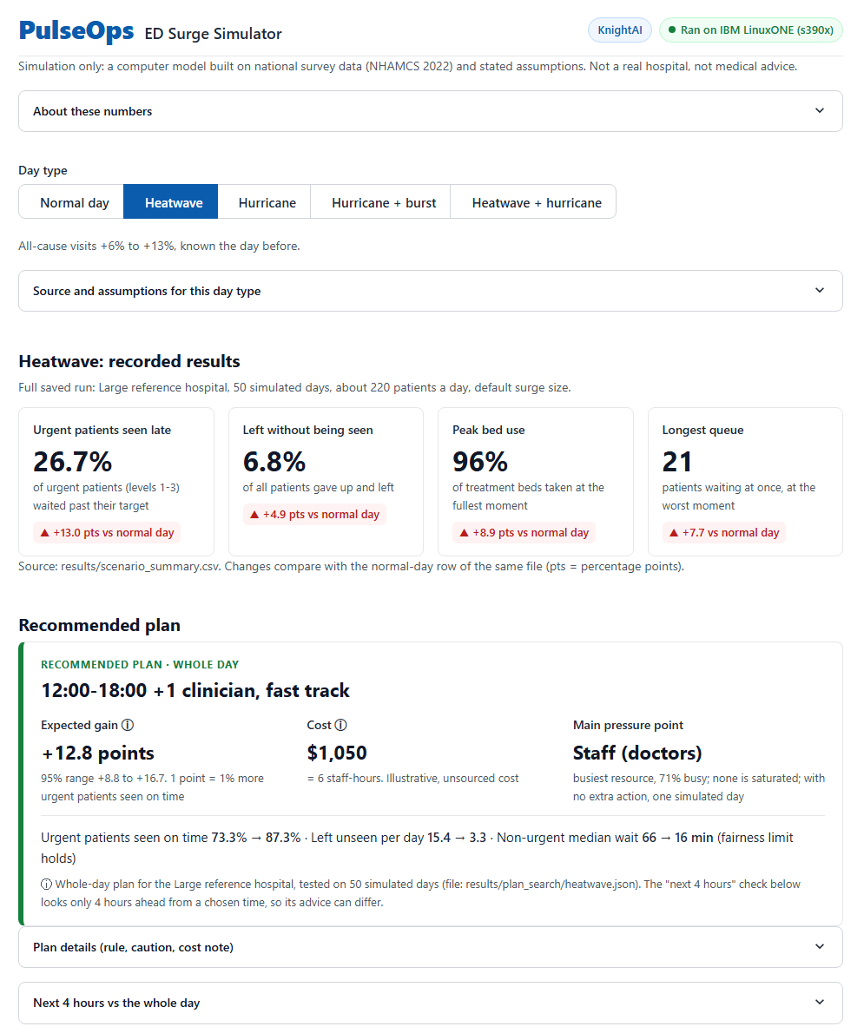
PulseOps tests every fix before the surge hits
HOW IT WORKS
1
Real patient patterns
NHAMCS 2022: 16,025 real ED visits (CDC survey)
2
Calibrated simulator
Arrivals, triage mix and care times fitted to the survey
3
Plan search
78 plans × 50 days; act only if the 95% range clears the gate
4
Early-warning ML
Scores breach risk for the next 4 hours from 150,000 snapshots
The PulseOps dashboard on a simulated heatwave day
Notes:
PulseOps starts from real patient patterns in the CDC's NHAMCS 2022 survey: when people arrive, how urgent they are, and how long care takes. A calibrated simulator replays the department event by event. Then we search 78 plans, such as an extra clinician or fast track, on the same 50 simulated days, and recommend one only when its 95 percent range clearly beats doing nothing. On the heatwave, that lifts urgent patients seen on time from 73 to 87 percent. An early-warning model scores the next four hours.

Slide 3
The whole pipeline runs on IBM LinuxONE in under four minutes
RESULTS ON IBM LINUXONE (s390x)
228 s
11.6 s
2.8×
Identical
Full pipeline on s390x: tests, scenarios, plan search, ML
150,000 snapshots (3,750 simulated days) on 3 cores
4 workers vs 1 on 3 cores: 9.06 s → 3.24 s
Scenario results on x86 and s390x, all 5 rows
Scenario | Urgent seen late | Left unseen | Recommended plan | Gain, points (95% range)
Normal day | 13.8% | 1.9% | Do nothing | Below gate (+0.3 to +1.9)
Heatwave | 26.7% | 6.8% | +1 clinician 12:00–18:00, fast track | +12.8 (+8.8 to +16.7)
Hurricane | 22.3% | 5.2% | +1 clinician 12:00–18:00 | +8.5 (+5.1 to +11.9)
Hurricane + burst | 45.0% | 11.1% | +1 clinician 12:00–18:00 | +10.7 (+7.7 to +13.6)
Heatwave × hurricane | 38.9% | 11.8% | +1 clinician 12:00–18:00, fast track | +19.7 (+15.8 to +23.5)
50 simulated days per scenario, reference ED. Gain = percentage points of urgent patients seen on time vs doing nothing, paired on the same days.
Notes:
This is the part that runs on IBM LinuxONE. Our final full run on an s390x machine with three cores took 228 seconds end to end: tests, five scenarios, the plan search and model training. It produced 150,000 early-warning snapshots in 11.6 seconds, and four workers ran 2.8 times faster than one. The scenario results match our x86 run exactly. The table shows the payoff: doing nothing on a normal day, and on every surge a plan whose 95 percent range is clearly above zero.

Slide 4
Today's models retrain on LinuxONE; next they run on Telum
FROM BASELINE TO AI ON IBM Z
TODAY · BUILT
NEXT · FUTURE, NOT BUILT
LATER · FUTURE, NOT BUILT
Classical ML on Z
On-chip inference
Live, multi-hospital
XGBoost early warning retrained in 90 s on s390x
Urgent-late AUC 0.873; flags 82% of risky moments at 5% false alarms
Models saved as JSON; they load on big‑endian s390x
Export the models to ONNX
Compile with the IBM Z Deep Learning Compiler
Score on the Integrated Accelerator for AI (Telum)
Real-time HL7 / FHIR feeds from ED systems
One LinuxONE serving many hospitals
Validation against real hospital outcomes
Today's early-warning model learns the simulator; it is not validated on a real hospital.
Notes:
Here is where this goes. Today, built and running: classical machine learning retrained on LinuxONE in 90 seconds, flagging urgent-late risk with an AUC of 0.873, saved in a format that loads on big-endian s390x. Next, and not built yet: export those models to ONNX and compile them with the IBM Z Deep Learning Compiler, so scoring runs on Telum's on-chip AI accelerator. Later, also future: real-time HL7 and FHIR feeds and many hospitals on one LinuxONE, validated against real outcomes.

Slide 5
We publish our limits, starting with the gap in urgent wait times
LIMITS, NEXT STEPS AND TEAM
5.1 vs 15.0 min
Next steps
1
Close the wait gap
Boarding and patience from NHAMCS, not fixed values
Urgent median wait: simulated normal day vs NHAMCS 2022. We report this gap rather than hide it.
2
Calibrate every hospital size
Small and Medium presets are scaled, not yet fitted
A simulation, not validated on a real hospital
National survey sample (about 40% response), not one ED
Patience, fast track and costs are assumptions (README)
3
Test on a partner hospital's data
Compare plans and alarms with what really happened
Team KnightAI Abhigyan Tiwari · Ken · Narandelgerekh
github.com/naranll/ed-surge-simulator
Notes:
We want to be clear about what this is. PulseOps is a simulation, not validated on a real hospital, built on a national survey sample rather than one emergency department. Our biggest open gap: simulated urgent patients wait a median 5.1 minutes, real ones 15.0. We show that number instead of hiding it. Next, we draw boarding and patience from the data, calibrate every hospital size and test on a partner hospital's records. We are Team KnightAI. Thank you.

