Slide 1

HAND WRITTEN DIGIT RECOGNITION
USING DEEP LEARNING
NAME: N.Mahesh
COURSE: Data science

Slide 2
INTRODUCTION
Project Objective
Problem Statement
Proposed Solution
Technologies Used
System Architecture
Model Workflow
Dataset
Model Architecture(CNN)
Implementation Tools
Results
Advantages
Limitations
Future Scope
Conclusion

Slide 3
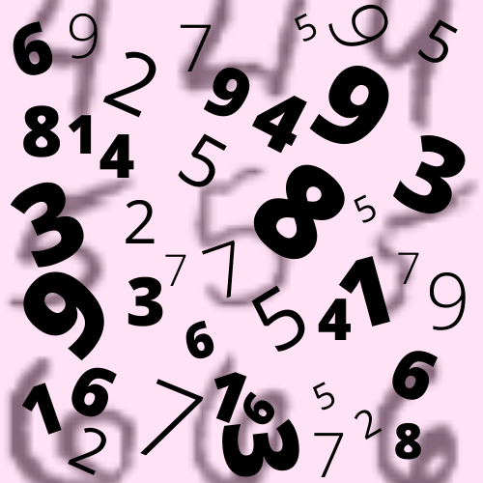
PROJECT OBJECTIVE
To build a machine learning system that can recognize handwritten digits (0–9)
To develop a simple web interface for real-time prediction
To improve automation in digit classification tasks.

Slide 4
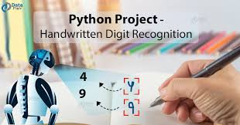
PROBLEM STATEMENT
Manual digit recognition is time-consuming and error-prone
Need for an automated system for fast and accurate classification
Application in postal services, banking, and form processing.

Slide 5
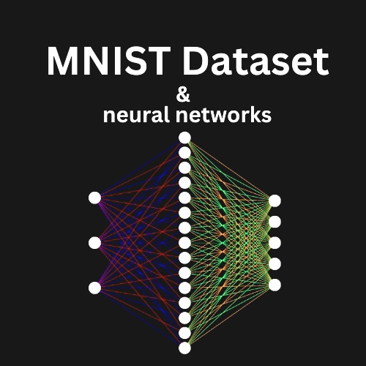
PROPOSED SOLUTION
Train a deep learning model using MNIST dataset
Use Convolutional Neural Network (CNN)
Deploy model using Streamlit web application
Allow users to upload images and get instant predictions.

Slide 6





TECHNOLOGIES USED
Python
TensorFlow / Keras
NumPy
Pillow (PIL)
Streamlit.

Slide 7

System Architecture
User uploads image via Streamlit UI
Image is preprocessed (grayscale, resize 28x28)
Model processes image
CNN predicts digit (0–9)
Output displayed on web interface.

Slide 8

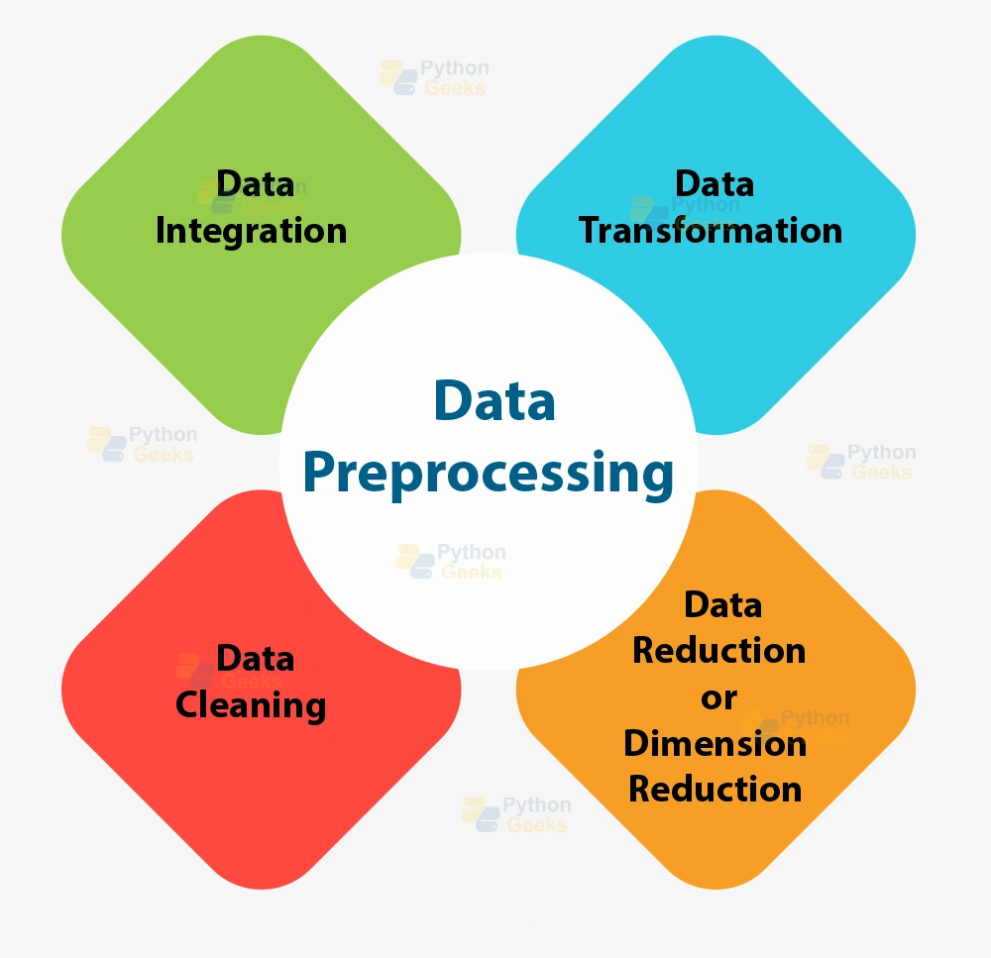
Model Workflow
Input Image
Preprocessing
Grayscale conversion
Resize to 28x28
Normalize pixel values
CNN Model Prediction
Output Digit Display

Slide 9
Dataset
MNIST Dataset
70,000 images of handwritten digits
60,000 training images
10,000 testing images
Image size: 28x28 grayscale.

Slide 10
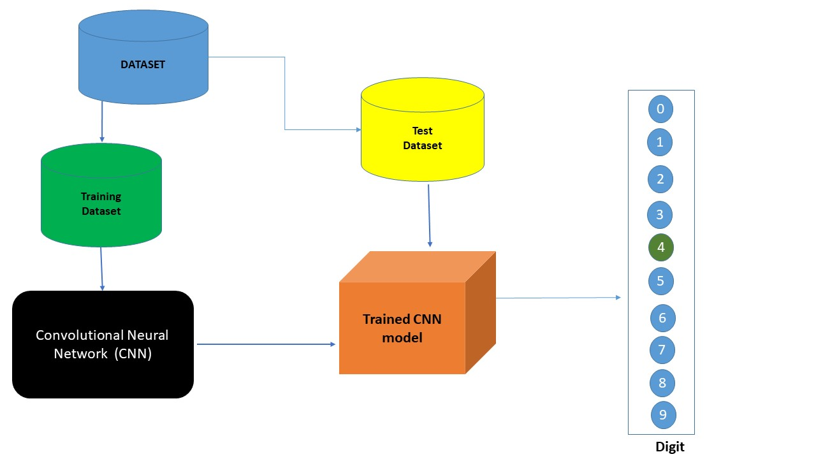
Model Architecture(CNN)
Input Layer (28x28x1)
Convolution Layers
Max Pooling Layers
Flatten Layer
Dense Fully Connected Layers
Output Layer (10 classes: 0–9)

Slide 11
Implementation Tools
Streamlit → UI development
TensorFlow/Keras → Model training & prediction
Python → Backend logic
PIL → Image processing.

Slide 12
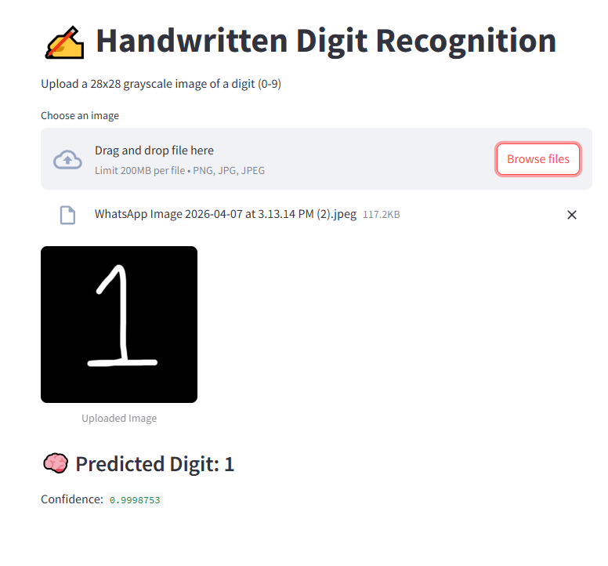
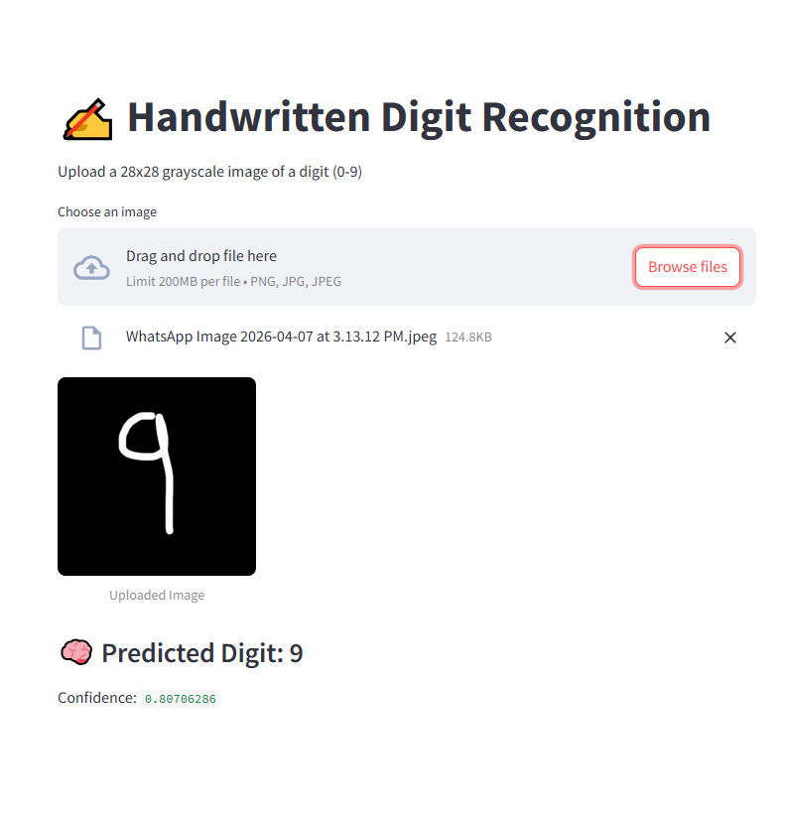
Results
Model predicts digits with high accuracy (~95–99% depending on training)
Real-time prediction via web interface
Fast and user-friendly system

Slide 13
Advantages
Automated digit recognition
Easy to use interface
Fast prediction
Can be extended to real-world applications.

Slide 14









Limitations
Accuracy depends on image quality
Works best on clean handwritten digits.
Limited to digits (0–9 only)

Slide 15
Future Scope
Extend to handwritten letters (A–Z)
Mobile application integration
Improve accuracy using advanced CNN models
Deploy on cloud (AWS / Azure)

Slide 16
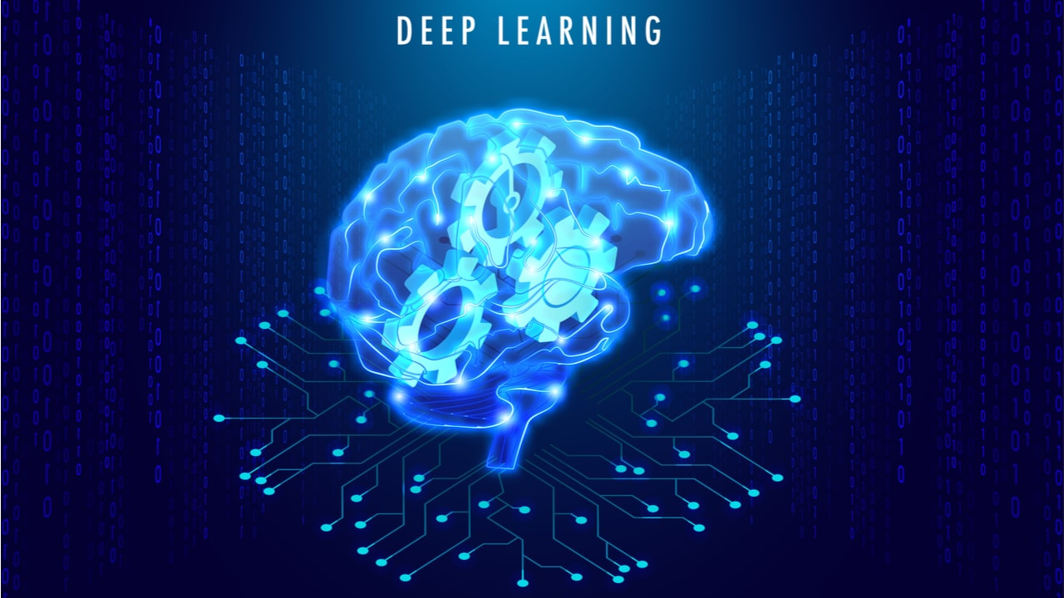
Conclusion
Successfully built a digit recognition system using deep learning
Integrated machine learning model with Streamlit UI
Achieved real-time prediction capability
Provides foundation for advanced OCR systems.

Slide 17
THANK YOU

