Slide 1
Modbus Master/Slave communication using virtual COM ports.
What we do:
Install null modem emulator
Create two serial ports that connect each other
Share one serial port to Ubuntu VM
Run Modbus Slave (off the shelf tool) in windows
Run Modbus RTU Master program (Python) in Ubuntu
Print values onto terminal after the register values are read.

Slide 2
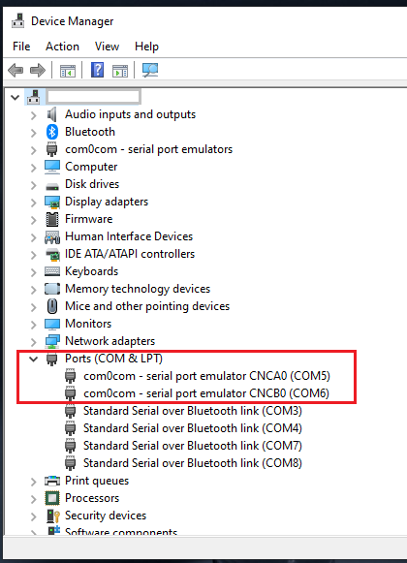
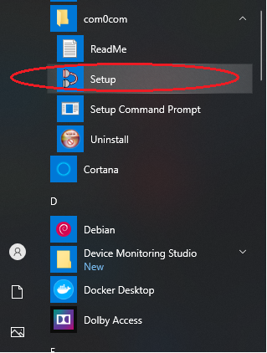
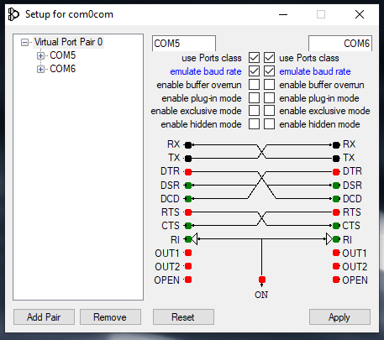
Creating virtual COM ports
Download com0com from following website
https://sourceforge.net/projects/com0com/
Once installation is complete, open ‘Setup’ from com0com from start menu (Figure:1)
Create COM ports as shown in the below screenshot (Figure: 2). We create two COM ports (COM5 and COM6) that logically connected together. Make sure click ‘Apply’ to take effect of any changes made.
You can also emulate the baud rate.
Open Windows Device Manager and verify for the virtual COM ports which are COM5 and COM6 in this case. (Figure: 3)
Figure:2
Figure:3
Figure:1

Slide 3
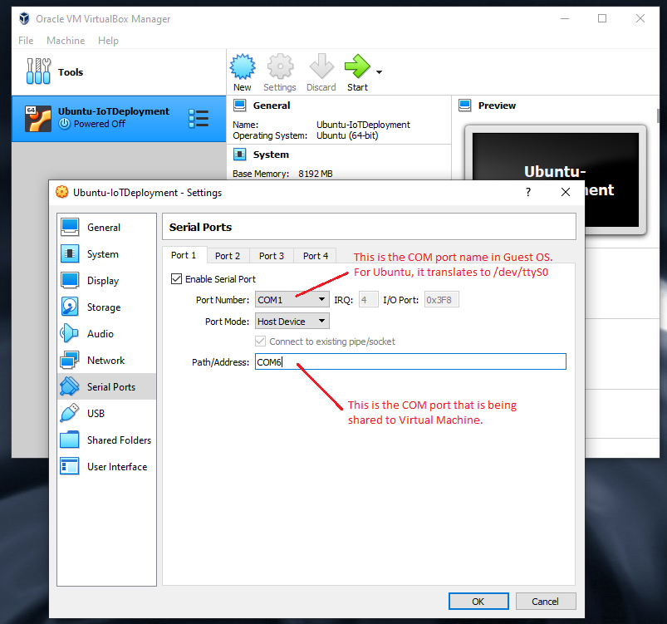
Sharing COM port to a Virtual Machine
Now let us share the COM port (COM6) with VirtualBox VM which is running Ubuntu virtual machine. Refer screenshot in Figure: 4
Figure: 4

Slide 4
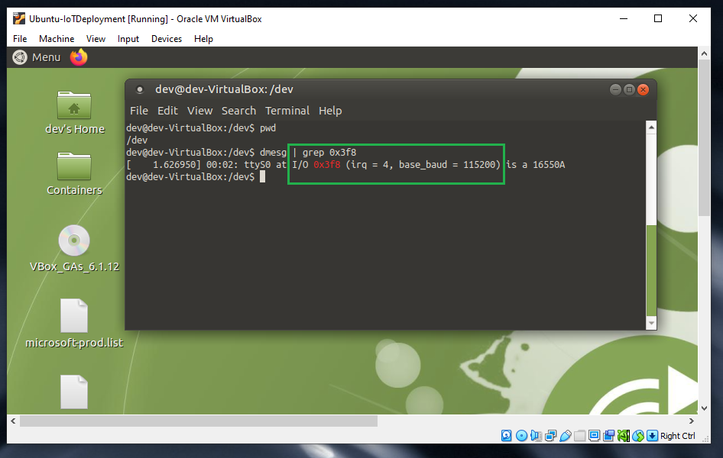
Now, let us switch to Ubuntu virtual machine. I am using MATE desktop environment, but it does not matter if you are using any other display manager.
Open the terminal and go to ‘/dev’ where you will see list of devices.
Now let us find out which COM port device in VirtualBox you selected (Which is COM1), maps to the device on Ubuntu.
To find it out, refer to Figure: 4 for I/O port value for the selected COM1 port. This value is 0x3F8 from Serial Port Setting from VirtualBox
Now execute the following command within the terminal from /dev path.
$ dmesg | grep 0x3f8
Above command displays the proper tty device (which is ttyS0 in this case) that can be used in Ubuntu for Serial Communication.
Figure: 5

Slide 5
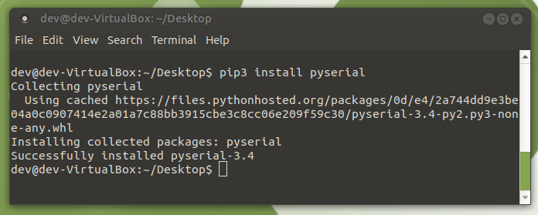
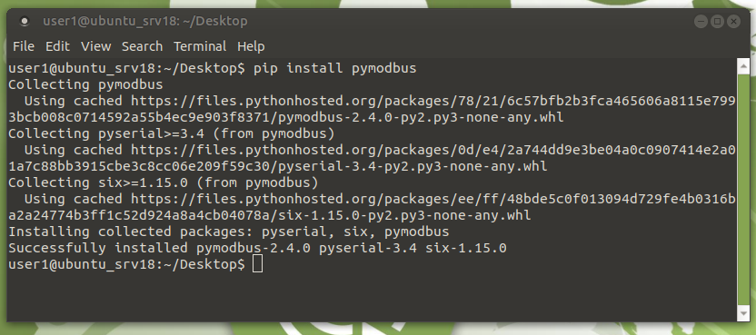
Install necessary Modbus libraries in Ubuntu
Make sure Python Serial libraries are installed in Guest OS (Ubuntu)
Figure: 6
Install ‘pymodbus’ library using terminal as shown in below Figure: 7
Figure: 7

Slide 6
Modbus Master Python Source code running inside Ubuntu 18.04 Server:
Click the below link to open the source code
Modbus Slave running in windows:
Install following trial version of Modbus simulator from below link
https://www.modbustools.com/modbus_slave.html
Open the below configuration file from the tool to simulate THD sensor

Slide 7
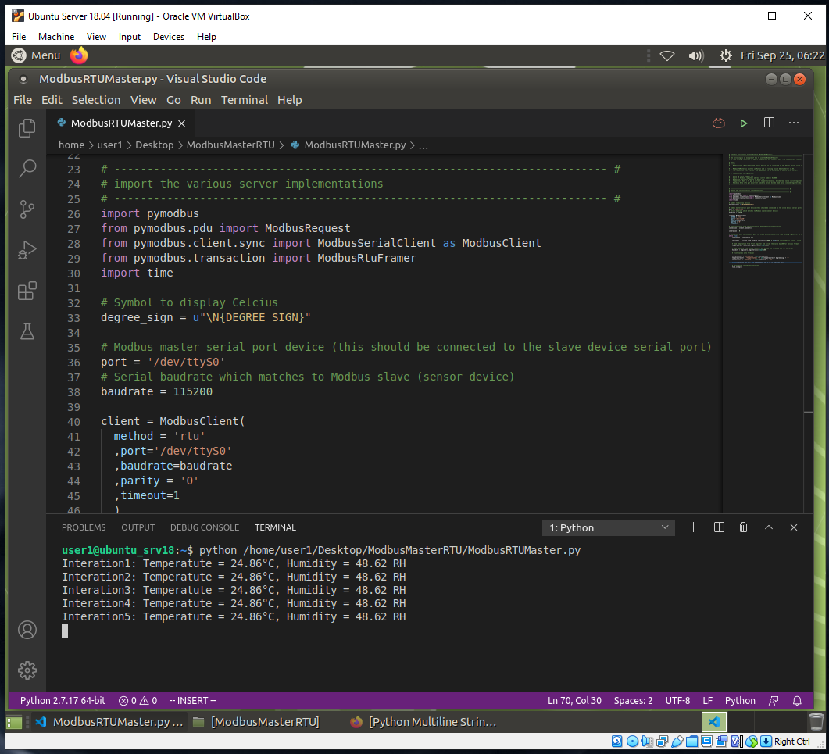
Modbus Master (Ubuntu 18.04 Server):
See the Sensor output as marked in the RED block
Figure: 8

Slide 8
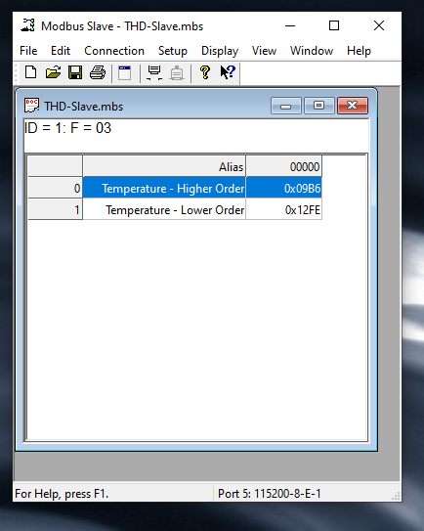
Modbus Slave (Windows 10 Simulated App):
Figure: 9

