Slide 1
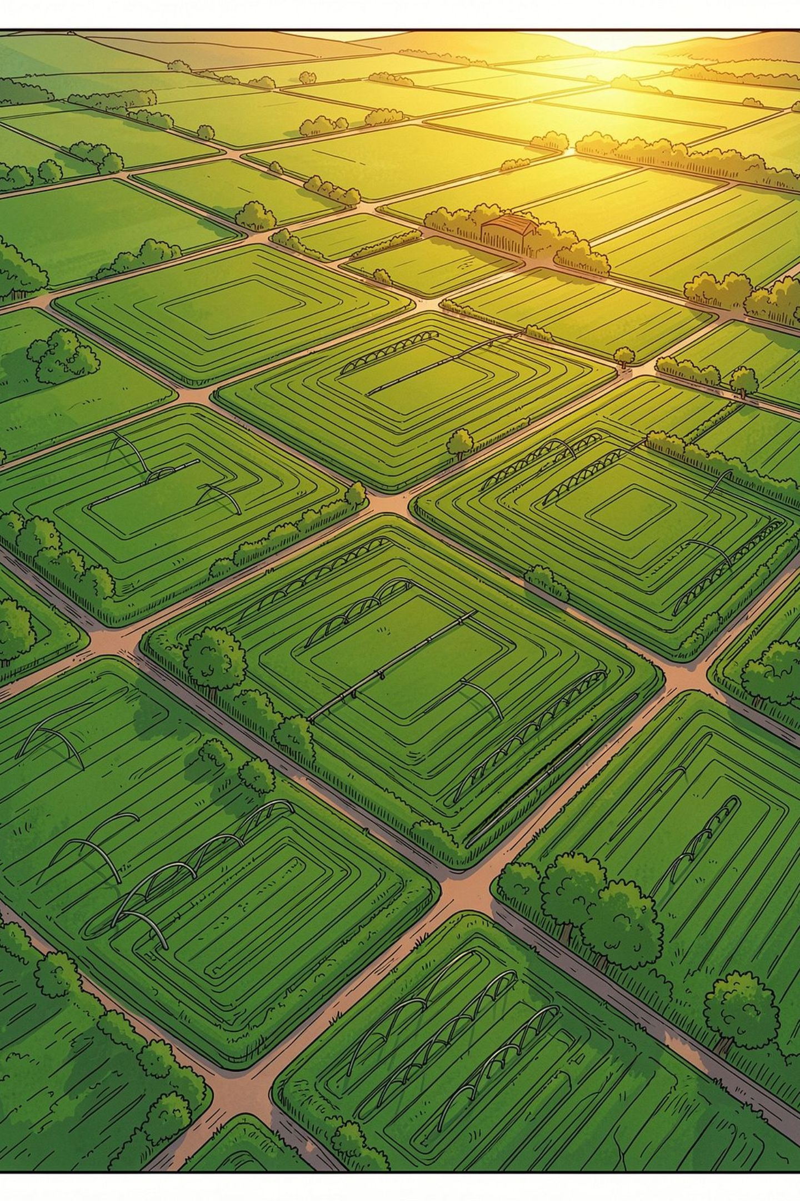
Crop Yield Prediction System
A machine learning–driven platform integrating rainfall, soil characteristics, and fertilizer usage to forecast agricultural productivity with precision — empowering farmers, researchers, and policymakers.
ACADEMIC PROJECT
MACHINE LEARNING
SMART AGRICULTURE
N.LALITHA
323129510067

Slide 2
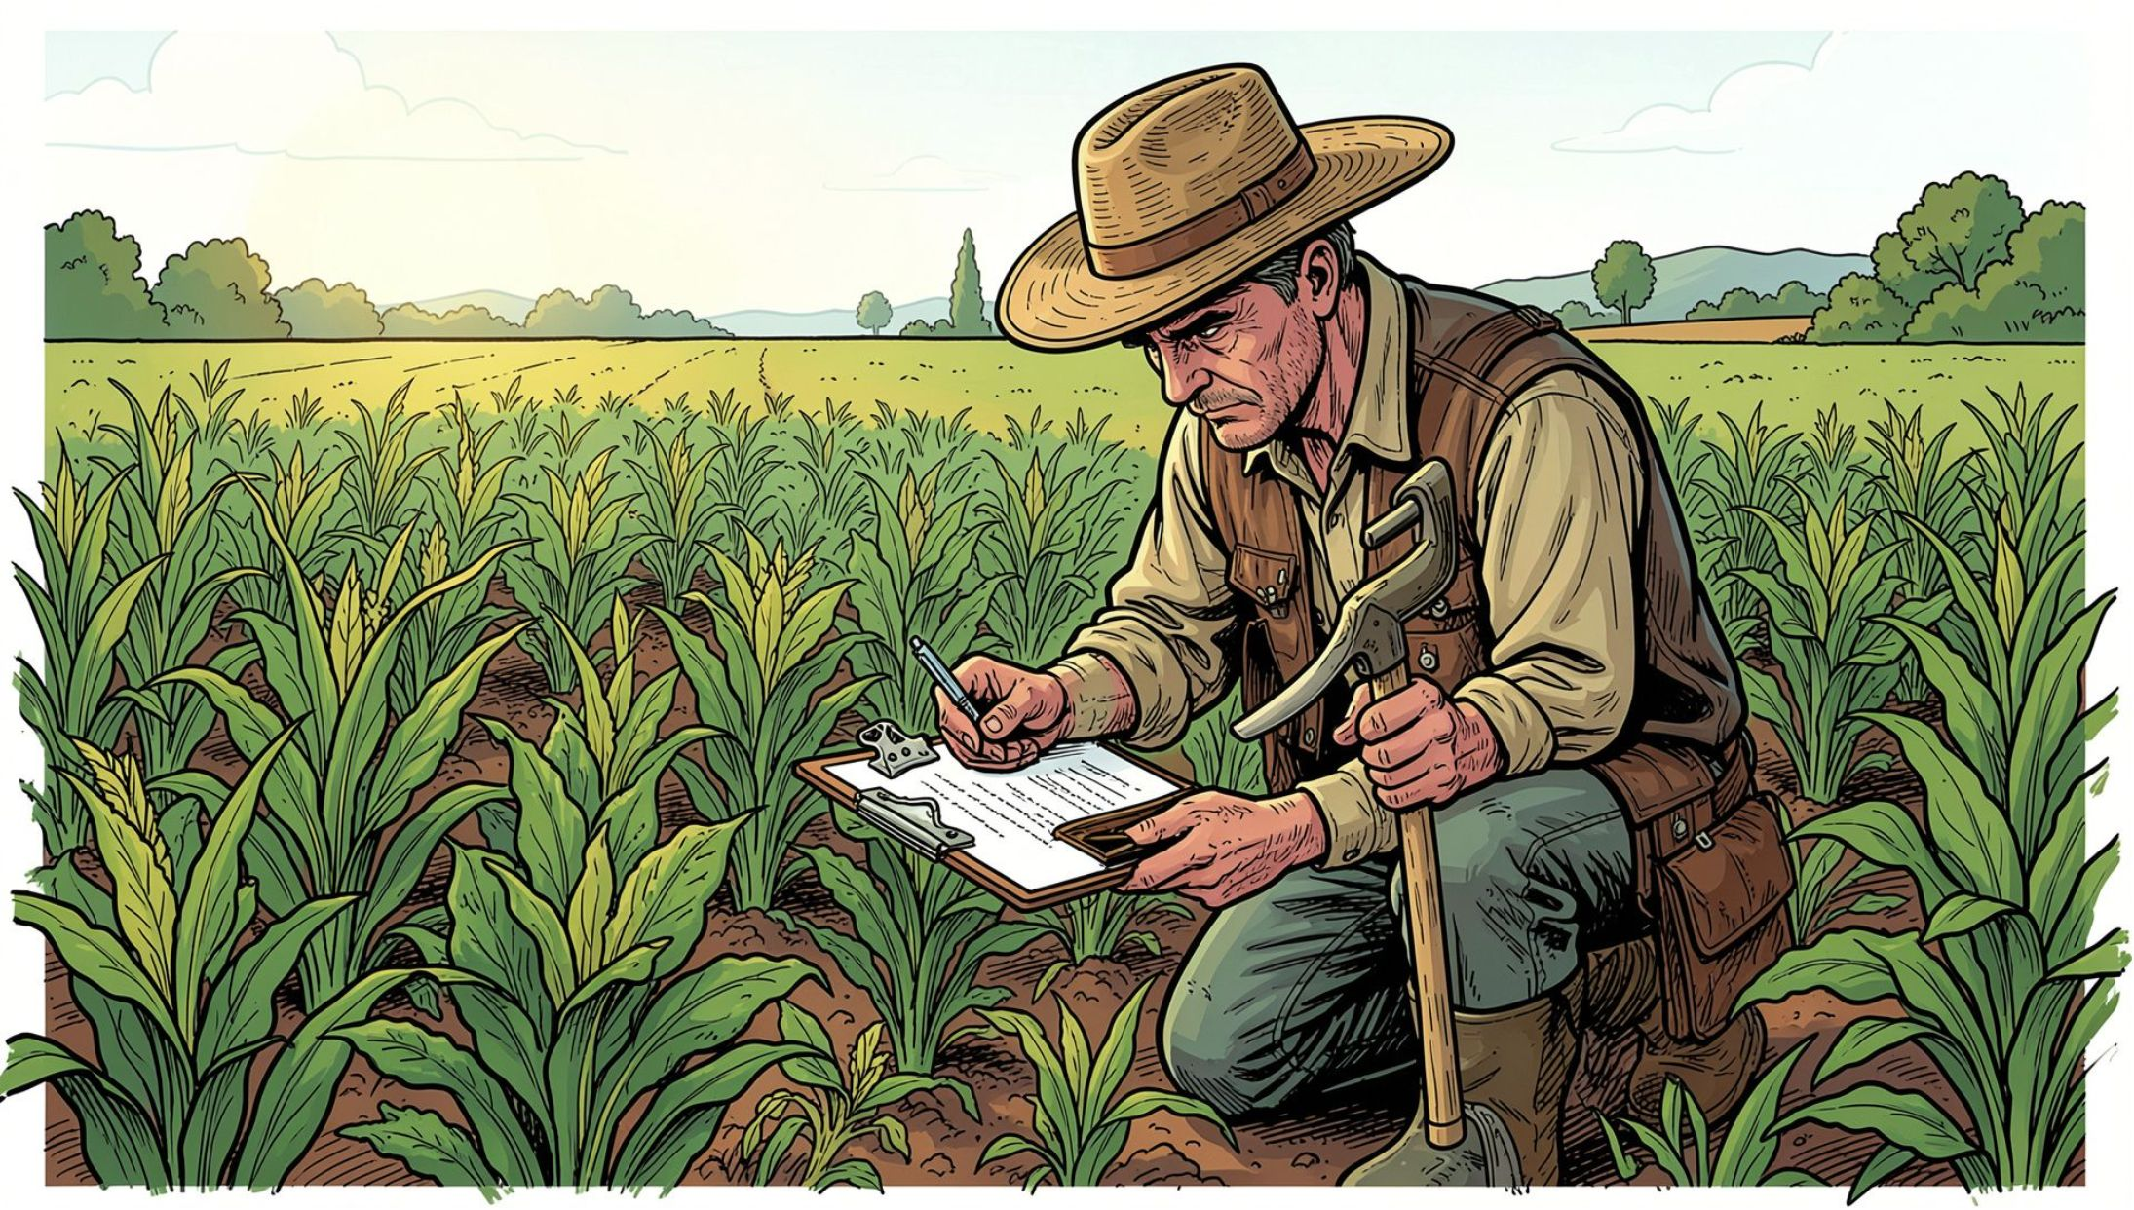
The Problem with Traditional Crop Estimation
Conventional yield estimation relies on subjective field observations, historical intuition, and delayed reporting — producing unreliable forecasts that undermine planning and resource allocation.
Manual Observations
Historical Guesswork
Resource Waste
Prone to human error and inconsistency across regions and seasons.
Past experience fails to capture dynamic climate and soil variability.
Over- or under-application of water, fertilizer, and labor reduces efficiency.

Slide 3
Key Factors Influencing Crop Yield
Crop productivity is shaped by a complex interplay of environmental, soil, and management variables. The system ingests all six dimensions to build robust predictive models.
Rainfall
Soil Characteristics
Volume, timing, and distribution of precipitation directly affect growth cycles.
pH, texture, organic matter, and nutrient content define soil fertility.
Fertilizer Usage
Temperature & Humidity
NPK application rates and timing drive nutrient availability for crops.
Ambient conditions govern photosynthesis rates and stress responses.
Farming Practices
Crop Variety
Irrigation methods, crop rotation, and tillage influence final output.
Genetic traits and cultivar selection determine yield potential.

Slide 4
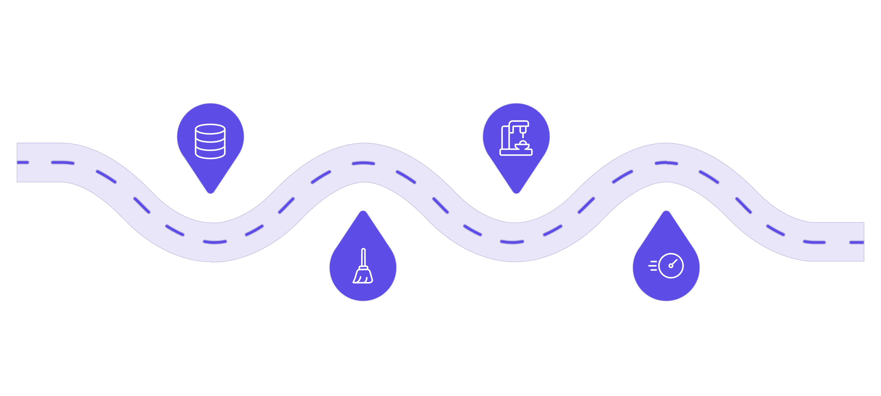
System Architecture & Workflow
Data Collection
Model Training
Sensors, APIs, and surveys gather field data
Train regression models on engineered data
Prediction Engine
Preprocessing
Clean, validate, and engineer features
Generate yield forecasts for fields
The end-to-end pipeline transforms raw agricultural data into actionable yield forecasts, with each stage validated before passing to the next.
Stakeholder Roles
Core Functional Modules
Farmers
Data Collection
Prediction Engine
Submit field data, receive localized predictions and recommendations.
Researchers
Analytics Dashboard
Report Generator
Analyze trends, validate models, publish findings.
Government Agencies
Monitor regional output, plan subsidies and food security.
Administrators
Manage users, datasets, and system configurations.

Slide 5
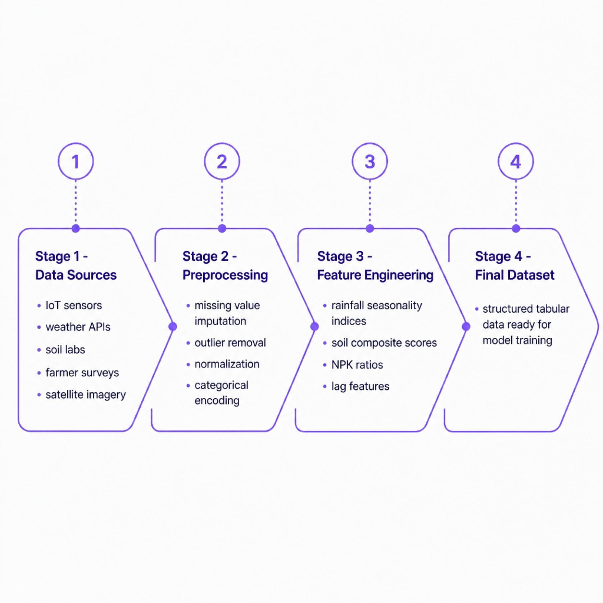
Data Pipeline: Collection, Preprocessing & Feature Engineering
Dataset Overview
The system integrates multi-source agricultural data spanning multiple growing seasons and geographic regions.
~50K Records
20+ Features
80/20 Split
Historical yield observations across diverse agro-climatic zones.
Environmental, soil, fertilizer, and management variables.
Training and test partition with stratified cross-validation.

Slide 6
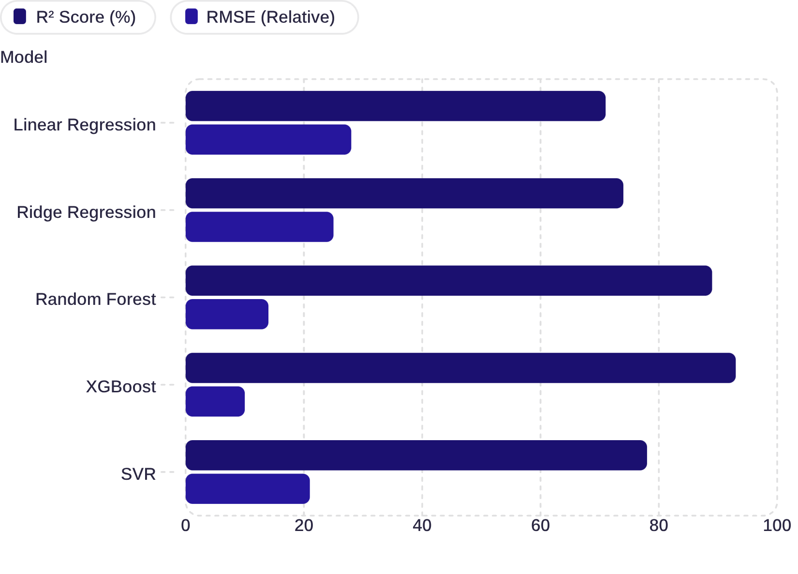
Regression Algorithms & Model Comparison
Algorithm Selection Rationale
Multiple regression techniques were benchmarked. XGBoost achieved the strongest performance, capturing non-linear interactions between rainfall, soil nutrients, and fertilizer timing.
Linear / Ridge
Random Forest
XGBoost
SVR
Baselines for interpretability and regularization.
Robust to outliers, handles mixed feature types.
Gradient boosting with highest accuracy — selected model.
Effective in high-dimensional spaces, slower at scale.

Slide 7
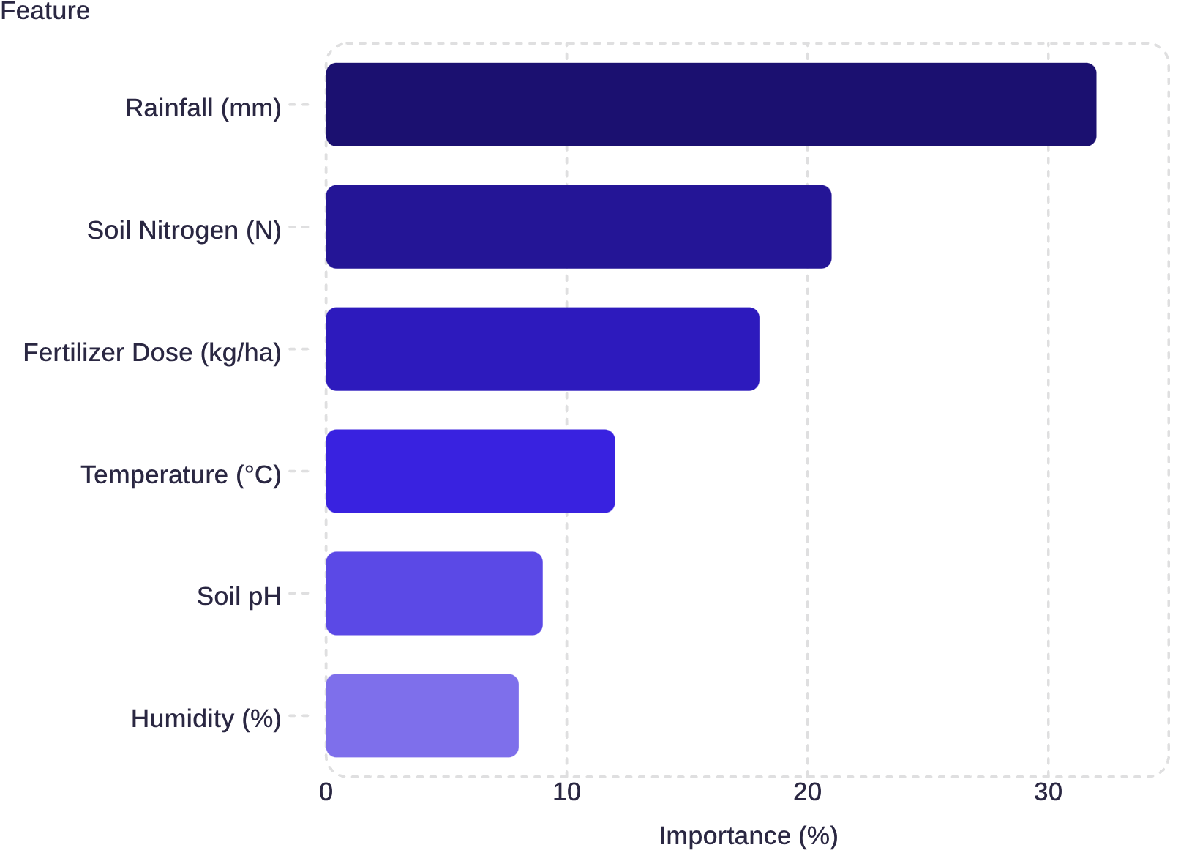

Feature Importance & Prediction Analysis
What Drives Yield Predictions?
SHAP-based feature importance reveals rainfall and soil nitrogen as the dominant predictors, together accounting for over 50% of model variance.
Rainfall timing during critical growth stages (flowering, grain filling) has outsized impact compared to total seasonal precipitation.
The model generates probabilistic yield ranges, enabling farmers to plan harvest logistics, storage, and market sales with confidence intervals.

Slide 8
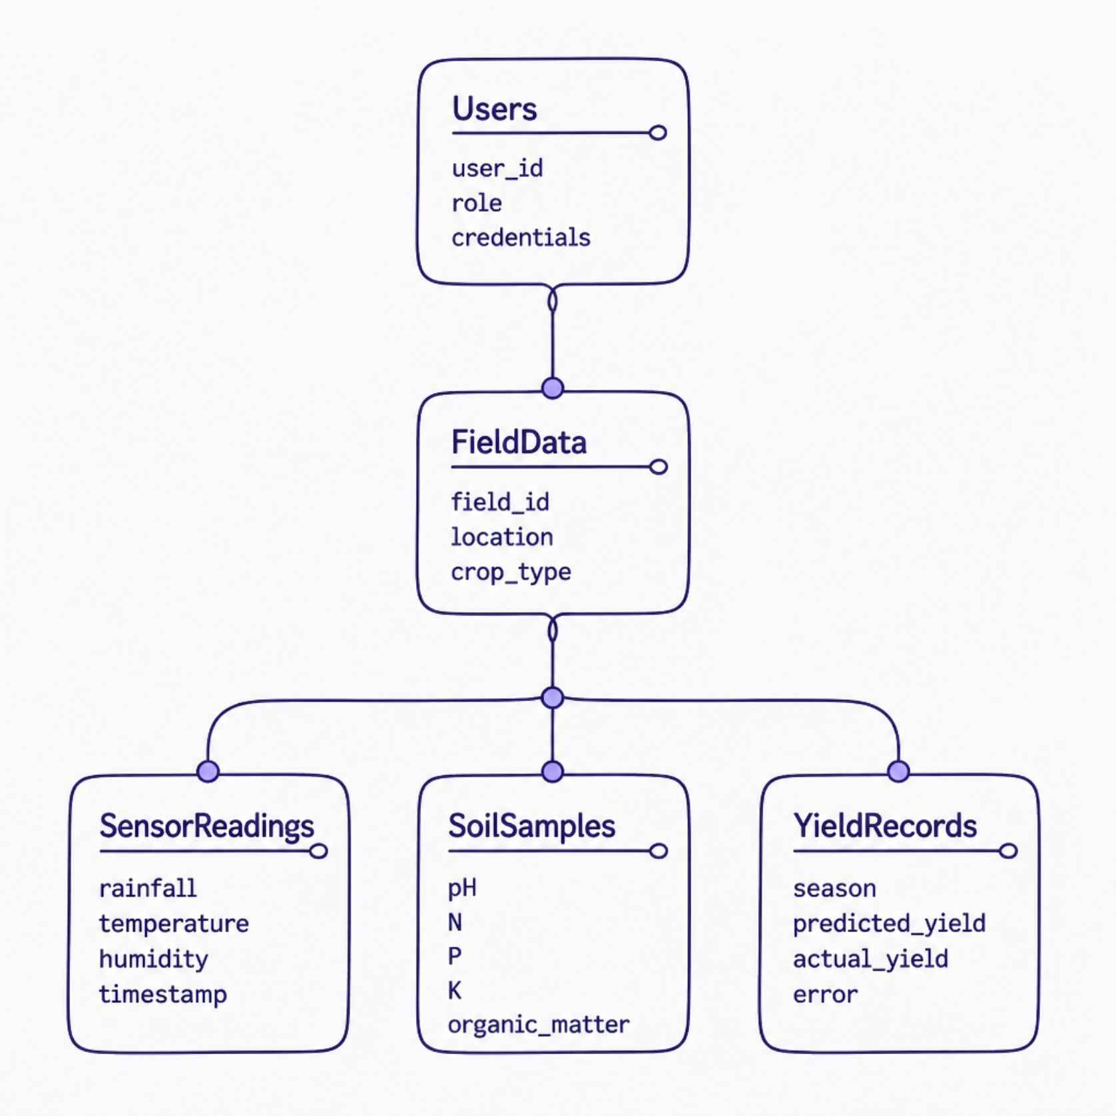
Database Design, Security & Access Control
Security Architecture
1
Role-Based Access Control (RBAC)
Four tiers: Farmer, Researcher, Agency, Admin — each with scoped permissions.
2
Authentication
JWT-based session tokens with refresh rotation and multi-factor authentication for admins.
3
Data Encryption
AES-256 at rest; TLS 1.3 in transit for all API communications.
4
Audit Logging
Immutable logs track all data submissions, predictions, and administrative actions.

Slide 9
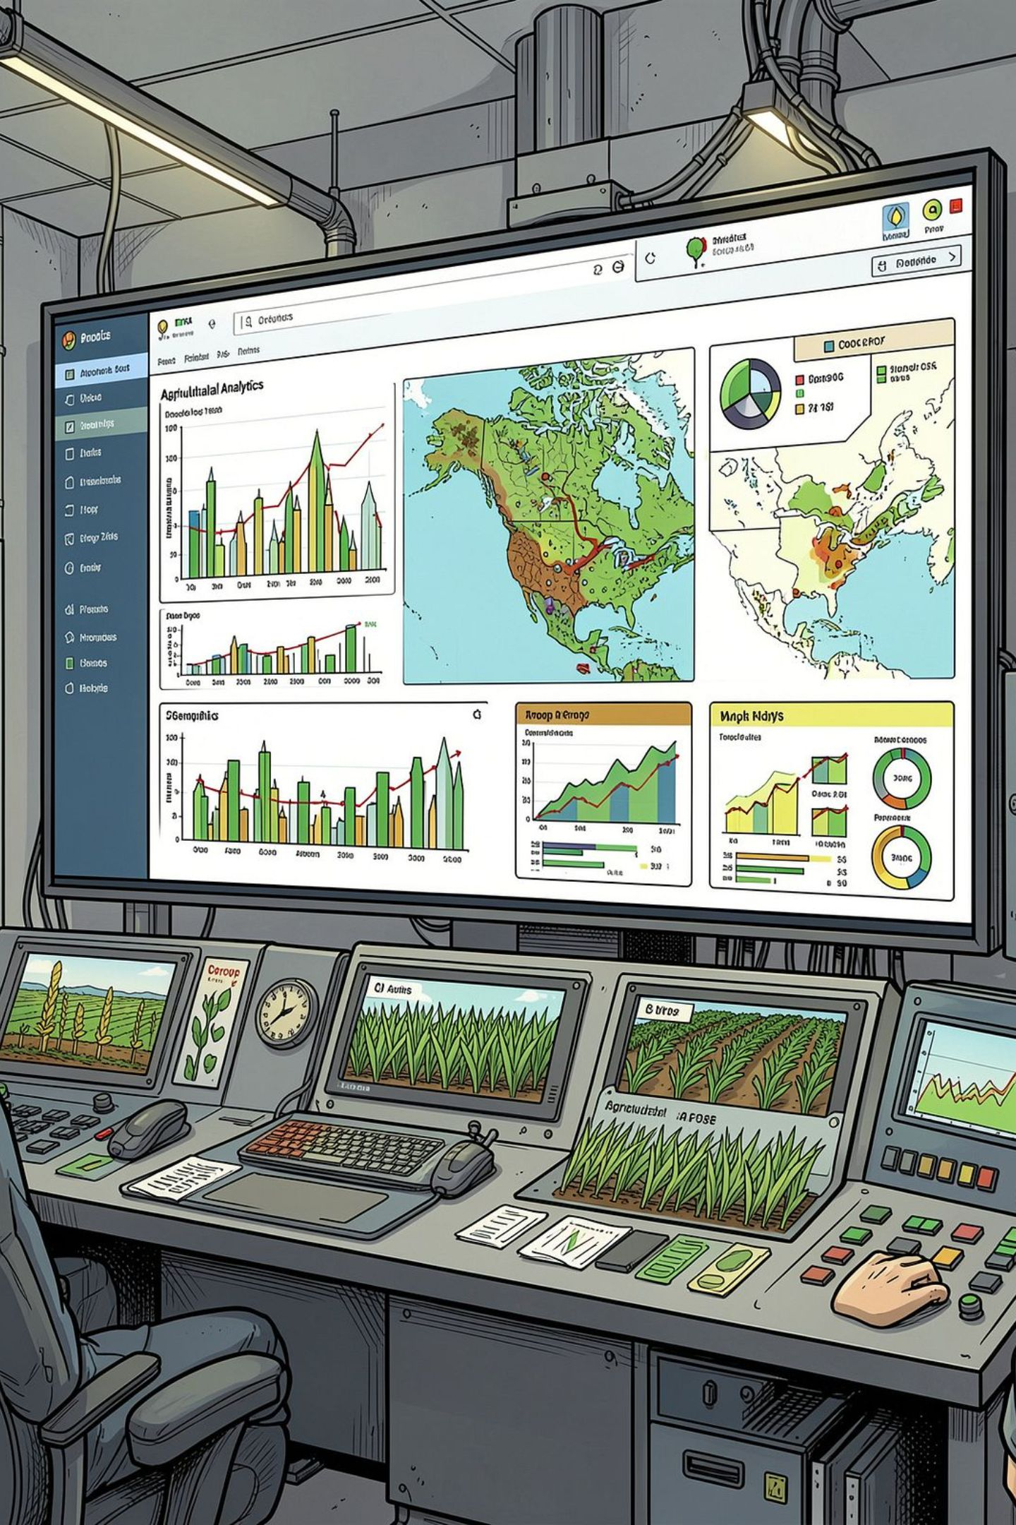
Analytics Dashboard & Reporting Features
Yield Forecasting
Real-time predictions with confidence intervals displayed on interactive maps.
Historical Trends
Multi-season comparisons revealing productivity patterns and anomaly detection.
Recommendation Engine
AI-generated suggestions for fertilizer adjustment, irrigation scheduling, and crop selection.
Automated Reports
Scheduled PDF and CSV exports for government submissions and research publications.

Slide 10

Outcomes, Limitations & Future Roadmap
Expected Outcomes
Limitations & Future Enhancements
↑ Prediction Accuracy
Data Gaps
Model Drift
Target R² > 0.90 across major crop types.
Rural areas lack sensor coverage; satellite imputation needed.
Climate shifts require continuous retraining pipelines.
↓ Resource Waste
Precision input recommendations reduce over-application.
Future: Remote Sensing
Future: Mobile App
Offline-capable field data collection with sync-on-connect.
Scalable Deployment
Integrate drone and satellite imagery for real-time canopy analysis.
Cloud-native architecture supports regional and national rollout.
Real-World Impact: Deployable across agribusiness, government agricultural departments, research institutions, and smart farming ecosystems — transforming data into food security.

