Slide 2
Using Microsoft Power BI to Explore and Visualize Data
Raghuramji
NarasimaPerumal

Slide 3
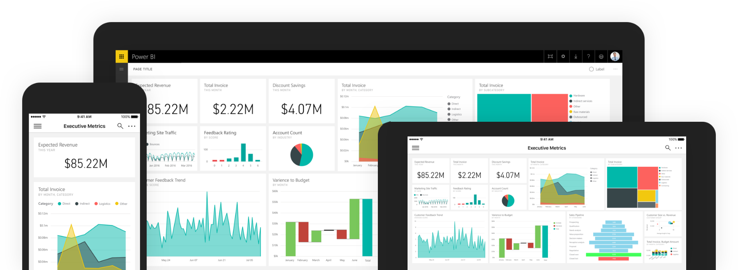
Power BI
Power BI is a suite of business analytics tools to analyze data and share insights, with tools for business users to gain access to their most important metrics in a single location across all devices and platforms.
Notes:
Power BI can unify all of your organization’s data, whether in the cloud or on-premises. Using the Power BI gateways, you can connect SQL Server databases, Analysis Services models, and many other data sources to your same dashboards in Power BI. If you already have reporting portals or applications, you can embed Power BI reports and dashboards into web and app scenarios for a unified experience across any device or platform.

Slide 4
Tools & Platforms
Services
Desktop
Mobile
Embedded
Web-based
All platforms
Limited design tools
Limited data sources
Dashboards
Publishing
Windows only
Robust design tools
Query and modeling tools
Cross-platform
Report viewers
Report integration
REST services
Create custom visualizations
Notes:
Power BI is a high-level name for Microsoft’s Power BI Services and Tools Suite. In general, all tools draw on the underlying foundation of Power BI Services, which is exposed to users via a web-based design and administration experience. More powerful features are available in the Power BI Desktop application targeting the Windows platform, and mobile versions of Power PI exist for Windows Mobile, iOS, and Android devices that enable end users to interactively access and navigate report and dashboard information. Developer and administrators can also exposed the services of Power BI via Power BI embedded which includes a robust REST-based API as well as tools to create custom visualizations.

Slide 5
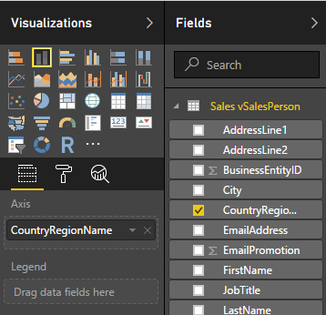
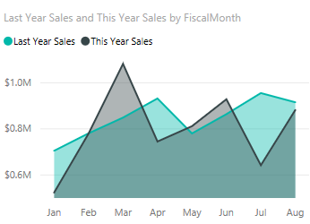
Power BI Building Blocks
Visualizations
Datasets
Reports
Dashboards
Tiles
Notes:
Power BI is a set of services and tools that serve as building blocks for creating powerful Business Intelligence experiences. The primary elements of the Power BI design experience are Visualizations, Datasets (or connections to data stores and services), Reports, Dashboards, and Tiles. The elements are combined into an experience that gets published and shared to users in your organization.

Slide 6
Building Block Associations
REPORTS
DATA SOURCES
DASHBOARDS
DEVICES
+
VISUALIZATIONS
Notes:
The basic building block for all Business Intelligence elements in Power BI begins with the data itself. Data from various sources is filtered, cleaned, and combined into Reports via Visualizations, and optionally published to Dashboards. Dashboard data is surfaced to users on any device, based on permissions and organization needs.

Slide 7
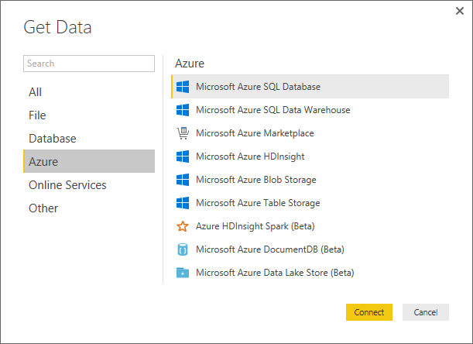
Getting Data
Power BI can connect to wide variety of data sources, including on-premises databases, Azure storage, Excel worksheets and a large number of 3rd party services.
Clean and transform data with the Query Editor
Connect to advanced data sources and create transformations
“Massage” irregularly formatted data
Notes:
A primary goal of Microsoft Power BI is to enable report creators, managers, and stakeholders to connect to any data source necessary to create a unified experience that makes sense to audiences and viewers of the content. Along with full support for more typical, legacy systems such as an Excel spreadsheet or SQL Server database, Power BI can authenticate and access data across a wide variety of data sources via “Connectors”, including Azure, Oracle, or even external services such as Facebook, Salesforce, or MailChimp,

Slide 8
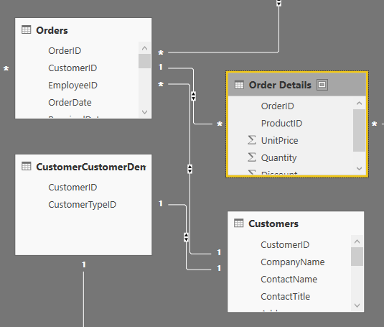
Modeling
Modeling is the technique of creating a logical connections and relationships between data sources.
Create Calculated Columns
Optimize data models for better visuals
Create Measures and work with time-based functions
Create Calculated Tables
Notes:
Creating logical connection between different data sources leverages the concept of relationships. A relationship enables Power BI to comprehend how tables and data structures relate to each another to ultimately design and create compelling visuals and reports. The processes of managing and adjusting these relationships across data sources is referred to as modeling, and uses the concepts of Measures, Calculated Columns, and even Calculated Tables (similar to the old fashioned notion of views.)

Slide 9
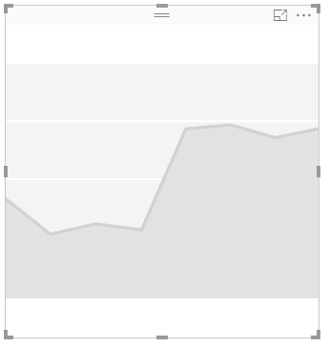
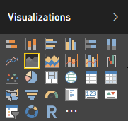
Visualizations
A visualization is a visual representation of data, such as a chart, graph, map, or other “visual” representations of data.
Line, bar, pie, stacked
Matrix/pivots
Key performance
Tree maps
Geo and filled maps
Slicers/filters
Custom visualizations
Notes:
Visualizations or “Visuals” are the end-result of any Business Intelligence effort. Ultimately, the aim is to access data, any data that makes sense in our organization, and present it to users in a meaningful, compelling, interactive, and insightful way. Power BI exposes a large number of out-of-the-box visualizations found in common Business Intelligence tools, such as numerous graphs, charts, maps, and filters, while also enabling visualization “extensibility” for creating organization-specific or scenario-specific custom visuals to be created by developers and power users.

Slide 10
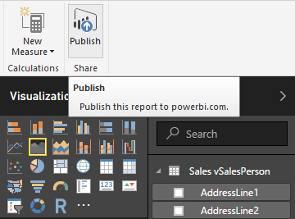
Publishing & Sharing
Publish reports from Power BI Desktop to the Power BI Service
Print and export dashboards
Manually republish and refresh data
Create and connect to content packs
Integrate OneDrive for Business
Notes:
Power BI content, typically in the form of Reports and Dashboards, can be shared and published (securely if necessary) for viewing over the web as well as printing and exporting reports to numerous supported formats. Entire Power BI experiences, along with the essential dependences (like Dashboards, associated Reports, and the underlying Datasets) can easily be packaged into Power BI “Content Packs” for distribution in an organization. Content Packs are then available to the appropriate users within their Power BI experience automatically. OneDrive for Business can be used as well as the source for you content as well, making it easy to leverage built in permission and security trimming, as well as more document-centric features such as versioning.

Slide 11
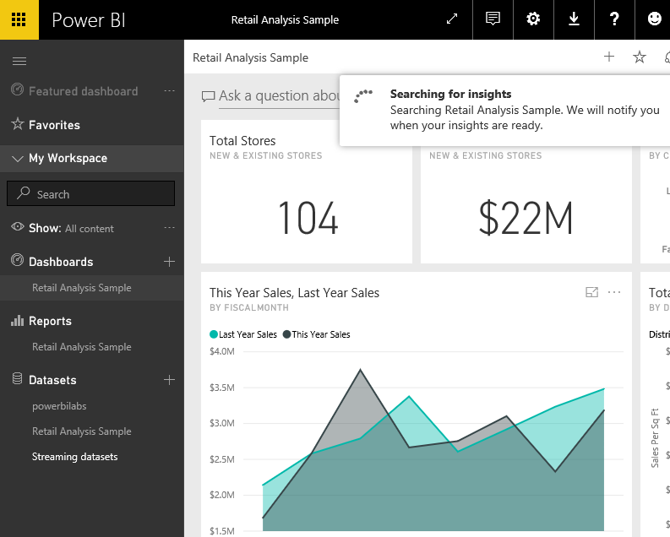
Exploring Data
Use Quick Insights
Ask questions using natural language
Create custom Q&A suggestions
Share Dashboards with your organization
Edit Tile details
Notes:
Built into the Power BI experience is the ability for users to glean additional information “on-the-fly” via a natural language question and answer paradigm, as well as providing quick “insights” into a dashboard, report, or the associated data based on intelligent analysis of current datasets. Power BI makes it easy to access these features by keeping the front and center during the user experience.

Slide 12
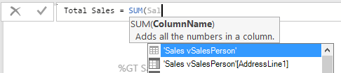
Data Analysis Expressions
DAX is a collection of functions, operators, and constants that can be used in a formula, or expression, to calculate and return one or more values.
Measure Calculation on a collection of rows AFTER aggregation.
Calculated Column Calculation on each individual row BEFORE aggregation.
Notes:
Data Analysis Expressions, or “DAX” includes a library of over 200 functions, operators, and constructs and are similar to Excel formulas. DAX has many of the same functions as Excel, except that DAX functions are meant to work over data interactively “sliced” or filtered in a report. If users are familiar with writing Excel functions, its an easy transition into DAX.

Slide 13
Power BI Service Integration
Power BI Service integration is facilitated via Power BI Embedded. Power BI Embedded is an Azure service that enables developers to surface Power BI data experiences within their applications.
DEVELOPER
AZURE
SUBSCRIPTION
AZURE
DATA
WORKSPACES
WORKSPACE
APP
APP
Notes:
As an optional Azure Service, Power BI Embedded is the mechanism used by app developers to surface Power BI data and data experiences in their applications. Although Power BI Embedded is a paid service, end-users don’t need Power BI accounts to use services or applications exposed via Power BI Embedded. Power BI Embedded is quickly become the primary Business Intelligence integration mechanism for developers previously creating solutions with older tools and technologies such as SQL Server Reporting Services.

Slide 14
Hands-On Lab
https://goo.gl/nD37qe

Slide 15
Resources
https://www.edx.org/course/analyzing-visualizing-data-power-bi-microsoft-dat207x-6
https://powerbi.microsoft.com/en-us/guided-learning/
https://powerbi.microsoft.com/en-us/blog/

