Slide 1
EMPLOYEES MENTAL HEALTH PREDICTION
Group - 53
Rohan Venkatesh Sirigeri
Narasimha Gaonkar
Shreya Guru
Aishwarya Halvagal Veeresh

Slide 2
AGENDA
Introduction
Data Description
Analysis and Visualization
Result and Summary

Slide 3
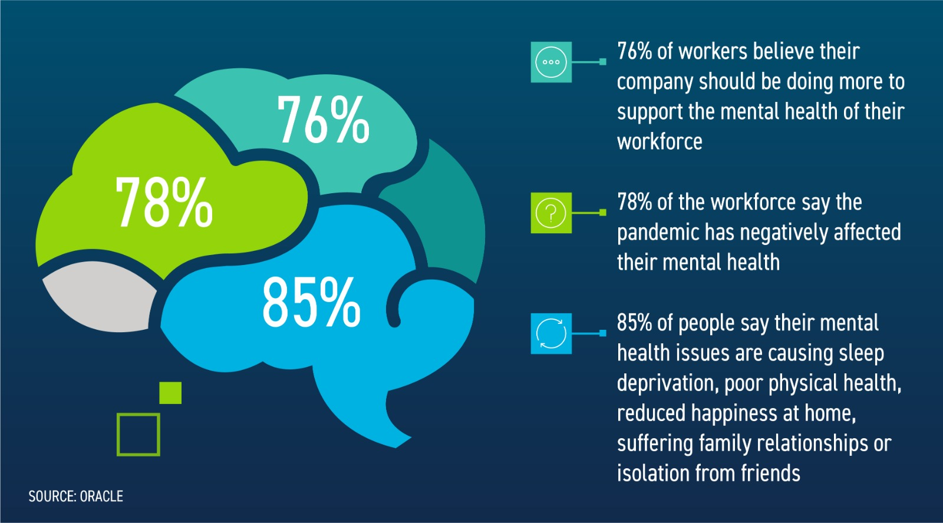
Introduction
Our emotional, psychological, and social well-being all fall under the category of mental health.
It has an impact on our decisions, thoughts, emotions, and behavior.
It influences how we interact with people, manage stress and to have healthy work life balance.

Slide 4
Data Description
We obtained csv file which had about 1250 records.
The file consists of 27 attributes like Timestamp, Age, Gender, Country, state, self_employed family_history, treatment, work_interfere, no_employees, remote_work, tech_company, benefits care_options, wellness_program, seek_help, anonymity, leave, mental_health_consequence, phys_health_consequence, coworkers, supervisor, mental_health_interview, phys_health_interview, mental_vs_physical, obs_consequence, comments.

Slide 5
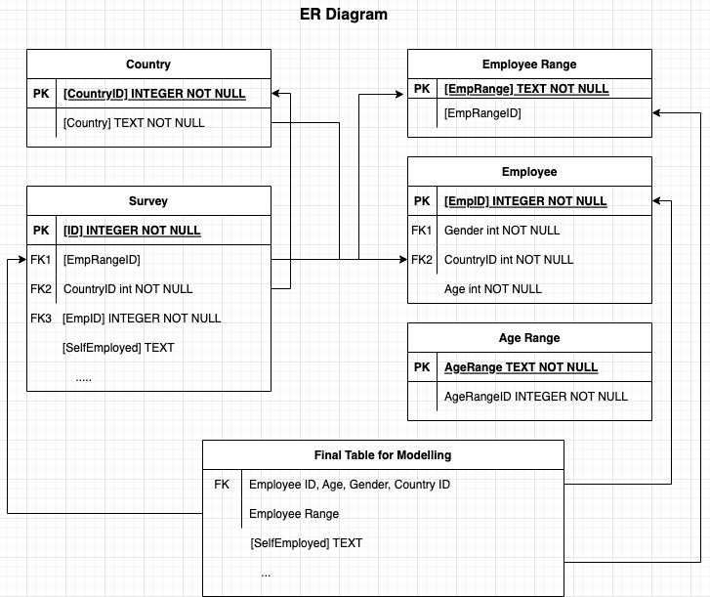
Page 2
Entity-Relationship Diagram
Notes:
donutChart
No alt text provided

Slide 6
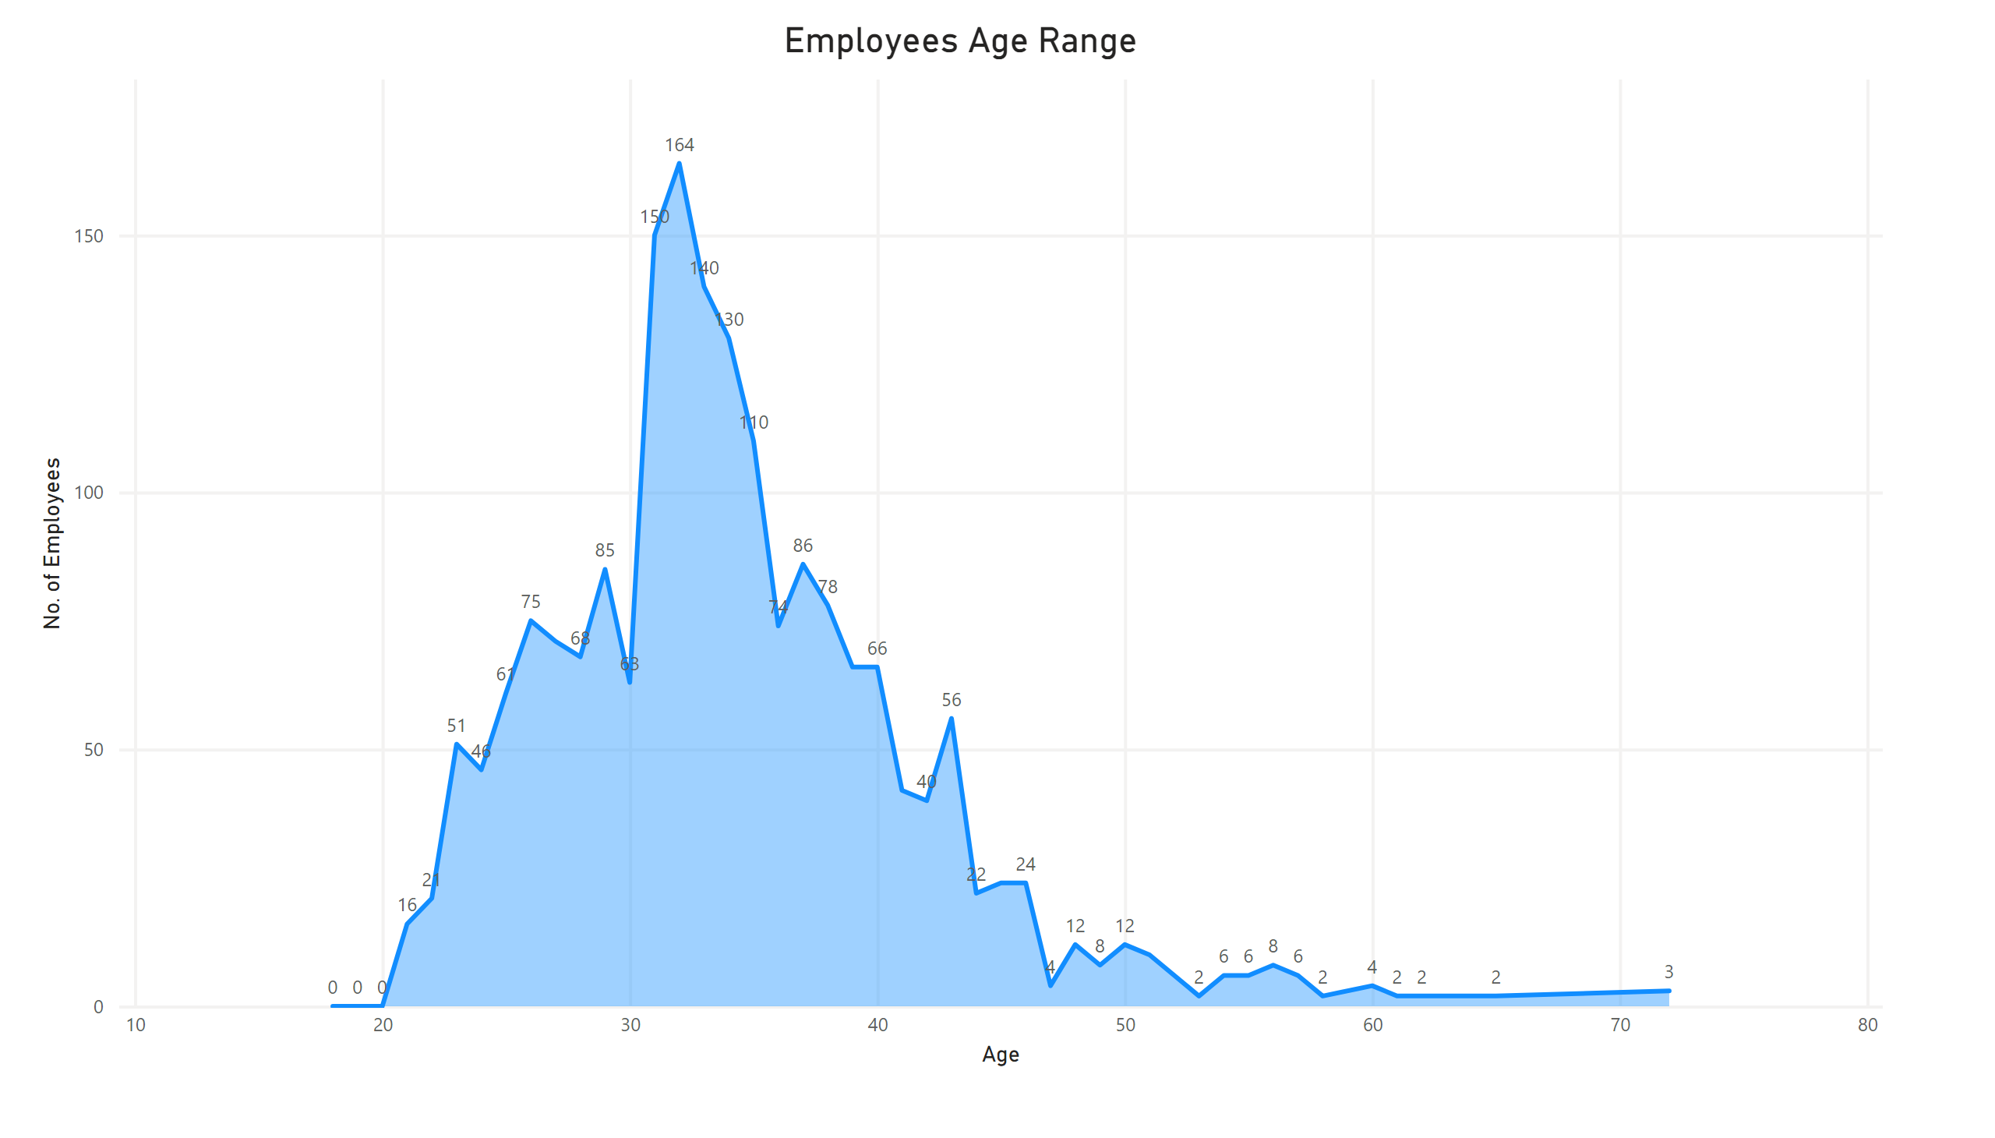
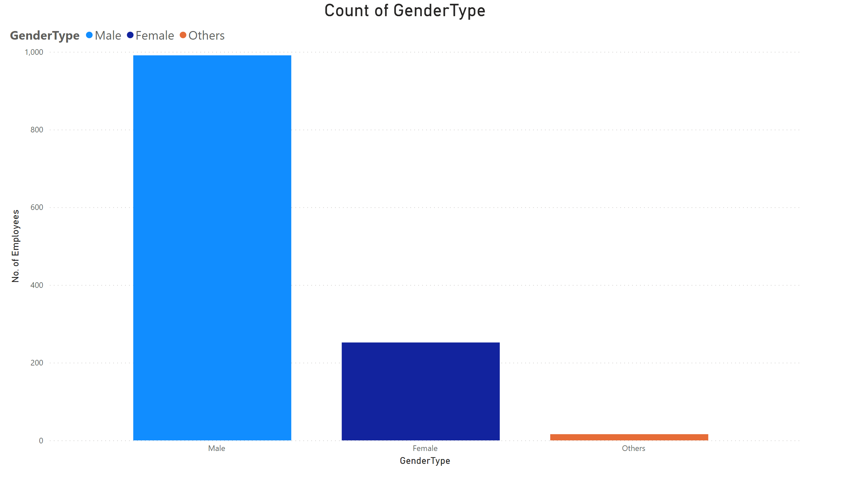
Page 1
Data Analysis and Visualization
Notes:
Employees Age Range
No alt text provided

Slide 7
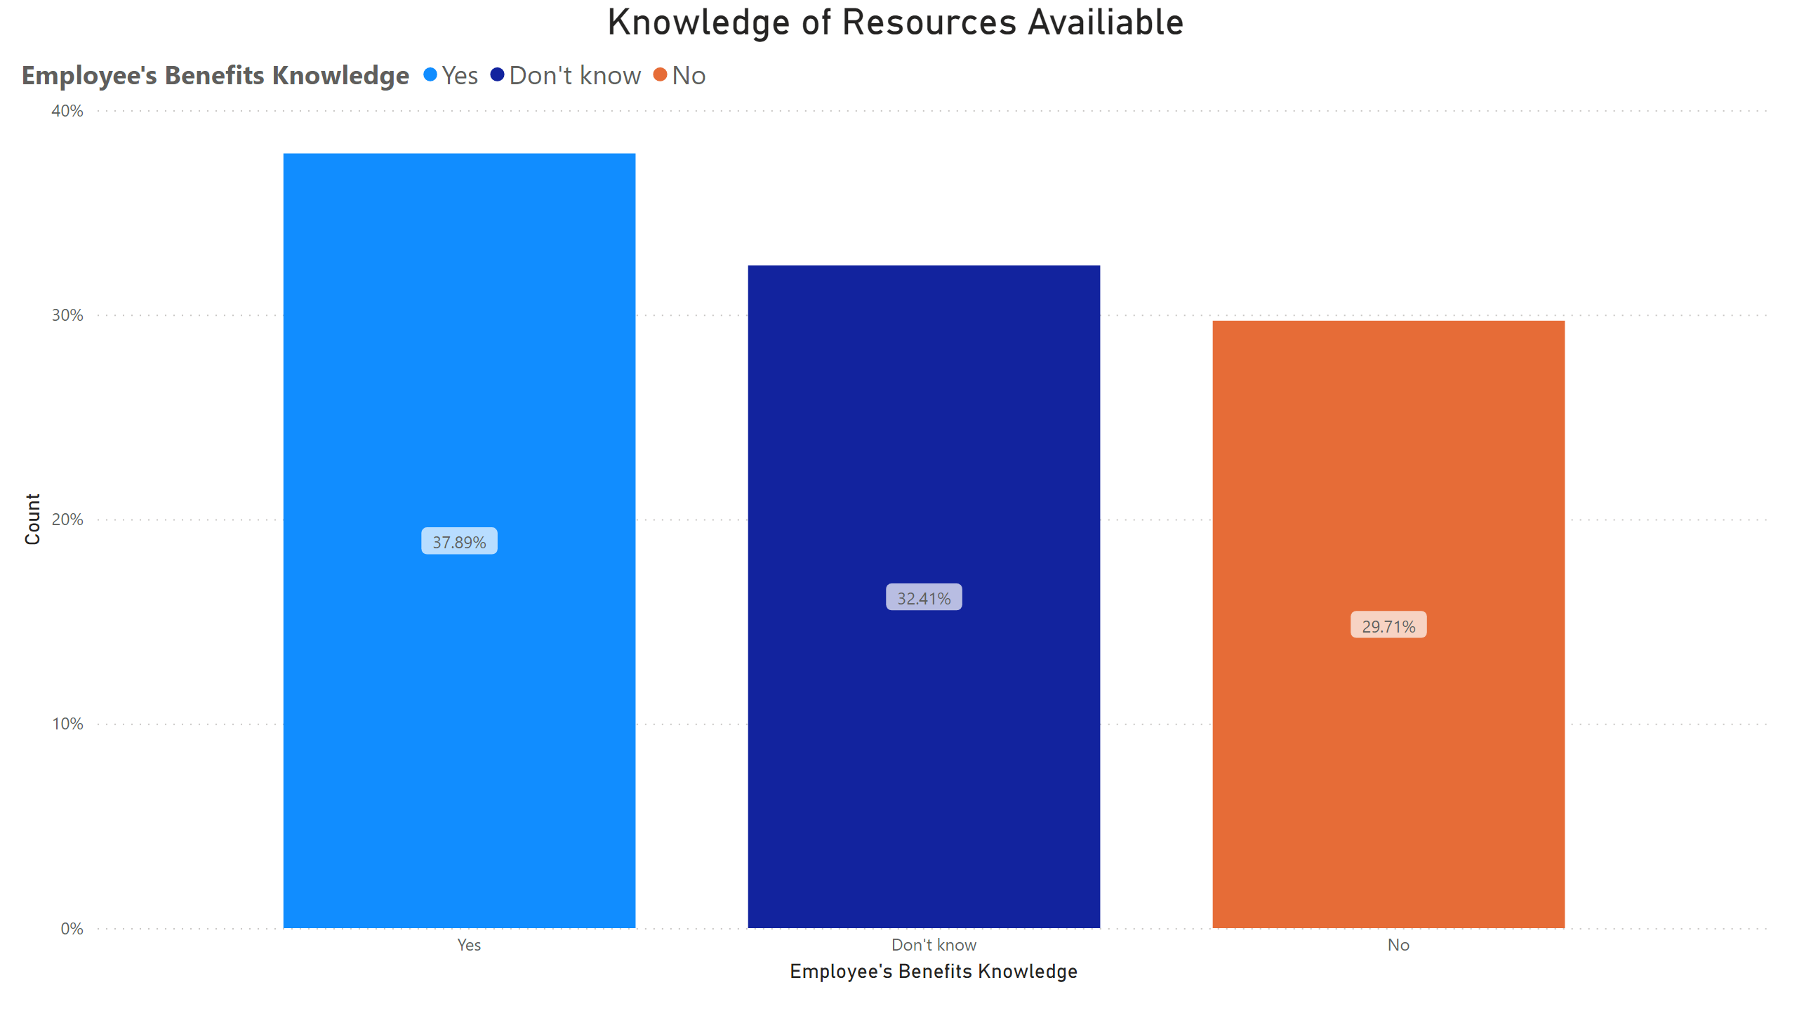
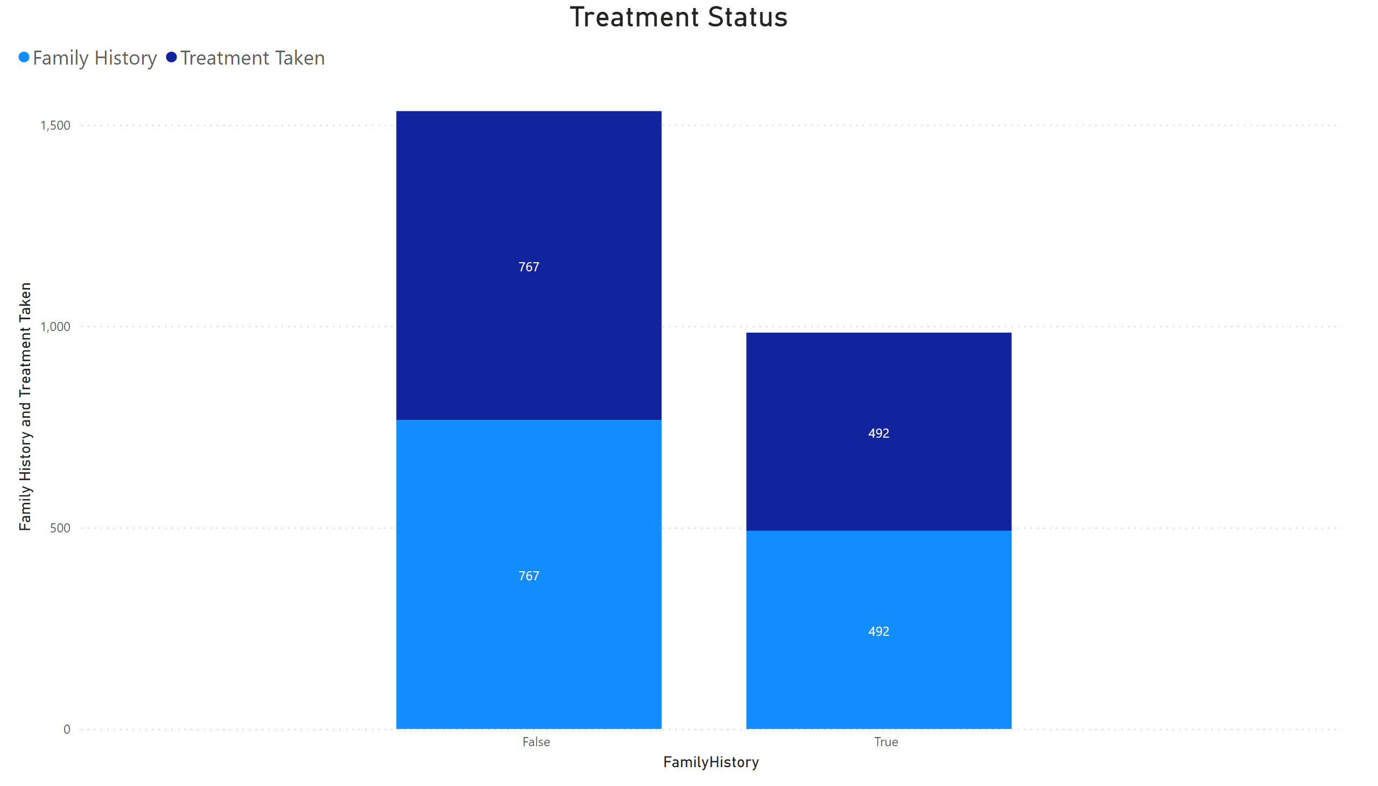
Page 1
Data Analysis and Visualization
Notes:
Knowledge of Resources Availiable
No alt text provided

Slide 8
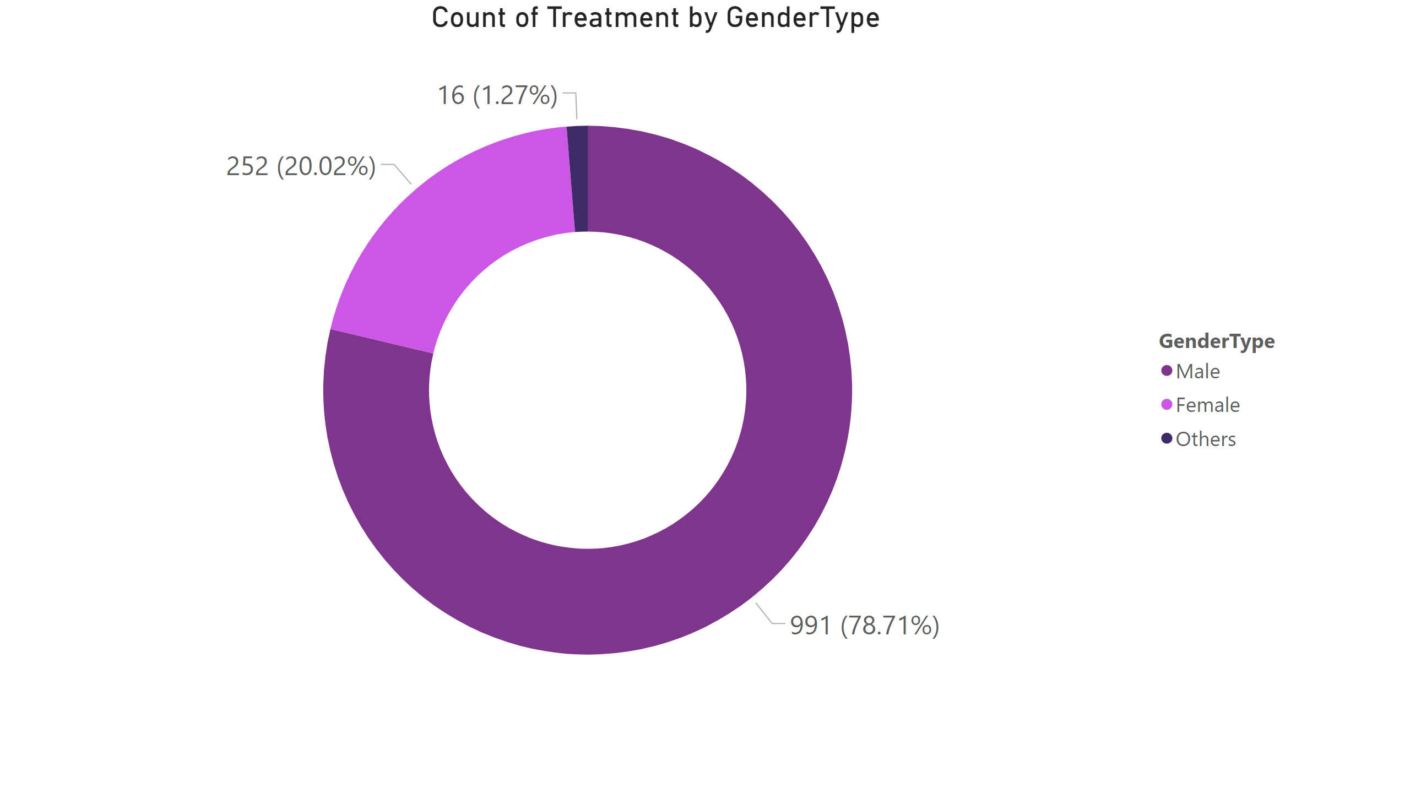
Page 2
Data Analysis and Visualization
78% of the Male employees sought treatment whereas 20% female employees sought treatment in case of mental illness.
Notes:
donutChart
No alt text provided

Slide 9
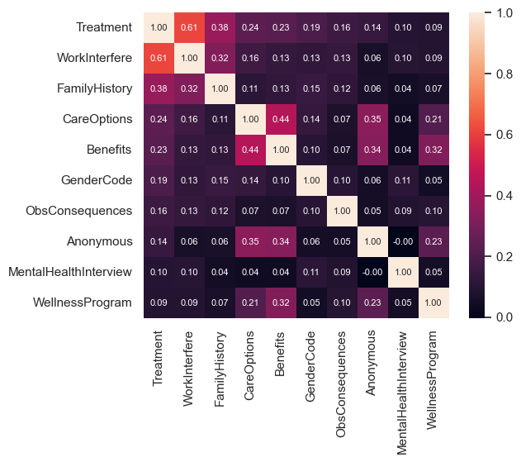
Correlation Matrix

Slide 10
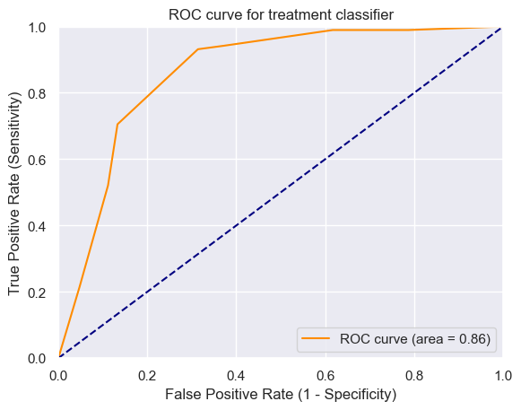
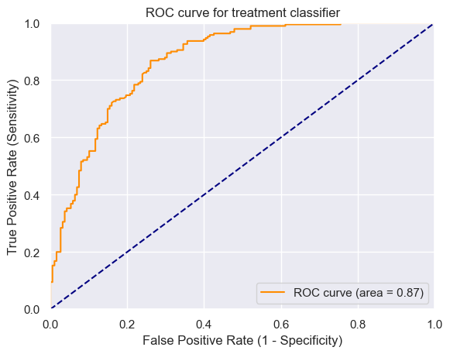
Prediction using classification model

Slide 11
Results and Summary
Conclusion:
Logistic Regression performs efficiently over other method based on the Train accuracy and False positive rate .
Model | Train Accuracy | False Positive Rate
Logistic Regression | 78.83% | 25.00%
Decision Tree Classifier | 80.95% | 31.38%

Slide 12


Thank you

