Slide 1
PREDICTION OF SECONDARY INSURANCE PURCHASE
Team 7
Rohan Venkatesh Sirigeri
Narasimha Gaonkar
Suryatej Hittala Mathada
Aishwarya Halvagal Veeresh

Slide 2
Agenda
Project Overview
Data Description & Cleaning
Analysis & Visualization
Results & Summary

Slide 3
Project Overview
Create a reliable framework for forecasting secondary insurance purchases using information from prior health insurance purchases.
In this presentation we will go thorough Implementation of different techniques for understanding the relationship between the previously available data and predicting the secondary purchase .Higher the accuracy , better the prediction of purchase.
The results will assist insurance providers in designing their marketing strategy.

Slide 4
Data Description & Cleaning
Data Description:
There are 12 columns which consist of Gender, Age, Driving_Licence, Region_Code, Previously_Insured, Vehicle_Age, Vehicle_damage, Annual_Premium , Policy_Sales_Chanel, Vintage and Response.
Data Cleaning:
Check for the null and NA values in the data and treat them.
Changing the data types of the attribute to make the prediction easier.
For example, conversion of gender attribute from string to int.

Slide 5
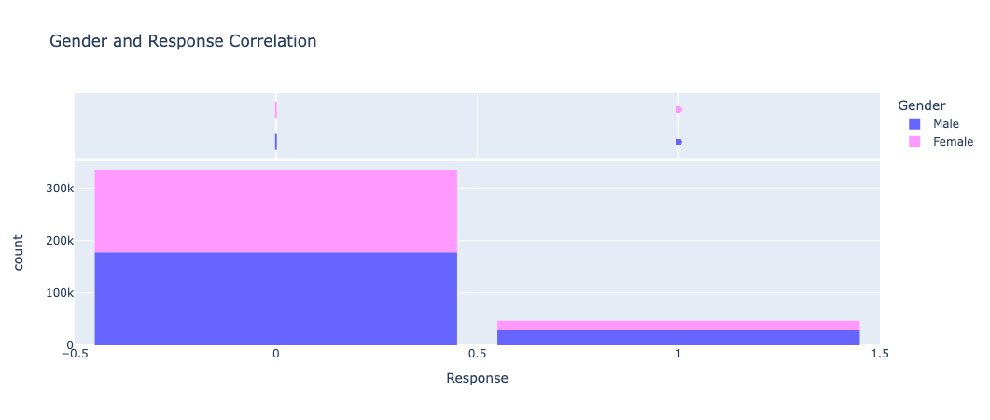
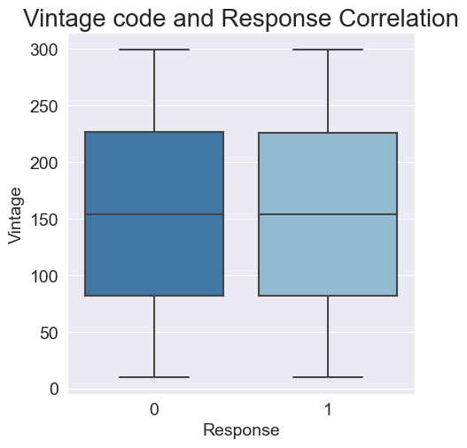
Analysis & Visualization

Slide 6
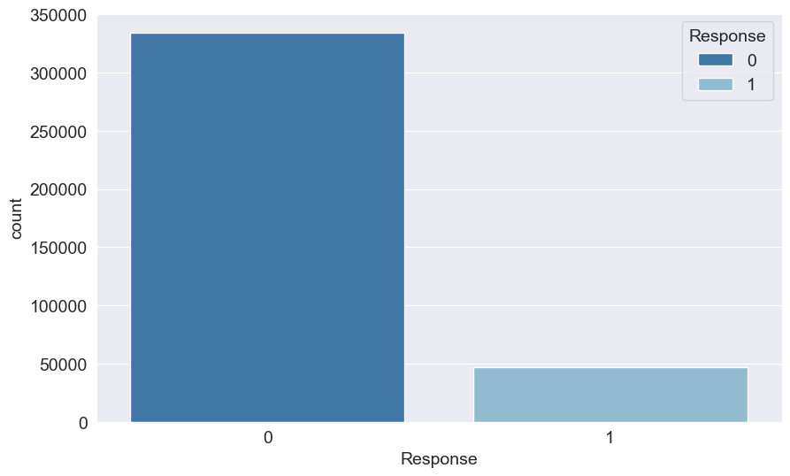
Analysis & Visualization
The major issue here is that we only have about 12% of the people who bought the insurance. Hence 2 classes are really imbalanced.
Therefore, any model would have a tough time making confident prediction. In general, we'd like to have evenly represented classes. Otherwise, we would need to up-sample the minority class, or down-sample the majority.

Slide 7
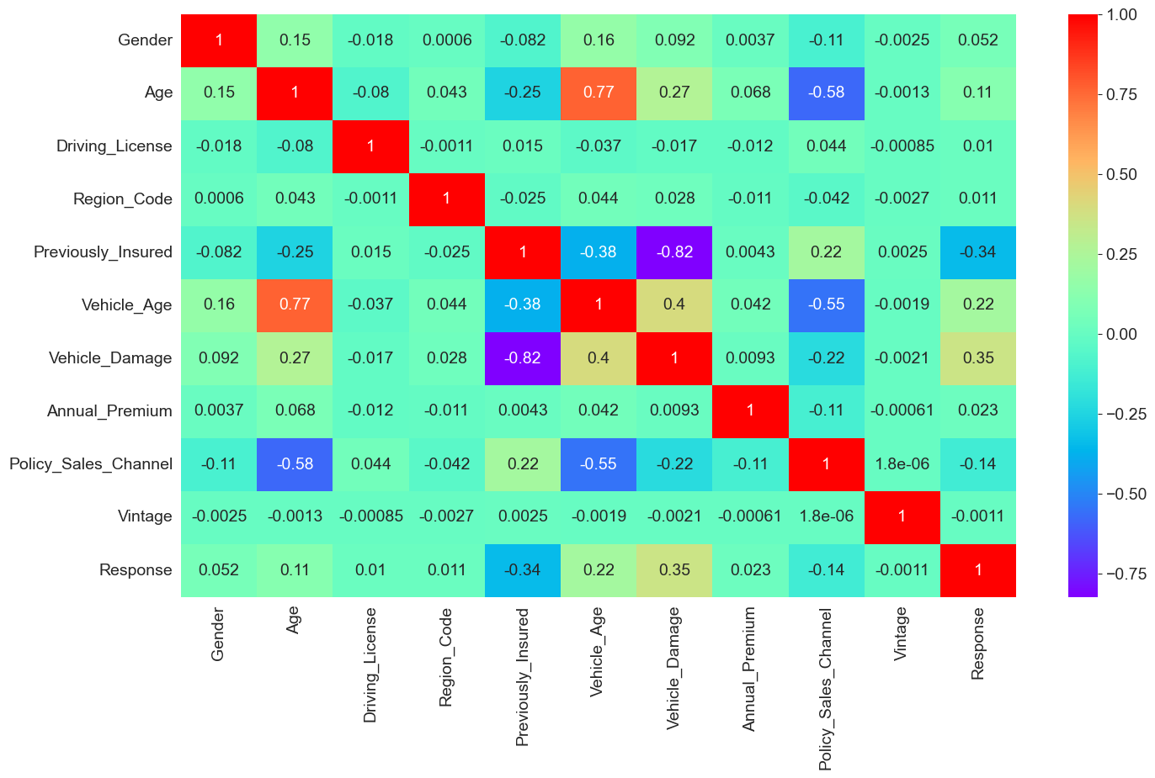
Correlation Matrix

Slide 8
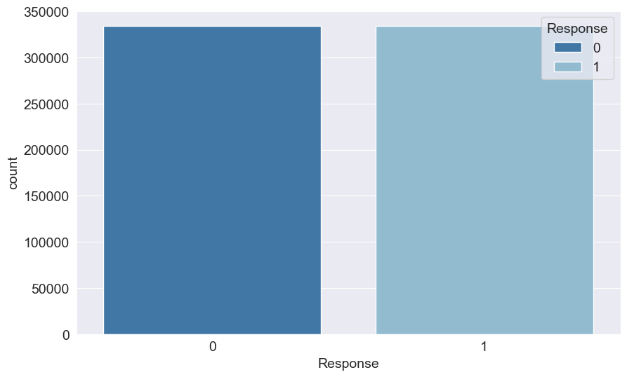
SMOTE Technique
Synthetic Minority Oversampling Technique is used to upsample the minority class.

Slide 9
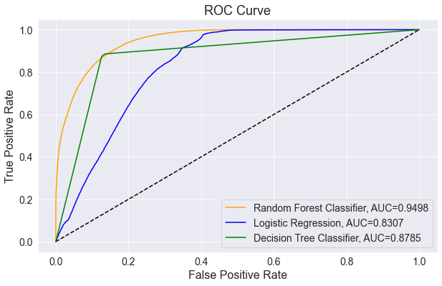
ROC Curve
This graph depicts the trade-off between sensitivity and specificity of different classification methods.

Slide 10
Results and Summary
Conclusion:
Random Forest classification performs efficiently over other methods based on the F1 score and Accuracy.
Model | F1 Score | Accuracy
Logistic Regression | 81.99% | 79.0%
Decision Tree Classifier | 87.46% | 87.0%
Random Forest Classification | 87.62% | 87.0%

Slide 11
Thank you

