Slide 1
OPENCART WEBSITE
Under Guidance of Mrs. Vaishali Sonali's Mam.
Presented By:
-Narasimha Kuruva

Slide 2
Introduction :
OpenCart is the one of the world’s largest e-commerce platforms, widely used for
online shopping.
Like any large-scale web application, it must be tested to ensure accuracy, reliability,
and user satisfaction.
The objective of this report is to identify functional bugs with severity and priority in
OpenCart’s website.

Slide 3
Responsibilities
Identify and analyze functional bugs on the OpenCart website.
Test core features such as Login, Address Update, Search, Add to Cart/Delete, and Product Display.
Document each bug with Title, Steps to Reproduce, Expected vs. Actual Result.
Classify bugs based on Severity and Priority.
Ensure proper reporting format for better understanding by developers and QA team.
Provide suggestions for improvements to enhance user experience.

Slide 4
Overview
OpenCart is a leading global e-commerce platform used by millions of users daily.
Ensuring flawless functionality is critical for maintaining trust, usability, and sales performance.
This study focuses on bug detection and analysis in core modules of the OpenCart website.
Key areas tested include:
Login & Account Management
Address Update
Search & Product Filtering
Add to Cart & Delete
Identified bugs are classified by Severity (impact) and Priority (fix urgency) to aid better defect management.

Slide 5
Modules Covered
1. Login
Tested login functionality with valid/invalid credentials.
Verified error messages, session handling, and account redirection.
2. Search
Checked product search accuracy for keywords and price-based queries.
Validated whether filters (price, category) return correct results.
3. Change Password
Tested profile update features for name and delivery address.
Verified whether updates reflect across checkout and account sections.
Notes:
Module 1: Signn in page
Checked all the functionalities on Sign in page which included personal info as email
address, password
Module 2: Women page
Checked all the functionalities on Women page which included item details, Quantity, Filters,compare button,Add to cart button,product info,grid,list button
Module 3: Tshirt page
Checked all the functionalities on T-Shirt page which included item details, Quantity, Filters,compare button,Add to cart button,product info,grid,list button
Module 4: All Buttons and Drop Down Arrow :
team checked if all the buttons and drop down arrows of different fields are functioning properly or not

Slide 6
4. Change Currency
Tested website language switch (e.g., US dollar, Euro, Pound Sterling).
Verified UI labels, navigation text, and product details display correctly.
5. Product Discrimination
Verified whether product listings match the search intent.
Checked if unrelated products (e.g., groceries in toy search) appear incorrectly.
6. Add to Cart
Tested adding items to the cart and removing them.
Verified cart updates (quantity, total price) after changes.

Slide 7
7. Search By category
Search by Category functionality working.
product search accuracy for keywords and price-based queries.
5. Add to WishList
Verified the functionality of WishList
Products able to add the products WishList by the Users
6. Product Compare
Tested adding items to the Compare.
After adding the Products to compare, Check the details of the item.
10.Checkout
Tested Checkout user able to Checkout the Product
After adding the Products to Cart, Then Checkout the product.

Slide 8
Defects
1. Search
Search functionality Does not Working Properly, While search with under rate tags.
Search with partial Name , it does not shows any related products.
Search by category functionality not working properly.
2. Checkout
Product Added in the Wishlist or in Cart, while user want to checkout the product,
it Shows product out of stock, even product shows availability count.

Slide 9
Defect Identifier :- B_001
Defect Summary: Search result “ phone under 2000” Does not displays any result.
Test Id: TC_010
Test Case Name: TC_Search_Price_Filter
Module Name: Search
Reproducible: Yes
Severity: Medium
Priority: Medium
Raised by: Narasimha
Assigned to: Developer Team Lead
Date of Assignment: — 6-09-2025
Status: Pending
Snapshots: — Available
Fixed by: Developer
Date of Fixing: —

Slide 10
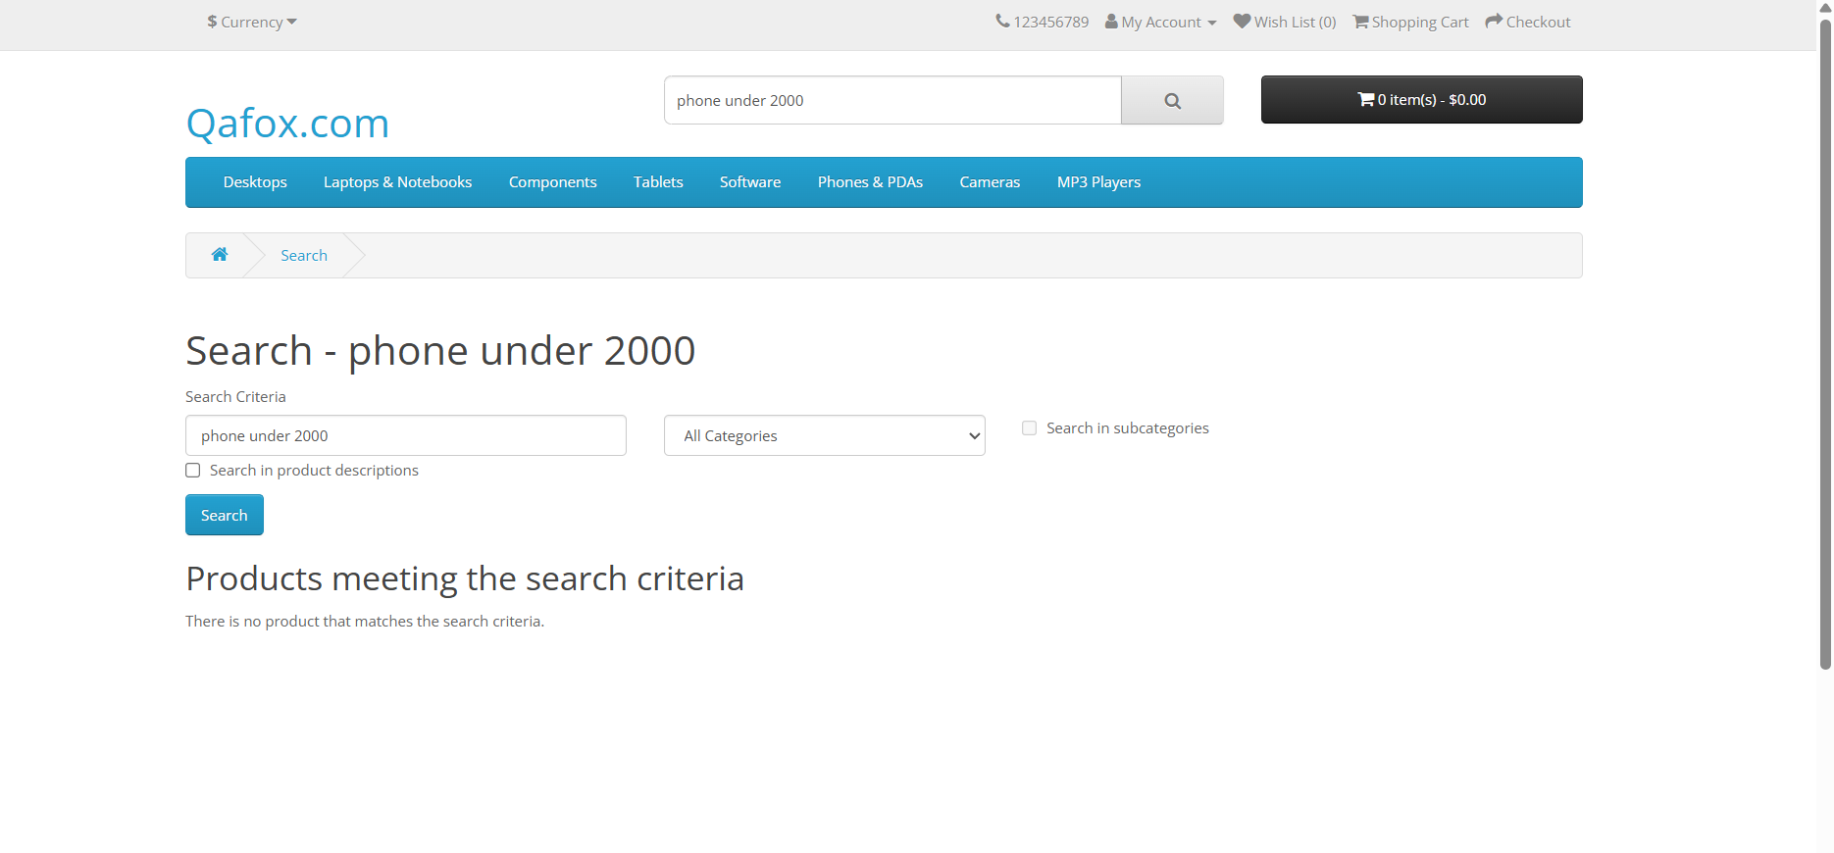

Slide 11
Defect Identifier :- B_004
Defect Summary: While checkout the items it shows out of stock,
even if stock is available.
Test Id: TC_040
Test Case Name: TC_Checkout_Field_Validation
Module Name: Checkout
Reproducible: Yes
Severity: High
Priority: High
Raised by: Narasimha
Assigned to: Developer Team Lead
Date of Assignment: — 6-09-2025
Status: Pending
Snapshots: — Available
Fixed by: Developer
Date of Fixing: —

Slide 12
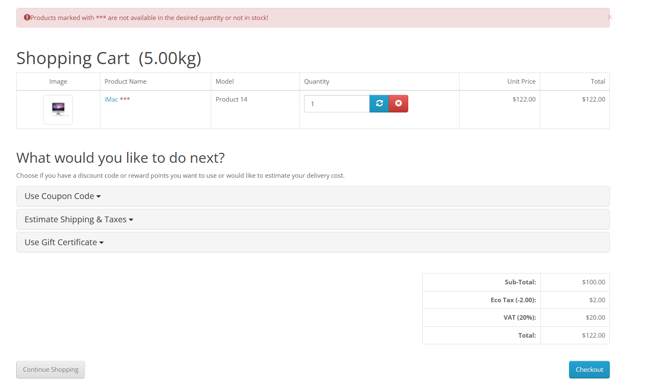

Slide 13
Challenges
Starting in the Project I getting confusions on Bug, UI related and
Improvement requests.
Bugs are sometimes hard to reproduce consistently.
Complex workflows (login, cart, checkout) take more effort.

Slide 14
Experience
Gained hands-on practice in identifying and reporting bugs.
Learned how to classify defects by severity and priority.
Improved skills in writing clear bug reports and test cases.
Understood real-world challenges in testing large applications
like OpenCart
Enhanced knowledge of QA processes and documentation.

Slide 15
Thank You!!!
Vaishali Mam For Guiding Us through out the Project.

