Slide 1
eBay WEBSITE
Under Guidance of Mrs. Vaishali Somali's Mam.
-Narasimha Kuruva

Slide 2
Introduction :
Ebay is the one of the world’s largest e-commerce platforms, widely used for
online shopping.
Like any large-scale web application, it must be tested to ensure accuracy, reliability,
and user satisfaction.
The objective of this report is to identify functional bugs with severity and priority in
Amazon’s website.

Slide 3
Responsibilities
Identify and analyze functional bugs on the Ebay website.
Test core features such as Login, Address Update, Search, Add to Cart/Delete, and Product Display.
Document each bug with Title, Steps to Reproduce, Expected vs. Actual Result.
Classify bugs based on Severity and Priority.
Ensure proper reporting format for better understanding by developers and QA team.
Provide suggestions for improvements to enhance user experience.

Slide 4
Overview
Ebay is a leading global e-commerce platform used by millions of users daily.
Ensuring flawless functionality is critical for maintaining trust, usability, and sales performance.
This study focuses on bug detection and analysis in core modules of the Ebay website.
Key areas tested include:
Login & Account Management
Address Update
Search & Product Filtering
Add to Cart & Delete
Identified bugs are classified by Severity (impact) and Priority (fix urgency) to aid better defect management.

Slide 5
Modules Covered
1. Login
Tested login functionality with valid/invalid credentials.
Verified error messages, session handling, and account redirection.
2. Search
Checked product search accuracy for keywords and price-based queries.
Validated whether filters (price, category) return correct results.
3. Change Name & Address
Tested profile update features for name and delivery address.
Verified whether updates reflect across checkout and account sections.
Notes:
Module 1: Signn in page
Checked all the functionalities on Sign in page which included personal info as email
address, password
Module 2: Women page
Checked all the functionalities on Women page which included item details, Quantity, Filters,compare button,Add to cart button,product info,grid,list button
Module 3: Tshirt page
Checked all the functionalities on T-Shirt page which included item details, Quantity, Filters,compare button,Add to cart button,product info,grid,list button
Module 4: All Buttons and Drop Down Arrow :
team checked if all the buttons and drop down arrows of different fields are functioning properly or not

Slide 6
4. Change Language
Tested website language switch (e.g., English, Hindi, regional languages).
Verified UI labels, navigation text, and product details display correctly.
5. Product Discrimination
Verified whether product listings match the search intent.
Checked if unrelated products (e.g., groceries in toy search) appear incorrectly.
6. Add to Cart & Delete
Tested adding items to the cart and removing them.
Verified cart updates (quantity, total price) after changes.

Slide 7
Defects
1. Search
-“toys under 120” displays items priced above ₹120.
- Irrelevant products (e.g., groceries) appear in Cars searches.
2. Change Name & Address
Special characters (@@@@, #$%) allowed in Name/Address field.
Default address selection sometimes not applied during checkout

Slide 8
Defect Identifier :- B_001
Defect Summary: Search result “toys under 120 rupees” displays items above ₹120.
Test Id: TC_030
Test Case Name: TC_Search_Price_Filter
Module Name: Search
Reproducible: Yes
Severity: Medium
Priority: Medium
Raised by: Narasimha
Assigned to: Developer Team Lead
Date of Assignment: — 19-08-2025
Status: Pending
Snapshots: — Available
Fixed by: Developer
Date of Fixing: —

Slide 9
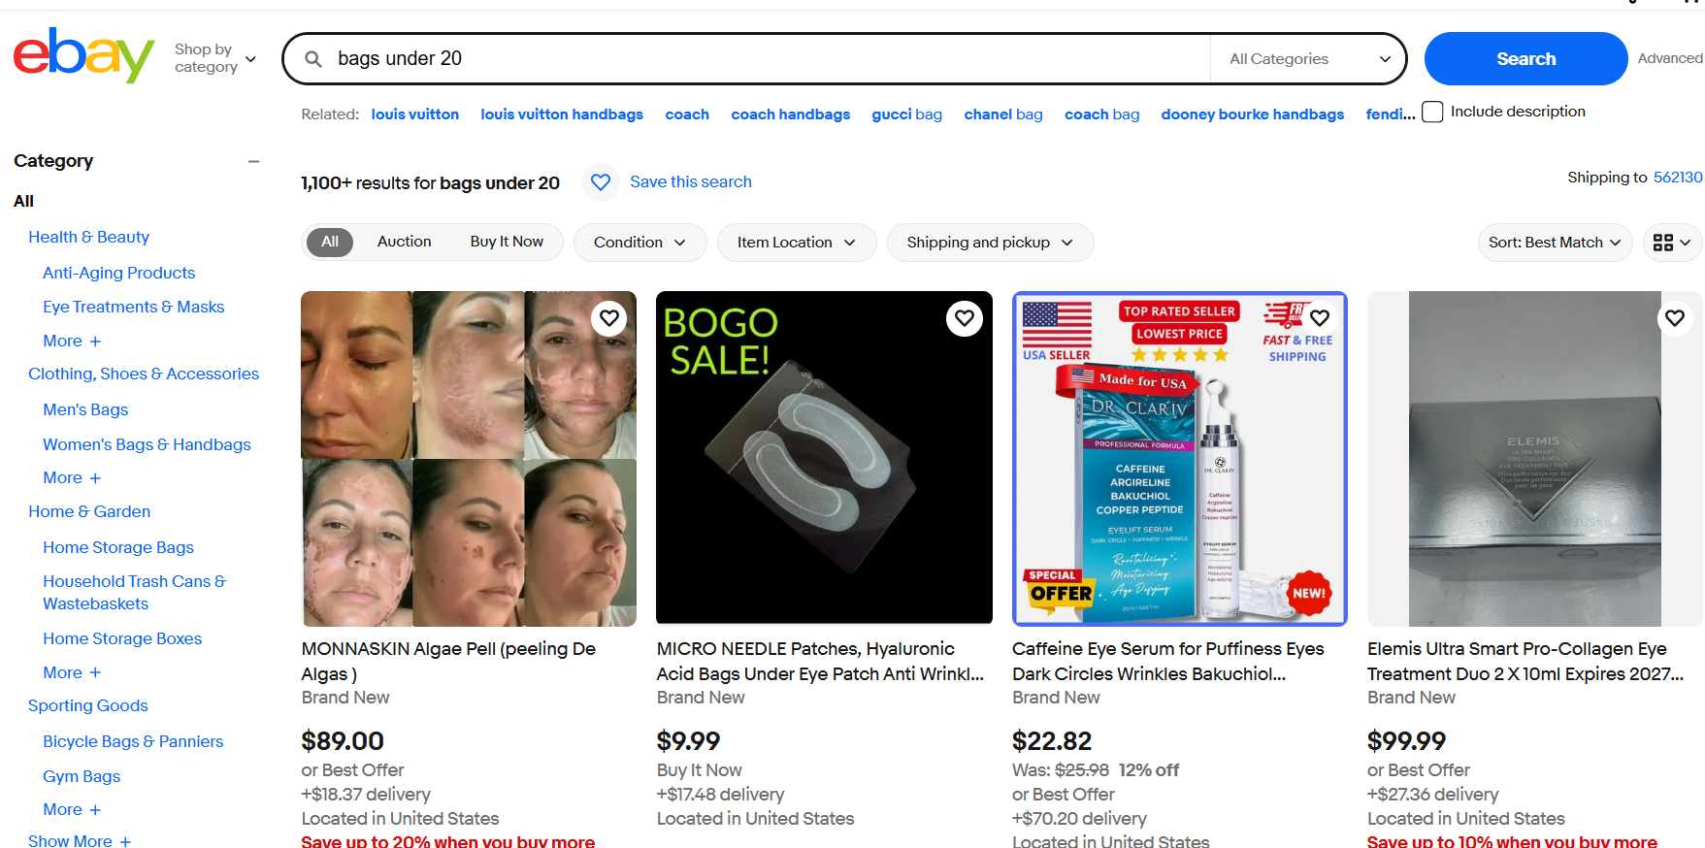
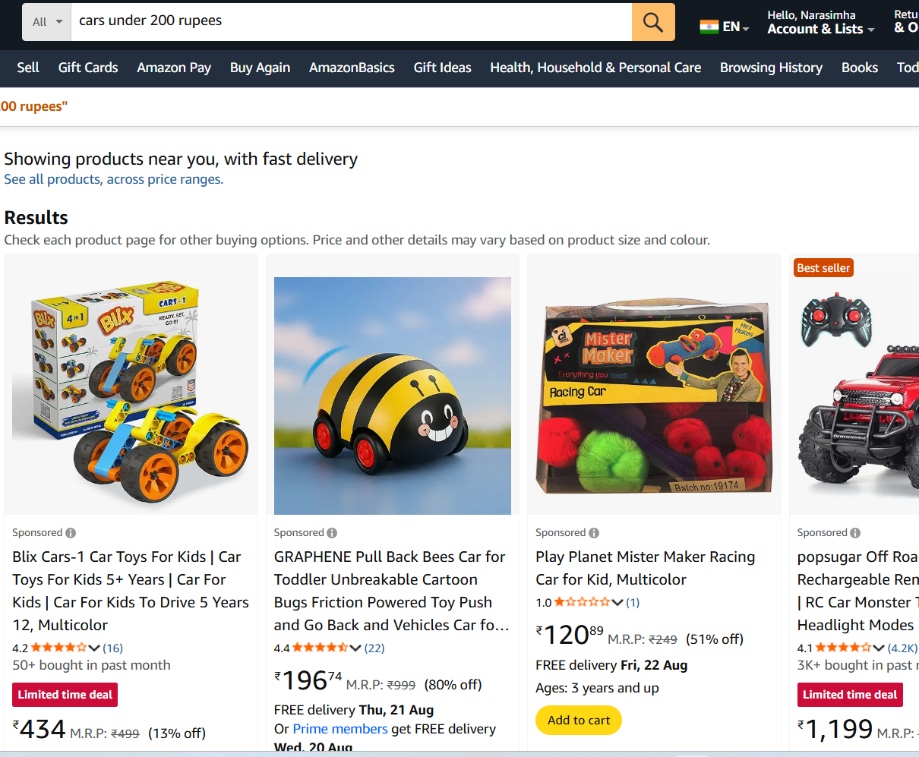

Slide 10
Defect Identifier :- B_002
Defect Summary:Address field accepts invalid/special characters (e.g., @@@@, #$%)
and saves successfully.
Test Id: TC_040
Test Case Name: TC_Address_Field_Validation
Module Name: ChangeAddress
Reproducible: Yes
Severity: Medium
Priority: Medium
Raised by: Narasimha
Assigned to: Developer Team Lead
Date of Assignment: — 19-08-2025
Status: Pending
Snapshots: — Available
Fixed by: Developer
Date of Fixing: —

Slide 11
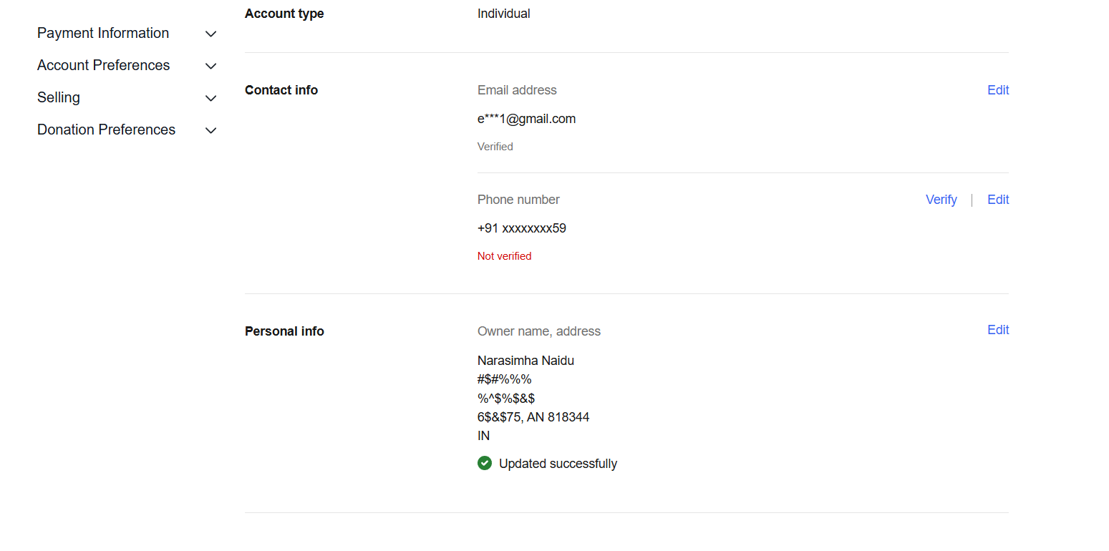
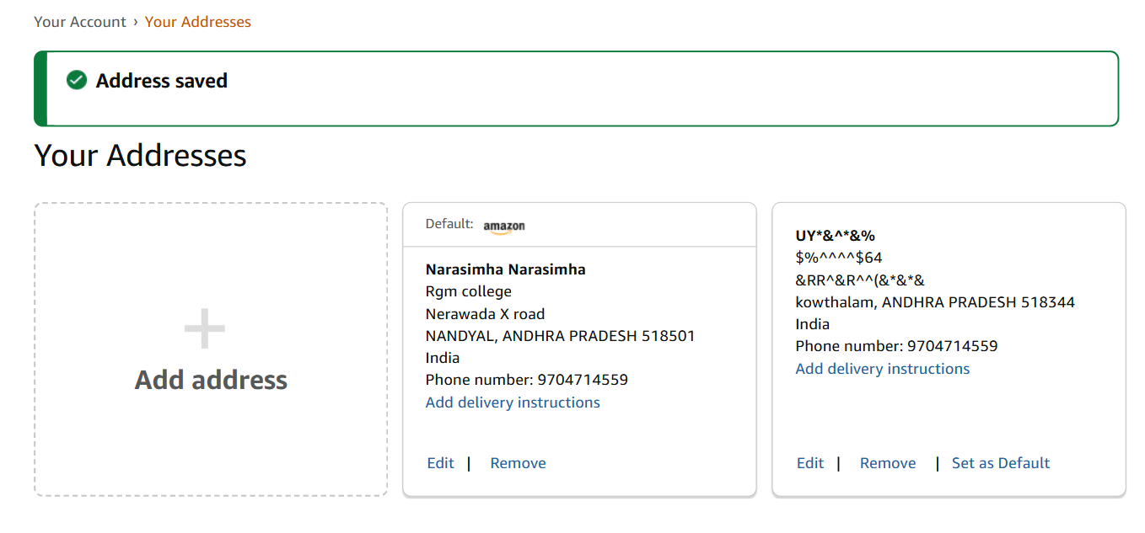

Slide 12
Challenges
Starting in the Project I getting confusions on Bug, UI related and
Improvement requests.
Bugs are sometimes hard to reproduce consistently.
Complex workflows (login, cart, checkout) take more effort.

Slide 13
Experience
Gained hands-on practice in identifying and reporting bugs.
Learned how to classify defects by severity and priority.
Improved skills in writing clear bug reports and test cases.
Understood real-world challenges in testing large applications
like Ebay.
Enhanced knowledge of QA processes and documentation.

Slide 14
Thank You!!!
Vaishali Mam For Guiding Us through out the Project.

