Slide 1
Blockchain Technology for Digital Records Security
Narasimha Bharadwaj M R 1MS19CS080
Prajwal S 1MS19CS089
Pruthviraaj U 1MS19CS092
Under the guidance of: Dr Ganeshayya I Shidaganti

Slide 2
Problem Statement
Paper based certificates are prone to frauds and manipulation. They can be easily digitalized and changed, which compromises the credibility of the certificate.
It is therefore very important to validate the certificates and maintain them in a safe and secure manner.

Slide 3
Objectives
To provide a secure platform for maintenance of legitimate records in the educational field.
To avail a decentralized storage platform for easy access and visibility of certificates and records.
To avoid manipulation of academic records.
To avoid third party invasion for storage and to implement a tamperproof system to enable safety of records.
To implement a blockchain based certificate storage technology to avoid any misrepresentation or forgery of digital signatures and data.
To improve efficiency of examination of records from physical to digital, to prevent malpractices like false validation.

Slide 4
WHAT IS BLOCKCHAIN TECHNOLOGY?
Blockchain defined: Blockchain is a shared, immutable ledger that facilitates the process of recording transactions and tracking assets in a business network. An asset can be tangible (a house, car, cash, land) or intangible (intellectual property, patents, copyrights, branding). Virtually anything of value can be tracked and traded on a blockchain network, reducing risk and cutting costs for all involved.
Why blockchain is important: Business runs on information. The faster it’s received and the more accurate it is, the better. Blockchain is ideal for delivering that information because it provides immediate, shared and completely transparent information stored on an immutable ledger that can be accessed only by permissioned network members. A blockchain network can track orders, payments, accounts, production and much more. And because members share a single view of the truth, you can see all details of a transaction end to end, giving you greater confidence, as well as new efficiencies and opportunities.

Slide 5
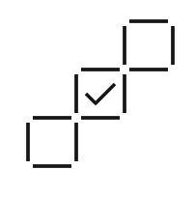
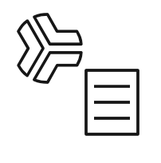

How blockchain works:
As each transaction occurs, it is recorded as a “block” of data
Those transactions show the movement of an asset that can be tangible (a product) or intangible (intellectual). The data block can record the information of your choice: who, what, when, where, how much and even the condition — such as the temperature of a food shipment.
Each block is connected to the ones before and after it these blocks form a chain of data as an asset moves from place to place or ownership changes hands. The blocks confirm the exact time and sequence of transactions, and the blocks link securely together to prevent any block from being altered or a block being inserted between two existing blocks.
Transactions are blocked together in an irreversible chain: each additional block strengthens the verification of the previous block and hence the entire blockchain. This renders the blockchain tamper-evident, delivering the key strength of immutability. This removes the possibility of tampering by a malicious actor - and builds a ledger of transactions you and other network members can trust.

Slide 6


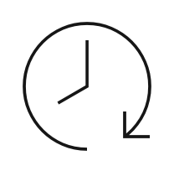
BENEFITS OF A BLOCKCHAIN:
Greater trust
With blockchain, as a member of a members-only network, you can rest assured that you are receiving accurate and timely data, and that your confidential blockchain records will be shared only with network members to whom you have specifically granted access.
Greater security
Consensus on data accuracy is required from all network members, and all validated transactions are immutable because they are recorded permanently. No one, not even a system administrator, can delete a transaction.
More efficiencies
With a distributed ledger that is shared among members of a network, time-wasting record reconciliations are eliminated. And to speed transactions, a set of rules — called a smart contract — can be stored on the blockchain and executed automatically.

Slide 7
APPLICATIONS OF BLOCKCHAIN IN EDUCATIONAL TECHNOLOGY :
1.STUDENT RECORD MAINTENANCE
2.USING BLOCKCHAIN IN CERTIFICATE VALIDATION
3.TAMPER PROOF RECORD STORAGE MECHANISMS
4.USING BLOCKCHAIN FOR LOWERING EDUCATION COSTS

