Slide 1

Technology: Java
ALOHA TOURS AND TRAVELS

Slide 2
INDEX
Abstract
Introduction
Literature review
Existing Method
Drawbacks
Proposed method
Advantages
Implementation
Architecture
Modules

Slide 3
ABSTRACT
Aloha Tours and Travels project provides great chances for users to obtain rich information. Particularly, tourists want to easily get tremendous information about their tourism plans. Therefore, in this paper, we aim to design a tourism resources management system and guide the tourists to plan their travel routes. In general if any user plans for any tour they must consult any traveling agency for purchasing package. At the same time the user has to do traveling reservations from source to destination, hotel reservations at destination place and other travel reservations from destination to other places, this involves lot of manual work. For all these type of reservations must be done by user by standing lot of time in a queue. To avoid these problems to reduce the manual work to the user new project was developed i.e. Aloha Tours and Travels.

Slide 4
INTRODUCTION
In recent years, with the improvement of people's living standards, more and more people travel. How to better manage scenic spot information has become the focus of tourism information management departments . Access to relevant and accurate information is at the heart of tourism, more so in this era of the Internet information overload has become a prevalent phenomenon and as such a serious issue for those seeking for appropriate information. Furthermore, various researches have been carried out on how to make information on tourism website more effective. Therefore, in this paper, we aim to design a tourism resources management system and guide the tourists to plan their travel routes. In general if any user plans for any tour they must consult any traveling agency for purchasing package. At the same time the user has to do traveling reservations from source to destination, hotel reservations at destination place and other travel reservations from destination to other places, this involves lot of manual work . So ,here the user can see the places and hotels and can book the hotels and can see the path from source address to the destination address.

Slide 5
LITERATURE REVIEW
S. No | Journal Type with year | Authors | Title | Outcomes
1 | 2021. | Qi Xianwen, | Tourism Management Information System | Tourism information management department is the manager and supervisor of tourism information, which bears great work pressure. How to help scenic spot managers grasp the scenic spot information in time.
2 | 2017. | Chen Chongfu, | On the Design and Application of Tourism Management Information System | The traditional way of tourism and information management level has been unable to meet the current tourism needs of tourists. The development of information technology promotes the rapid development of tourism information technology
3 | 2017 | Cerosaletti, P.E., Fox, D.G., Chase, L.E | Research on the Intelligent Examination System Based on Genetic Algorithm | With the mutual integration of computer technology and education, promoting the reform of education and teaching network, online examination mode has gradually become an important means of new education measurement.
4 | 2001 | Research on Freight Route Planning System Based on Genetic Algorithm | Research on Freight Route Planning System Based on Genetic Algorithm | We first meet the requirements of the genetic algorithm of logistic development, use the division method to divide the delivery area of the gene, and formulate a functional delivery plan

Slide 6
EXISTING METHOD
In the existing system, all the records are not kept perfectly because all the work is done manually, so keeping up to date details of the hotels , places is not perfectly followed .User can book the hotels but there is no map to show the path from the source address to the destination address . Manually a person has to g and search for the hotels in a particular place ,it will take a lot of time to do such process, in the existing system. It will consumes money also.
Dis advantages:
It is time consuming.
Manual searching.
Data is secured.

Slide 7
PROPOSED METHOD
Tourist Management System is the project which gives all the required facilities to their customers when they are ready to plan for any tour. By using this portal the user can book any hotels and also it provides help to the users .User can see the path of the route in map.
Advantages:
Data will be stored systematically and accurately.
Computerized work.
Easy to analyze the hotels and rooms details.
Reducing the transport cost.

Slide 8
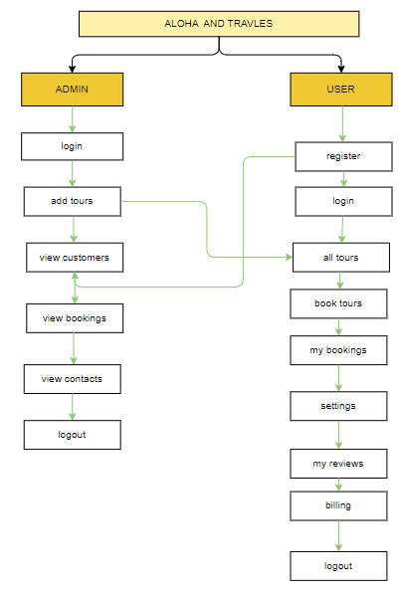
PROPOSED METHOD
Block diagram of proposed method

Slide 9
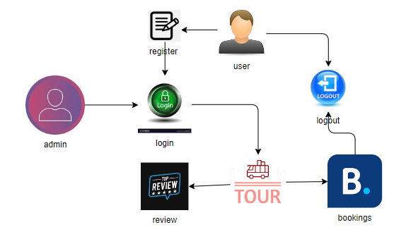
ARCHITECTURE
Architecture diagram of proposed method

Slide 10
SYSTEM REQUIREMENTS
SOFTWARE REQUIREMENTS:
Operating system : Windows 7 or 7+
Ram : 8 GB
Hard disc or SSD : More than 500 GB
Processor : Intel 3rd generation or high with 8 GB Ram
Software’s : Java 8 or high version, Eclipse.

Slide 11
SYSTEM REQUIREMENTS
HARDWARE REQUIREMENTS:
Scripts : JavaScript.
Front End : React js ,Html, Css
Technology : Node Js
Database Connectivity : JDBC
Database : MongoDbs

Slide 12
MODULES
1. Admin:
Admin login with their credentials. Admin can add the details of tourist place that can view the customers .
View Tours: Admin can view the tours added by him
View Customers: Admin can view the newly customers .
View Bookings: Admin can view all the bookings that are done by the customer.

Slide 13
MODULES
2. User:
User can register and login with the correct credentials, user can view the places, that are added by the admin
Book Tour: User can book the tour that are added by the admin. After book the tour user need to pay amount for the booking. User able to give the review for the particular tourist place.
My bookings: After booking completed user can view the booking that are done by him/her.
Settings: User can change the profile by changing their details and by adding photo.
My Reviews: User can view the reviews that are give by him/her.
Billing: User can able to view the billing details.

