Slide 1

Technology: Java
ALOHA TOURS AND TRAVELS

Slide 2
INDEX
Abstract
Introduction
Literature review
Existing Method
Drawbacks
Proposed method
Advantages
Implementation
Architecture
Modules

Slide 3
ABSTRACT
Aloha Tours and Travels project provides great chances for users to obtain rich information. Particularly, tourists want to easily get tremendous information about their tourism plans. Therefore, in this paper, we aim to design a tourism resources management system and guide the tourists to plan their travel routes. In general if any user plans for any tour they must consult any traveling agency for purchasing package. At the same time the user has to do traveling reservations from source to destination, hotel reservations at destination place and other travel reservations from destination to other places, this involves lot of manual work. For all these type of reservations must be done by user by standing lot of time in a queue. To avoid these problems to reduce the manual work to the user new project was developed i.e. Aloha Tours and Travels.

Slide 4
INTRODUCTION
In recent years, with the improvement of people's living standards, more and more people travel. How to better manage scenic spot information has become the focus of tourism information management departments . Access to relevant and accurate information is at the heart of tourism, more so in this era of the Internet information overload has become a prevalent phenomenon and as such a serious issue for those seeking for appropriate information. Furthermore, various researches have been carried out on how to make information on tourism website more effective. Therefore, in this paper, we aim to design a tourism resources management system and guide the tourists to plan their travel routes. In general if any user plans for any tour they must consult any traveling agency for purchasing package. At the same time the user has to do traveling reservations from source to destination, hotel reservations at destination place and other travel reservations from destination to other places, this involves lot of manual work . So ,here the user can see the places and hotels and can book the hotels and can see the path from source address to the destination address.

Slide 5
LITERATURE REVIEW
S. No | Journal Type with year | Authors | Title | Outcomes
1 | 2021. | Qi Xianwen, | Tourism Management Information System | Tourism information management department is the manager and supervisor of tourism information, which bears great work pressure. How to help scenic spot managers grasp the scenic spot information in time.
2 | 2017. | Chen Chongfu, | On the Design and Application of Tourism Management Information System | The traditional way of tourism and information management level has been unable to meet the current tourism needs of tourists. The development of information technology promotes the rapid development of tourism information technology
3 | 2017 | Cerosaletti, P.E., Fox, D.G., Chase, L.E | Research on the Intelligent Examination System Based on Genetic Algorithm | With the mutual integration of computer technology and education, promoting the reform of education and teaching network, online examination mode has gradually become an important means of new education measurement.
4 | 2001 | Research on Freight Route Planning System Based on Genetic Algorithm | Research on Freight Route Planning System Based on Genetic Algorithm | We first meet the requirements of the genetic algorithm of logistic development, use the division method to divide the delivery area of the gene, and formulate a functional delivery plan

Slide 6
EXISTING METHOD
In the existing system, all the records are not kept perfectly because all the work is done manually, so keeping up to date details of the hotels , places is not perfectly followed .User can book the hotels but there is no map to show the path from the source address to the destination address . Manually a person has to g and search for the hotels in a particular place ,it will take a lot of time to do such process, in the existing system. It will consumes money also.
Dis advantages:
It is time consuming.
Manual searching.
Data is secured.

Slide 7
PROPOSED METHOD
Tourist Management System is the project which gives all the required facilities to their customers when they are ready to plan for any tour. By using this portal the user can book any hotels and also it provides help to the users .User can see the path of the route in map.
Advantages:
Data will be stored systematically and accurately.
Computerized work.
Easy to analyze the hotels and rooms details.
Reducing the transport cost.

Slide 8
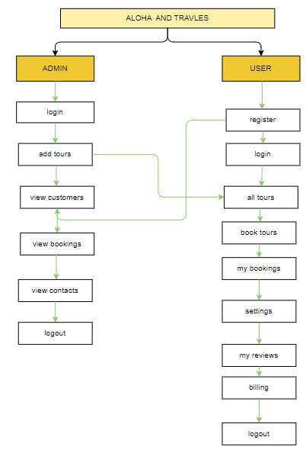
PROPOSED METHOD
Block diagram of proposed method

Slide 9
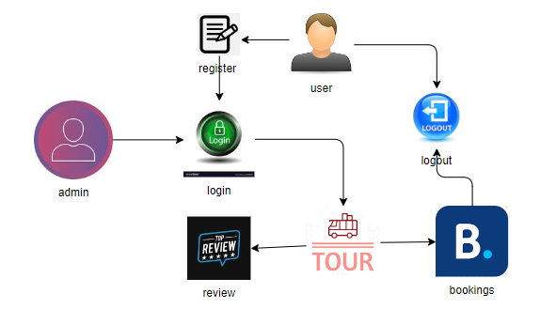
ARCHITECTURE
Architecture diagram of proposed method

Slide 10
SYSTEM REQUIREMENTS
SOFTWARE REQUIREMENTS:
Operating system : Windows 7 or 7+
Ram : 8 GB
Hard disc or SSD : More than 500 GB
Processor : Intel 3rd generation or high with 8 GB Ram
Software’s : Java 8 or high version, Eclipse.

Slide 11
SYSTEM REQUIREMENTS
HARDWARE REQUIREMENTS:
Scripts : JavaScript.
Front End : React js ,Html, Css
Technology : Node Js
Database Connectivity : JDBC
Database : MongoDbs

Slide 12
MODULES
1. Admin:
Admin login with their credentials. Admin can add the details of tourist place that can view the customers .
View Tours: Admin can view the tours added by him
View Customers: Admin can view the newly customers .
View Bookings: Admin can view all the bookings that are done by the customer.

Slide 13
MODULES
2. User:
User can register and login with the correct credentials, user can view the places, that are added by the admin
Book Tour: User can book the tour that are added by the admin. After book the tour user need to pay amount for the booking. User able to give the review for the particular tourist place.
My bookings: After booking completed user can view the booking that are done by him/her.
Settings: User can change the profile by changing their details and by adding photo.
My Reviews: User can view the reviews that are give by him/her.
Billing: User can able to view the billing details.

Slide 14
UML DIAGRAMS
Uml stands for unified modeling language. Uml is a standardized general-purpose modeling language in the field of object-oriented software engineering. The standard is managed, and was created by, the object management group.
The goal is for uml to become a common language for creating models of object oriented computer software. In its current form uml is comprised of two major components: a meta-model and a notation. In the future, some form of method or process may also be added to; or associated with, uml.
The unified modeling language is a standard language for specifying, visualization, constructing and documenting the artifacts of software system, as well as for business modeling and other non-software systems.
The uml represents a collection of best engineering practices that have proven successful in the modeling of large and complex systems.

Slide 15
The uml is a very important part of developing objects oriented software and the software development process. The uml uses mostly graphical notations to express the design of software projects.
GOALS:
The Primary goals in the design of the UML are as follows:
Provide users a ready-to-use, expressive visual modeling Language so that they can develop and exchange meaningful models.
Provide extendibility and specialization mechanisms to extend the core concepts.
Be independent of particular programming languages and development process.
Provide a formal basis for understanding the modeling language.
Encourage the growth of OO tools market.
Support higher level development concepts such as collaborations, frameworks, patterns and components.
Integrate best practices.

Slide 16
Use case diagram:
A use case diagram in the unified modeling language (uml) is a type of behavioral diagram defined by and created from a use-case analysis. Its purpose is to present a graphical overview of the functionality provided by a system in terms of actors, their goals (represented as use cases), and any dependencies between those use cases. The main purpose of a use case diagram is to show what system functions are performed for which actor. Roles of the actors in the system can be depicted.

Slide 17
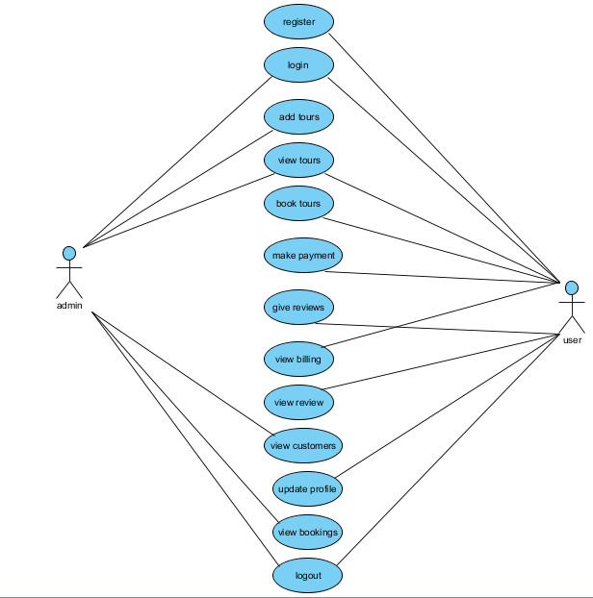

Slide 18
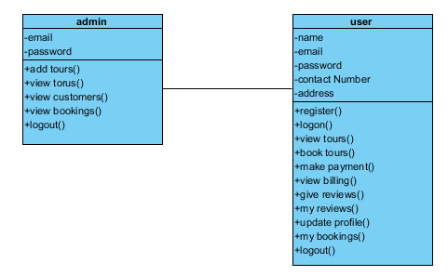
Class diagram:
In software engineering, a class diagram in the unified modeling language (uml) is a type of static structure diagram that describes the structure of a system by showing the system's classes, their attributes, operations (or methods), and the relationships among the classes. It explains which class contains information.

Slide 19
Sequence diagram:
A sequence diagram in unified modeling language (uml) is a kind of interaction diagram that shows how processes operate with one another and in what order. It is a construct of a message sequence chart. Sequence diagrams are sometimes called event diagrams, event scenarios, and timing diagrams.

Slide 20
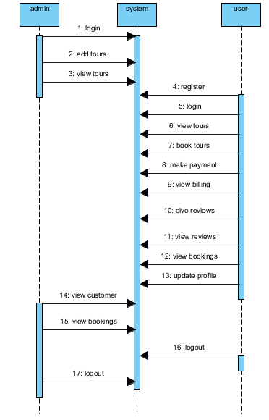

Slide 21
Collaboration diagram:
In collaboration diagram the method call sequence is indicated by some numbering technique as shown below. The number indicates how the methods are called one after another. We have taken the same order management system to describe the collaboration diagram. The method calls are similar to that of a sequence diagram. But the difference is that the sequence diagram does not describe the object organization whereas the collaboration diagram shows the object organization.

Slide 22
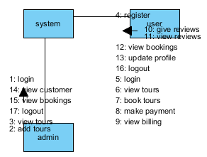

Slide 23
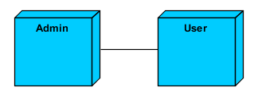
Deployment diagram:
Deployment diagram represents the deployment view of a system. It is related to the component diagram. Because the components are deployed using the deployment diagrams. A deployment diagram consists of nodes. Nodes are nothing but physical hard ware’s used to deploy the application.

Slide 24
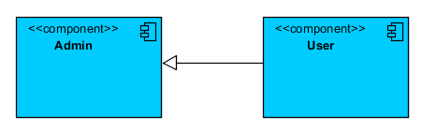
Component diagram:
Component diagrams are used to describe the physical artifacts of a system. This artifact includes files, executable, libraries etc. So the purpose of this diagram is different, component diagrams are used during the implementation phase of an application. But it is prepared well in advance to visualize the implementation details. Initially the system is designed using different uml diagrams and then when the artifacts are ready component diagrams are used to get an idea of the implementation.

Slide 25
Activity diagram:
Activity diagrams are graphical representations of workflows of stepwise activities and actions with support for choice, iteration and concurrency. In the unified modeling language, activity diagrams can be used to describe the business and operational step-by-step workflows of components in a system. An activity diagram shows the overall flow of control.

Slide 26
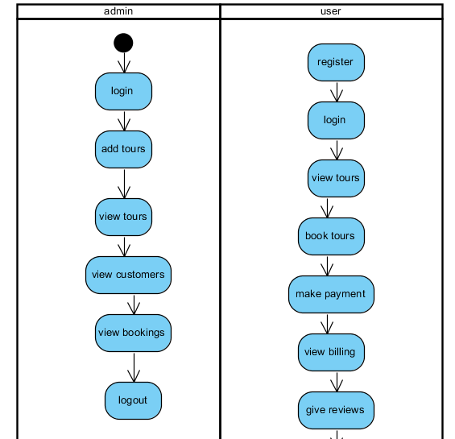

Slide 27
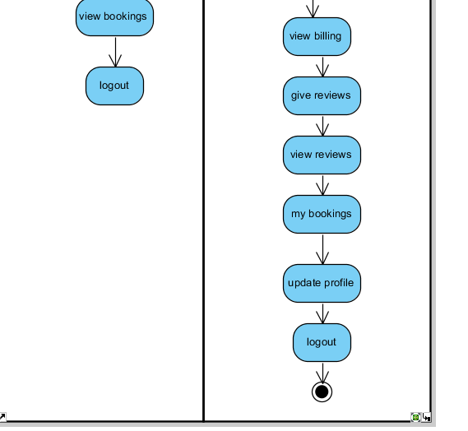

Slide 28
ER Diagram:
An Entity–relationship model (ER model) describes the structure of a database with the help of a diagram, which is known as Entity Relationship Diagram (ER Diagram). An ER model is a design or blueprint of a database that can later be implemented as a database. The main components of E-R model are: entity set and relationship set.
An ER diagram shows the relationship among entity sets. An entity set is a group of similar entities and these entities can have attributes. In terms of DBMS, an entity is a table or attribute of a table in database, so by showing relationship among tables and their attributes, ER diagram shows the complete logical structure of a database. Let’s have a look at a simple ER diagram to understand this concept.

Slide 29
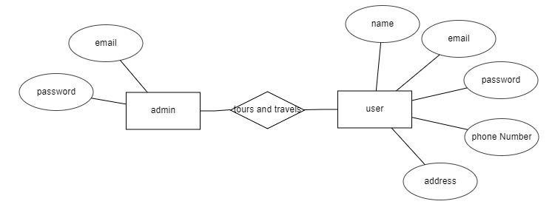

Slide 30
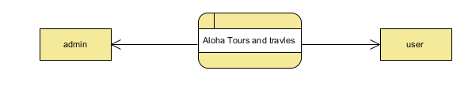
DFD Diagram:
A Data Flow Diagram (DFD) is a traditional way to visualize the information flows within a system. A neat and clear DFD can depict a good amount of the system requirements graphically. It can be manual, automated, or a combination of both. It shows how information enters and leaves the system, what changes the information and where information is stored. The purpose of a DFD is to show the scope and boundaries of a system as a whole. It may be used as a communications tool between a systems analyst and any person who plays a part in the system that acts as the starting point for redesigning a system.

Slide 31
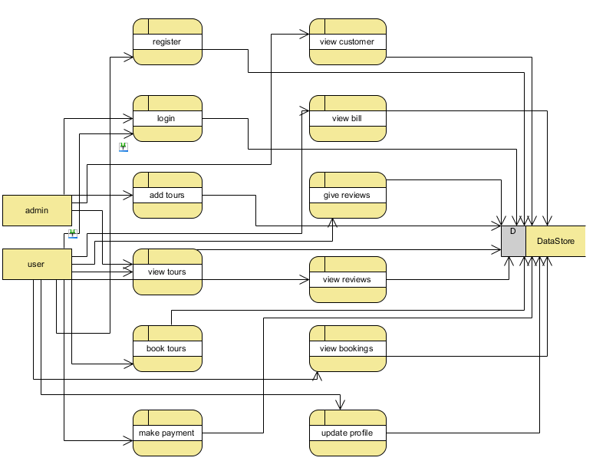

Slide 32
