Slide 1

PROJECT REVIEW-2
LLM-Based Intelligent Personal Finance Advisor with Personalized Savings Prediction and Investment Recommendation
Team Members:
1) Narasimha Sai-2420030406
2) Ch. Srikar-2420030610
3) D. Hari Haran-2420080075
4) P. Jyothik Kshitij-2420080039
Notes:
Title slide. Introduce the project scope: an LLM-assisted personal finance advisor combining machine learning with generative guidance.

Slide 2
Methodology
Nine stages from raw financial data to personalised, explainable recommendations
1
Data Collection
2
Data Preprocessing
3
Expense Analysis
A synthetically generated personal finance dataset covering income and all major expense categories.
Clean, structure and prepare the financial records for analysis and machine-learning prediction.
Compute total expenses, actual savings, expense percentage and savings percentage.
4
Savings Prediction
5
Financial Health Analysis
6
Budget Recommendation
Apply an XGBoost regression model to forecast the user's monthly savings.
Derive a Financial Health Score from savings, expenses and emergency-fund status.
Identify spending patterns and suggest ways to control unnecessary expenditure.
7
Investment Recommendation
8
LLM Guidance
9
Visualisation
Generate options aligned to the user's savings level and selected risk profile.
Use Google Gemini to turn the results into simple, personalised financial advice.
Present every insight through an interactive Streamlit dashboard.
2
Notes:
Walk through the nine-stage pipeline. Stages 1-3 prepare and analyse the data, 4-7 generate the quantitative outputs, and 8-9 translate them into guidance the user can act on.

Slide 3
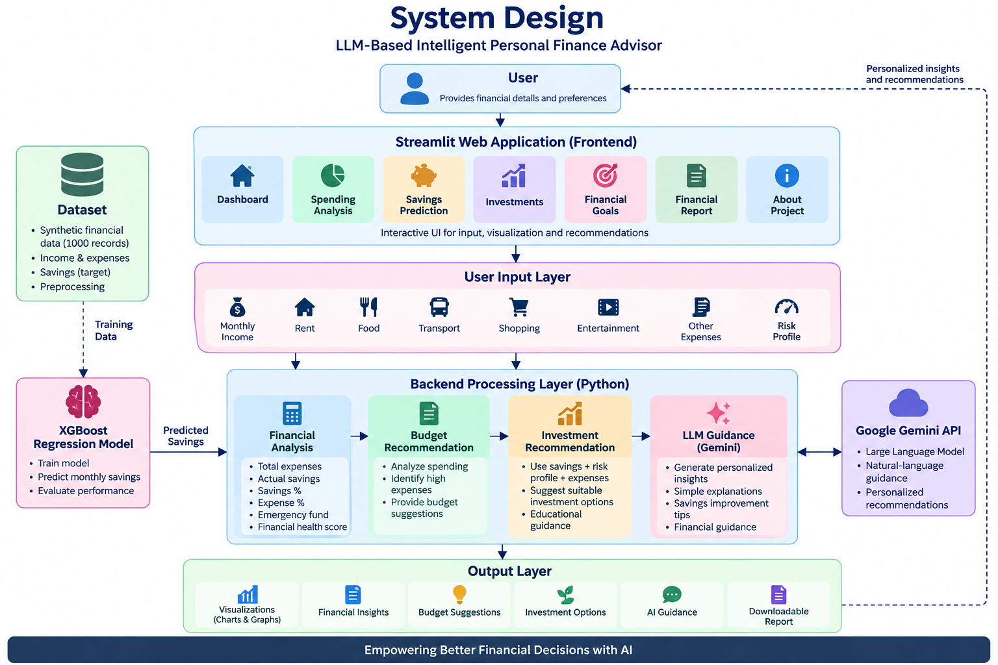
System Design
Layered architecture spanning the Streamlit front end, the Python processing layer and the output services
3
Notes:
Explain the flow from user input through the processing layer to the recommendation and guidance outputs.

Slide 4
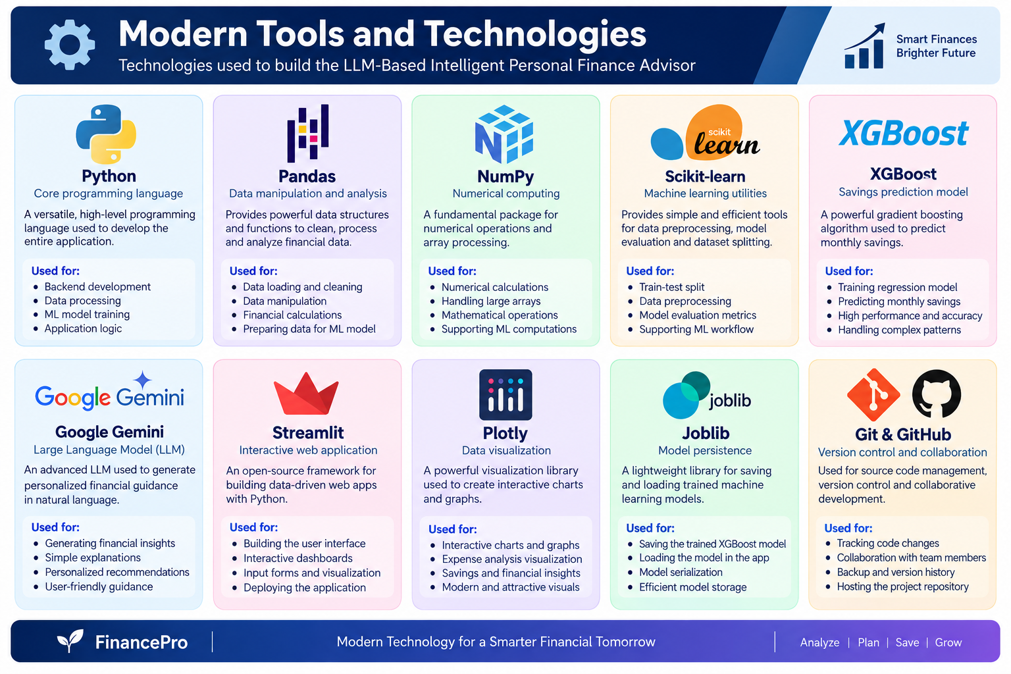
Tools and Technologies
The libraries, models and services used to build the advisor
4
Notes:
Python and Pandas handle data work, XGBoost and Scikit-learn the prediction, Gemini the guidance, and Streamlit with Plotly the interface.

Slide 5
Implementation and Results
5
Notes:
Transition into the demonstration of the working application.

Slide 6
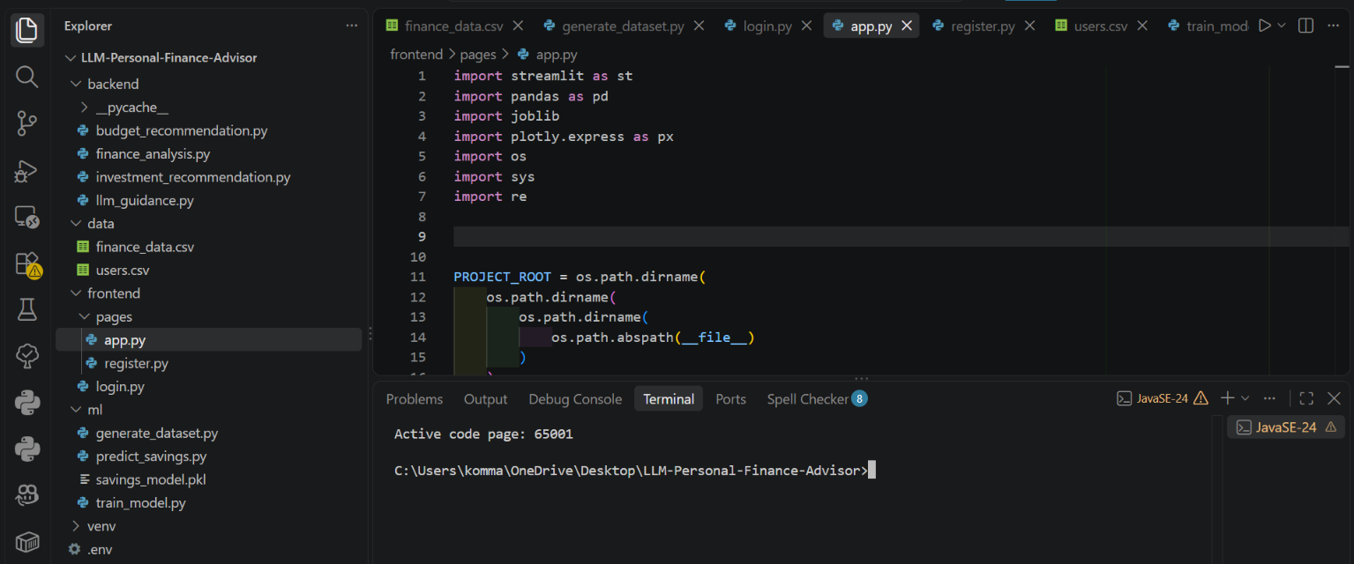
Project Structure and Codebase
Modular Python application organised by data, models, services and dashboard components
6
Notes:
Highlight the separation between data handling, model logic and the interface.

Slide 7
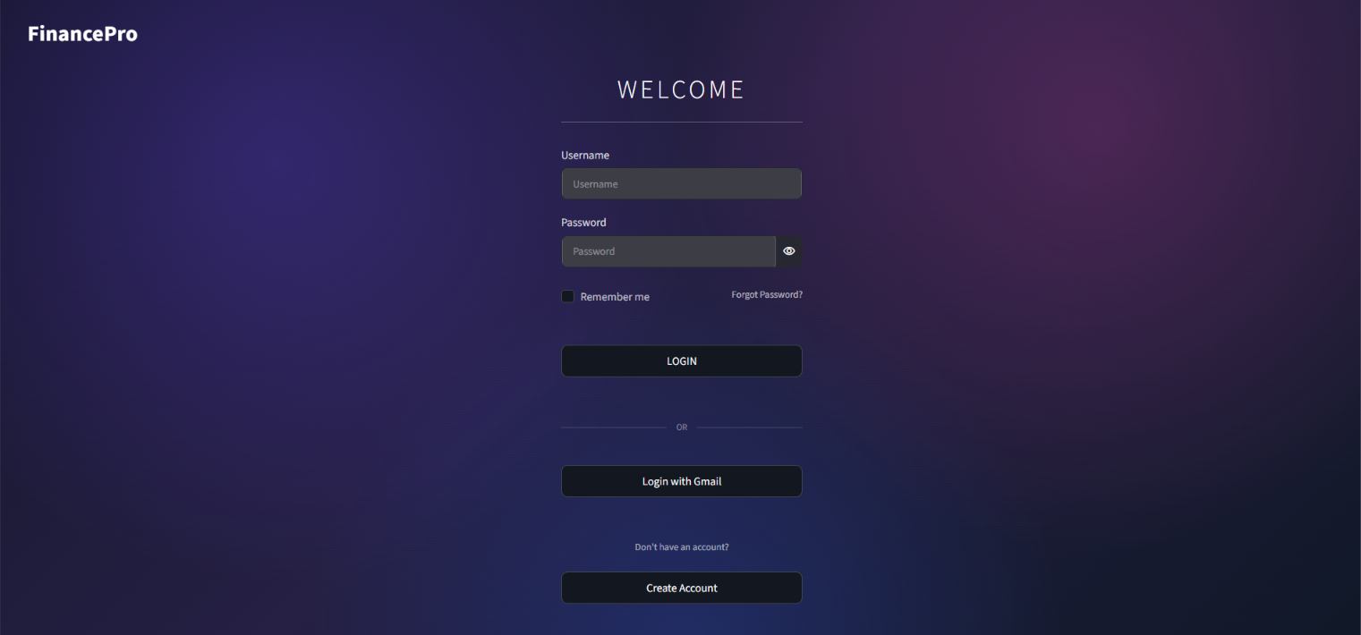
User Authentication
Secure login and registration gate for each user's financial profile
7
Notes:
Each user session is isolated so profiles and results remain private.

Slide 8
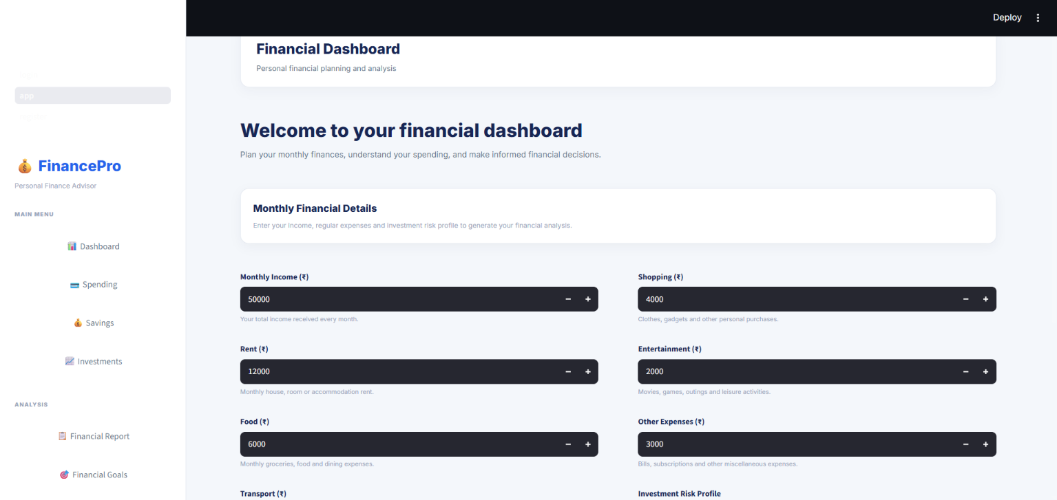
Financial Data Entry
Monthly income and category-wise expenses captured through the dashboard
8
Notes:
Inputs collected here feed directly into the analysis and prediction modules.

Slide 9
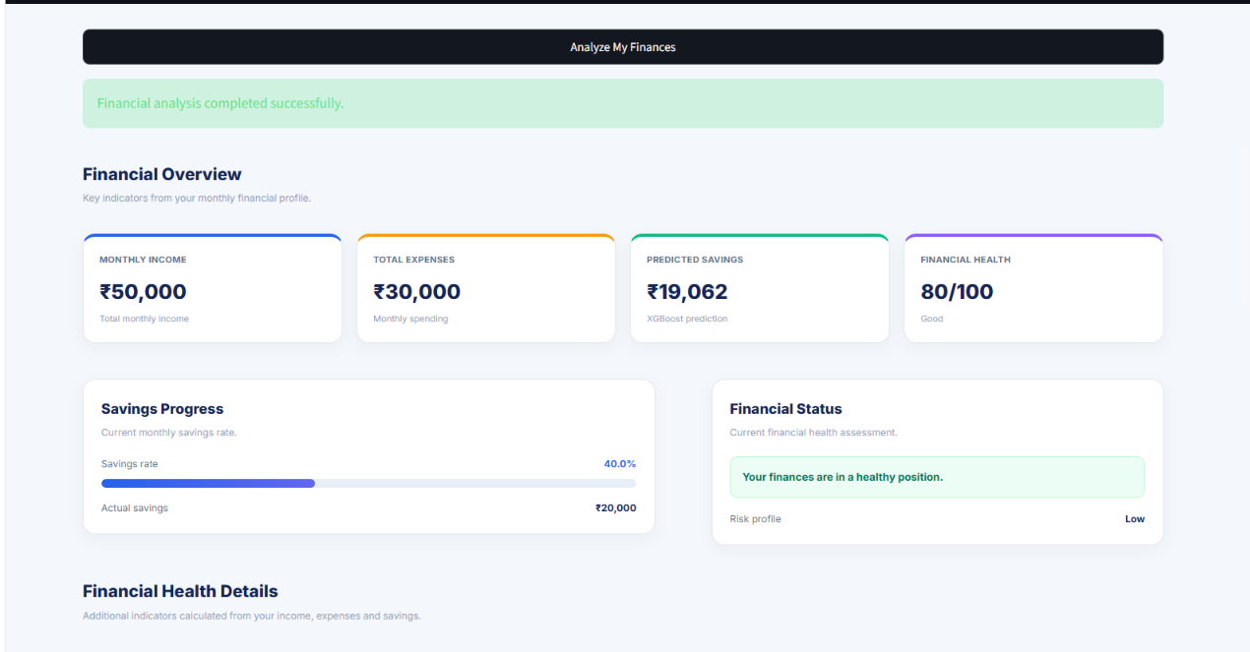
Financial Overview and Health Score
Income, expenses, predicted savings and the computed Financial Health Score at a glance
9
Notes:
The health score combines savings rate, expense ratio and emergency-fund status into a single indicator.

Slide 10
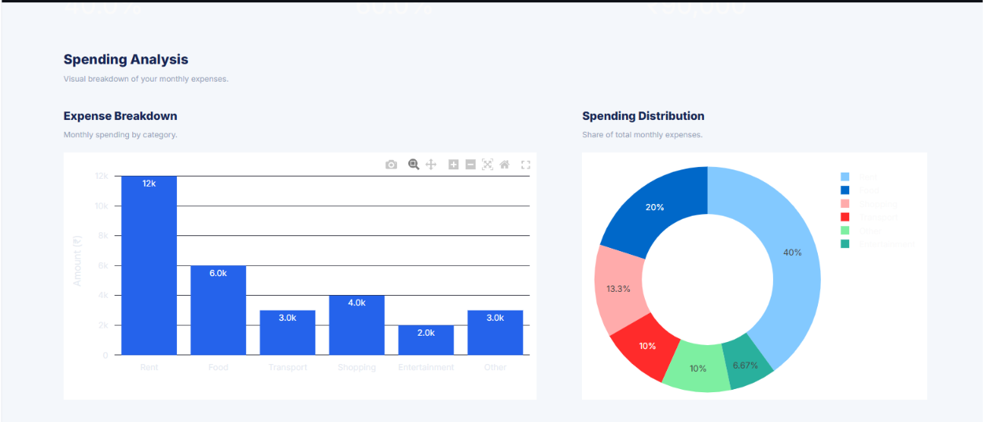
Spending Analysis
Category-wise expense breakdown and spending distribution
10
Notes:
These visualisations expose the categories driving the largest share of monthly spend.

Slide 11
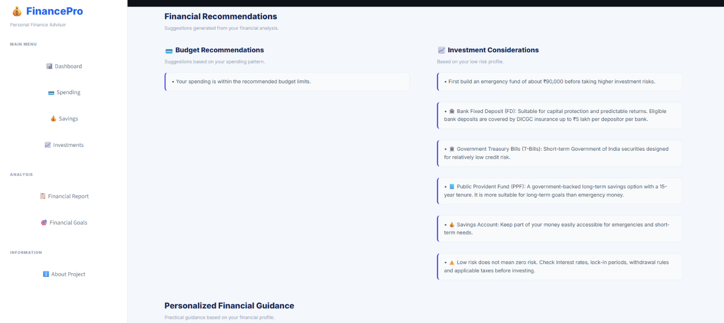
Recommendations and Guidance
Budget actions, investment considerations and personalised advice generated by the LLM
11
Notes:
Recommendations are tailored to the savings level and the risk profile the user selects.

Slide 12
Conclusion
End-to-end pipeline
Machine learning at the core
Raw financial data is turned into savings predictions, a health score and actionable advice in a single workflow.
XGBoost regression drives the savings forecast that underpins every downstream recommendation.
Guidance people can read
Interactive delivery
Google Gemini converts numerical outputs into plain-language, personalised financial guidance.
The Streamlit dashboard makes the analysis explorable rather than static.
12
Notes:
Summarise the outcome and invite questions.

