Slide 1
IBM University Engagement Project Submission
“Exploring the Power of Agentic AI with IBM Granite and IBM Bob”

Slide 2

Project Tile – [Investment Recommendation Agent]
Domain of Project – [ Finance]
Student Name | Recent Passport Photo | Email ID | Mobile number [WhatsApp]
M. Narasimhulu |  | narasimhulu.srit789@gmail.com | 8919365263
Recommended font style and size: Font Style: Arial Font Size (Heading): 28
Font Size (Content): 20

Slide 3
Problem Statement -
Problem Statement : Investment Recommendation Agent
The Challenge
Investors often struggle to analyze market trends, assess risks, and choose suitable investments due to scattered financial information and lack of personalized guidance. This can lead to poor investment decisions and financial losses..
The Objective
Build an AI-powered Investment Recommendation Agent that provides personalized investment advice based on user goals and risk tolerance. The solution should:
Personalized Recommendations – Suggest stocks, mutual funds, ETFs, and other investments.
Financial Data Retrieval – Fetch and summarize market and company information.
Portfolio Analysis – Evaluate and optimize investment portfolios.
Risk Assessment – Analyze risks and market volatility.
Multi-Agent System Investment Knowledge Agent, Portfolio Recommendation Agent, Risk Analysis Agent, Market Monitoring Agent
AgentDashboard – Visualize portfolio performance, risk, and returns.

Slide 4
Proposed Solution -
Proposed Solution: AI-Powered Investment Recommendation Agent
The proposed solution is a multi-agent AI-powered Investment Recommendation Agent built using IBM BOB, IBM watsonx.ai, IBM Granite Models, and IBM Cloud to deliver personalized, real-time investment guidance.
The system uses Retrieval-Augmented Generation (RAG) with a Vector Index to retrieve trusted financial data and generate accurate investment recommendations.
Key Agents:
Investment Knowledge Agent – Retrieves financial and market information.
Portfolio Recommendation Agent – Suggests personalized investment portfolios.
Risk Analysis Agent – Evaluates investment risks and diversification.
Market Monitoring Agent – Tracks market trends and provides real-time alerts.
An interactive dashboard visualizes portfolio performance, asset allocation, expected returns, and risk metrics.
Overall, the solution acts as an intelligent financial advisor, helping users make informed investment decisions through personalized recommendations, risk analysis, and real-time market insights.

Slide 5
Technology Used
IBM BOB Platform – Designs and orchestrates the multi-agent workflow.
IBM Granite-4.0-8B-Instruct – Performs financial reasoning, investment recommendations, and natural language understanding.
IBM watsonx.ai – Enables model deployment, RAG, embeddings, and AI governance.
IBM Cloud – Provides secure, scalable deployment and hosting.
Vector Index – Stores financial knowledge embeddings for RAG-based retrieval.
File Component – Stores user portfolios, financial reports, and datasets.
Prompt Engineering – Optimizes prompts for accurate investment recommendations and risk analysis.
Streamlit / React – Builds an interactive dashboard for portfolio visualization and user interaction.

Slide 6
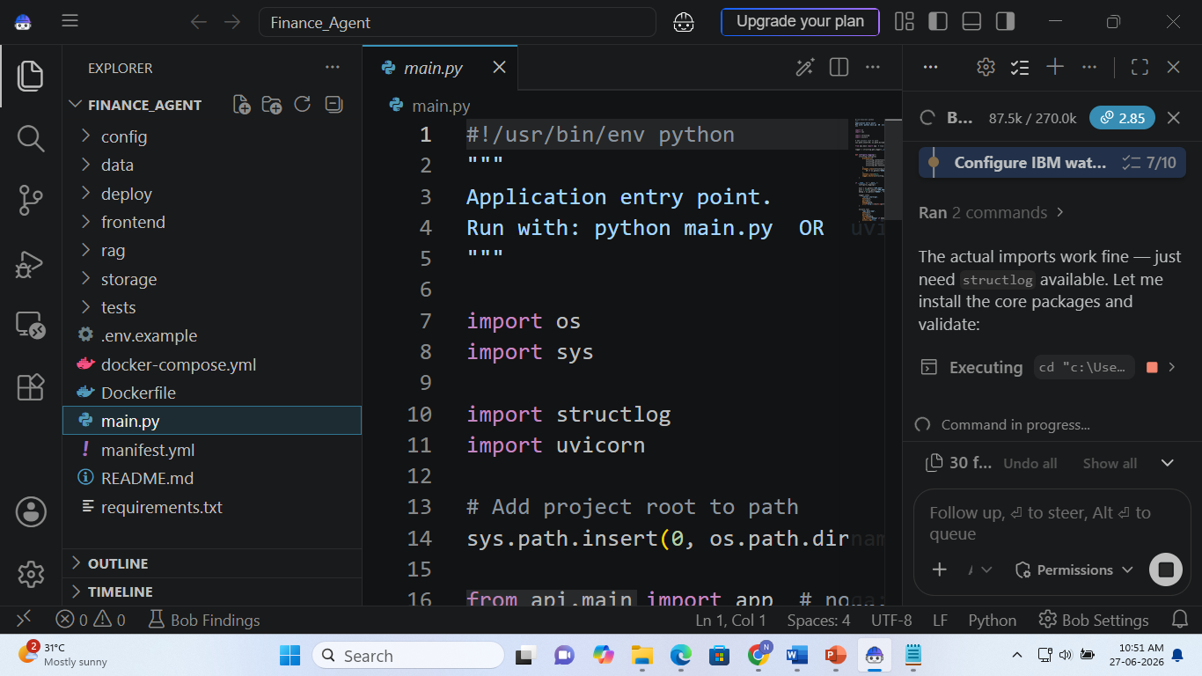
Required Files created using IBM bob -
Important Files Created Using IBM BOB
Agent Workflow (workflow.json) – Defines the complete multi-agent workflow.
Agent Configuration (agents.json) – Configures all AI agents and their roles.
Prompt Templates (prompts.md) – Contains prompts used by the AI agents.
Knowledge Base (knowledge_base.pdf / financial_data.csv) – Financial reports and investment datasets.
Vector Index – Stores embeddings for RAG-based retrieval.
Application Configuration (config.yaml) – Model, API, and deployment settings.
Dashboard (app.py or App.jsx) – User interface for investment recommendations and portfolio visualization.
README (README.md) – Project setup, execution, and deployment instructions.

Slide 7
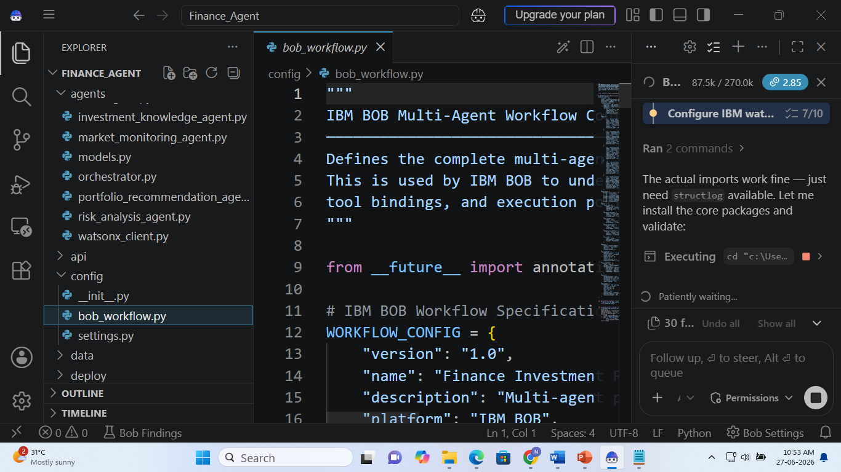
IBM Bob Screenshots:

Slide 8
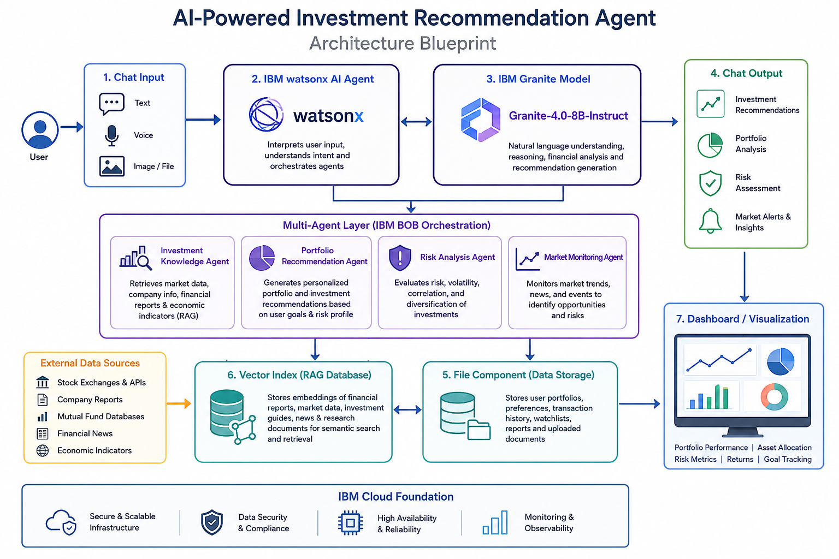
Architecture blueprint for IBM bob:

Slide 9

Role of Agentic AI in the solution
Agentic AI enables the Investment Recommendation Agent to act as an intelligent financial advisor by coordinating multiple specialized AI agents. Using IBM BOB, IBM watsonx.ai, and IBM Granite Models, each agent independently performs tasks such as retrieving financial data, generating investment recommendations, analyzing portfolio risk, and monitoring market trends.
The agents collaborate by sharing information and adapting recommendations based on user goals, risk tolerance, budget, and real-time market conditions. This autonomous, context-aware approach ensures accurate, personalized, and timely investment guidance.
Overall, Agentic AI makes the solution proactive, personalized, and goal-driven, helping users make informed investment decisions with minimal manual effort.

Slide 10
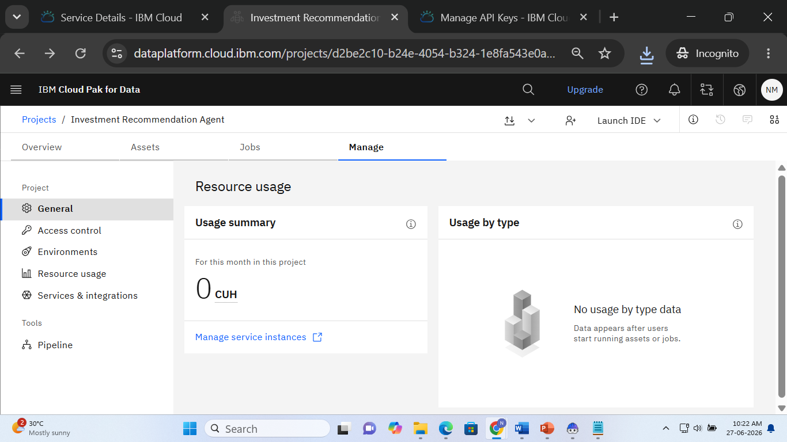
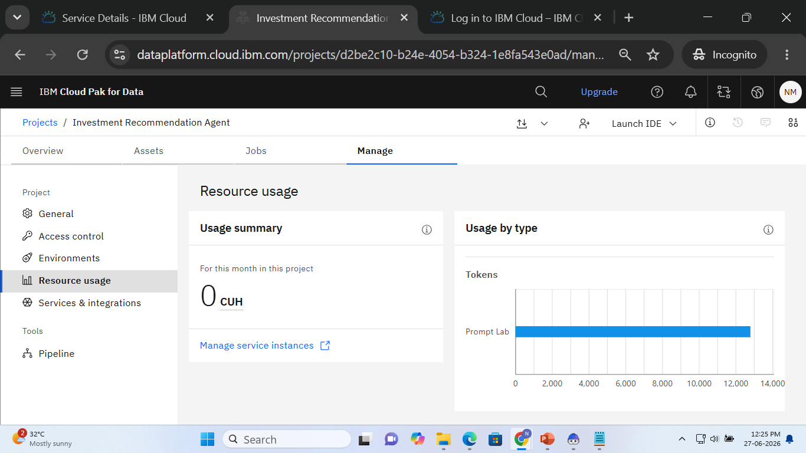
Token Usage
11,761 token are used
Before Prompt
After the Prompt
·
·
·

Slide 11
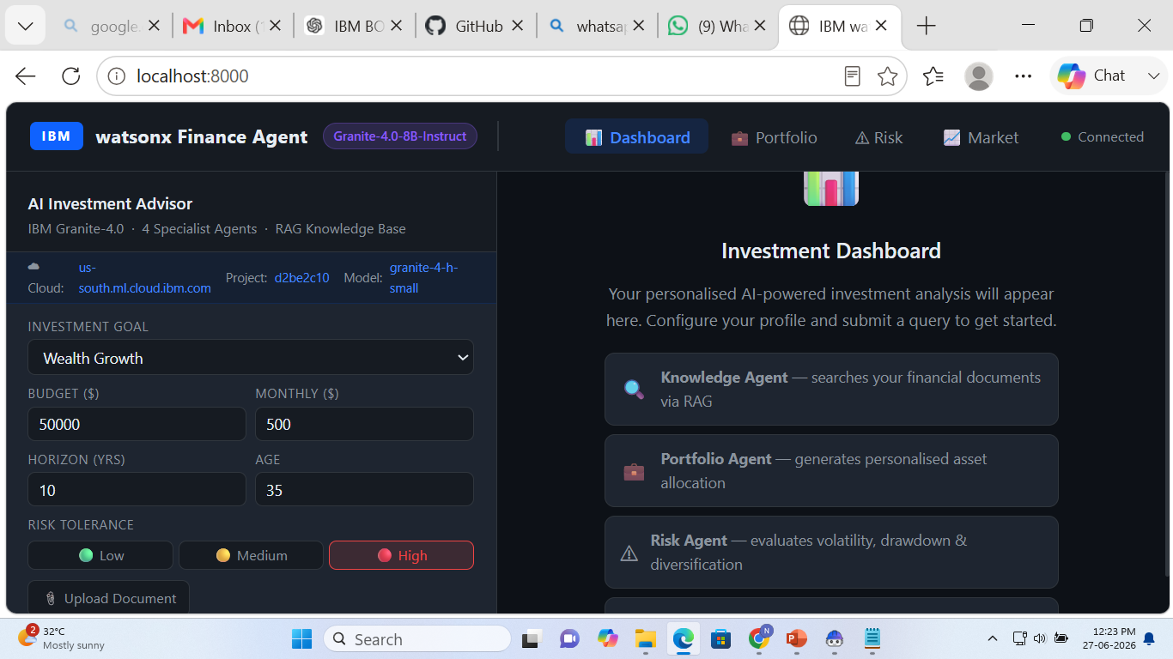
Project Output Screenshot
Please put IBM Bob output screenshots with 2-3 prompts.
You can take 2-3 more slides for each screenshot
·
·
·

Slide 12
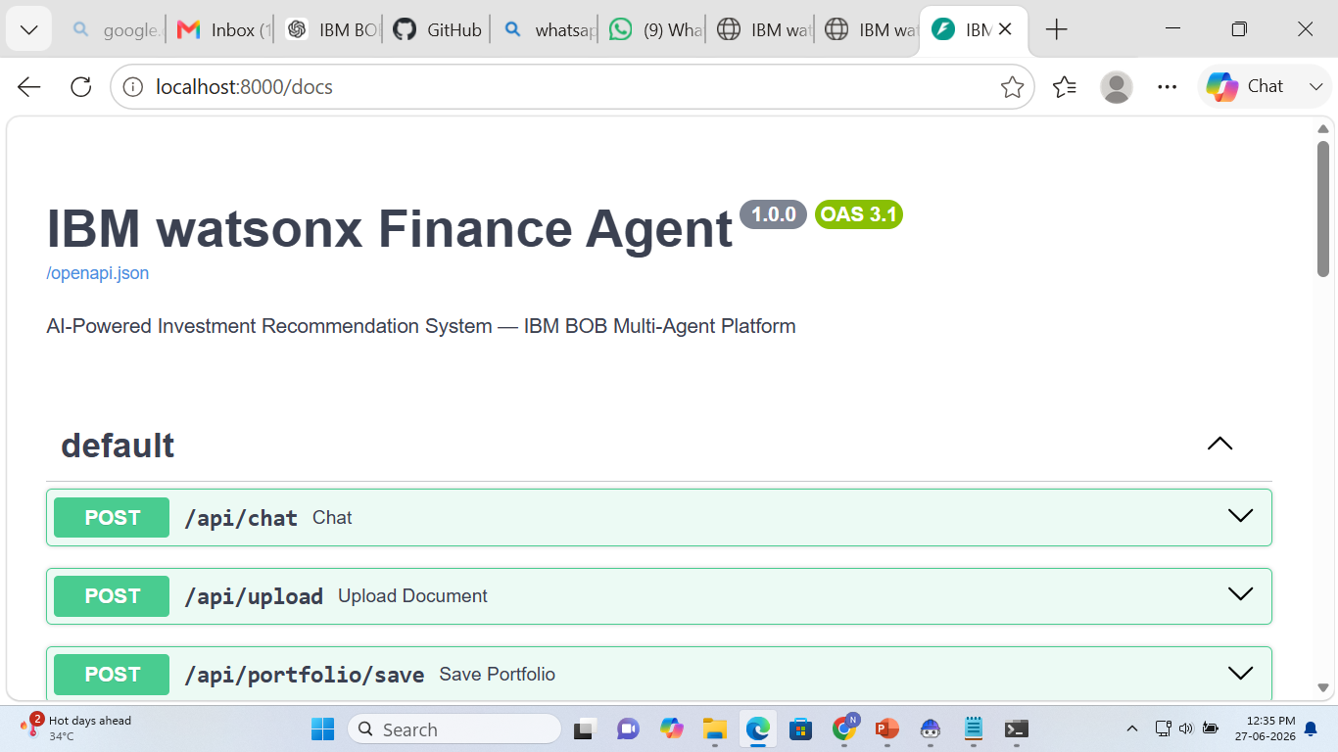
Project Output Screenshot
Please put IBM Bob output screenshots with 2-3 prompts.
You can take 2-3 more slides for each screenshot
·
·
·

Slide 13
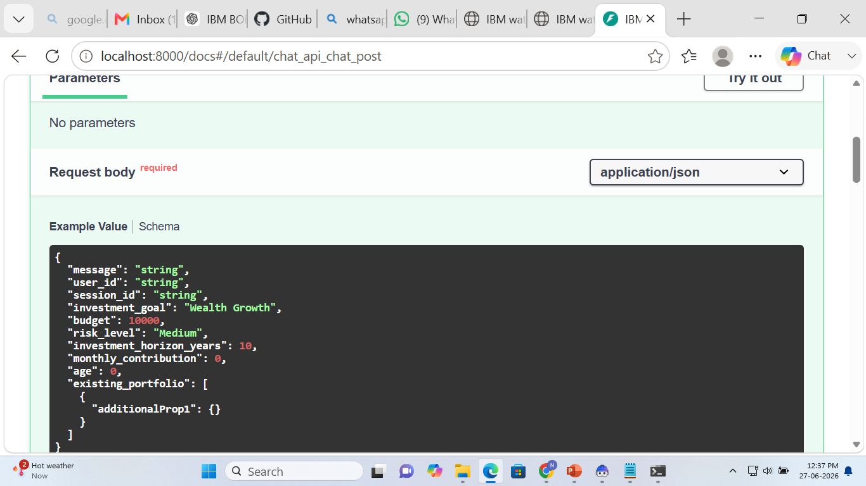
Project Output Screenshot
Please put IBM Bob output screenshots with 2-3 prompts.
You can take 2-3 more slides for each screenshot
·
·
·

Slide 14
Novelty and Uniqueness
The proposed Investment Recommendation Agent stands out by combining Agentic AI, RAG, and real-time financial intelligence into a single intelligent system.
Multi-Agent Intelligence – Instead of a single chatbot, multiple specialized agents collaborate to deliver accurate and context-aware investment guidance.
RAG-Based Financial Accuracy – Integrates real-time financial data retrieval with AI generation, reducing misinformation and ensuring trustworthy recommendations.
Hyper-Personalization – Tailors investment portfolios based on financial goals, budget, risk tolerance, and investment horizon.
Real-Time Market Monitoring – Continuously adapts recommendations based on live market trends, portfolio performance, and economic updates.
Proactive Risk Analysis – Goes beyond investment recommendations by identifying portfolio risks, diversification gaps, and market volatility.
Interactive Investment Dashboard – Provides visual insights into portfolio performance, asset allocation, expected returns, and risk metrics.
Scalable & Enterprise-Ready – Built on IBM BOB, IBM watsonx.ai, and IBM Granite Models, ensuring reliability, security, governance, and scalability.
This makes the solution a smart, adaptive, and proactive digital investment advisor, not just a static investment recommendation tool.

Slide 15
Git Hub Link
· Please create public github repository (Enable Add README button while creating repository) with format –
Please test and Paste the working Github URL –https://github.com/narasimhulusrit789-crypto/Finance_Agent
Make sure you have Uploaded following three files into your github repository 1) All Agent relevant files of IBM Cloud , 2) yourproblemstatement.pdf file 3) your projectpresntation.pptx file 4)any other files
·
·
·

Slide 16
Future Scope
AI Portfolio Optimization – Continuously optimize investments using AI.
Real-Time Market Data – Integrate live stock and financial market updates.
Predictive Analytics – Forecast market trends and investment opportunities.
Multi-Asset Support – Recommend stocks, mutual funds, ETFs, bonds, and cryptocurrencies.
Automated Portfolio Rebalancing – Suggest portfolio adjustments based on market changes.
Voice-Enabled Assistant – Enable voice-based investment guidance.
Global Market Integration – Support international financial markets.
Enterprise Deployment – Integrate with banks and wealth management platforms using IBM Cloud.
·
·
·

Slide 17
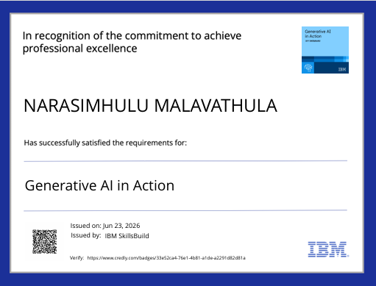
Certificates Earned:
Please add your credly certificate

Slide 18
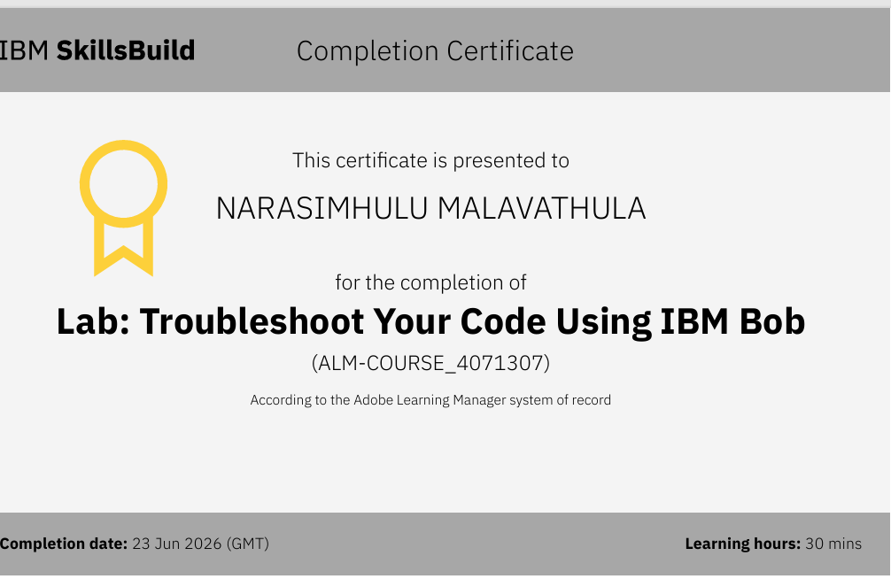
Certificates Earned:​
Add your IBM BOB Certificate

Slide 19


