Slide 1
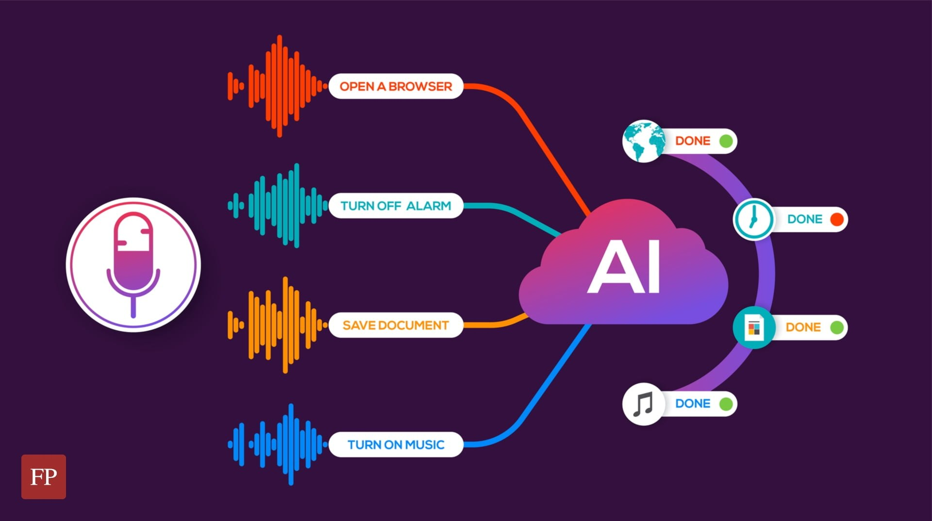
TransArt: A Multimodal Application for Vernacular Language Translation and Image Genaration
Lead Developer
C.NARASIMMARAJ

Slide 2
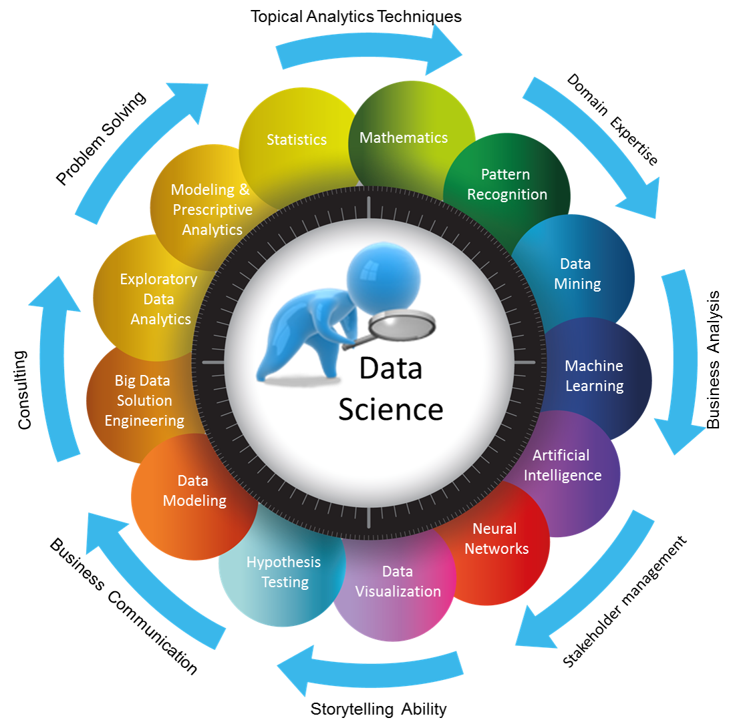
Introduction to TransArt Application
01
02
Language Education
Cultural Preservation
TransArt enables immersive learning experiences in vernacular languages through real-time translation and interactive visuals.
The application assists in preserving endangered vernacular languages by providing tools for documentation and visual storytelling.
03
04
Global Communication
Creative Expression
Enhances communication for local communities by bridging language barriers with accurate translations and context-aware visuals.
Facilitates artistic expression by allowing users to create images and art in their native language, inspiring creativity.

Slide 3
Project Introduction
Trans Art is a versatile application combining AI-driven language translation and image generation. The app is designed to seamlessly transcribe, translate, and visualize content from vernacular languages, specifically Tamil, into English, while offering creative text generation and image synthesis capabilities.
Multimodal Translation Pipeline
Tamil audio transcription using Whisper models.
Romanized Tamil transliteration into native script.
Tamil-to-English translation using Google Translator.
Creative Text Generation
GPT-Neo model generates creative outputs from translated content.
Image Synthesis
Leverages Stable Diffusion for generating custom images based on input text.

Slide 4
Tamil Audio Transcription & Translation
Process:
Tamil speech is converted to text using advanced speech-to-text models. This transcription can be further transliterated to Tamil script or translated into English.
Use Case:
Language accessibility for media, customer support, and content creators working with Tamil-speaking regions.

Slide 5
Creative Text Generation & Image Synthesis
Creative Text Generation:
GPT-Neo's large language model generates unique, creative narratives based on the translated content, aiding in storytelling and marketing.
Image Generation:
Using Stable Diffusion (v1.4), users can transform text prompts into stunning visual representations. This feature supports content creation in marketing, art, and design.
Integration:
Combining language and visual creation into one unified experience, enhancing creative workflows for multilingual users.

Slide 6
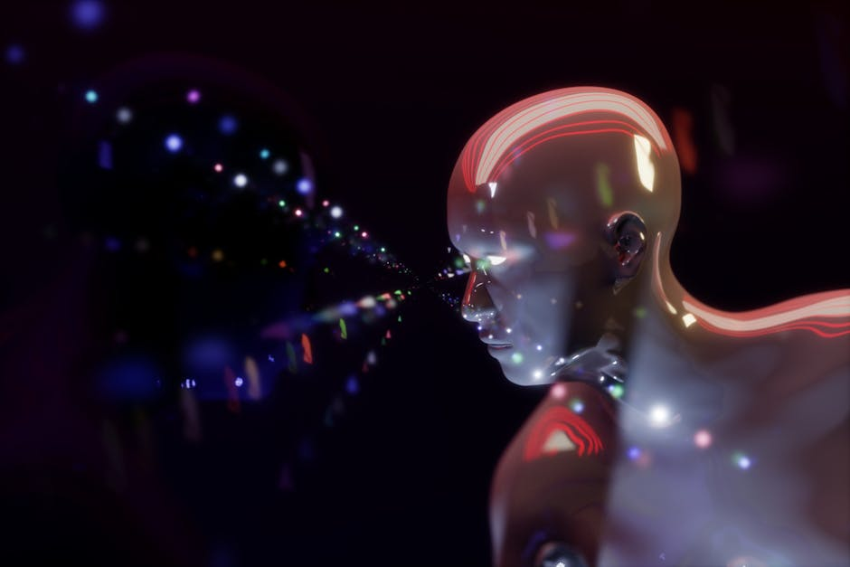
Understanding From Vernacular Language Translation
Cultural Relevance
Translations must reflect local culture and dialect for accuracy.
User Engagement
Engage users through tailored content using vernacular languages.
Technology Integration
Utilize AI to enhance translation accuracy and speed.
Broad Accessibility
Ensure accessibility across various digital platforms and formats.

Slide 7
Conclusion
Trans Art's Impact:
Trans Art is a groundbreaking tool for anyone seeking to bridge language gaps while creating visually engaging and emotionally resonant content.
Its multimodal capabilities enable seamless communication and creativity across languages, industries, and artistic domains.
Thank You!
C.NARASIMMARAJ

