Slide 1
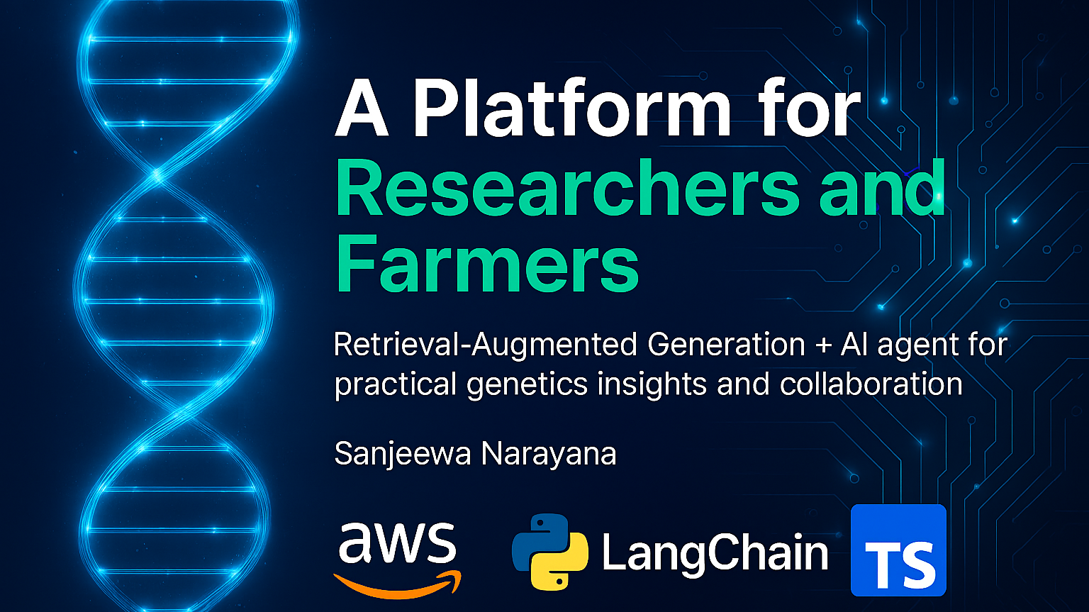
Gevin Madharha
Notes:
Hello everyone. My name is Sanjeewa Narayana, and I’m an independent software developer working with the University of Guelph. Today I want to share a project close to my heart called 'Emilia.' It is a platform designed to bridge the gap between complex genetics research and practical farming decisions, powered by a RAG-driven AI agent. My goal today is to show you how we are using advanced AI not just to chat, but to drive real scientific and agricultural outcomes.

Slide 2

What will we demonstrate today?
🎯 Goal – Show how advanced AI drives real scientific and agricultural outcomes
🧬 Introduction to Emilia – A platform connecting genetics research with farming decisions
🤖 Powered by RAG-driven AI agent – Retrieval-Augmented Generation for actionable insights
🌱 Collaboration – Bridging researchers and farmers for practical impact

Slide 3

The Origin Story – From Infrastructure to Insight
Background & Experience:
Managed IT and Networking infrastructure across 10+ Research Stations.
Supported diverse teams: Animal Behavior Researchers, Graduate Students, and Field Technicians.
The Operational Reality:
Data Pipelines: Helped design workflows to gather, store, and analyze sensor/field data.
Budgeting: Strategized infrastructure investments for long-term research projects.
Observation: Technology was available, but the human workflow was broken.
Notes:
Before I started building this, I spent years managing IT and networking infrastructure across more than ten research stations. My job was to help students and researchers set up data pipelines and budget for technology, specifically for animal behavior research. I was the guy in the server room and the guy in the field, which gave me a front-row seat to the daily reality of scientific research. And what I saw was frustrating.

Slide 4
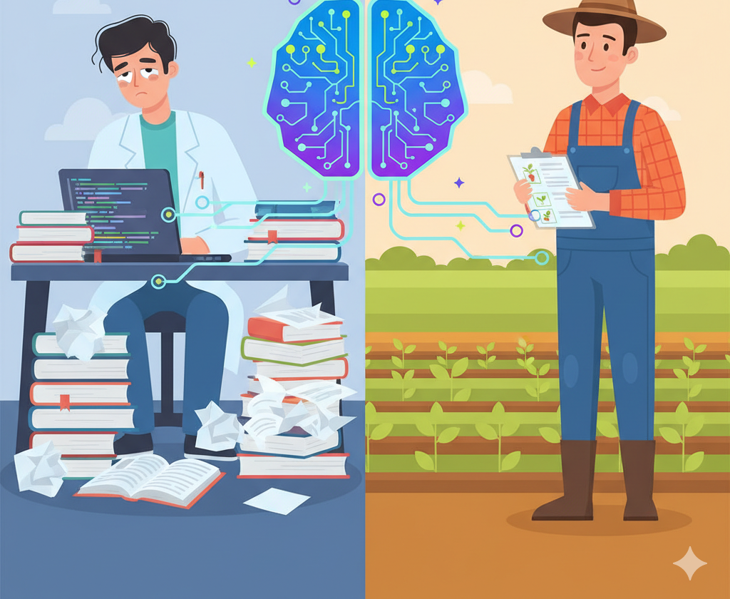
The "Aha!" Moment Identifying the Gap
The Disconnect:
Researchers have the knowledge but struggle with data volume and tooling.
Farmers have the practical need but lack real-time access to that knowledge.
The Vision:
What if a single solution could connect Expertise, Literature, and Data?
Goal: Shift focus from "Managing Data" to "Analyzing Insights."
The Proposed Solution:
An integrated platform where the latest academic literature informs real-time farm decisions.
Notes:
I noticed a pattern. I watched researchers burn hours fighting with data storage or manually organizing papers, often giving up on promising technologies. At the same time, I saw farmers entirely dependent on intermittent advice from vets because they didn't have easy ways to monitor their own production. I thought: 'What if I could build a solution that connects all this expertise—the latest literature, the lab data, and the farm records—in a way that lets everyone focus on what they do best?

Slide 5

The Researcher's Struggle
Challenge 1: Data Management Friction
Spending 80% of time collecting/formatting data and only 20% analyzing it.
Struggle with fragmented storage (USBs, local drives, legacy servers).
Challenge 2: Literature Overload
Traditional tools (e.g., Mendeley) are passive repositories, not active assistants.
Impossible to keep up with the exponential growth of new papers.
Challenge 3: Technology Abandonment
High learning curves lead to abandoning advanced analytics tools.
Reverting to manual Excel sheets limits discovery potential.
Notes:
Let's drill into the Researcher's problem. In my time at the stations, I saw brilliance slowed down by drudgery. Students would spend weeks just cleaning data or trying to find that one paper they read a month ago. Traditional reference managers weren't cutting it. The sheer volume of new literature is overwhelming, and when technology becomes a burden rather than an enabler, researchers revert to old, inefficient methods.

Slide 6
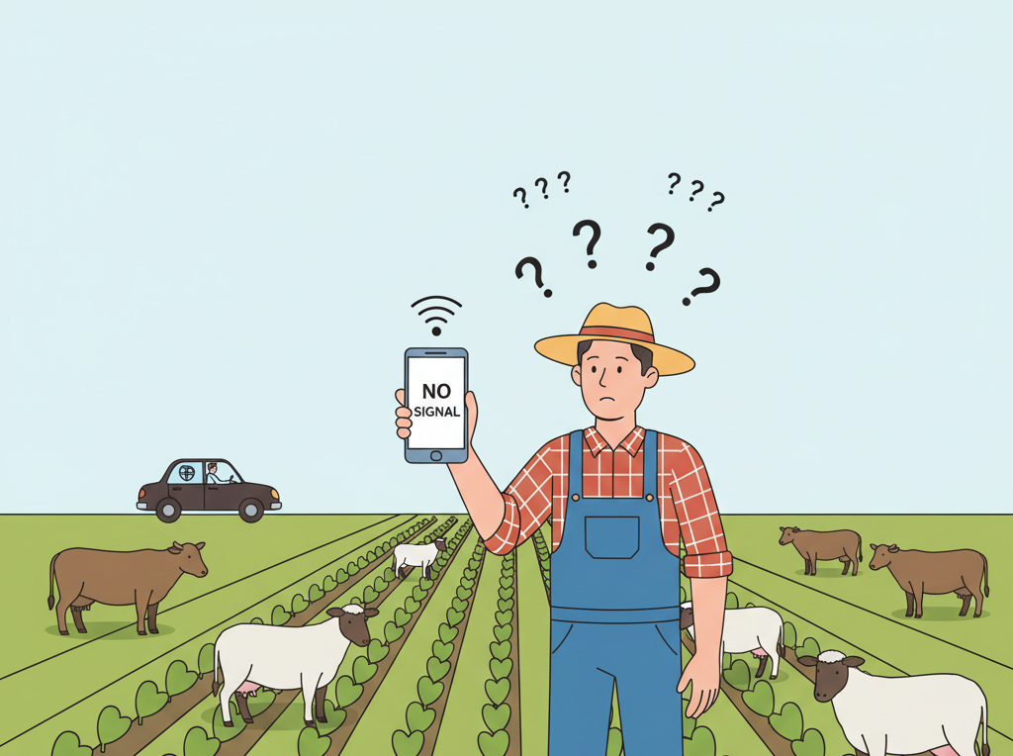
The Farmer's Operational Blind Spot
Challenge 1: Dependency on External Experts
Reliance on scheduled visits from technicians, veterinarians, or advisors.
Lack of autonomy in interpreting complex data.
Challenge 2: Reactive vs. Proactive
"Lag Time" in decision making: Disease or yield issues are often identified too late.
No easy way to monitor production metrics in real-time.
The Need:
A "Digital Advisor" that is available 24/7 to interpret data and flag risks immediately.
Notes:
On the other side of the fence, we have the farmers. They are making high-stakes decisions about breeding and disease management, but they are often flying blind. They rely heavily on periodic visits from technicians. If a problem arises between those visits, they might miss it until it's too late. They needed a way to monitor their own production and health metrics in real-time, without needing a degree in data science to understand the dashboard.

Slide 7
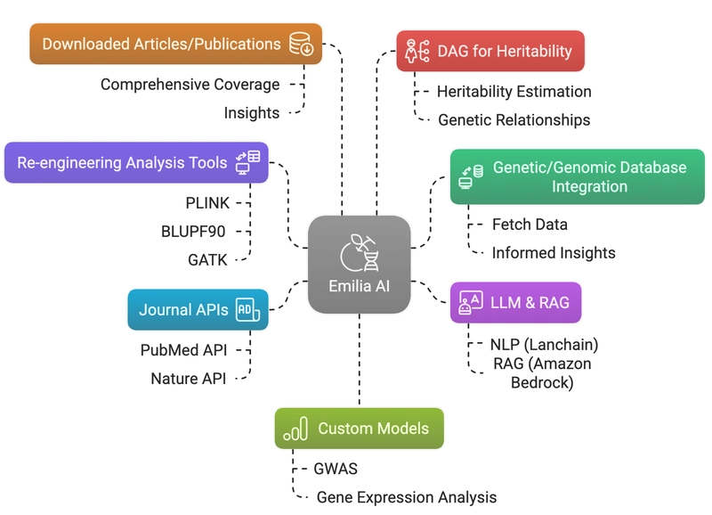
Connecting the Dots – ” Emilia AI " Agent Overview
A Unified Ecosystem:
Connects Lab (Genomics), Library (Publications), and Land (Farm Records).
Key Capabilities:
Automated Synthesis: AI scans thousands of papers to find relevant insights.
Context-Awareness: An "Expert on Demand" that knows the literature and the farm data..
User-Centric Design:
Advanced Analytics environments (JupyterHub) for Researchers.
Mobile-first, offline-capable dashboards for Farmers.
Notes:
That led to the idea of Emilia. I wanted to build a system that doesn't just store data but understands it. A platform where a researcher's latest findings on a genetic marker could immediately inform a farmer's breeding decision. To do this, I realized we needed more than just a database; we needed intelligence. We needed a way to automate the synthesis of knowledge. That’s where AI comes in.

Slide 8
GPT‑5.1‑Class Models: The Opportunity
Why GPT‑5.1‑class foundation models are exciting
Very strong at reasoning across long, complex documents.
Excellent at summarizing literature, explaining code, and handling multi‑step tasks.
Can generalize across domains: genetics, animal health, agronomy, economics.
What they can do for this platform
Read long genomic or trial reports and explain them in plain language.
Synthesize dozens of journal papers into a clear, structured overview.
Help design analysis workflows: suggest code, checks, and visualizations.
Ideal role for us
Use GPT‑5.1 as a general brain for understanding language and reasoning.
Let it handle “how to think,” while our own data provides “what to think with.”
Notes:
I want to start by acknowledging how powerful modern foundation models like GPT‑5.1 actually are. These models are extremely good at reasoning over long, messy inputs. They can read full genomic reports, trial summaries, and even code, and then turn that into clear, structured explanations. They can also synthesize dozens of research papers into a single, coherent overview, and even help design analysis workflows by suggesting code or sanity checks.
For a platform like ours, this is exactly what we want from an AI partner: a very strong general brain that understands language and can reason across genetics, animal health, agronomy, and more. In our design, GPT‑5.1 is the engine for ‘how to think’—how to reason—while our own data and tools give it the right information to think with.

Slide 9
GPT‑5.1 in Practice: Why We Chose a RAG‑First Path
Why we don’t self‑host GPT‑5.1
GPU cost: Requires many high‑end GPUs to serve low‑latency responses.
Operational load: 24/7 monitoring, scaling, security, model updates.
Trade‑off: Money and time pulled away from actual genetics and farm research.
Our practical decision
Use a managed GPT‑5.1‑class model via API (no GPUs for us to run).
Focus our engineering effort on a strong RAG layer:
Farm records, genomic analyses, trial data.
Journal APIs (PubMed, Nature, etc.) and internal documents.
Benefits of RAG‑first
Much lower infrastructure and maintenance cost.
Easy to update: change or add data sources instead of retraining the model.
Answers are grounded in our evidence, not the model’s guesses.
Notes:
However, when we move from theory to practice, there’s a big constraint: cost and operations. Running a GPT‑5.1‑class model yourself is not realistic for most research groups. You need racks of expensive GPUs, engineers to keep them running 24/7, security reviews, and constant upgrades. Every dollar and every hour we spend on that is a dollar and an hour we’re not investing in actual genetics and farming outcomes.
So we made a very intentional choice. We use a managed GPT‑5.1‑class model through an API, and we put our effort into building a strong Retrieval‑Augmented Generation layer around it. All the important knowledge—farm records, genomic analyses, trial results, and literature from sources like PubMed and Nature—lives in our own systems. The model becomes a reasoning engine on top of that. This RAG‑first strategy keeps our infrastructure simpler and cheaper, it makes the system easy to update as new data comes in, and most importantly, it keeps the answers grounded in real evidence instead of confident guesses.

Slide 10
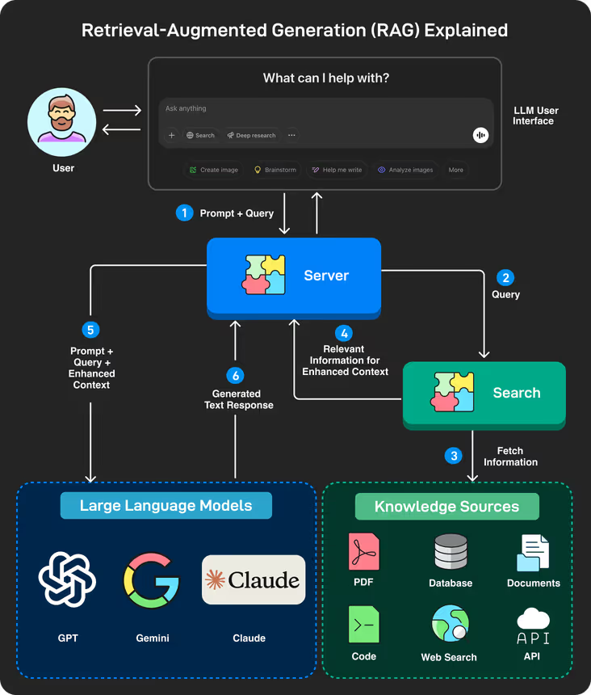
Retrieval‑Augmented Generation (RAG): Why It Matters
What is RAG?
Combines a large language model with a retrieval step over your own data.
Before answering, the model looks up relevant documents, records, or APIs.
The response is generated using that retrieved context, not just what the model remembers.
Why we need it (beyond pure foundation models)
Keeps answers up to date: Can use the latest reports, logs, and papers without retraining.
Domain grounding: Adapts a general model to any domain (genomics, finance, law, etc.) by pointing it at domain‑specific data.
Reduces hallucinations: The model is encouraged to rely on retrieved evidence instead of “making things up.”
Source: ByteByteGO
Notes:
Let me step back and introduce a concept that shows up again and again in real‑world AI systems: Retrieval‑Augmented Generation, or RAG. A standard language model answers based on what it learned during training. That can be powerful, but it’s also frozen in time and doesn’t know anything about your private data.
RAG adds a missing piece. Before the model answers, we run a retrieval step: we search across our own knowledge sources—databases, documents, APIs, logs—and pull back the most relevant pieces of information. Then the model is asked to answer using that evidence. So instead of guessing, it’s effectively doing an open‑book exam.
This matters for three reasons. First, it keeps answers fresh: as soon as new reports or papers are available, they can influence what the model says without retraining. Second, it grounds the model in a specific domain—whether that’s genetics, law, or finance—by pointing it at the right data. And third, it helps reduce hallucinations, because we can encourage the model to rely on retrieved evidence and even show the user which documents were used.
Later in the talk, I’ll show how we apply this idea in our own architecture, but at a high level, RAG is one of the key patterns that turns a general AI model into something you can actually trust in production.

Slide 11

The Importance of Cloud Computing
Why Cloud? (AWS)
Accessibility: Access from anywhere—Remote fields, Research Labs, or Home.
Agility: Rapid deployment of new features and updates.
Collaboration: Shared data environment for multi-institution projects.
Infrastructure as Code (IaC):
Automated setup of environments ensuring consistency (Dev, Test, Prod).
Removes "it works on my machine" issues.
Notes:
None of this AI magic matters if the system is offline when you need it. That brings us to the infrastructure. We built this on the cloud because agriculture doesn't happen in a single office. It happens in fields, in barns, and in labs across the country. We needed a system that is accessible from anywhere—whether you're on a tablet in a muddy field or a high-performance workstation in the university.

Slide 12

Scalability & High Availability
Scalability (Handling Growth):
Genomic Data Volume: Petabytes of sequencing data require elastic storage (S3).
Compute Power: Auto-scaling compute (Fargate) for heavy AI processing.
High Availability (Reliability):
Uptime: Critical for real-time farming decisions.
Redundancy: Deployed across multiple Availability Zones (AZs) to prevent outages.
Future Proofing:
Ready for next-gen sensors, IoT devices, and larger AI models.
Notes:
Finally, we had to design for scale. Genomic data is massive, and as we add more farms and more sensors, the data volume explodes. By leveraging cloud scalability—technologies like AWS Fargate and scalable databases—we ensure that the platform is fast and responsive today, but also ready for the future. We are building a foundation that can grow with the industry.

Slide 13
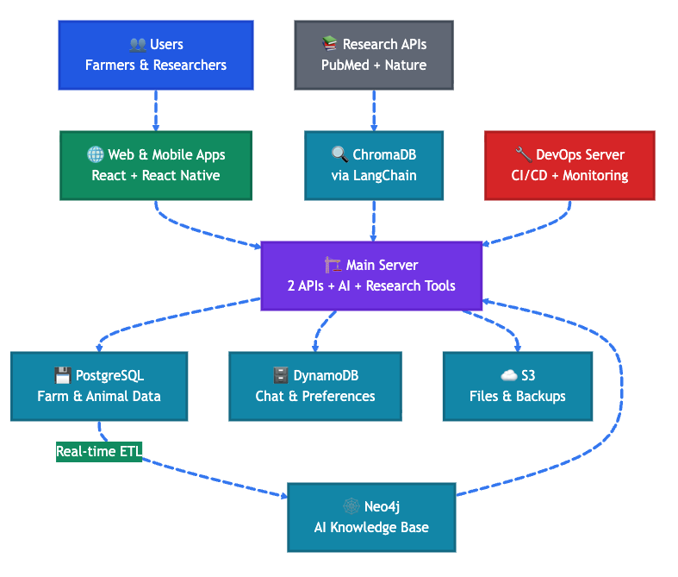
Simplified Architecture: Users, Apps, and Core Services
Users & Entry Points
Farmers & Researchers access the platform through:
Web application (React) for rich, desktop workflows.
Mobile / tablet app (React Native) for field use and quick checks.
Shared authentication and role‑based access (farmer, technician, researcher, admin).
Web & Mobile Apps
Unified design system so the experience feels consistent across devices.
Capture questions, upload files, view dashboards, and interact with the AI agent.
Offline‑friendly patterns for poor connectivity in remote research stations or farms.
Main Server (“2 APIs + AI + Research Tools”)
Operational API: farm, animal, production and management endpoints.
AI & Research API: chat with Emilia, recommendations, literature search.
Hosts AI orchestration: calling GPT‑5.1‑class model, RAG flows, and analysis tools.
Notes:
In this first architecture slide, I want to focus on how people actually touch the system. We have two main user groups: farmers and researchers. They come in through a React web app for rich, desktop workflows, and a React Native mobile app for field work, barn checks, and quick lookups. Both apps share the same authentication and roles, so the experience is consistent whether you’re in an office or in a muddy field.
Those apps talk to what we call the main server. This is the central brain on the backend. It exposes two main families of APIs. The operational API handles the everyday work—farm, animal, and production data. The AI and research API is where Emilia lives: it powers chat, recommendations, and literature search. This is also where we orchestrate calls to the GPT‑5.1‑class model and plug in the RAG flows and research tools that you’ll see later.

Slide 14
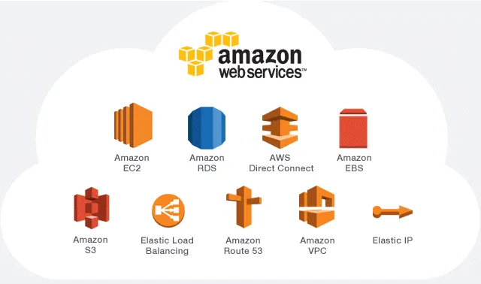
Simplified Architecture: Data, Knowledge, and Operations
Data & Knowledge Stores
PostgreSQL: canonical store for farm, herd, trial, and operational data.
DynamoDB: chat sessions, user preferences, and agent state for fast lookups.
S3: documents, reports, uploads, backups, and large artifacts.
Neo4j: graph of relationships between animals, traits, trials, and literature.
ChromaDB via LangChain: vector database for RAG over documents and journal content.
External Intelligence & Integrations
Research APIs: PubMed, Nature, and others feeding papers into ChromaDB.
Managed GPT‑5.1‑class foundation model accessed via API as the reasoning engine.
Connectors / ETL jobs to keep operational data and knowledge base in sync.
Delivery & Operations (High‑Level)
Containerized services for the main server and supporting components.
CI/CD pipeline to build, test, and deploy changes safely.
Monitoring and logging across APIs, databases, and AI calls for reliability.
Notes:
The second architecture slide focuses on what sits underneath that main server. At the core we have our data and knowledge stores. PostgreSQL is the source of truth for farm, herd, and trial data. DynamoDB keeps track of chat sessions, user preferences, and the agent’s short‑term state so we can respond quickly. S3 holds the heavier artifacts—reports, uploads, and backups.
On top of that, we add smarter layers. Neo4j captures the graph of relationships between animals, traits, trials, and publications. ChromaDB, connected through LangChain, is our vector store for Retrieval‑Augmented Generation over documents and journal content. From the outside world, research APIs like PubMed and Nature continuously feed new papers into this knowledge layer, and a managed GPT‑5.1‑class model provides the reasoning engine via API.

Slide 15
AWS Building Blocks Behind Emilia
Data & Databases
Amazon DocumentDB – application users, chat history, configuration.
Amazon RDS for PostgreSQL – genetics warehouse: animals, traits, trials, analytics data.
Compute & Containers
Amazon ECS (Fargate) – two containerized backends (user‑backend + main‑backend).
Amazon ECR – stores versioned Docker images for those services.
Amazon EC2 – used as a secure jump/bastion host to reach DocumentDB in a private subnet.
Networking & Access
Application Load Balancer (ALB) – routes HTTPS traffic to the ECS services, handles health checks.
Elastic IP (EIP) – stable public IP for the EC2 jump host.
Edge, DNS & Security
Amazon CloudFront – global edge layer for HTTPS, caching, and SSL termination for the frontend / API domain.
Deployment & Operations
AWS Copilot CLI + CloudFormation – define and deploy ECS services, load balancers, and environments as code.
AWS CLI – scripting, troubleshooting, and ad‑hoc operations from the terminal.
Notes:
This slide summarizes the main AWS services that sit underneath the platform.
For data, we use Amazon DocumentDB to store application users, chat history, and configuration, and Amazon RDS for PostgreSQL as our internal genetics warehouse for animals, traits, trials, and analysis results.
For compute, both the user‑backend and the main‑backend run as containers on Amazon ECS using Fargate, with their images stored in Amazon ECR. Where we need direct access into the private network—for example to reach DocumentDB securely—we use a small EC2 instance as a controlled jump or bastion host.
Traffic comes in through an Application Load Balancer, which terminates HTTP(S), runs health checks, and routes requests to the right ECS service. An Elastic IP gives us a stable address for the jump host when we need operational access. At the edge, Amazon CloudFront provides global distribution, caching, and SSL for the frontend and API entrypoints.
Finally, everything is deployed and managed as code. We use the AWS Copilot CLI, which generates and updates CloudFormation stacks for our ECS services and environments, and the AWS CLI for scripting, diagnostics, and one‑off operational tasks. Together, these services give us a secure, scalable foundation without having to hand‑manage infrastructure for every component.

Slide 16
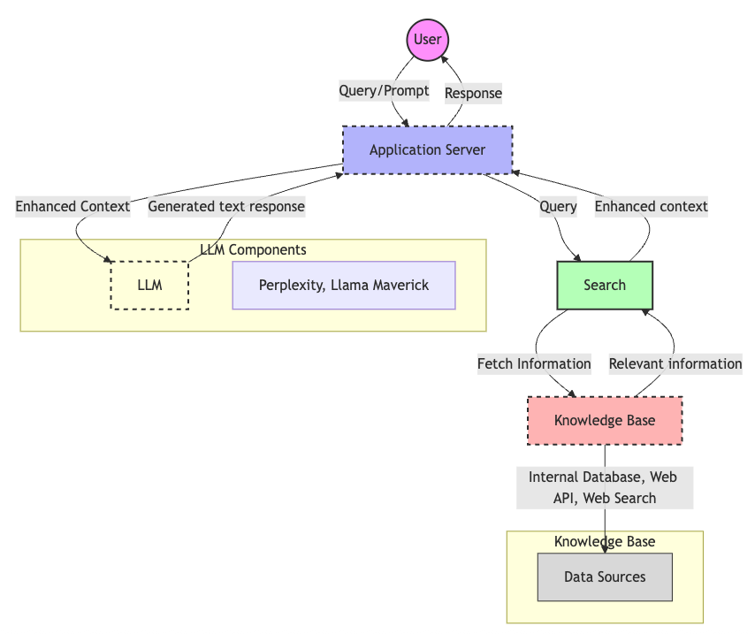
Proposed Emilia AI Agent Orchestrating Action
From Chatbot to Agent
Chatbot → single reply, no real tools
Agent → plans, calls tools, iterates
Core Flow (from arch‑overview)
User → Application Server → Search
Search → Knowledge Base → back to Server
Server → LLM with enriched context → User
Toolset
Literature APIs (PubMed, Nature, etc.)
Data analysis (Python sandbox / notebooks)
Database connectors (PostgreSQL, other stores)
Notes:
In this slide, I want to show how Emilia behaves as an agent, not just a chatbot.
A simple chatbot takes your message, generates a single reply from the model, and that’s it. It doesn’t really do anything in the world. Emilia, by contrast, follows the flow you see in the architecture diagram.
When a user asks a question, the request first goes through the application server. The server doesn’t immediately call the LLM: it calls a search component that looks into our knowledge base—this includes internal data, indexed documents, and external research sources. The search component fetches the most relevant information, sends it back to the server, and only then does the server call the LLM with this enriched context. The final answer is returned to the user with that extra understanding baked in.
As an agent, Emilia can also choose from a set of tools. She can talk to literature APIs like PubMed or Nature to fetch new papers, spin up a Python environment for quick analysis or plotting, and query databases like PostgreSQL and other internal stores. So instead of just generating text, Emilia is orchestrating a small workflow: plan, retrieve, analyze, and then explain.

Slide 17
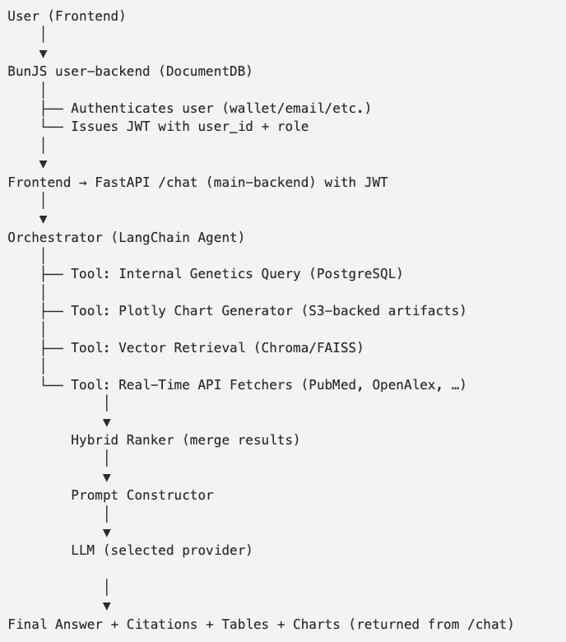
Current Emilia Agent Workflow (Orchestration Level)
Intent Intelligence
Analyze each question: database vs research vs mixed
Decide: table, chart, plain answer, or citations
Data & Tool Orchestration
Internal tools: genetics DB queries, Plotly chart builder
External tools: literature RAG (Chroma + PubMed / OpenAlex / Nature APIs)
Natural Language + Artifacts
Combine results into:
Clear explanation in natural language
Structured tables and charts
Research citations only when relevant
Notes:
I want to show what Emilia is doing inside when you send a message—at the orchestration level.
The first thing that happens is intent intelligence. The agent doesn’t just blindly forward the text to a model. It runs an intent analysis step that classifies the question: is this primarily a database question, a literature question, or a mix of both? It also decides whether the user is really asking for a table, a chart, or just a narrative explanation. That same intent model is what lets us, for example, show citations only for true research questions and not when you’re just asking for a simple database count.
Based on that intent, the orchestrator then chooses the right tools. For internal data questions, it uses our genetics tools to query PostgreSQL and, when appropriate, passes those results into a Plotly chart generator. For research questions, it uses the RAG system: vector retrieval from Chroma plus real‑time calls to APIs like PubMed, OpenAlex, or other literature sources. For mixed questions, it can do both—pull internal stats and external papers—and merge them.
Finally, Emilia turns everything into a response that’s easy to consume. The orchestrator shapes the output into natural language plus artifacts: a clear explanation in plain language, structured tables and charts when they help, and a citation block only when the intent and the data actually justify it. This is the same flow we hardened during our frontend table and chart refinement work, where we made sure that database queries show clean tables and charts, and research queries show clean citations, without mixing the two by accident.

Slide 18
Emilia Enhanced Features in /chat
Natural‑language data access
Ask questions like “Count animals by sex” or “Top 10 breeds by growth” in plain English.
LangChain SQL agent translates to safe SQL and returns structured tables.
Data‑aware analysis & visualization
Summaries that understand the table content (not just echoing rows).
Interactive Plotly charts: trends, distributions, PCA, GWAS plots, etc.
Built‑in statistical tooling
Regression, random forest, and Q‑Q plots available as tools behind /chat.
Results come back as explanations plus charts you can inspect and reuse.
Research & code integration
RAG over scientific literature (e.g., arXiv and journal sources) for research‑style queries.
Copyable code snippets with syntax highlighting for reproducing analyses.
Notes:
First, the system supports natural‑language SQL. That means farmers and researchers can ask questions like ‘Count animals by sex’ or ‘Show me the top 10 breeds by growth’ in plain English. A LangChain SQL agent interprets the query, generates the appropriate SQL, and returns structured tables, not just raw text.
On top of that, we added data‑aware summarization and visualization. Emilia doesn’t just dump rows; she understands what’s in the table and produces short explanations, and when it makes sense, she returns interactive Plotly charts—for trends, distributions, PCA plots, or even GWAS Manhattan plots.
For more advanced users, we’ve wired in statistical tools behind the scenes: regression, random forest models, Q‑Q plots and similar analyses can be triggered through /chat, with the results coming back as both charts and narrative explanations.
The research side is handled by a RAG layer over scientific literature, including arXiv and other journal sources, so when the intent is research‑oriented, Emilia can pull in relevant papers and cite them. And for people who want to reproduce or extend the work, the responses can include copyable code snippets with syntax highlighting.
Finally, all of these features are controlled via simple feature flags in the environment—LLM in chat, the LangChain summarizer, charts, and RAG are all enabled by default, but we can turn them on or off per environment to manage cost or experiment safely.

Slide 19
How Emilia Helps Farmers
Decision support in plain language
Explains complex genetic and production metrics in farmer‑friendly terms.
Guides breeding, culling, and health decisions with clear “next‑step” suggestions.
Data & visualization from their own herd
Turns raw records into charts: milk yield, growth, fertility, culls, disease events.
Highlights outliers and risk animals instead of just listing numbers.
Examples of “hard” questions Emilia can handle
“Show me a simple graph of test‑day milk weight for each cow over the last 6 months and highlight any animals below herd average.”
“Based on my herd and current proofs, which sires are best for improving fertility in these heifers?”
“Given this health and insemination history, when is the best window for artificial insemination for animal X?”
“Compare performance of animals on pasture vs TMR in my farm and show it as a chart.”
Notes:
For farmers, Emilia is designed to feel like a knowledgeable advisor that lives inside their own data. Instead of dumping tables or genetic codes on them, she translates everything into plain language and very specific next steps.
Because the platform has access to the farm’s own records in PostgreSQL and can generate visualizations with Plotly, farmers can ask for concrete views of their herd: for example, ‘Show me a graph of test‑day milk weight for each cow over the last six months and highlight anyone below the herd average.’ Emilia will query the genetics database, build the table, and return a clear chart that makes those animals obvious.
They can also ask more strategic questions, like ‘Based on my herd and the current proofs, which sires are best for improving fertility in this group of heifers?’ or ‘Given this animal’s health and insemination history, when is the best window for AI?’ Behind the scenes, the agent uses intent detection to recognize that these are database‑plus‑analytics questions, calls the internal genetics tools, and only then generates a recommendation in simple language.
The key idea is that farmers don’t need to know SQL, statistics, or genetics jargon. They just describe what they want to see or decide, and Emilia uses the data, charts, and rules we’ve built to support that decision in a way that’s accessible from a phone in the barn or a laptop in the office.

Slide 20
How Emilia Helps Researchers
Faster analysis on internal genetic data
Natural‑language access to complex schemas (traits, SNPs, proofs, trials).
Auto‑generated tables and charts: PCA, Manhattan plots, distributions, time series.
Context‑aware literature & RAG
Hybrid RAG over Chroma + real‑time journal APIs (PubMed, OpenAlex, Nature, etc.).
Merges internal results with external papers in one coherent answer.
Examples of “hard” questions Emilia can handle
“Run a PCA on growth and carcass traits for this cohort and show me clusters by breed, with a scatter plot.”
“Explain the top SNPs influencing this GWAS peak and list recent papers that discuss those markers in similar environments.”
“Compare fertility traits for my high‑risk group against published benchmarks and summarize any gaps.”
“Find the latest open‑access papers on heat‑stress tolerance in dairy cattle and relate them to our trial data from 2023.”
Notes:
For researchers, Emilia is less of a tutor and more of a collaborator. She understands the internal genetics schema in PostgreSQL, and she has tools to generate tables and visualizations directly from that data. That means a researcher can say something like, ‘Run a PCA on growth and carcass traits for this cohort and show me clusters by breed,’ and Emilia will not only run the internal query, but also return a properly structured table and a PCA scatter plot that renders right inside the chat interface.
Where it becomes especially powerful is when we combine internal analysis with external research. The agent uses a hybrid RAG system over Chroma and a set of real‑time APIs—PubMed, OpenAlex, Nature, and others. So a question like, ‘Explain the top SNPs influencing this GWAS peak and list recent papers that discuss those markers in similar environments,’ triggers two paths: one to summarize the internal GWAS results from PostgreSQL, and another to fetch, rank, and embed relevant literature. The final answer explains the pattern in the internal data and cites specific papers that support or challenge those findings.
Researchers can also ask context‑aware questions such as, ‘Compare fertility traits for my high‑risk group against published benchmarks,’ or ‘Find the latest open‑access work on heat‑stress tolerance in dairy cattle and relate it to our 2023 trial data.’ Because of the role‑aware design in the user‑backend, Emilia knows when the user is acting as a researcher and adjusts the level of detail, the type of tools she uses, and the style of explanation accordingly. The end result is less time spent wiring data and hunting PDFs, and more time interpreting results and designing the next experiment.

Slide 21
Future Roadmap: Advanced Research & Behaviour Analytics
Dedicated cloud research environments (not implemented yet)
RStudio Server and JupyterHub workspaces tied to platform logins and roles.
Users can bring their own data (farm spreadsheets, trial CSVs) and combine it with platform genetics data.
Runs on auto‑scaling AWS infrastructure, so users can analyse large‑scale datasets without being limited by laptop CPU/RAM.
Animal behaviour video analysis (not implemented yet)
Live video ingestion from barn / pen cameras.
Computer vision models to auto‑annotate behaviours (lying, feeding, standing, lameness, social interactions).
Replaces manual tools like BORIS by using computer vision models to automatically extract structured animal behaviour data from video.
Why this matters
One environment for personal data, platform data, and cloud‑scale compute.
Connects behaviour, genetics, and environment for more powerful questions and models.
Notes:
The first big item on the roadmap is a dedicated cloud research environment. Instead of only using the central chat interface, each user would have access to RStudio Server or JupyterHub workspaces that are tied to their platform account and role.
Inside that environment, they won’t be restricted to just the genetics database. They can bring their own data—farm spreadsheets, trial CSVs, exported sensor data—and combine it with the platform’s internal genetics tables. Because these workspaces run on auto‑scaling AWS infrastructure, they aren’t limited by laptop memory or CPU. If a researcher wants to run a heavy GWAS on millions of records or a long simulation, it runs on scalable servers rather than freezing their machine.
Alongside that, we’re planning animal behaviour video analysis. Today, tools like BORIS require a lot of manual annotation. Our goal is to stream video from barn or pen cameras, run computer‑vision models to automatically label behaviours like lying, feeding, or signs of lameness, and feed those annotations back into the same data platform. Then Emilia can answer questions like, ‘Compare lying time and milk yield for cows flagged as lame versus healthy,’ combining behaviour data with genetics and production.
These pieces aren’t live yet, but they show where we’re going: a dedicated, cloud‑scale environment where users can analyse their own data plus large shared datasets, with Emilia helping them at every step.

Slide 22

Demo Time !!!
Prod: app.naratech.ca Dev: dev-app.naratech.ca
Notes:
Thank you all for your time and attention today. My goal with Emilia is to connect genetics, behaviour, and farm data with a RAG‑driven AI agent so that both farmers and researchers can spend less time fighting with tools and more time making decisions. If you’re interested in collaborating—whether that’s piloting the platform on a farm, integrating it into a research project, or involving students—I’d love to talk. I really value your feedback and ideas. Thanks again, and I’m happy to take any questions.

