Slide 1
Session - 3
02-APRIL-2021

Slide 2
Python - Functions …. Continuation
We create functions broadly with two intention ….
First, To do some operations and return nothing (this is called void function on other languages).
Second, To do some operations and return a value as a result of that operations (this is function that returns some value(datatype/object).
“return” keyword is used to return some value(s) from function
The “return” statement terminates the function call and returns a value to the caller.
The “return” statement without an expression argument returns “None”, and a function without a “return” statement also returns “None”.
02-APRIL-2021

Slide 3
Python - Functions ….
Example: 1 (Function not implemented)
def add():
pass
print(add())
#Output:None
————————————————————
Example: 2 (Return statement not reached)
def add(a,b):
c=a+b
if c>10:
return c
print(add(1,2))
#Output:None
———————————————————-
Example: 3 (No return statement)
def add(a,b):
c=a+b
print(add(1,2))
#Output:None
02-APRIL-2021

Slide 4
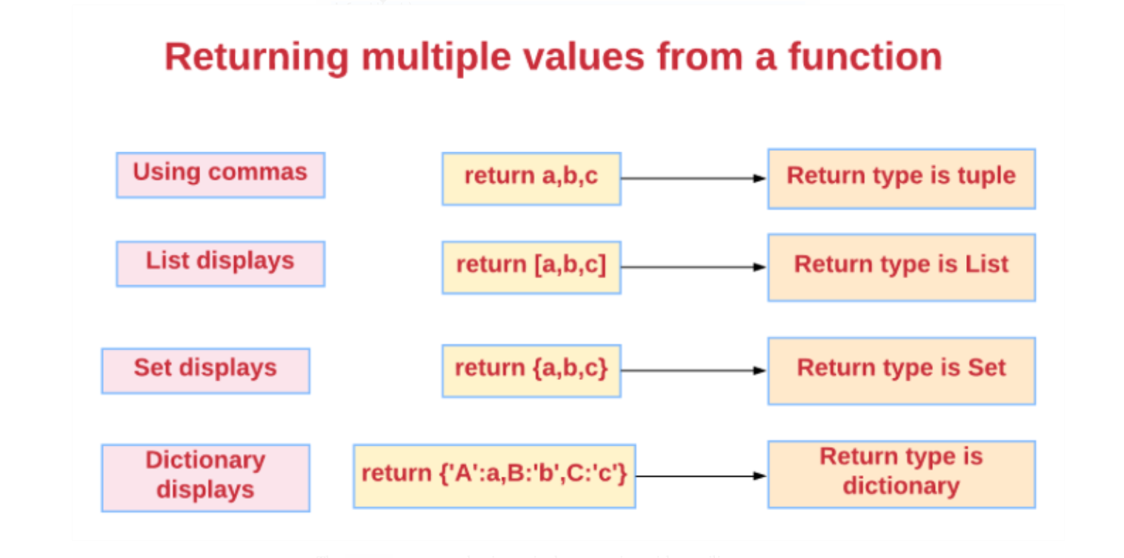
Python - Conditional Loops
02-APRIL-2021

Slide 5
Python - Functions ….
def add(a,b): ——————> The return type is a tuple.
result=a+b
return a,b,result
print(add(1,2))
#Output:(1,2,3)
def add(a,b): —————-> The return statement having a single expression with a trailing comma returns a tuple.
result=a+b
return result,
print(add(1,2))
#Output:(3,)
def calc(a,b): —————> Returning multiple values using list displays
sum=a+b
dif=a-b
mul=a*b
div=a/b
return [sum,dif,mul,div]
print(calc(5,4))
#Output:[9, 1, 20, 1.25]
02-APRIL-2021

Slide 6
Python - Functions ….
def calc(a,b): ————————> Returning multiple values using dictionary displays
sum=a+b
dif=a-b
mul=a*b
div=a/b
return {"Addition":sum,"Subtraction":dif,"Multiplication":mul,"Division":div}
print(calc(5,4))
#Output:{'Addition': 9, 'Subtraction': 1, 'Multiplication': 20, 'Division': 1.25}
———————————————————————————————————
def calc(a,b): -———————> Returning multiple values using set displays
sum=a+b
dif=a-b
mul=a*b
div=a/b
return {sum,dif,mul,div}
print(calc(5,4))
#Output:{9, 20, 1, 1.25}
02-APRIL-2021

Slide 7
Python - Functions ….
def add(a,b): —————————————> Returning a single value from a function
result=a+b
return result
print(add(1,2))
#Output:3
print(add("Hello ","Python"))
#Output:Hello Python
print(add([1,2],[3,4]))
#Output:[1, 2, 3, 4]
print(add((1,2),(3,4)))
#Output:(1, 2, 3, 4)
———————————————————-
def num(a): —————————————-> Multiple ‘return’ statements in a single function
if a%2==0:
return "Even Number"
else:
return "Odd Number”
print(num(5))#Output:Odd Number
print(num(30))#Output:Even Number
02-APRIL-2021

Slide 8
Python - Functions
‘return’ vs. ‘print’ statements inside a function
The return statement will terminate the function call and return the value to the caller.
The print statement will just print the value.
We can’t assign that result to another variable or pass the result to another function.
def add(a,b):
r1=a+b
return r1
def sub(c,d):
r2=c-d
return r2
#We can assign the return value to a variable
r3=add(3,4)
print(r3)#Output:7
#We can pass the return value to another function also.
print(sub(r3,5))#Output:2
02-APRIL-2021

Slide 9
Python - packing and unpacking
Packing means collecting several values into a single variable (tuple), Example: a=‘red’,’square’,’apple’
Unpacking means extracting those values into different variables.
Example: color, shape, fruit = a
02-APRIL-2021

Slide 10
Python - Packing, Unpacking Python Tuples
While unpacking, we have to mention the number of variables equal to the length of the sequence (list/tuple).
#tuple packing
emp_info='Python',5,'Developer'
print (emp_info)
#Output:('Python', 5, 'Developer')
print (type(emp_info))
#Output:<class 'tuple'>
#tuple unpacking
skill,exp,role=emp_info
print (skill)#Output:Python
print (exp)#Output:5
print (role)#Output:Developer
02-APRIL-2021

Slide 11
Python - Unpacking Python List, Range Object
Unpacking the elements of one Python list
emp_info=['Python',5,'Developer']
#List unpacking
skill,exp,role=emp_info
print (skill)#Output:Python
print (exp)#Output:5
print (role)#Output:Developer
Unpacking two Python lists to a single tuple/list
even=[2,4,6,8]
odd=[1,3,5,7,9]
num= *even,*odd
print (num)
#Output:(2, 4, 6, 8, 1, 3, 5, 7, 9)
02-APRIL-2021

Slide 12
Python - Unpacking Python List, Range Object
#unpacking range object
a,b=range(0,2)
print (a) #Output :0
print (b) #Output: 1
02-APRIL-2021

Slide 13
Python - Extended Iterable Unpacking
While unpacking, we have to mention the number of variables equal to the length of the sequence (list/tuple).
To overcome this, we can use extended iterable unpacking.
Extended unpacking uses the * operator.
A variable preceded by the * operator is used for extended unpacking.
It will be a list containing all elements from the iterable that is not assigned to variable names.
first,*rest — It will unpack the first element to first and all the remaining elements to rest. rest will be a list of all items except the first element.
first,*middle, last — It will unpack the first element to first and the last element to last. The remaining elements will be a list of all items except the first and last elements.
*rest, last — It will unpack the last element in last and all the remaining elements to rest. rest will be a list of all items except the last element.
02-APRIL-2021

Slide 14
Python - Extended Iterable Unpacking
# Extended unpacking (tuples)
num=[1,2,3,4,5]
#unpacking only first and second element. Remaining all elements to be captured in a list
a,b,*c = num
print (a)#Output: 1
print (b)#Output: 2
print (c)#Output: [3,4,5]
# Extended unpacking (lists)
num=[1,2,3,4,5]
#unpacking only first and second element. Remaining all elements to be captured in a list
a,b,*c = num
print (a) #Output: 1
print (b) #Output: 2
print (c) #Output: [3,4,5]
02-APRIL-2021

Slide 15
Python - Extended Iterable Unpacking
#unpacking first and rest of elements
num=(1,2,3,4,5)
first,*rest= num
print (first)#Output: 1
print (rest)#Output: [2,3,4,5]
#unpacking first,middle,last elements
num=(1,2,3,4,5)
first,*middle,last= num
print (first)
#Output: 1
print (middle)
#Output: [2,3,4]
print (last)
#Output: 5

Slide 16
Python - Extended Iterable Unpacking
Ignoring Single Value While Unpacking Tuples/Lists
If we want to ignore a single value while unpacking, we can mention _.
#ignoring value "green" while tuple unpacking
t=("red","green","blue")
t1,_,t2=t
print (t1)#Output:red
print (t2)#Output:blue
Ignoring Multiple Values While Unpacking Tuples/Lists
If we need to ignore multiple values while unpacking, we can mention *_.
#Ignoring multiple values in tuple unpacking
num=[1,2,3,4,5,6]
#Ignoring all values except first and last element in tuple.
t1,*_,t2=num
print (t1)#Output: 1
print (t2)#Output: 6

