Slide 1
Session - 1
02-APRIL-2021

Slide 2
Python - IDEs
https://www.python.org/downloads/ (Download latest version of python according to convenient OS)
There are many IDEs that can be used for python development / script development
IDLE (Native IDE, comes with python package itself)
Pycharm community edition. (My preference).
VIM (can also be configured to jel with python)
Feel free to use any IDE of your choice.
02-APRIL-2021

Slide 3
Python - Keywords
Keywords are the very first things we need to learn from any Language.
Python keywords is generally stored in python keywords library.
import keywords
keywords.kwlist
['False', 'None', 'True', 'and', 'as', 'assert', 'async', 'await', 'break', 'class', 'continue', 'def', 'del', 'elif', 'else', 'except', 'finally', 'for', 'from', 'global', 'if', 'import', 'in', 'is', 'lambda', 'nonlocal', 'not', 'or', 'pass', 'raise', 'return', 'try', 'while', 'with', ‘yield']
02-APRIL-2021

Slide 4
Python - Builtins
https://docs.python.org/3/library/functions.html
Builtins - are directly available functions or readymade functions, which can be used without importing it.
At the time of taking session below are the list of builtins available in python (3.9.2)
02-APRIL-2021

Slide 5
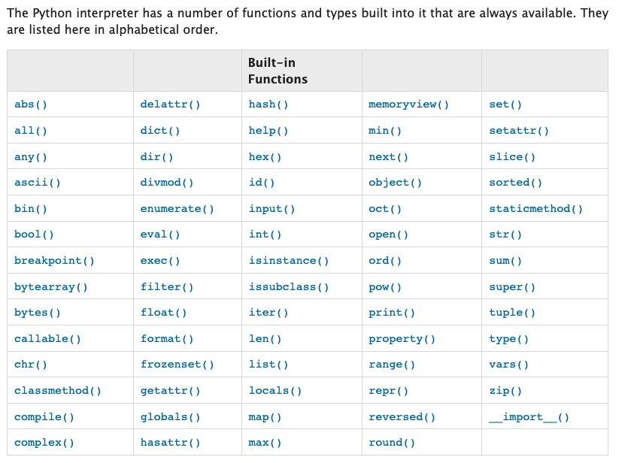
02-APRIL-2021

Slide 6
Python - Variables
What are Variables ?. Variables are used to store information to be referenced and manipulated in a computer program. ... It is helpful to think of variables as containers that hold information Example:
name = “Lunus Torvalds” name = ‘Lunus Torvalds’ name = Lunus Torvalds’
num = 1
numbers = [ 1, 2. 3, 4, 5 ]
02-APRIL-2021

Slide 7
Python - Data Types
Data Groups | Individual Data Types
Scalar Data Types | Integer, Float, Complex Numbers, Bool, None
Sequence Types | String, List, Tuple, Set
Map Types | Dictionary
Immutable Data Types | Mutable Datatypes
String, Tuple | List, Dictionary, Set

Slide 8
Python - Data Types
Numbers (Integers, BigNumber) num = 89
Floats (This datatype also not much used in devops landscape) gdp = 4.8 Sequences/Iterables
string name = “Shiva” gotchas: 1. String is an immutable object. 2. String is a character sequence. 3. String elements can be accessed by indexing.
02-APRIL-2021

Slide 9
Python - Data Types
List
Sequence of Elements. country_capital = [ “India”, “USA”, “UK”] gotchas: 1. List can hold elements of any data type in it. 2. List is ordered sequence.
3. List elements can be duplicated. 4. Elements of List can be accessed by its index.
02-APRIL-2021

Slide 10
Python - Data Types
Dictionaries
Dictionary (key, value) pairs. country_capital = { “India”: “delhi”, “USA”: ”Washington”, “UK”:London } gotchas: 1. Dictionary can hold elements of any data type in it. 2. Keys are unique in a dictionary 3. Dictionary is un-ordered sequence. 4. Elements of dictionary can be accessed by its key.
02-APRIL-2021

Slide 11
Python - Data Types
Set countries = {“India”, “USA”, “UK”, “Germany”} Gotchas: 1. Its elements are unique (duplicate elements will be erased). 2. It is un-ordered sequence. 3. Since it is un-ordered sequence, Indexing is not possible. 4. It can hold elements of any data type.
02-APRIL-2021

Slide 12
Python - Data Types
Tuples prime_numbers = (1,2,3,5,7)
Gotchas: 1. It allows duplication. 2. It is an ordered sequence. 3. It allows indexing. 4. It is an immutable object.
Complex numbers … (generally not used in devops landscape).
02-APRIL-2021

Slide 13
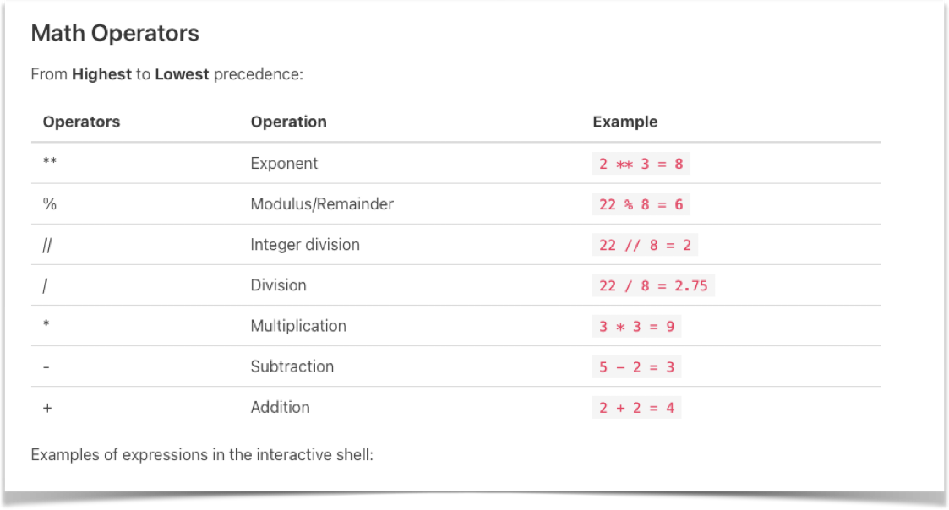
Python - Operators
02-APRIL-2021

Slide 14
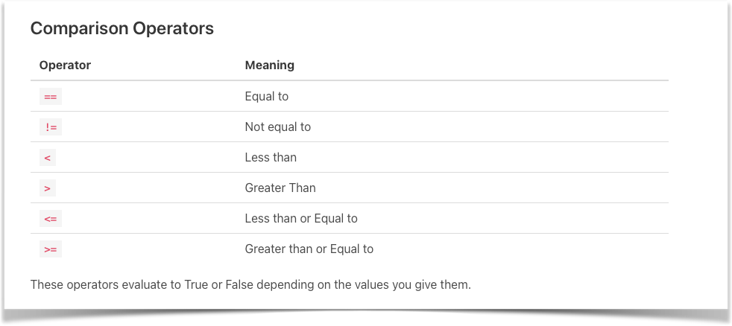
Python - Operators
02-APRIL-2021

Slide 15
Python - Boolean & emptiness
True and False are two explicit boolean constants.
They can even be assigned to any variable.
None is another special constant in python which can represent emptiness or null in python.
None can also be assigned to any variable.
02-APRIL-2021

Slide 16
Python - Strings
Python Strings are sequence of characters.
They can be represented in single quotes or double quotes or triple quotes.
They are immutable. Example: lang = “python” text = “””Hi All Deployment of {0} version:{1} is completed in {2} Environment. Please reach out to deployment Team in case of any issues. Thanks Mr.Jenkins “””
02-APRIL-2021

