Slide 1
Terraform Basics
Terraform Basics

Slide 2
Terraform Variables
Terraform variable types
Simple Variable Types:
Complex Variable Types: Note: you don’t have to specify the type in variables, but it’s recommended

Slide 3
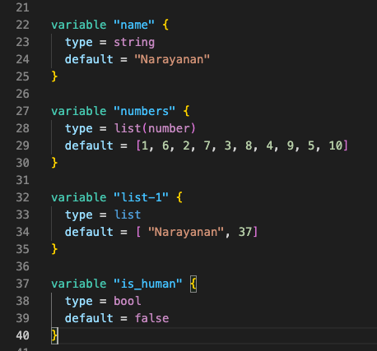
Terraform Variables
Simple Variable Types
String
Number
Bool Example:

Slide 4
Terraform Variables
Complex variable types
List(type)
Set(type)
Map(type)
Object({<ATTR NAME> = <TYPE>, …})
Tuple([<TYPE>,…])

Slide 5
Terraform variables
References: https://dev.to/pwd9000/terraform-complex-variable-types-173e

