Slide 1

Dropout analysis of students
Sustar

Slide 2

Agenda
Explore the factors contributing to student dropout rates in schools and colleges and discover effective strategies for reducing these rates.

Slide 3

Introduction
Purpose of the Presentation
  Learn why students drop out and understand the importance of addressing this issue.
Importance of Understanding Dropout Rates
  Discover the long-term effects of dropout rates on individuals and society as a whole.

Slide 4

Analysis of Dropout Students
Factors Contributing to Dropout Rates
Identify the key factors that influence students to drop out of
school or college.
Demographic Analysis of Dropout Students
Explore how dropout rates vary based on area, gender, school type,
debtor, and age.

Slide 5
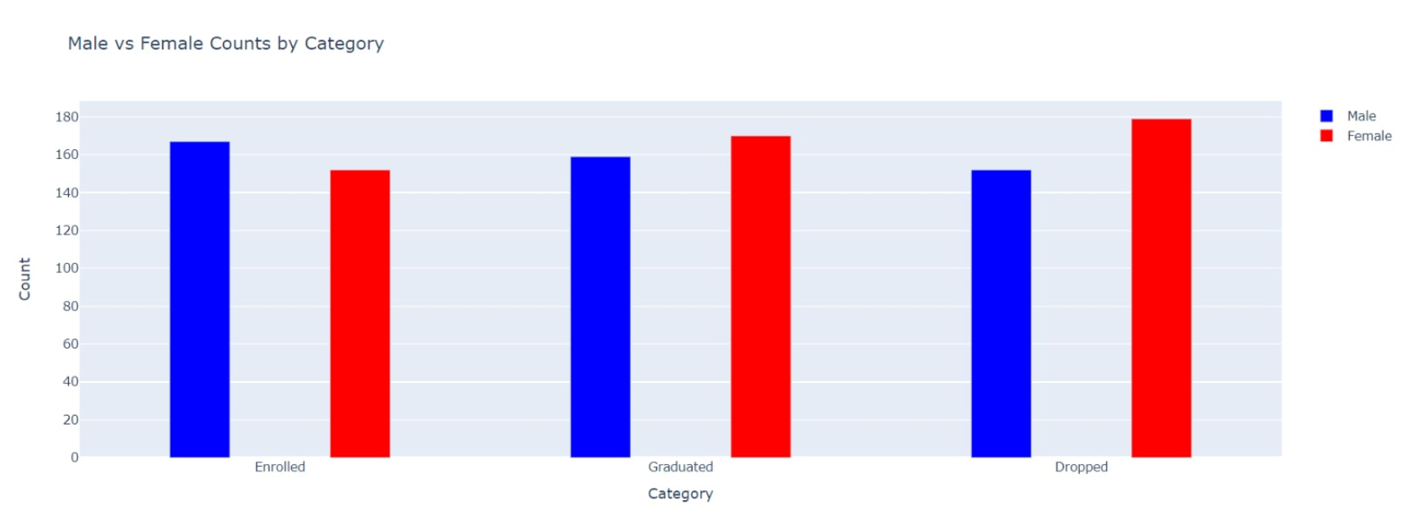
Graphical Presentation of Dropout Analysis

Slide 6
Solution to Reduce Dropout Rates
Strategies for Improving Retention
Discover effective methods to enhance student engagement and create a supportive learning environment.
Interventions to Address Specific Dropout Risk Factors
Explore targeted interventions to help students overcome challenges that may lead to dropping out.

Slide 7

Summary of the Presentation
Recap the main points discussed and highlight the importance of addressing student dropout rates.
Call to Action for Addressing Dropout Rates
Encourage individuals, NGO, schools, and institutions to take action in reducing dropout rates and supporting student success.

Slide 8




Meet our team
Shekhar
Shrivas
Shravan
ram
Divyansh
mishra
Narayan
jat

Slide 9
THANK YOU

