Slide 1

What is Jenkins

Slide 2
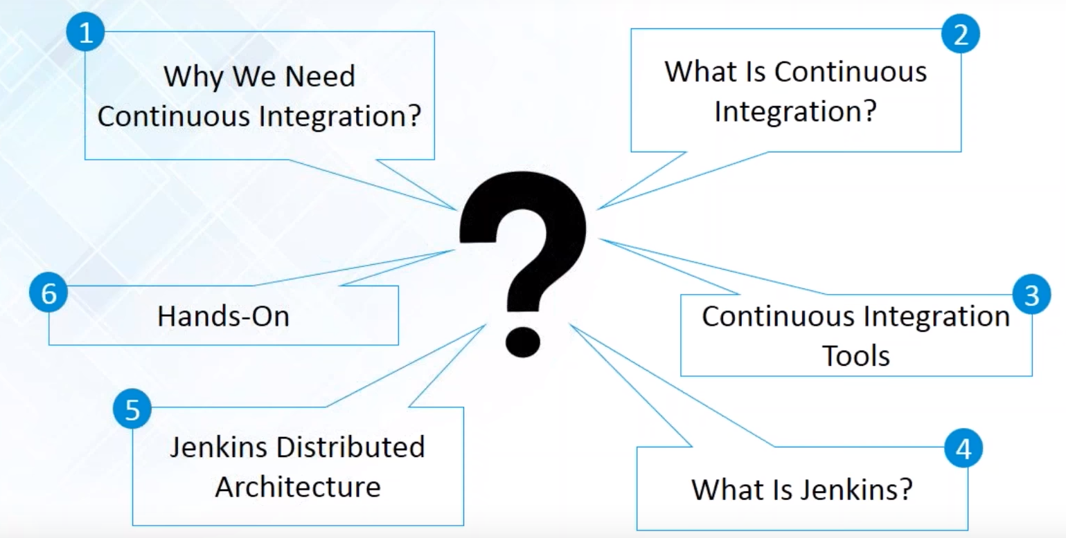
Do you know the following :

Slide 3
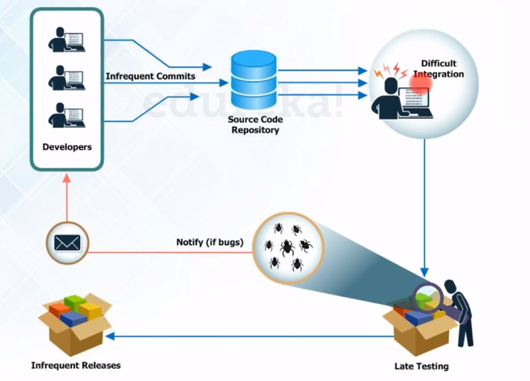
Process before Continuous Integration

Slide 4
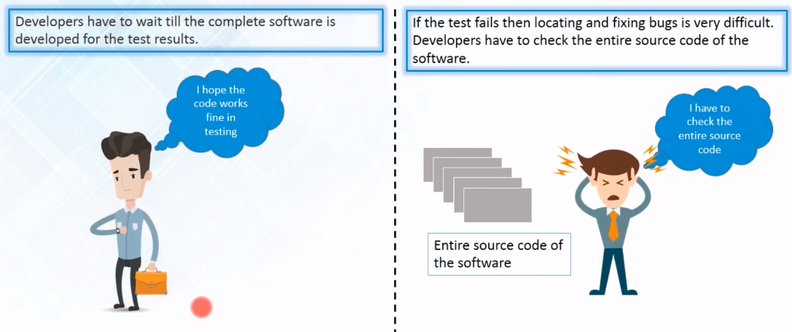
Process before Continuous Integration

Slide 5
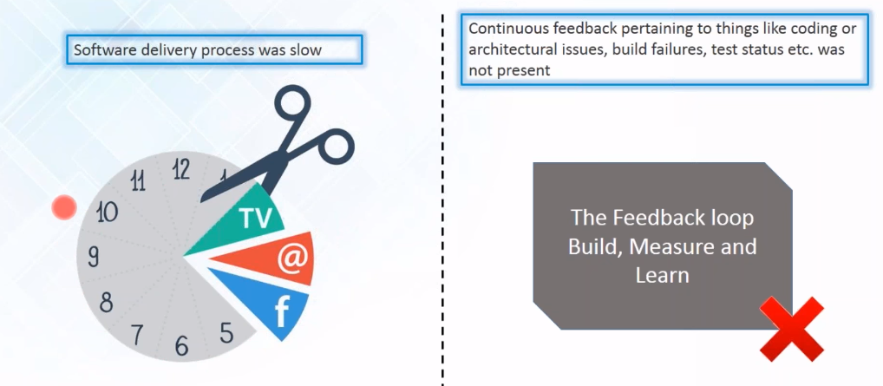
Process before Continuous Integration

Slide 6
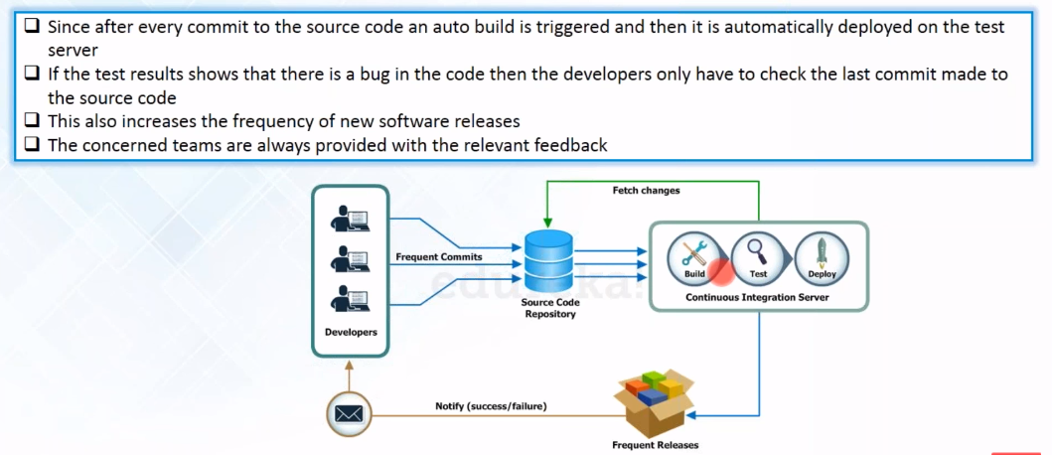
Continuous Integration to Rescue

Slide 7
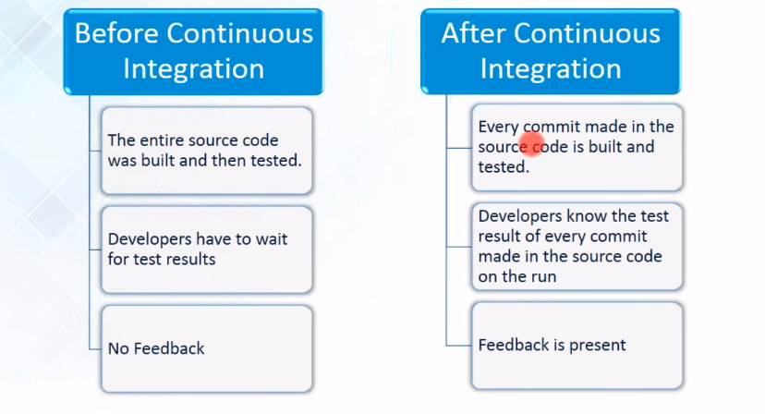
Continuous Integration to Rescue

Slide 8
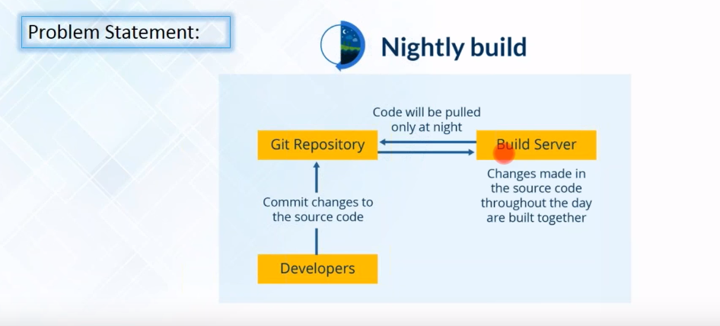
CI Case Study :

Slide 9
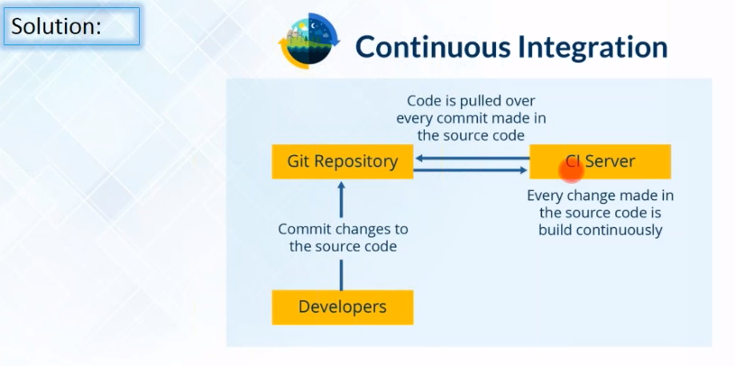
CI Case Study :

Slide 10
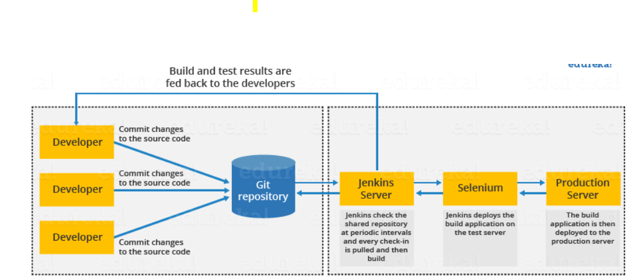
CI Case Study : Jenkins

