Slide 1
Kubernetes
What
Why
Advantages
Where
Why we used EKS

Slide 2
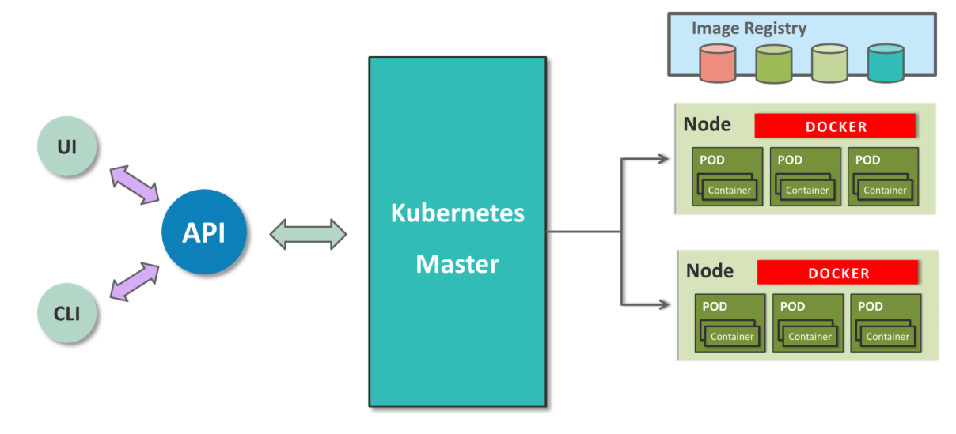

Slide 3

Docker/Nexus Private Repo
Kubernetes cluster

Slide 4
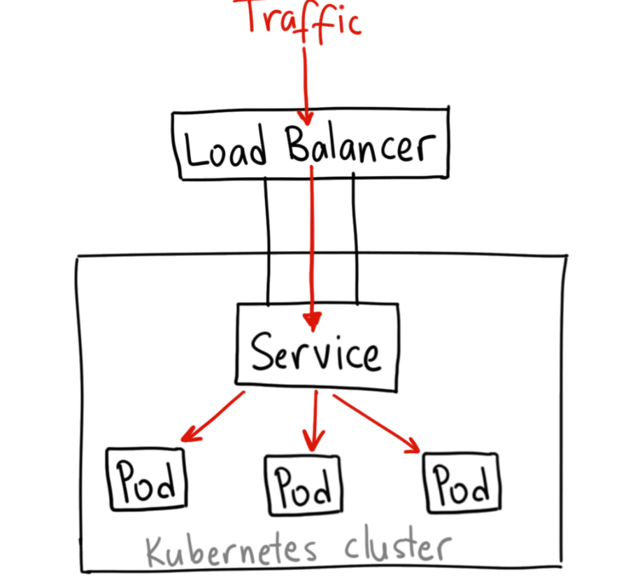

Slide 5
Deployment methods
Recreate
Rolling update
Blue green
….etc

