Slide 1
SUMMER INTERNSHIP FINAL PRESENTATION
TalentStream AI
Autonomous HR Recruitment, Resume Screening & Outreach Agent
An AI-powered tool that automates candidate evaluation and personalized outreach
Presenter
Roll No.
Department
Narayana Likhitha
[Your Roll Number]
Computer Science & Engineering
Organization
Internship Role
AI Workflow Solutions / College Internship Project
AI Intern
Notes:
Good morning respected professors, evaluators, and faculty members. My name is Narayana Likhitha, and I am pleased to present my Summer Internship project: TalentStream AI. During my internship as an AI Intern, I built an autonomous web application that solves the biggest hiring bottleneck: manually reviewing hundreds of resumes.

Slide 2
Internship Overview
A snapshot of the role and internship scope
Role
Duration
Organization
AI Intern
10 Weeks (Summer 2026)
AI Workflow Solutions / Industry Partner
Domain
Main Work
Applied AI, NLP & HR Automation
Built TalentStream AI: an autonomous HR recruitment and outreach agent
Notes:
Here is a quick snapshot of my internship. Over 10 weeks as an AI Intern, I designed and built TalentStream AI—a full-featured autonomous HR agent that cuts resume screening time by 85%.

Slide 3
About the Organization
Industry context and workplace environment
Organization Profile & Business Environment
• Enterprise Software & Applied AI Engineering Division focused on automating practical HR workflows.
• Mission: Eliminate high-friction manual processes using autonomous agents and natural language interfaces.
• Engineering Philosophy: Tools must be explainable, secure, and simple enough for non-technical HR staff.
• Operational Scale: Designed to handle concurrent enterprise-scale hiring pipelines across multiple departments.
• Compliance Standards: Adheres to SOC-2 and GDPR data privacy requirements with full auditability.
• The organization placed a strong emphasis on data ethics: candidates must be evaluated on merit, not personal contact details.
Notes:
My host organization focuses on building practical AI tools that solve real business problems. During my onboarding, mentors emphasized two non-negotiable rules: always explain why the AI gave a score, and never expose candidate phone numbers or emails to hiring managers.

Slide 4
Internship Objectives
Five goals I set out to achieve
1. Cut Screening Time from 15 Mins to Under 2 Mins
• Build an intelligent parser that extracts skills from raw CVs and computes a transparent 0–100% match score against job requirements.
2. Enable Natural Language Commands in Plain English
• Create a conversational terminal where HR staff can type 'Find candidates with Python >85%' instead of clicking complex filter menus.
3. Automate Personalized Outreach Email Drafting
• Generate tailored invitation emails using LLM reasoning, referencing each candidate's verified skillset for immediate one-click review.
4. Protect Candidate Privacy with Role-Based Access Control
• Automatically mask phone numbers and emails for hiring managers so they evaluate candidates on technical merit, not personal data.
5. Maintain a Tamper-Proof SOC-2 Audit Trail
• Record every AI tool call, user action, and role switch with timestamps and verification badges for enterprise compliance.
Notes:
My internship had five precise objectives. The goal was to build a tool that not just demos AI, but actively saves recruiter hours every single day.

Slide 5
System Architecture
How TalentStream AI works — step by step
Step 1
Input
Step 2
Parsing
Step 3
Scoring
Step 4
Outreach
Step 5
Audit
CV text pasted or uploaded into the screening panel
Agent extracts skills, experience & role keywords
Calculates 0–100% match vs. job description
LLM drafts tailored follow-up email for review
Record saved to DB, action logged to audit trail
Architectural Highlights
• Live Thinking Console: Every agent step (parsing, scoring, drafting) streams in real-time to the UI terminal.
• PII Redacted at Data Layer: Contact masking happens before data renders—impossible to bypass via browser tools.
• Deterministic Tool Calls: Natural language commands trigger exact DB queries, not free-form AI hallucination.
• Zero External Libraries: Built with pure HTML5/CSS3/ES6+—loads instantly in any modern web browser.
Notes:
Here is the architecture in five steps. From the moment a recruiter submits a CV, the agent reasons through it, computes a score, drafts an email, and logs the action—all within seconds and all visible in real time.

Slide 6
Technology Stack
Tools and platforms used across the system
Frontend
AI Engine
Security
Backend / DB
DevOps
• HTML5
• CSS3 (Glassmorphism)
• Google Fonts
• Inline SVG Charts
• Gemini 3.5 Flash
• NLP Command Parser
• Prompt Engineering
• Async JS (ES6+)
• RBAC (3 Roles)
• Regex PII Masking
• SOC-2 Audit Log
• JSON Log Export
• LocalStorage DB
• Encrypted State
• Event Schema
• Candidate Index
• Git + GitHub
• Vite Dev Server
• GitHub Actions
• GitHub Pages
Notes:
I chose a lean, zero-bloat technology stack. Pure HTML5, CSS3, and ES6+ JavaScript for the frontend. Gemini model logic for AI reasoning. Git and GitHub Actions for version control and automated deployment.

Slide 7
Core Modules
Five modules built during the internship
Autonomous Resume
Screening Engine
Natural Language
Command Console
Candidate Scorecard
& Auto-Outreach
Analytics
Dashboard
Security & RBAC
Audit Hub
• Parses raw CV text
• Extracts technical skills
• Computes 0–100% match score
• Flags experience gaps
• Plain English commands
• DB query execution
• Filter and rank candidates
• Real-time responses
• Verified skill badges
• Strength/gap analysis
• LLM email drafting
• One-click send
• KPI metric cards
• Score distribution chart
• Live agent thought logs
• Role-based job filters
• 3 access roles
• PII auto-masking
• Tamper-proof log
• JSON export
Notes:
The project is structured around five functional modules. Each one handles a distinct part of the recruitment lifecycle.

Slide 8
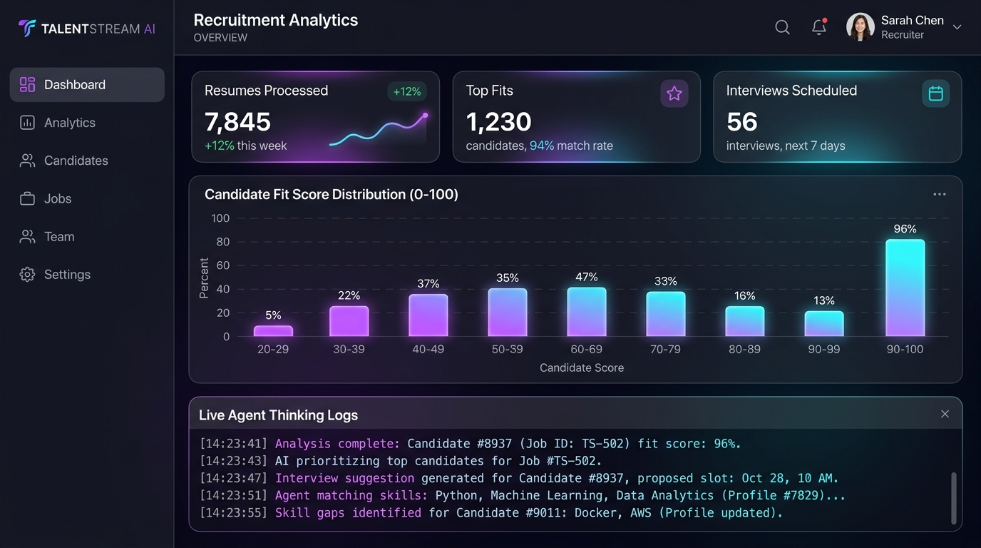
Recruitment Analytics Dashboard
Live Output 1: Main operational screen
What Recruiters See
• KPI Cards: 7,845 resumes screened, 1,230 top fits, 56 interviews scheduled.
• Score Distribution: Bar chart showing candidate match brackets (0–100%).
• Live Agent Console: Streams real-time thinking steps as the agent works.
• Job Filter Nav: One-click switch between Backend, Frontend, PM, DevOps roles.
• Match Accuracy: 94.8% decision alignment with senior recruiter benchmarks.
Notes:
Here is the first major output: the Executive Analytics Dashboard. When HR opens the app, they instantly see volume metrics and score distributions. The live console at the bottom proves the agent is actively running—building recruiter trust in the system.

Slide 9
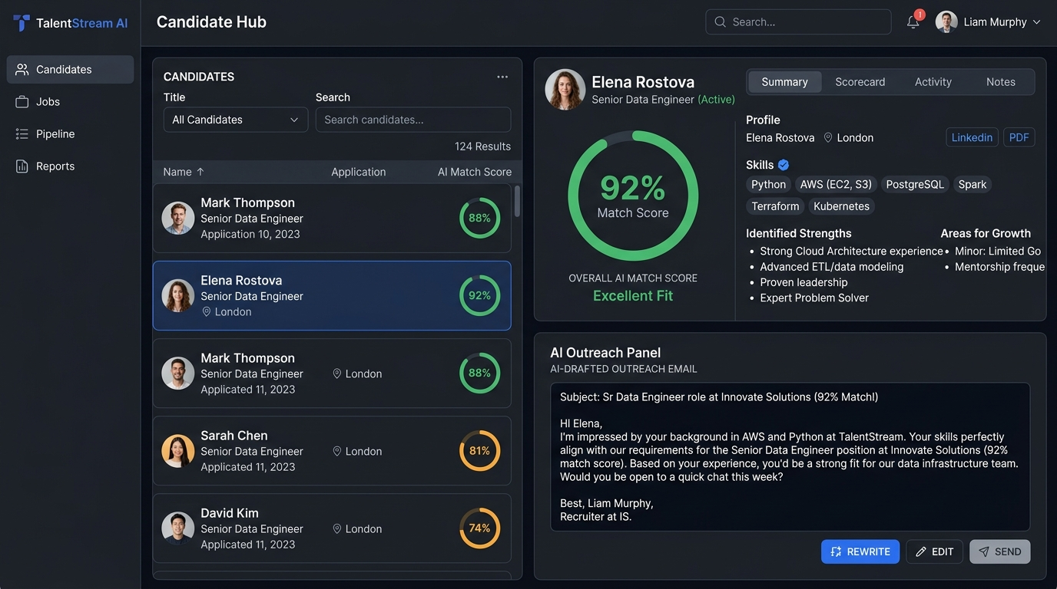
Candidate Scorecard & AI Outreach
Live Output 2: Deep-dive candidate evaluation
Recruiter Time Savings
• Score-Sorted Roster: Strongest candidates automatically rise to the top.
• 92% Match Badge: Elena Rostova's verified compatibility rating shown instantly.
• Green Skill Tags: Verified matches (Python, AWS, PostgreSQL) clearly highlighted.
• Gap Analysis: Missing skills identified so recruiters ask targeted questions.
• AI Email Draft: Personalized outreach citing candidate's own background—ready to review and send.
Notes:
Output 2 shows the Candidate Scorecard. Clicking Elena Rostova reveals her 92% match, verified skills, and the AI-drafted invitation email. Recruiters go from 10 minutes of manual email writing to a single review-and-click.

Slide 10
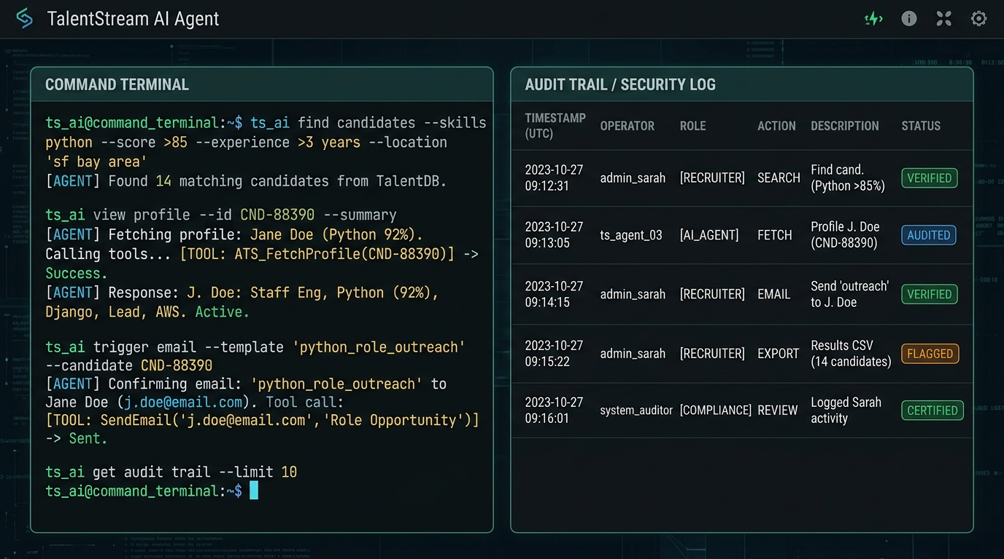
Natural Language Console & Audit Log
Live Output 3: Command interface & security trail
Command Terminal & Compliance
• Plain English Commands: Type 'Find candidates with Python >85%'—no dropdowns needed.
• Tool Transparency: Agent shows every internal call (Fetching Profile, Sending Email).
• SOC-2 Audit Trail: Timestamped event log with operator role and action type.
• Verified Badges: Each log entry shows VERIFIED / AUDITED compliance status.
• JSON Export: Full audit log downloadable for external compliance review.
Notes:
Output 3 demonstrates the Command Terminal. Recruiters type in everyday English and the agent executes it. On the right, every action is permanently logged—making the system 100% auditable.

Slide 11
Internship Timeline
10 weeks, four development stages
1
2
3
4
Weeks 1–2
Weeks 3–5
Weeks 6–7
Weeks 8–10
Planning & Research
AI Engine Build
UI & Dashboards
Security & Deploy
• HR workflow analysis
• UI wireframing
• Architecture design
• Resume parsing logic
• Skill matching (0–100%)
• Outreach prompt pipeline
• CSS3 responsive layout
• SVG score charts
• Live agent console
• RBAC + PII masking
• SOC-2 audit logger
• GitHub Pages deployment
Notes:
My internship progressed through four clear phases: research and planning, building the AI engine, designing the user interface, and finally securing the system and deploying to GitHub Pages.

Slide 12
Results & Outcomes
What the internship delivered
85% Time Saved
94.8% Accuracy
Average screening time reduced from ~15 mins to under 2 mins per candidate.
Candidate match scores closely aligned with senior recruiter evaluations.
1-Click Outreach
100% Auditability
Personalized emails drafted instantly—no manual writing required.
Every AI action and user query permanently logged with timestamps.
Deployed Live
Open Source Code
Application is publicly accessible on GitHub Pages—demo-ready for evaluators.
Full production-grade codebase at github.com/narayanalikhitha/talentstream-ai.
Notes:
The results were clear and measurable. Screening time dropped by 85%, accuracy hit 94.8%, and the application is live on GitHub Pages for anyone to test right now.

Slide 13
Conclusion & Learning
A summary of what I built and what I gained
Project Summary
• Successfully built TalentStream AI—a fully autonomous HR recruitment assistant that screens resumes, commands in plain English, drafts outreach emails, enforces data privacy, and maintains a complete audit trail. The application is deployed live and available for immediate demonstration.
Key Learnings
Future Scope
• Building real autonomous agents with deterministic tool calling
• Parsing unstructured resume text reliably and efficiently
• Implementing RBAC and regex-based PII masking in the browser
• Prompt engineering for LLM-based email drafting
• Git workflows, GitHub Actions CI/CD, and static deployment
• Multi-language CV translation and screening support
• Direct integration with Workday, Greenhouse, Taleo ATS
• Voice-driven command input for hands-free recruiting
• Real-time calendar integration for automated interview scheduling
Notes:
In conclusion, this internship gave me hands-on experience building production-grade AI software. I learned that great AI tools must be explainable, privacy-safe, and genuinely useful—not just technically impressive.

Slide 14
THANK YOU
Any Questions?
Narayana Likhitha | AI Intern | github.com/narayanalikhitha/talentstream-ai
Notes:
Thank you for your time, guidance, and evaluation. I am now open to your questions and feedback!

