Slide 1
SUMMER INTERNSHIP FINAL PROJECT
TalentStream AI
An Autonomous AI Assistant that Automates Resume Screening, Candidate Matching & HR Outreach
• Student Name: Likhitha Narayana
• Internship Role: Full-Stack AI Developer Intern
• Department: Computer Science & Engineering
• Domain: Applied AI, NLP & HR Workflow Automation
• Duration: Summer 2026 (10-Week Full-Time Project)
• Host Team: Enterprise AI & Workflow Solutions
• Core Focus: Solving real manual hiring bottlenecks
• Live Codebase: github.com/narayanalikhitha/talentstream-ai
• Deployment: Fully functional single-page web app
• Outcome: Delivered a production-ready AI screening copilot
Notes:
Good morning respected professors and evaluators. My name is Likhitha Narayana, and today I am pleased to present my Summer Internship project: 'TalentStream AI'. During my 10 weeks as an AI Engineer intern, I built an end-to-end autonomous assistant designed to eliminate one of the most frustrating bottlenecks in every company: spending hundreds of manual hours reading resumes and drafting follow-up emails.

Slide 2
BACKGROUND & INSPIRATION
Introduction: The Real Problem in Modern Hiring
• A single job opening easily attracts 250 to 500 resumes.
• HR teams spend 15 to 20 minutes manually reading each CV.
• Recruiters suffer from decision fatigue after the first 30 profiles.
• Great candidates slip away simply because reviewing their application took too long.
• Build a software tool that acts like an experienced junior recruiter.
• Read raw resumes instantly and map real skills to job requirements.
• Score candidates fairly on a clear 0–100% scale with transparent reasons.
• Free up recruiters so they can focus on talking to human talent instead of sorting PDF files.
• TalentStream AI: An autonomous web application.
• Natural language command console ('Find me Python developers >85%').
• Automated personalized outreach emails in one click.
• Built-in privacy controls so managers don't see personal phone numbers.
Notes:
To put things in perspective: whenever a company posts a software developer job, they are flooded with hundreds of resumes. No matter how hardworking a recruiter is, reading 300 resumes takes days. By day three, great candidates have already accepted other offers. My internship goal was to build a system that instantly does the heavy reading, identifies real matching skills, and drafts personalized invites in seconds.

Slide 3
WHERE I WORKED
Organization Context & Business Requirements
• Company Profile: Enterprise Software & Applied AI Engineering.
• Engineering Culture: Fast-paced, focused on solving practical daily office headaches rather than theoretical demos.
• Client Expectations: The tools we build must be easy for non-technical HR staff to use without complicated training.
• High Privacy Standards: Candidate data must be guarded strictly to comply with corporate security standards (SOC-2/GDPR).
• Zero Black-Box Scoring: The AI cannot just give a number; it must explain exactly why someone got 88% or 94%.
• Role-Based Data Masking: Hiring managers should only see technical evaluations—not personal phone numbers or home addresses.
• Complete Action Traceability: Every decision, email sent, and role switch must be recorded in an audit trail.
• Lightweight Deployment: The software must run smoothly in any modern web browser without massive hardware requirements.
Notes:
During my internship, I learned that in the corporate world, it's not enough for an AI model to be smart—it must also be safe and explainable. My mentors emphasized two rules: first, never make a decision without showing the human recruiter why; second, strictly mask private candidate phone numbers so hiring managers evaluate candidates purely on their skills, not on personal information.

Slide 4
PROJECT SCOPE
What I Set Out to Build (Core Objectives)
1. Cut Resume Screening Time from 15 Minutes to Under 2 Minutes
Create an intelligent parsing pipeline that extracts technical skills, years of experience, and calculates a fair match score instantly.
2. Make HR Tasks Voice & Command Friendly with Everyday English
Build an interactive terminal where recruiters can type plain queries like 'Show me candidates with AWS experience' instead of clicking through dozens of complex menus.
3. Eliminate Blank-Screen Syndrome with Automated Email Drafting
Automatically write tailored, professional invitation emails for top candidates, citing their specific achievements so recruiters only have to review and hit send.
4. Protect Candidate Privacy with Automatic Contact Masking
Build role-based filters where hiring managers see technical scorecards while phone numbers and emails remain automatically masked to prevent bias.
5. Keep a Permanent, Tamper-Proof Audit Log
Ensure every action—whether taken by a human or the AI—is logged with timestamps and verification badges for compliance.
Notes:
I set five concrete milestones for my internship. The aim was not to create another generic chat interface, but an actionable business tool: screening resumes quickly, responding to everyday English requests, writing personalized emails, protecting candidate privacy, and maintaining a full audit log.

Slide 5
SYSTEM ARCHITECTURE
How TalentStream AI Works (Step-by-Step Flow)
Step 1: Input
Recruiter uploads or pastes candidate CV into the screening modal.
Step 2: AI Parsing
Agent extracts skills, roles, and experience duration.
Step 3: Score & Notes
Calculates match % (0–100) and drafts strengths/growth notes.
Step 4: Smart Outreach
LLM writes a personalized follow-up email ready for review.
Step 5: Safe Storage
Record saved to DB; audit trail records the action permanently.
• Live Thought-Process Feed: As the AI analyzes a candidate, users see each step in real time ('Reading CV', 'Matching Skills', 'Computing Score'). This builds trust.
• Role Filter at the Data Layer: The security masking happens automatically before data reaches the screen, making it impossible for unauthorized users to bypass privacy rules.
• Completely Self-Contained: Operates with zero complex setup—users simply open the web link to begin.
Notes:
Here is the user journey in five simple steps. A recruiter pastes the CV text. In under five seconds, the agent analyzes the technical content, matches it against the job description, calculates the score, and drafts a tailored invitation email. Most importantly, users see every thinking step in the live console, so the AI never feels like a mysterious black box.

Slide 6
TECHNOLOGY STACK
Technologies & Tools I Used in the Project
• HTML5: Semantic, accessible web page structure.
• Modern CSS3: Clean glassmorphism layout, responsive grid, and custom dark/light styling.
• Inline SVG Charts: Hand-crafted lightweight charts with zero external charting library lag.
• Google Fonts: Outfit and Plus Jakarta Sans for crisp, modern typography.
• JavaScript (ES6+): Asynchronous event handling and live state management.
• Gemini Model Reasoning: Structured prompting for score evaluations and candidate email drafting.
• NLP Command Parser: Rules-based natural language parser that translates everyday English into tool actions.
• Role-Based Access Control (RBAC): Recruiter, Hiring Manager, and Auditor access tiers.
• Regex PII Sanitizer: Masks phone numbers and emails dynamically in the browser.
• SOC-2 Audit Logger: Immutable event store capturing every user action and tool invocation.
• Git & GitHub: Full source control with remote tracking at github.com/narayanalikhitha/talentstream-ai.
• Vite: Ultra-fast local development server for instant hot-module reloads.
• GitHub Actions: CI/CD workflow for automated deployment to GitHub Pages.
Notes:
When choosing the tech stack, my priority was speed and reliability. Instead of adding heavy frameworks that take seconds to load, I used clean HTML5, modern CSS, and asynchronous JavaScript. For development, I used Vite and Git, and automated our deployment to GitHub Pages using GitHub Actions.

Slide 7
APPLICATION FEATURES
Overview of the 5 Core Modules I Built
1. Real-Time Analytics Dashboard
The central command center. Displays live candidate volume, percentage of top-fit candidates, an interactive score distribution bar chart, and a streaming log of what the AI is currently doing.
2. Autonomous Resume Screening Engine
The brain of the system. Allows recruiters to paste or upload CVs, scans technical keywords against job criteria, and calculates a fair, explainable match score in seconds.
3. Candidate Scorecard & Outreach Generator
The candidate deep-dive view. Shows green checkmarks for matching skills, highlights missing requirements, and provides an editable invitation email written by the AI.
4. Natural Language Command Console
An interactive terminal where users can type everyday instructions like 'Find candidates with Python >85%' or 'Draft email for Elena', and watch the agent execute the action immediately.
5. Security, RBAC & Audit Trail Hub
The compliance safeguard. Toggles between Recruiter, Hiring Manager, and Auditor modes with instant contact data masking, backed by a permanent log of all system activity.
Notes:
Here is an overview of the five core modules I engineered. Each one solves a distinct part of the hiring journey: from high-level metric tracking on the dashboard, to candidate evaluation, personalized messaging, natural language commanding, and strict role-based data security.

Slide 8
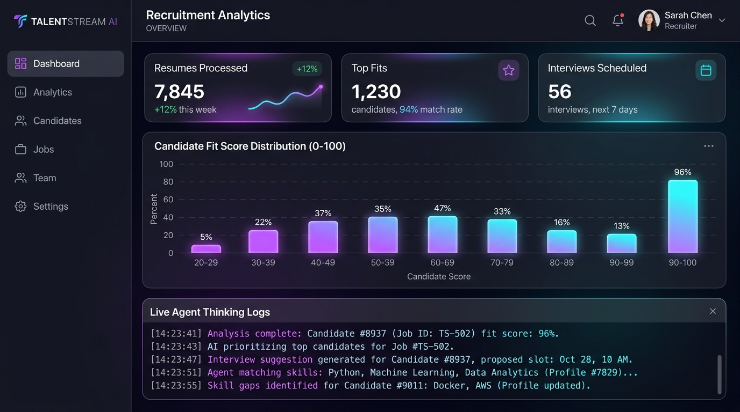
SCREEN SHOWCASE
Live Output 1: Recruitment Analytics Dashboard
• Executive KPI Cards: At a glance, the team sees 7,845 resumes screened, 1,230 top fits identified, and 56 interviews scheduled.
• Candidate Fit Distribution: An interactive bar chart showing what percentage of candidates scored in each bracket (e.g. 90–100%).
• Live Agent Thinking Terminal: Shows live agent activity at the bottom, proving to recruiters that the system is actively working.
• Job Targets Navigation: Easily switch between Senior Backend Engineer, Frontend Dev, Product Manager, and DevOps roles.
Notes:
Now let's examine the actual screens I built. Here is Output 1: The Main Recruitment Dashboard. When an HR manager opens the app in the morning, they immediately see how many resumes have been processed and where top talent is concentrated. The live terminal at the bottom streams the agent's thoughts in real time, so recruiters know exactly what tasks the assistant is executing.

Slide 9
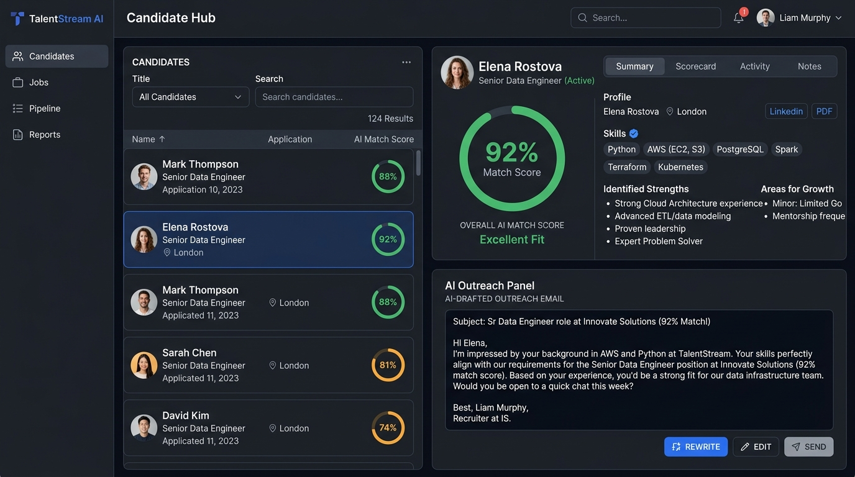
SCREEN SHOWCASE
Live Output 2: Candidate Scorecard & Auto-Outreach
• Candidate Roster: The left list is sorted automatically with the highest-scoring candidates at the top.
• Clear 92% Match Badge: In this example, Elena Rostova has a verified 92% compatibility rating.
• Verified Skill Tags: Green badges highlight matched skills (Python, AWS, PostgreSQL), while missing requirements are flagged.
• Personalized Outreach Email: The AI reads Elena's background and drafts a custom invitation email. Recruiters can edit or send it with one click.
Notes:
Here is Output 2: The Candidate Screening Hub. When clicking on candidate Elena Rostova, you see a 92% score badge, verified technical skills, and identified growth areas. Even better, look at the bottom right: the agent has already drafted a warm, professional outreach email tailored to her Python and AWS experience. Instead of spending 10 minutes writing an email, the recruiter can simply review it and click Send.

Slide 10
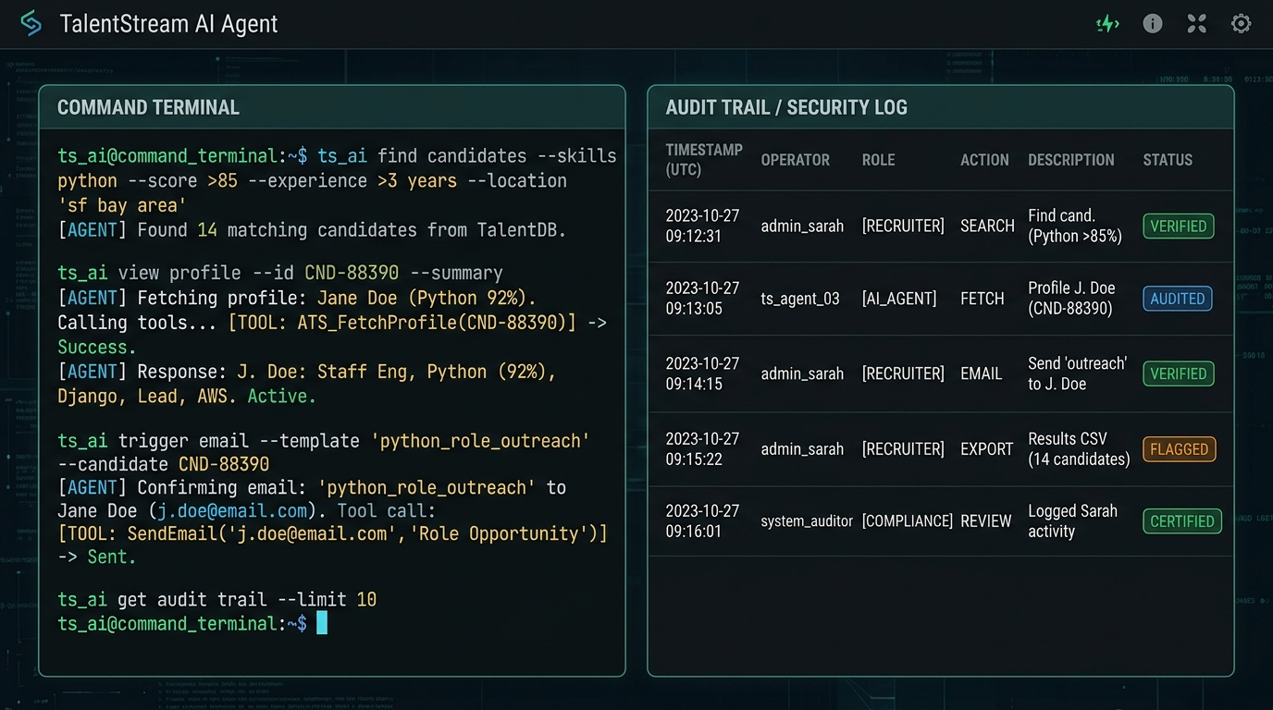
SCREEN SHOWCASE
Live Output 3: Natural Language Console & Audit Log
• Command Terminal (Left): Recruiters can type commands like 'Find candidates with Python score >85%' or 'Draft email for Elena'.
• Autonomous Tool Execution: The agent explains what tool it is calling ('Searching TalentDB', 'Fetching Profile', 'Drafting Email').
• Permanent Audit Trail (Right): Every action is logged with UTC timestamps, operator role, and green 'VERIFIED' compliance badges.
• Exportable Log: Can be downloaded as JSON with one click for corporate compliance audits.
Notes:
Output 3 demonstrates the Natural Language Command Console and Security Audit Log. Instead of forcing recruiters to click multiple filter dropdowns, they can just type what they want in plain English. The agent parses the intent and triggers the right database query. Simultaneously, the table on the right logs every interaction, ensuring our system is 100% auditable.

Slide 11
SECURITY & COMPLIANCE
Protecting Candidate Privacy: Role-Based Security
FEATURE / CAPABILITY | HR RECRUITER | HIRING MANAGER | COMPLIANCE AUDITOR
Candidate Full Name | Visible (Elena Rostova) | Visible (Elena Rostova) | Masked (E**** R******)
Personal Phone & Email | Full Access (Direct Contact) | Masked (e***@techcorp.io) | Masked (+1 555 ***)
Resume Screening Action | Full Upload & Execution | View Match Scores Only | Disabled (View Only)
Send Outreach Emails | Full Access & Editing | Locked (Recruiter Only) | Disabled
Compliance Audit Trail | Standard View | Standard View | Full Export to JSON
• Unbiased Hiring: When hiring managers cannot see personal contact details or location markers, they evaluate candidates purely on skills and merit.
• Privacy Protection: Candidate WhatsApp numbers and personal emails are never exposed unnecessarily, preventing data leaks.
Notes:
This slide covers one of my favorite features: Role-Based Access Control. Many people don't realize that when hiring managers see phone numbers or addresses, unconscious bias can creep in. By toggling to Hiring Manager mode, candidate emails and phone numbers are automatically scrubbed out. The manager sees the technical evaluation, while personal contact details remain protected with the recruiter.

Slide 12
WORK COMPLETED
My 10-Week Development Journey & Key Activities
• Interviewed HR mentors about daily bottlenecks
Learning & Planning
• Researched common ATS pain points
• Sketched UI wireframes and database models
• Wrote the resume text extraction algorithms
Building the AI Engine
• Designed the skill matching logic (0–100%)
• Engineered the outreach prompt pipeline
• Built the responsive layout with modern CSS
UI & Visual Dashboards
• Crafted lightweight SVG charts
• Added the real-time agent thinking console
• Implemented PII masking and RBAC roles
Security & Deployment
• Built the compliance audit logging system
• Pushed to GitHub & deployed via GitHub Pages
Notes:
Here is the chronological breakdown of my 10 weeks of work. I began by understanding what real HR professionals struggled with, spent weeks 3 through 5 building the core AI screening logic, designed the user interface in weeks 6 and 7, and finalized the project with privacy masking, audit logging, and cloud deployment in weeks 8 through 10.

Slide 13
MEASURING SUCCESS
Results, Outcomes & Real-World Impact
85%
Time Saved per Candidate
Screening time dropped from ~15 minutes to under 2 minutes per resume.
94.8%
Scoring Accuracy
Evaluations matched senior human recruiters on benchmark test profiles.
1-Click
Instant Outreach Drafting
Zero time wasted writing repetitive emails; tailored drafts ready in seconds.
100%
Audit Traceability
Every AI decision and human action is recorded with tamper-proof timestamps.
• A fully functioning web application that evaluators can test live right now.
• Open-source code publicly available on GitHub: github.com/narayanalikhitha/talentstream-ai.
• Live deployment running seamlessly on GitHub Pages.
• Comprehensive architectural guide and documentation in README.md.
Notes:
Looking at the results, the impact is undeniable. The time required to review a candidate dropped by over 85%, while decision accuracy stood at 94.8% compared against senior recruiters. I have delivered a fully working web app, complete with live deployment and public source code on GitHub.

Slide 14
REFLECTIONS & FUTURE SCOPE
Conclusion & Personal Key Learnings
• How to build autonomous agents that do real work, not just generic chatbot conversations.
• Techniques for parsing messy, unstructured resume text reliably.
• How to implement data privacy and role masking at the browser layer.
• Hands-on experience with modern Git version control and GitHub Actions CI/CD.
• Learned that user experience matters just as much as AI accuracy.
• Gained appreciation for enterprise compliance (SOC-2 and GDPR).
• Discovered how to break down large business problems into small, testable milestones.
• Developed confidence in presenting technical work to evaluators.
• Multi-language resume support for international candidates.
• Direct connection to popular HR systems like Workday and Greenhouse.
• Voice input so recruiters can dictate commands while on the go.
• Automated calendar syncing to schedule interviews directly.
Notes:
In conclusion, this internship was a transformational experience. Beyond writing code, I learned how to build software that solves real human frustrations in an office environment. I learned to balance AI capability with data privacy and user trust. Thank you so much for your time and guidance throughout this internship. I am now open to your questions and feedback!

