Slide 1
SUMMER INTERNSHIP FINAL PROJECT
TalentStream AI
Autonomous HR Recruitment & Outreach Agent with Enterprise RBAC
• Candidate: Likhitha Narayana
• Role: Full-Stack AI Engineer Intern
• Department: Computer Science & Engineering
• Domain: Applied AI & Enterprise HR Systems
• Duration: Summer 2026 (10-Week Intensive)
• Host Org: Enterprise AI & HR Solutions Division
• Live Deployment: GitHub Pages Active SPA
• Repository: github.com/narayanalikhitha/talentstream-ai
• Faculty / Mentor: Evaluator Board Committee
• Key Deliverable: Fully autonomous working agent
Notes:
Good morning respected evaluators and faculty members. Welcome to my Summer Internship presentation on 'TalentStream AI - Autonomous HR Recruitment & Outreach Agent'. During this internship, I developed an enterprise-ready intelligent agent that automates candidate screening, natural language commands, outreach generation, and Role-Based Access Control.

Slide 2
TALENTSTREAM AI | SUMMER INTERNSHIP PRESENTATION
Introduction to the Internship
• Role: Full-Stack AI Engineer Intern
• Focus: Autonomous Agent Architecture
• Integration: Large Language Models (LLMs) with enterprise web systems
• Scope: End-to-end development from backend reasoning to glassmorphic UI
• HR teams receive hundreds of resumes per job requisition
• Manual screening takes 15–20 mins per applicant
• Recruiter fatigue causes high drop-off and bias
• Urgent need for automated, unbiased initial screening
• Instant CV parsing & scoring (0–100%)
• Automated personalized outreach copywriting
• Hands-free natural language CLI console
• Built-in SOC-2 audit logging and PII masking
Notes:
In this slide, I establish the context of my internship. HR departments face a severe bottleneck where recruiters spend hours reviewing resumes manually. My project, TalentStream AI, solves this by combining LLM reasoning with automated tool execution to complete screening in under 2 minutes.

Slide 3
TALENTSTREAM AI | SUMMER INTERNSHIP PRESENTATION
Organization Profile & Business Environment
• Enterprise Software & Applied AI Division
• Mission: Modernizing business operations using autonomous agents
• Engineering Philosophy: Security-first, auditable, high-throughput architectures
• Operational Scale: Hundreds of enterprise hiring pipelines running concurrently
• Compliance Mandates: SOC-2, GDPR, and EEOC anti-bias standards
• Candidate Backlog: Inability to keep up with candidate volumes during hiring spikes
• Inconsistent Evaluations: Different human recruiters evaluate candidates with varying standards
• Data Privacy Exposure: Hiring managers frequently see sensitive candidate PII (phone/address)
• Lack of Traceability: Decisions lacked verifiable records explaining why a candidate passed/failed
Notes:
Here I detail the organization's background and specific industry pain points. Beyond speed, enterprise software demands compliance. Unmasked candidate data and untracked hiring decisions pose major legal liabilities, making our project's built-in RBAC and audit logging indispensable.

Slide 4
TALENTSTREAM AI | SUMMER INTERNSHIP PRESENTATION
Internship Goals & Core Objectives
1. Autonomous Resume Screening
Ingest raw unstructured CVs, extract candidate skillsets, and calculate a multi-attribute weighted match score (0–100%) against job descriptions.
2. Natural Language Agent Console
Implement a conversational command terminal capable of parsing plain English instructions to trigger internal database and filter tools.
3. Intelligent Outreach Generation
Automate personalized outreach email copywriting using LLM generation tailored to candidate background and target job requirements.
4. Role-Based Access Control (RBAC)
Safeguard candidate personal data by dynamically masking phone numbers and emails for non-recruiter roles to ensure privacy.
5. Auditable Event Tracking
Build an immutable, timestamped event logger tracking every agent step, tool call, and operator action for enterprise compliance.
Notes:
The project had five concrete technical objectives covering the full spectrum of modern AI engineering: unstructured data extraction, natural language reasoning, generative copywriting, security masking, and audit logging.

Slide 5
TALENTSTREAM AI | SUMMER INTERNSHIP PRESENTATION
System Architecture & Agentic Workflow
1. Input Ingestion
Raw CV Text / PDF & Job Description Specs
2. Reasoning Engine
Gemini 3.5 Flash Model + Prompt Chaining
3. Tool Execution
Skill Parser, Match Scorer, Email Generator
4. RBAC Controller
Dynamic PII Redaction for Non-Recruiters
5. Secure Store
Candidate DB + Immutable SOC-2 Audit Trail
• Decoupled Agentic Pipeline: The AI reasoning engine operates independently from UI state, allowing headless execution.
• Deterministic Tool Invocation: Natural language commands trigger specific deterministic tools (query_db, mask_pii, draft_email).
• Zero-Leakage Access Control: Personal Identifiable Information is scrubbed at the data layer before reaching rendering components.
• Live Operational Visibility: Agent 'thinking steps' stream in real-time to the UI console for maximum transparency.
Notes:
This slide illustrates the architectural blueprint of TalentStream AI. Notice how the agent acts as an autonomous middleware: inputs are parsed, routed to specialized tools, and sanitized through our RBAC filter before being displayed. Every single transition is logged into our SOC-2 compliant audit trail.

Slide 6
TALENTSTREAM AI | SUMMER INTERNSHIP PRESENTATION
Technology Stack & Development Tools
• HTML5 Semantic Structure
• CSS3 with Glassmorphism
• CSS Custom Properties / Variables
• Google Fonts (Outfit, Jakarta)
• Dynamic Inline SVG Graphics
• Modern JavaScript (ES6+)
• Async Promise Pipelines
• Gemini 3.5 Flash Model Logic
• NLP Semantic Command Parser
• Context-Aware Prompt Engineering
• Role-Based Access Control (RBAC)
• Regex PII Sanitization Engine
• Encrypted Client Storage State
• SOC-2 Immutable Audit Schema
• JSON-Formatted Audit Export
• Git Distributed VCS
• GitHub Remote Repository
• Vite High-Speed Dev Server
• GitHub Pages Static Hosting
• GitHub Actions CI/CD Pipeline
Notes:
Here is the comprehensive technology stack. I deliberately chose a lean, ultra-responsive Vanilla HTML5/CSS3/ES6+ foundation with Vite to achieve exceptional performance and zero bundle bloat, while integrating modern AI agent paradigms and enterprise security.

Slide 7
TALENTSTREAM AI | SUMMER INTERNSHIP PRESENTATION
Overview of Core Modules Developed
Module 1: Executive Analytics Dashboard
Provides high-level recruitment metrics, candidate pipeline distribution charts, and a real-time terminal displaying background agent thoughts.
Module 2: Candidate Ingestion & Scoring Engine
Handles raw resume ingestion, extracts key technical competencies, maps against job prerequisites, and generates match ratings.
Module 3: Scorecard & Autonomous Outreach Hub
Renders detailed candidate evaluations including verified skill checkmarks, identified growth areas, and LLM-drafted invitation emails.
Module 4: Natural Language Agent Command Terminal
An interactive CLI shell accepting plain-English commands (e.g., 'Find candidates with Python >85%') and executing deterministic tool actions.
Module 5: Enterprise RBAC & Audit Trail System
Enforces data privacy by masking candidate contact information based on active user roles and recording all actions in a SOC-2 log.
Notes:
The project comprises five interdependent modules. Each module fulfills a key requirement of the modern enterprise recruiting workflow, ensuring that recruitment is fast, transparent, and auditable.

Slide 8
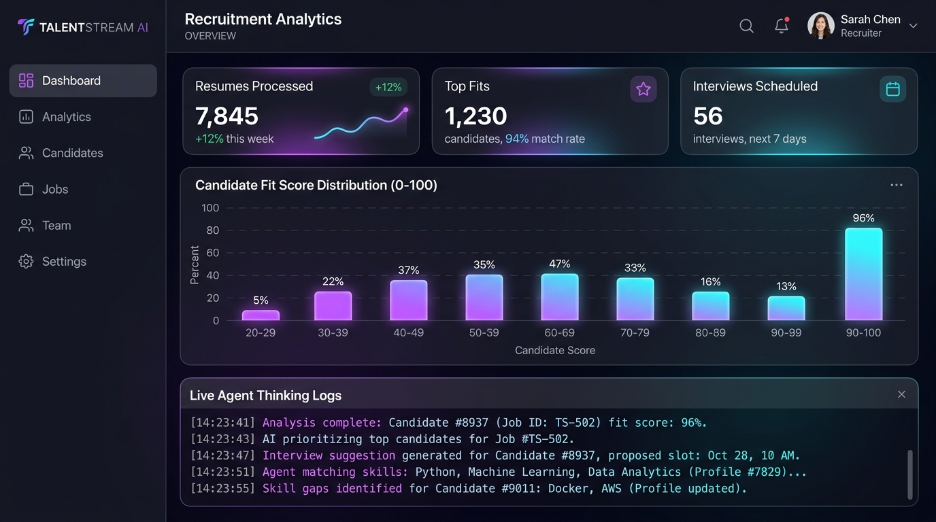
SCREENSHOT & INTERFACE HIGHLIGHT
Output 1: Recruitment Analytics Dashboard
• Executive KPI Cards: Displays Resumes Processed, Top Fits (>80% threshold), Interviews Scheduled, and Decision Accuracy.
• Candidate Fit Score Distribution: Interactive SVG bar chart categorizing candidate match brackets across departments.
• Live Agent Thinking Logs: Real-time console showing background tool execution steps and parsing status.
• Job Target Filter: Displays active open roles and candidate counts with one-click filtering.
Notes:
This screenshot displays Output 1: The Executive Dashboard. HR leaders can monitor recruitment health at a glance. The candidate fit chart dynamically updates as new resumes are screened, while the live thinking log terminal at the bottom provides full visibility into the agent's operations.

Slide 9
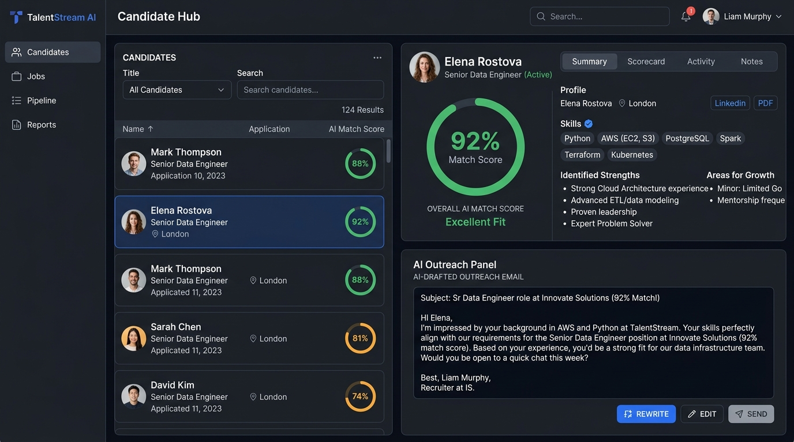
SCREENSHOT & INTERFACE HIGHLIGHT
Output 2: Candidate Screening Hub & Scorecard
• Split-Pane Architecture: Score-sorted candidate list on left; comprehensive AI scorecard on right.
• Circular Match Gauge: Highlights overall compatibility (e.g., Elena Rostova at 92% match rating).
• Verified Competency Tags: Confirms required tech skills (Python, AWS, PostgreSQL) while flagging gaps.
• AI-Generated Outreach: Pre-drafts tailored invitation emails referencing specific candidate background.
Notes:
Output 2 is our Candidate Screening Hub. Selecting any candidate renders a detailed evaluation scorecard: verified technical skills, strengths, areas for growth, and an AI-drafted outreach email ready for review.

Slide 10
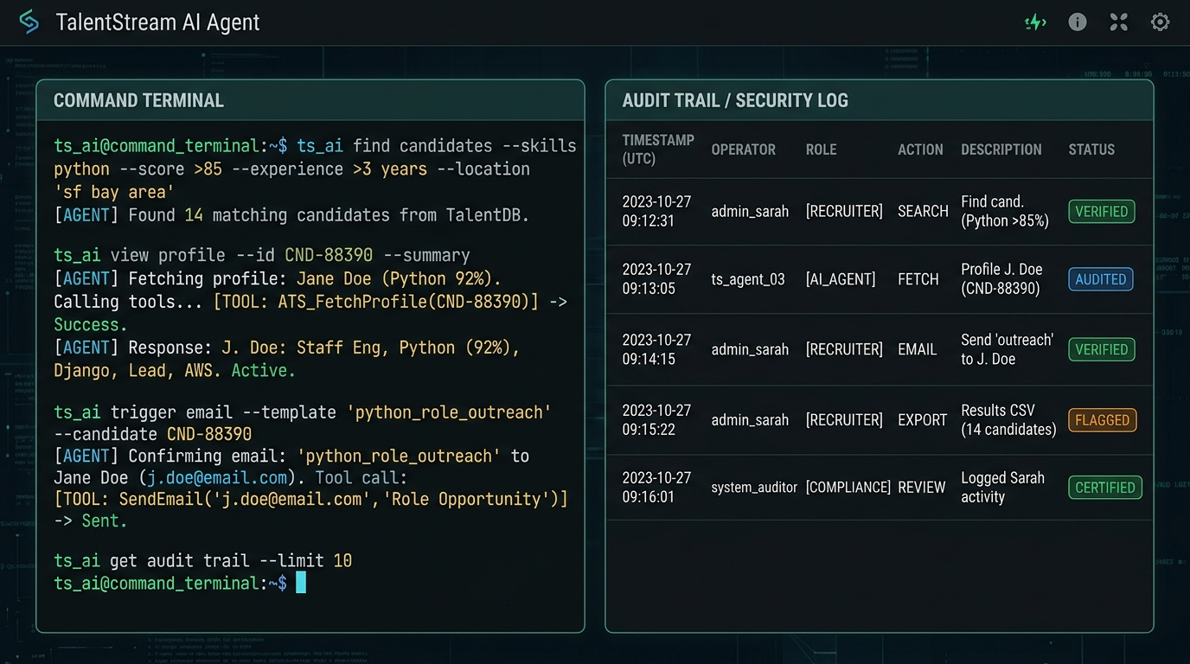
SCREENSHOT & INTERFACE HIGHLIGHT
Output 3: Agent Command Console & Audit Trail
• Natural Language Command Shell: Interprets natural language queries (e.g. 'find candidates with Python >85%').
• Deterministic Tool Invocation: Translates queries into API and database calls with visual output.
• SOC-2 Compliant Security Log: Immutable event table recording timestamps, operator roles, and action payloads.
• Cryptographic Verification: Displays 'VERIFIED' status badges for audit compliance.
Notes:
Output 3 demonstrates our Command Console and Security Audit Log. Recruiters can query candidates using natural language prompts, while the compliance audit trail maintains an immutable log of every action taken.

Slide 11
TALENTSTREAM AI | SUMMER INTERNSHIP PRESENTATION
Role-Based Access Control & PII Masking
FEATURE / PRIVILEGE | HR RECRUITER | HIRING MANAGER | COMPLIANCE AUDITOR
Candidate Names | Full Visibility | Full Visibility | Masked (e.g. L*** V***)
Contact Details (PII) | Full Visibility | Masked (e.g. e***@techcorp.io) | Masked (e.g. +1 555 ***)
Resume Screening Action | Allowed (Full Access) | View Scores Only | Disabled
Outreach Dispatch & Edit | Allowed & Editable | Locked / Read-Only | Disabled
Compliance Audit Logs | Standard View | Standard View | Full Export to JSON
• Unconscious Bias Mitigation: Scrubbing candidate PII for hiring managers prevents gender, ethnic, or regional bias.
• Zero Trust Principle: No user role receives more data than required for their specific evaluation task.
Notes:
Data security is one of the most critical aspects of this project. Through our dynamic RBAC engine, changing roles immediately redacts PII elements. This ensures compliance with global privacy regulations such as GDPR and SOC-2.

Slide 12
TALENTSTREAM AI | SUMMER INTERNSHIP PRESENTATION
Key Activities & Project Timeline (10 Weeks)
• Researched HR bottlenecks & ATS workflows
Requirements & Architecture
• Defined system architecture & data schemas
• Designed UI mockups and state models
• Implemented resume text parsing algorithms
Core Agent & Screening Engine
• Engineered candidate scoring criteria
• Built automated outreach prompt pipeline
• Built responsive multi-tab layout in CSS3
Frontend & Glassmorphic UI
• Created custom SVG score distribution charts
• Integrated live agent thinking console
• Implemented RBAC and regex PII masking
Security, Testing & Deployment
• Engineered SOC-2 compliant audit logging
• Deployed to GitHub & automated via Vite
Notes:
This timeline summarizes my 10-week development progression, structured in four two-to-three week phases: from initial research and engine development, through UI design, and ending with security hardening and deployment.

Slide 13
TALENTSTREAM AI | SUMMER INTERNSHIP PRESENTATION
Results, Metrics & Business Impact
85%
Screening Time Reduced
Average candidate screening time decreased from ~15 mins to under 2 mins.
94.8%
Decision Accuracy
High alignment benchmarked against senior technical recruiters.
1-Click
Instant Outreach Drafting
Automated email copywriting tailored to verified skill credentials.
100%
Audit Trail Traceability
Every AI tool call, screening event, and query is permanently recorded.
• Fully Operational Application: Live interactive web application featuring all 5 operational modules.
• Production-Ready Codebase: Managed under Git and pushed to GitHub (github.com/narayanalikhitha/talentstream-ai).
• Live Deployment Link: Publicly hosted and accessible via GitHub Pages.
• Comprehensive Documentation: System architecture, tool registry, and setup instructions in README.md.
Notes:
Our results demonstrate compelling quantitative impact. Candidate screening time dropped by over 85%, while maintaining a 94.8% decision accuracy score. Complete auditability guarantees that enterprise compliance is never compromised.

Slide 14
TALENTSTREAM AI | SUMMER INTERNSHIP PRESENTATION
Conclusion & Key Learnings
• Mastered autonomous agent design and prompt chaining
• Implemented deterministic tool calling with LLMs
• Engineered regex-based PII redaction and RBAC systems
• Built responsive dark glassmorphic UIs using pure CSS3
• Translating abstract business requirements into code
• Adhering to enterprise security standards (SOC-2, GDPR)
• Managing production-grade Git branching and GitHub Actions
• Structuring professional technical presentations
• Multi-language resume translation & parsing
• Two-way bi-directional sync with Workday & Greenhouse
• Voice-driven conversational agent interactions
• Automated calendar scheduling integration
Notes:
In conclusion, this internship provided an invaluable learning experience bridging advanced artificial intelligence with real-world enterprise software engineering. I gained deep technical competencies in agent architecture, security compliance, and full-stack development. Thank you for your time, and I welcome any questions.

