Slide 1
RNA-seq: From (good) experimental design to (accurate) gene expression abundance.
Steve Munger
Narayanan Raghupathy
The Jackson Laboratory
21st Century Mouse Genetics
11 August 2016

Slide 2
Outline
General overview of RNA-seq analysis.
Introduction to RNA-seq
The importance of a good experimental design
Quality Control
Read alignment
Quantifying isoform and gene expression
Normalization of expression estimates

Slide 3
RNA-seq: Sequencing Transcriptomes
mRNA
ATGCTCA
AGCTA
TAGATGCTCA
AGCTA
ATGCTCA
AGCTAATC
ATGCTCA
AGCTA
AGTAGATGCTCA
AGCTA
ATGCTCA
AGCTA
ATGCTCA
AGCTA
ATGCTCA
AGCTA
TAGATGCTCA
AGCTAATC
CTCA
AGCTAATCCTAG

Slide 4
Applications of RNA-seq Technology
Normal
Cancer
Differential Gene expression analysis

Slide 5
Applications of RNA-seq Technology
Evidence from
RNA-seq
Annotated gene
Novel exon discovery

Slide 6
Applications of RNA-seq Technology
Novel exon discovery

Slide 7
Applications of RNA-seq Technology
exon1
exon2
exon3
Isoform 1
Isoform 2
Alternative splicing

Slide 8
Applications of RNA-seq Technology
A
ATGCTCA
AGCTA
A
AGCTA
TAGATGCTCA
AGCTAAT
GCTCA
A
TGCTCA
A
AGCTAA
A
ATGCTCA
AGCTA
A
AGCTA
TAGATGCTCA
AGCTAATC
A
ATGCTCA
A
AGCTA
Mom
ATGCTCA
TAGATGCTCA
A
AGCTAATCCTAG
TAGATGCTCA
G
AGCTAATCCTAG
Dad
G
AGCTATCC
ATGCTCA
ATGCTCA
G
AGCTATCCT
G
AGCTA
ATGCTCA
Allele-Specific gene Expression (ASE)
Preferential expression of one allele over the other.

Slide 9
RNA-seq Work Flow
Study Design
RNA isolation/ Library Prep
Sequencing Reads (SE or PE)
Aligned Reads
Quantified isoform and gene expression
N

Slide 10
Total RNA
RNA-Seq
mRNA
mRNA after
fragmentation
cDNA
Adaptors ligated
to cDNA
Single/ Paired End
Sequencing
N

Slide 11
Know your application – Design your experiment accordingly
How many reads? Read depth
Single-end or Paired-end sequencing?
Read length?
How many samples?
N

Slide 12
RNA-seq Experimental design
Differential expression of highly expressed and well annotated genes?
Smaller sample depth; more biological replicates
No need for paired end reads; shorter reads (50bp) may be sufficient.
Better to have 20 million 50bp reads than 10 million 100bp reads.
Looking for novel genes/splicing/isoforms?
More read depth, paired-end reads from longer fragments.
N

Slide 13
Good Experimental Design
Multiplexing
Replication
Randomization
Illumina flowcell
N

Slide 14

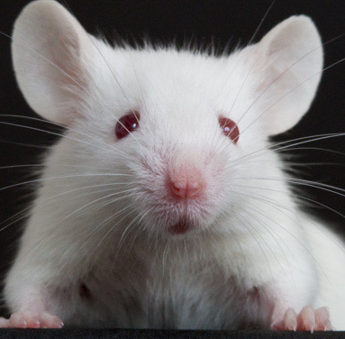
RNA-Seq Experimental Design: Randomization
Experimental Group 1
Experimental Group 2
Two Illumina Lanes
Bad Design
N

Slide 15
RNA-Seq Experimental Design: Randomization
Experimental Group 1
Experimental Group 2
Two Illumina Lanes
Bad Design
Better Design
Mouse ENCODE reanalysis: http://f1000research.com/articles/4-121/v1
N

Slide 16
RNA-seq Work Flow
Study Design
RNA isolation/ Library Prep
Sequencing Reads (SE or PE)
Aligned Reads
Quantified isoform and gene expression
N

Slide 17
Total RNA
RNA-Seq
mRNA
mRNA after
fragmentation
cDNA
Adaptors ligated
to cDNA
Single/ Paired End
Sequencing
N

Slide 18
Millions and millions of reads…
@HISEQ2000_0074:8:1101:7544:2225#TAGCTT/1
TCACCCGTAAGGTAACAAACCGAAAGTATCCAAAGCTAAAAGAAGTGGACGACGTGCTTGGTGGAGCAGCTGCATG
+
CCCFFFFFHHHHDHHJJJJJJJJIJJ?FGIIIJJJJJJIJJJJJJFHIJJJIJHHHFFFFD>AC?B??C?ACCAC>BB<<<>C@CCCACCCDCCIJ
@HISEQ2000_0074:8:1101:7544:2225#TAGCTT/1
The member of a pair
Instrument: run/flowcell id
Flowcell lane and tile number
Index Sequence
X-Y Coordinate in flowcell
Q = -10 log₁₀ P
10 indicates 1 in 10 chance of error
20 indicates 1 in 100,
30 indicates 1 in 1000,
Phred Score:
SN
Notes:
# = 35 – 33 = 2 D = 68-33 = 35 J = 74 – 33 = 41 = Highest Quality Score
1 = 49 – 33 = 16 F = 70 – 33 = 37
“=“ = 61 – 33 = 28 H = 72 – 33 = 39

Slide 19
Quality Control: How to tell if your data is clean
FASTX-Toolkit
http://hannonlab.cshl.edu/fastx_toolkit/
FastQC
http://www.bioinformatics.babraham.ac.uk/projects/fastqc/
RNA-seq Data: ftp://ftp.jax.org/dgatti/MouseGen2016/
B6-100K.fastq and Cast-100K.fastq
S

Slide 20
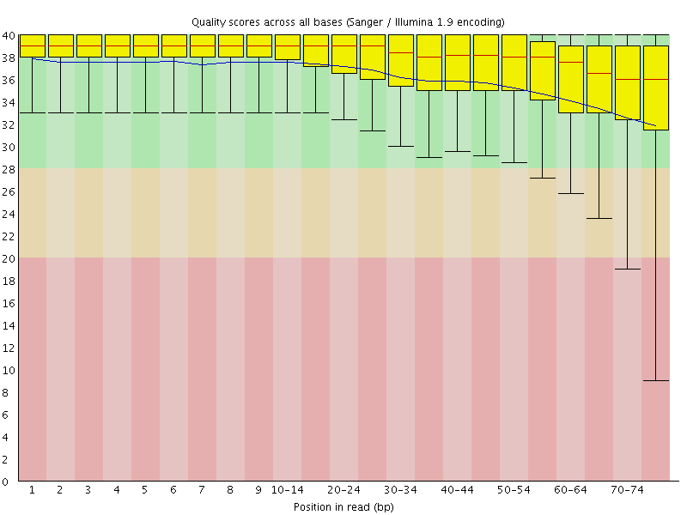
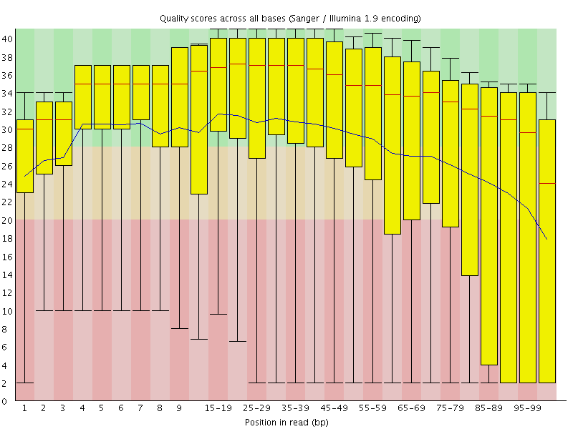
Quality Control: How to tell if your data is clean
Good data
Consistent
High Quality Along the reads
Bad data
High Variance
Quality Decrease with Length
RNA-seq Data: ftp://ftp.jax.org/dgatti/MouseGen2016/
B6-100K.fastq and Cast-100K.fastq
S

Slide 21
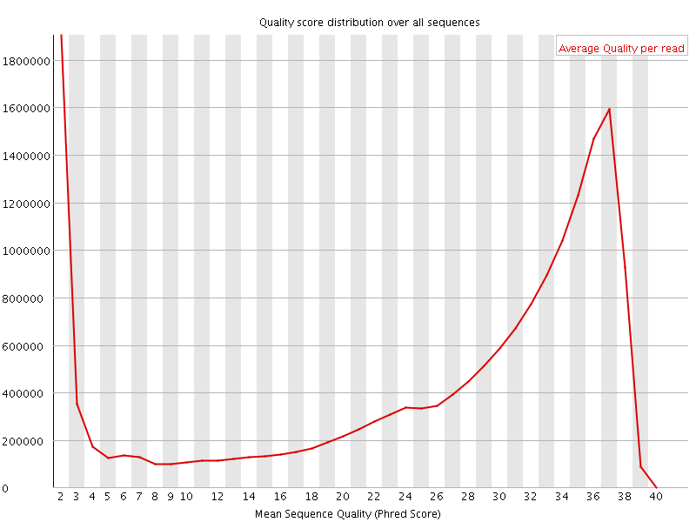
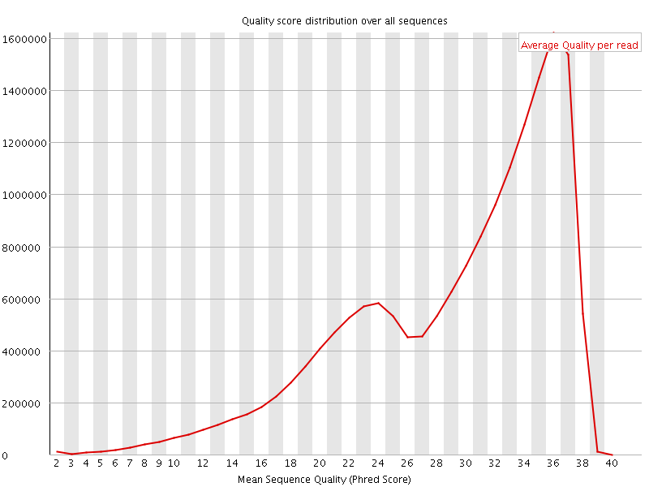
Per sequence quality distribution
bad data
Y= number of reads
X= Mean sequence quality
Average data
S

Slide 22
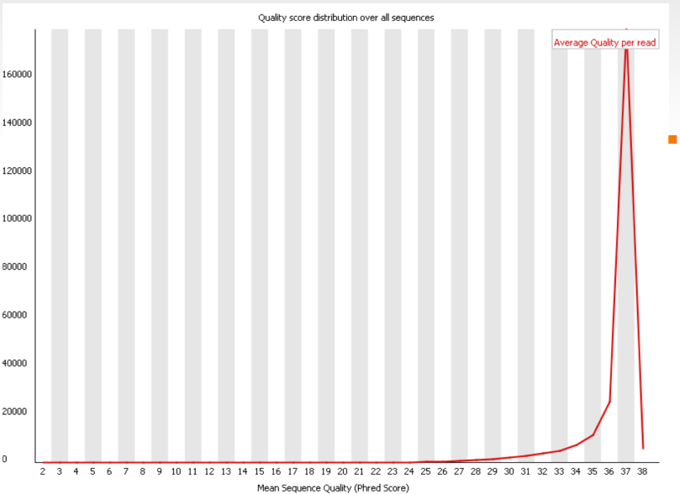
Per sequence quality distribution
bad data
Good data
Y= number of reads
X= Mean sequence quality
Average data
S

Slide 23
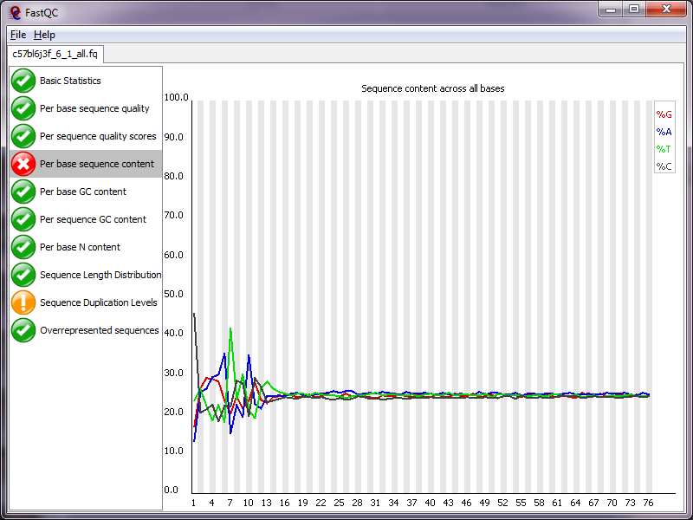
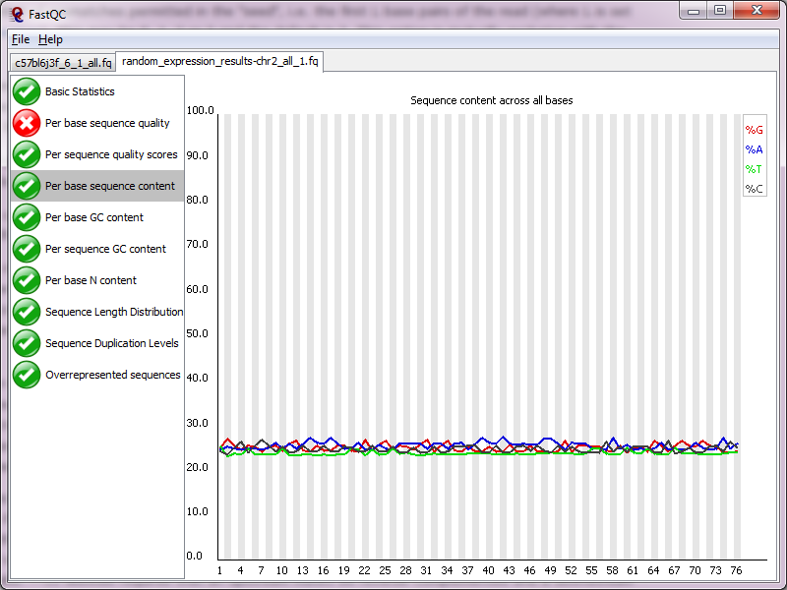
Quality Control: Sequence Content Across Bases
S

Slide 24
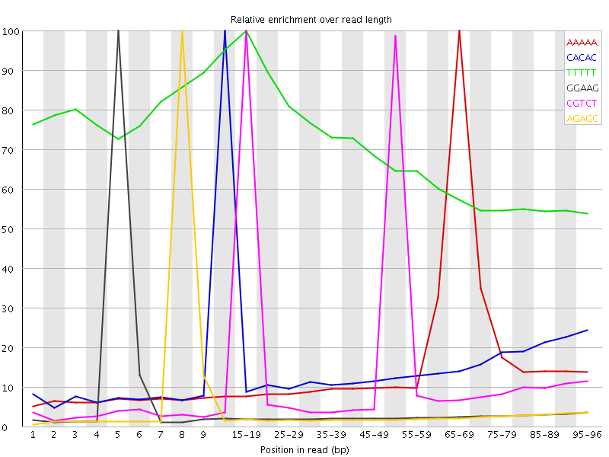
K-mer content
counts the enrichment of every 5-mer within the sequence library
Bad: If k-mer enrichment >= 10 fold at any individual base position

Slide 25
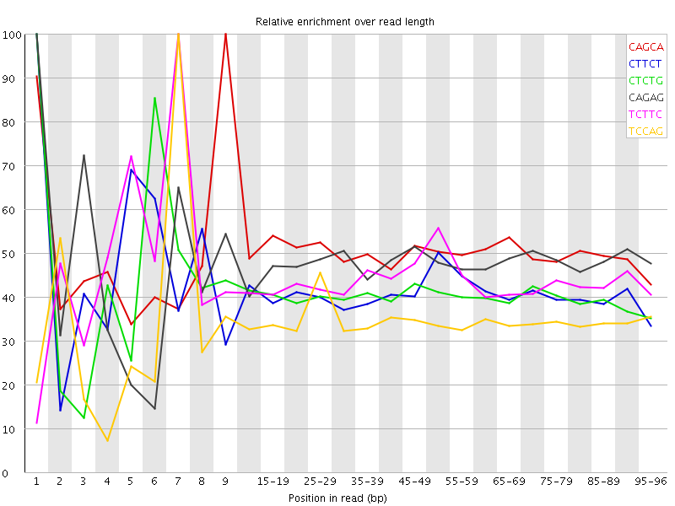
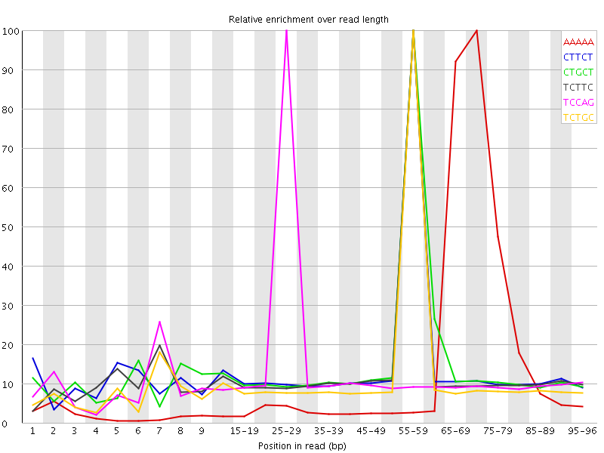
K-mer content
Most samples

Slide 26
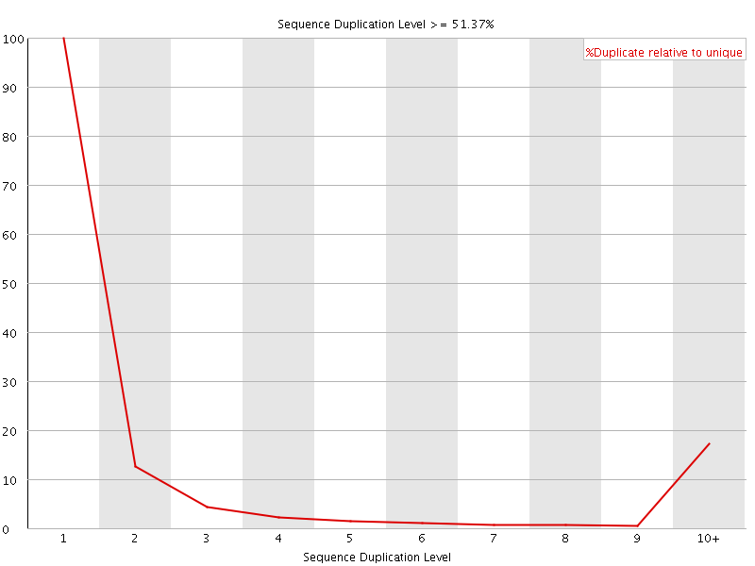
Duplicated sequences
Good: non-unique sequences make up less than 20%
Bad: non-unique sequences make >50%
S

Slide 27
Tradeoffs to preprocessing data
Signal/noise -> Preprocessing can remove low-quality “noise”, but the cost is information loss.
Some uniformly low-quality reads map uniquely to the genome.
Trimming reads to remove lower quality ends can adversely affect alignment, especially if aligning to the genome and the read spans a splice site.
Duplicated reads or just highly expressed genes?
Most aligners can take quality scores into consideration.
Currently, we do not recommend preprocessing reads aside from removing uniformly low quality samples.
S

Slide 28
RNA-seq Work Flow
Study Design
RNA isolation/ Library Prep
Sequencing Reads (SE or PE)
Aligned Reads
Quantified isoform and gene expression
S

Slide 29
Alignment 101
100bp Read
ACATGCTGCGGA
Chr 3
ACATGCTGCGGA
Chr 2
Chr 1
S

Slide 30
The perfect read: 1 read = 1 unique alignment.
100bp Read
ACATGCTGCGGA
✓
Chr 3
ACATGCTGCGGA
Chr 2
Chr 1
S

Slide 31
Some reads will align equally well to multiple locations. “Multireads”
100bp Read
✗
ACATGCTGCGGA
✓
ACATGCTGCGGA
✗
ACATGCTGCGGA
1 read
3 valid alignments
Only 1 alignment is correct
ACATGCTGCGGA
S

Slide 32
Aligning Millions of Short Sequence Reads
Gene A
Gene B
Aligners: Bowtie, GSNAP, STAR, BWA, BLAT,
HISAT2, Bowtie2, Kallisto, Salmon
N

Slide 33
Align to Genome or Transcriptome?
Genome
Advantages: Can align novel isoforms.
Disadvantages: Difficult, Spurious alignments, spliced alignment, gene families, pseudo genes
Transcriptome
N

Slide 34
Align to Genome or Transcriptome?
Genome
Advantages: Can align novel isoforms.
Disadvantages: Difficult, Spurious alignments, spliced alignment, gene families, pseudo genes
Transcriptome
Advantages: Easy, Focused to the part of the genome that is known to be transcribed.
Disadvantages: Reads that come from novel isoforms may not align at all or may be
misattributed to a known isoform.
N

Slide 35
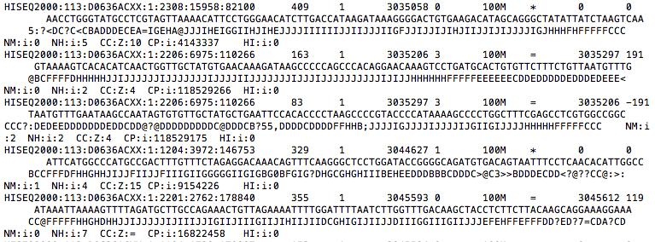
Output of most aligners: Bam/Sam file of reads and genome positions
N

Slide 36
Visualization of alignment data (BAM/SAM)
Genome browsers – IGV and UCSC
Integrative Genome Viewer (IGV)
http://software.broadinstitute.org/software/igv/download
RNA-seq Data: ftp://ftp.jax.org/dgatti/MouseGen2016/
DO.chr1XY.sorted.bam and DO.chr1XY.sorted.bam.bai
Notes:
Have students load IGV. Upload a BAM file to Sharepoint.

Slide 37
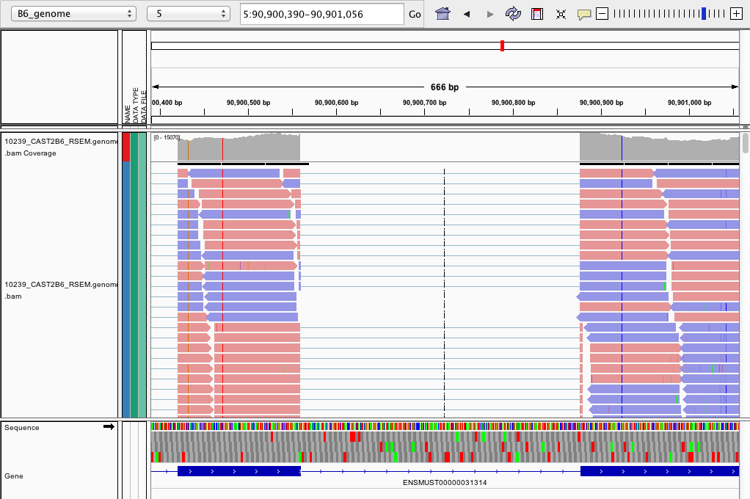
IGV is your friend.
SNP
Coverage density plot
Read color = strand

Slide 38
Example genes to look at in IGV
Tsn
Gorab
Fmo1, Fmo2, Fmo3, Fmo4, Fmo6
Ids
Zfx
Ssty1, Ssty2

Slide 39
Aligned Reads to Gene Abundance
Total RNA
100bp Reads
Aligned Reads
Quantified isoform and gene expression
N

Slide 40
Aligned Reads to Gene Abundance: Challenges
Long
Short
Many approaches to quantify expression abundance
N

Slide 41
Aligned Reads to Gene Abundance: Challenges
200
1000 reads
1
Long
100
2
Medium
50
3
Short
Relative abundance for these genes, f₁, f₂, f₃
N

Slide 42
Aligned Reads to Gene Abundance: Challenges
200
400
1
Long
100
400
2
Medium
50
200
3
Short
Relative abundance for these genes, f₁, f₂, f₃
N

Slide 43
Multireads: Reads Mapping to Multiple Genes/Transcripts
200
350
1
Long
150
100
300
2
Medium
Multireads
50
200
3
Short
Unique
Relative abundance for these genes, f₁, f₂, f₃
N

Slide 44
Approach 1: Ignore Multireads
200
350
1
Long
150
100
300
2
Medium
50
200
3
Short
Relative abundance for these genes, f₁, f₂, f₃
Nagalakshmi et. al. Science. 2008
Marioni, et. al. Genome Research 2008
N

Slide 45
Approach 1: Ignore Multireads
200
350
1
Long
150
100
300
2
Medium
50
200
3
Short
Over-estimates the abundance of genes with unique reads
Under-estimates the abundance of genes with multireads
Not an option at all, if interested in isoform expression
N

Slide 46
Approach 2: EM algorithm based allocation of Multireads
200
350
1
Long
150
100
300
2
Medium
50
200
3
Short
Relative abundance for these genes, f₁, f₂, f₃
RSEM, Cufflinks, isoEM, MMSEQ & eXpress
N

Slide 47
Approach 2: EM algorithm based allocation of Multireads
gene 1
gene 2
Long
9 reads
1 read
N

Slide 48
Approach 2: EM algorithm based allocation of Multireads
gene 1
gene 2
Long
9 reads
1 read
0.9
0.1
N

Slide 49
The rise of Pseduo-alignment a.k.a alignment-free methods
100bp Read
ACATGCTGCGGA
Sailfish, Salmon, and Kallisto
K-mers
Transcriptome
Chr 2

Slide 50
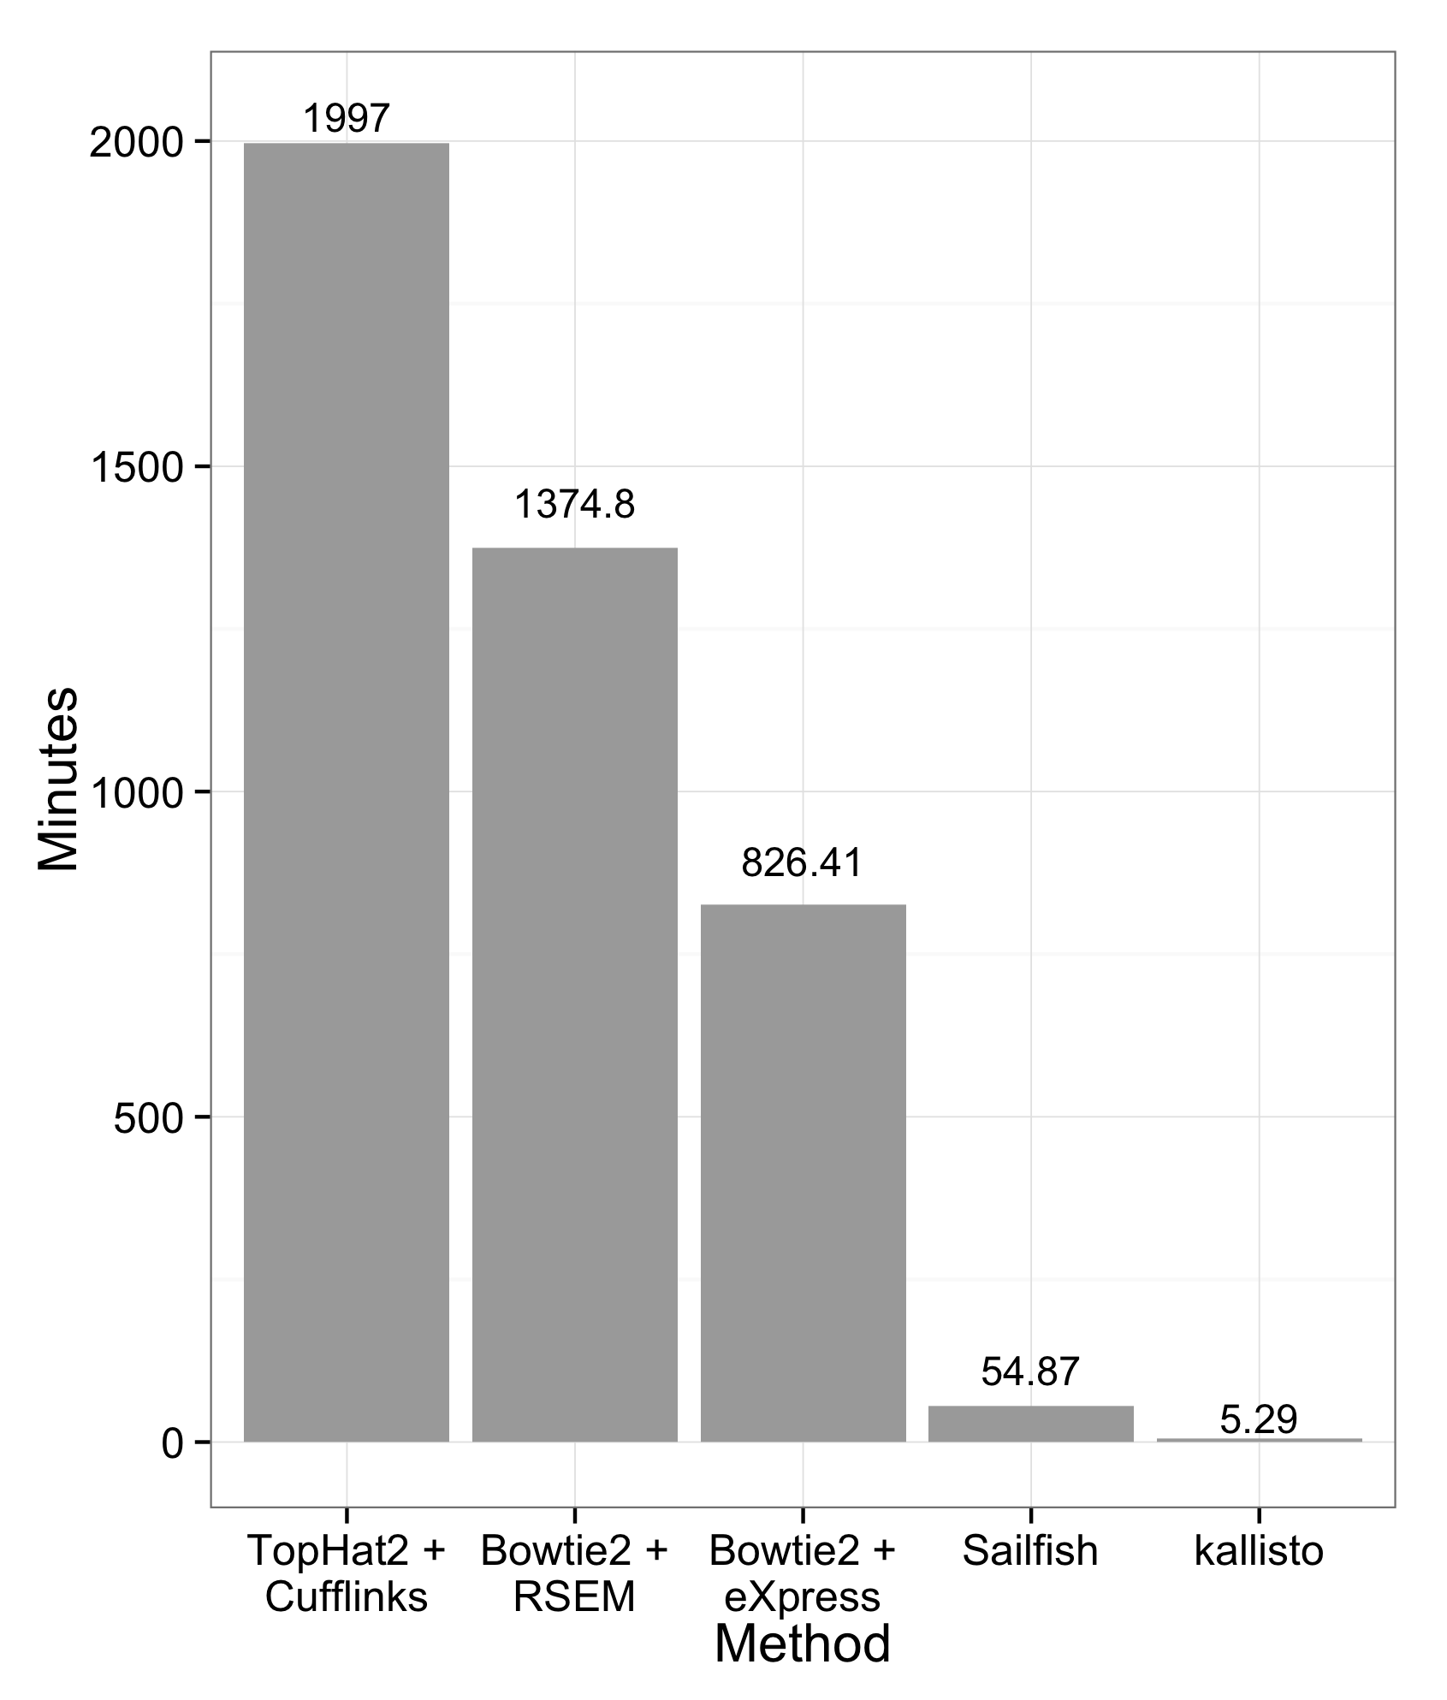
Kallisto: K-mer based pseudo-alignment
100bp Read
ACATGCTGCGGA
Expression quantitation for
30 Million Reads
Running time in minutes

Slide 51
Conclusions for quantitation
EM approaches are currently the best option.
Isoform-level estimates are stilll challenging and will become easier as read length increases.
K-mer counting methods (Salmon, Kallisto) are very fast – they can be run easily on your own PC – and are reasonably accurate.
N

Slide 52
Expression Abundance: Counts, RPKM/FPKM, TPM
Sample 1
Long Gene
Short Gene
Sample 2
Long Gene
Short Gene
Number of Fragments Matched to a Gene / Kilo base
FPKM
Total matched reads in Millions

Slide 53
Normalization
A speed bump on the road from raw counts to differential expression.
S

Slide 54
Large pool, small sample problem
Typical RNA library estimated to contain 2.4 x 10¹² molecules. McIntyre et al 2011
Typical sequencing run = 25 million reads/sample.
This means that only 0.00001 (1/1000th of a percent) of RNA molecules are sampled in a given run.
High abundance transcripts are sampled more frequently.
Example: Albumin = 13% of all reads in liver RNA-seq samples.
Sampling errors affect low-abundance transcripts most.
S

Slide 55
A finite pool of reads.
S

Slide 56
Perfect world: All transcripts counted.
Sample 1
Sample 2
Alb
Alb
Low1
Low1
S
Notes:
Albumin differentially expressed, but Low1 is not differentially expressed.

Slide 57
Sample 1
Real world: More reads taken up by highly expressed genes means less reads available for lowly expressed genes.
Alb
Low1
S

Slide 58
Sample 1
Sample 2
Alb
Alb
Highly expressed genes that are differentially expressed can cause lowly expressed genes that are not actually differentially expressed to appear that way.
Low1
Low1
S
Notes:
Higher expressed Albumin in sample 2 sucks up the reads that would have gone to Low1, making Low1 appear to be differentially expressed between the samples.

Slide 59
Normalization of raw counts
Wrong way to normalize data
Normalizing to the total number of mapped reads (e.g. FPKM). Top 10 highly expressed genes soak up 20% of reads in the liver. FPKM is widely used, and problematic.
Better ways to measure data
Normalize to upper quartile (75th %) of non-zero counts, median of scaled counts (DESeq), or the weighted trimmed mean of the log expression ratios (EdgeR).
S

Slide 60
Differential Expression Analysis
T-test
Expression
Normal
Cancer
Over-estimation of
Too conservative
Under-estimation of
Too sensitive
(Many false positives)
DESEQ2, edgeR, Voom, & CuffDiff
Notes:
t_g =
\dfrac{\hat{\mu}_{g,1}-\hat{\mu}_{g,2}}
{\sqrt{\dfrac{\hat{\sigma}^2_{g,1}}{N_1}+
\dfrac{\hat{\sigma}^2_{g,2}}{N_2}
}
}

Slide 61
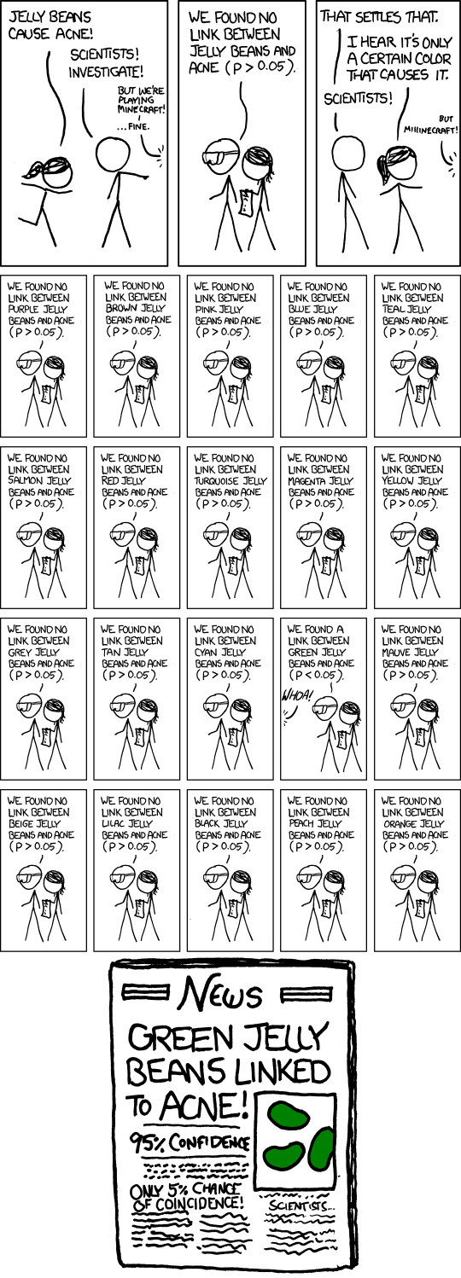
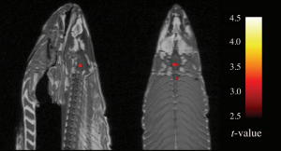
Multiple Testing Correction and False Discovery rate
XKCD Significant
2012 IgNobel prize in
Neuroscience for “finding
Brain activity signal in dead salmon using fMRI”
N

Slide 62
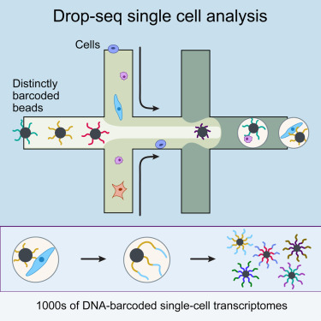
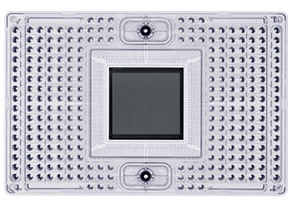
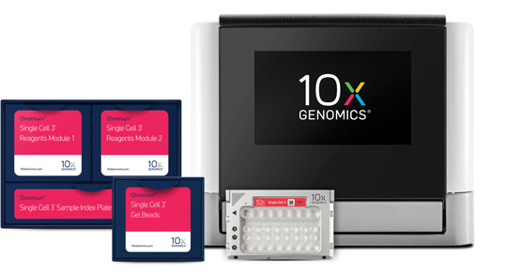
Single Cell RNA-seq Technologies
DropSeq: 40,000 cells
10X Genomics:
48,000 cells
Fluidigm C1 Chip
96 cells / 800 Cells

Slide 63
Summary
RNA
ATGCTCA
AGCTA
TAGATGCTCA
AGCTA
ATGCTCA
AGCTAATC
ATGCTCA
AGCTA
AGTAGATGCTCA
AGCTA
ATGCTCA
AGCTA
ATGCTCA
AGCTA
ATGCTCA
AGCTA
TAGATGCTCA
AGCTAATC
CTCA
AGCTAATCCTAG

Slide 64
Summary
RNA
ATGCTCA
AGCTA
TAGATGCTCA
AGCTA
ATGCTCA
AGCTAATC
ATGCTCA
AGCTA
AGTAGATGCTCA
AGCTA
RNA-seq analysis pipeline
Experimental Design
ATGCTCA
AGCTA
ATGCTCA
AGCTA
ATGCTCA
AGCTA
TAGATGCTCA
AGCTAATC
CTCA
AGCTAATCCTAG
As sequences get longer, alignment and isoform quantitation becomes easier!

Slide 65
Resources
Aligner
Bowtie 2 http://bowtie-bio.sourceforge.net/bowtie2/index.shtml
GSNAP http://research-pub.gene.com/gmap/
Transcript Discovery/Annotation
- STAR https://github.com/alexdobin/STAR/releases
- Tophat http://tophat.cbcb.umd.edu/
Transcript Abundance
Kallisto http://pachterlab.github.io/kallisto/
RSEM http://deweylab.biostat.wisc.edu/rsem/
EMASE https://github.com/churchill-lab/emase
Differential Expression
DESeq http://www-huber.embl.de/users/anders/DESeq/
edgeR http://bioconductor.org/packages/release/bioc/html/edgeR.html
EBSeq https://www.biostat.wisc.edu/~kendzior/EBSEQ/

Slide 66
Example 1
Differential expression in my mutant mouse compared to wild type. What genes are up- or down-regulated?

Slide 67
Things to consider…
Differential expression of highly expressed and well annotated genes?
Smaller sample depth; more biological replicates
No need for paired end reads; shorter reads (50bp) may be sufficient.
Better to have 20 million 50bp reads than 10 million 100bp reads.
Looking for novel genes/splicing/isoforms?
More read depth, paired-end reads from longer fragments.
N

Slide 68
Example 2
How to quantify gene expression in a species that has not been sequenced or annotated?
Multistep strategy using multiple sequencing technologies.

Slide 69
Example 3
How to quantify single cell gene expression in a heterogeneous human tumor?

Slide 70
Any other applications you are interested in? Steve Munger steven.munger@jax.org Narayanan Raghupathy narayanan.raghupathy@jax.org

Slide 71
Acknowledgements
KB Choi
Gary Churchill
Ron Korstanje/ Karen Svenson/ Elissa Chesler
Joel Graber
Doug Hinerfeld
Anuj Srivastava
Churchill Lab – Dan Gatti
Al Simons and Matt Hibbs
Lisa Somes, Steve Ciciotte, mouse room staff at JAX
Gene Expression Technologies group at JAX

