Slide 1

AIIT- Amity Institute of Information Technology
Presents
Student Driven Workshop on Sustainability awareness

Slide 2
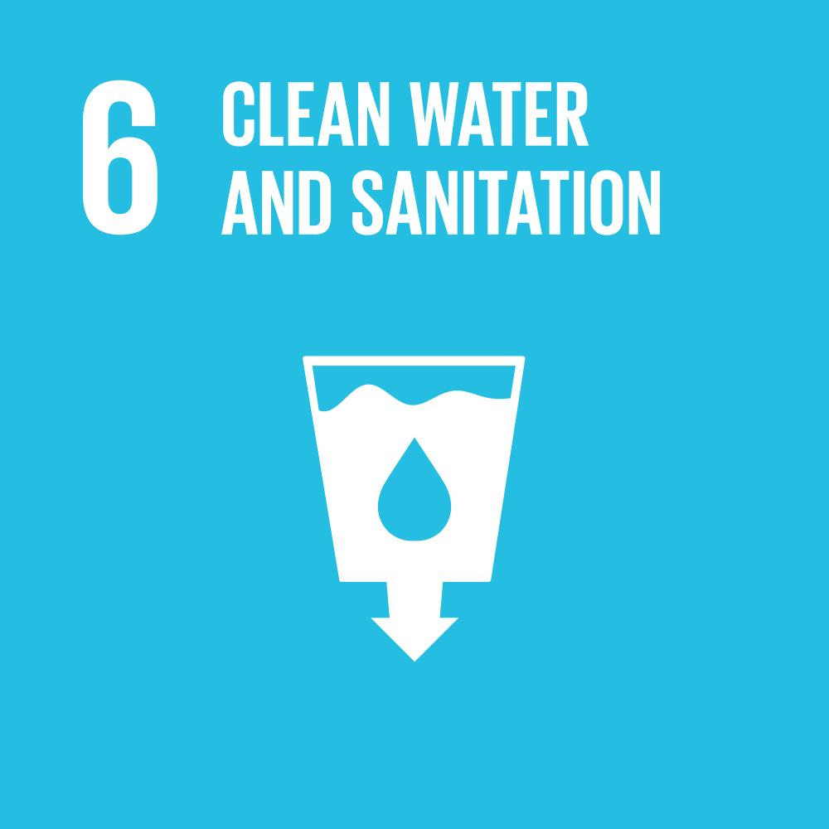

Slide 3
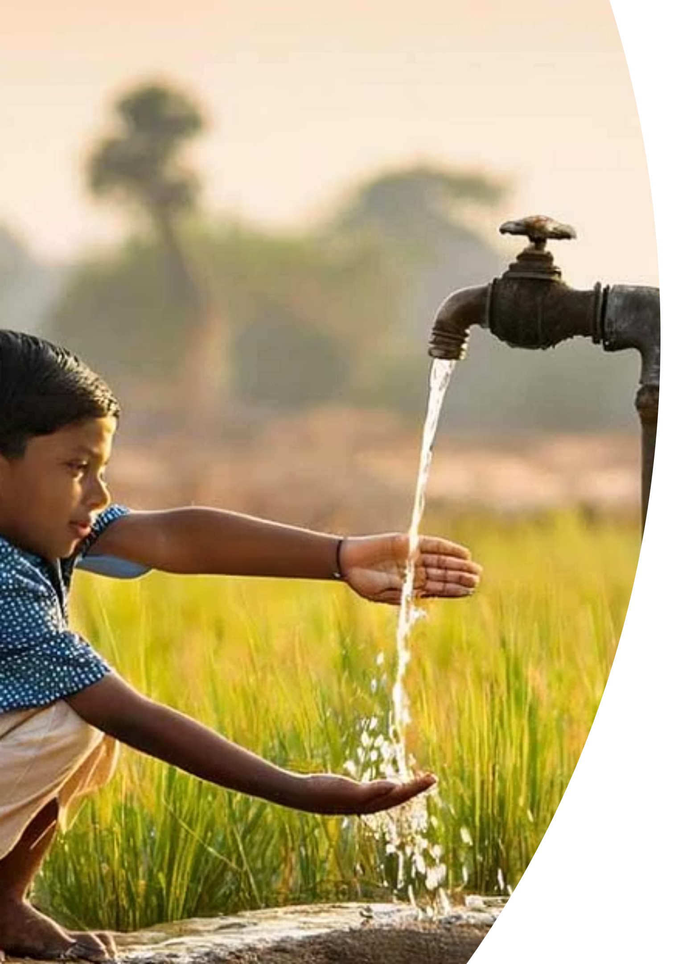
Clean Water and Sanitation
SDG GOAL 6
Ensuring access to safe water, sanitation, and hygiene for every person on the planet — a foundation for health, dignity, and sustainable development.

Slide 4


What Is SDG 6?
A Universal Human Right
Clean water means safe, accessible drinking water free from contamination. Sanitation means proper management of waste and promotion of hygiene practices. Together, they form a basic human right recognized by the United Nations.
SDG 6 calls on all nations to achieve universal and equitable access to safe drinking water and adequate sanitation by 2030.

Slide 5
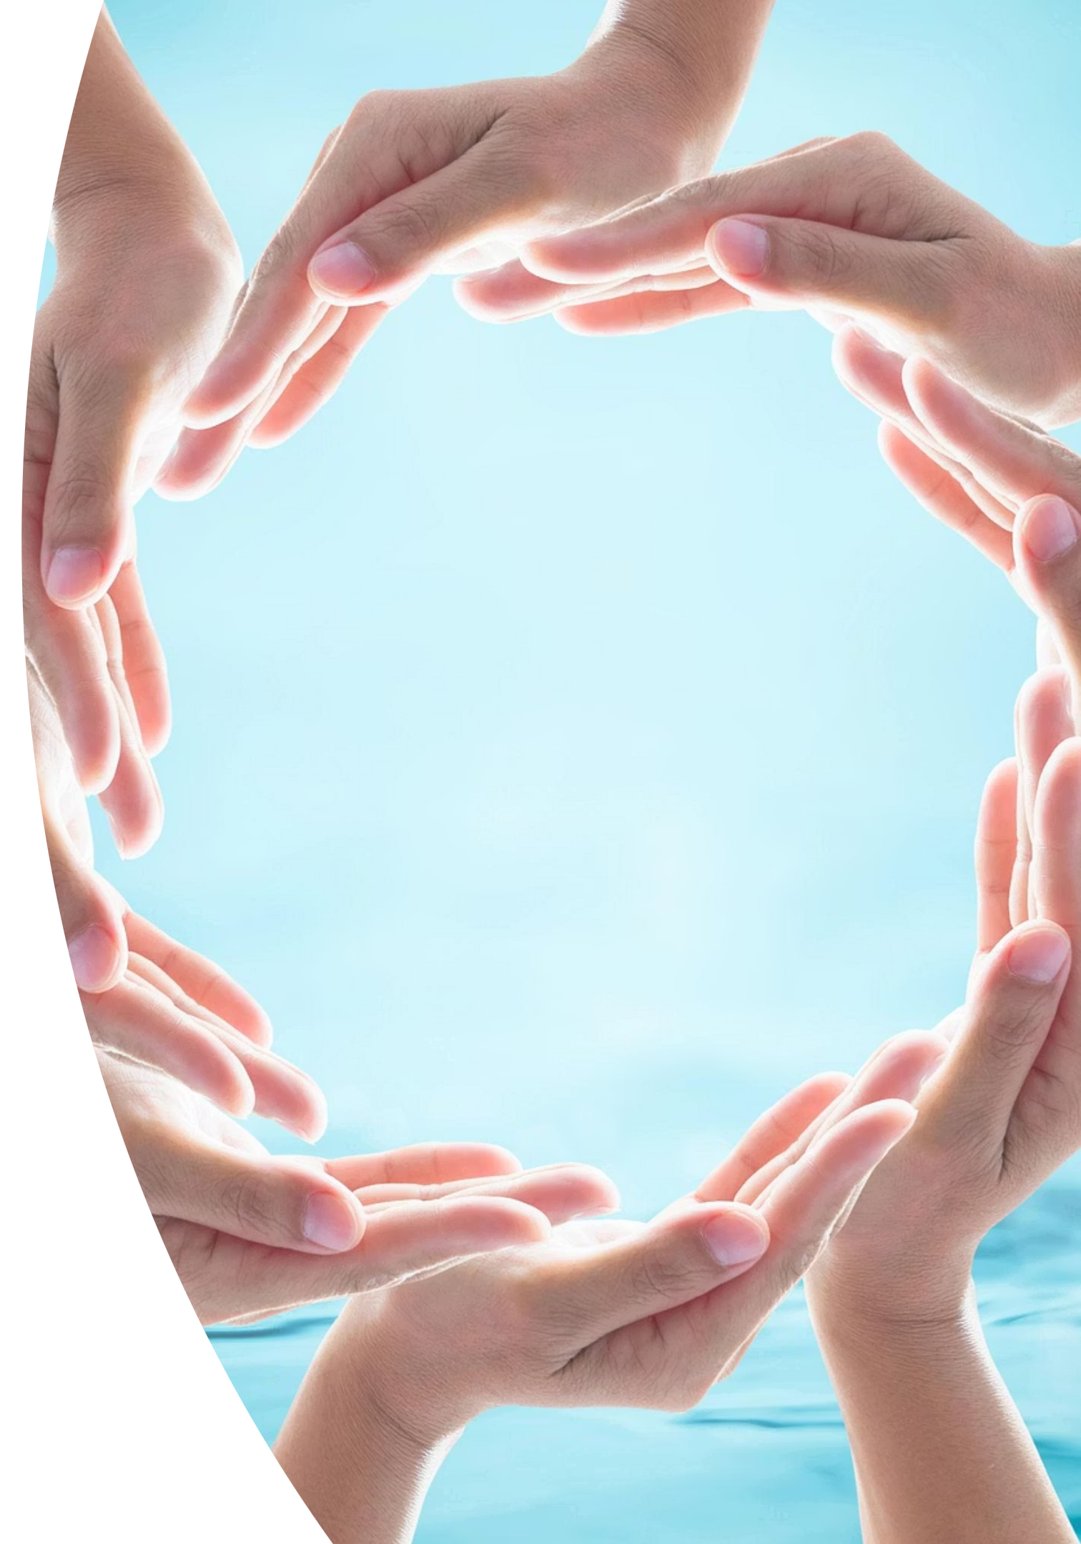
Why Clean Water and Sanitation Matter
🏥 Public Health
Prevents deadly diseases like cholera, typhoid, and diarrhea — the leading causes of child mortality worldwide.
🌾 Economy & Agriculture
Clean water sustains agriculture, supports industry, and reduces the economic burden of waterborne illness.
♻️ Environment
Proper sanitation protects ecosystems, reduces water pollution, and supports sustainable land and resource use.
📈 Poverty Reduction
Access to water and sanitation unlocks time, health, and economic opportunity — especially for women and girls.

Slide 6
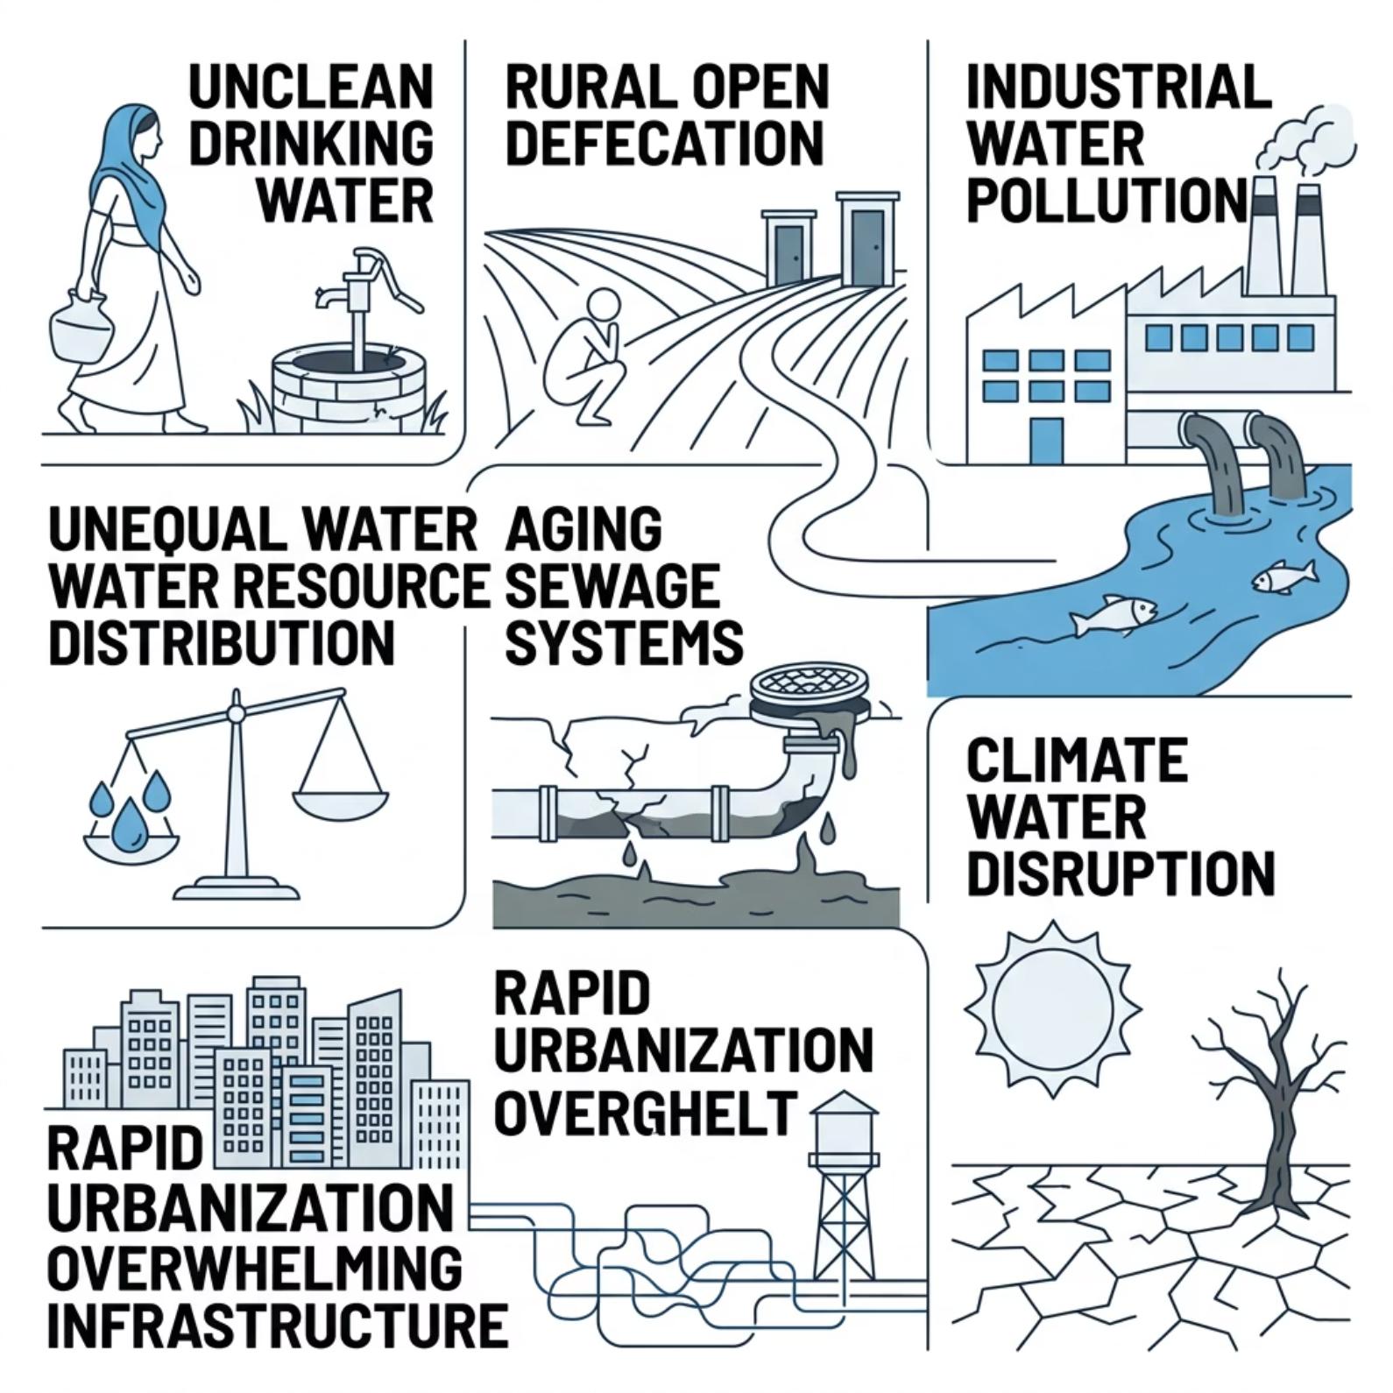


The Challenges We Face Today
A Complex, Interconnected Crisis
No single challenge stands alone. Pollution worsens scarcity; urbanization overwhelms infrastructure; climate change deepens inequality. Addressing SDG 6 requires understanding — and acting on — all of these pressures simultaneously.
Over 2 billion people still lack access to safely managed drinking water. More than 3.6 billion lack safe sanitation services.

Slide 7
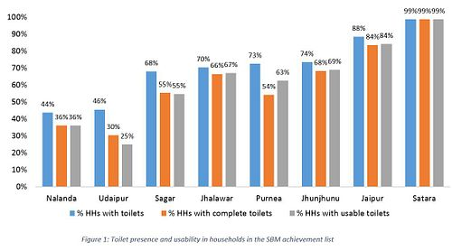
Toilet Presence vs. Usability
Data from India's SBM achievement list reveals a persistent gap: households may have a toilet on record, but many are incomplete or unusable. Building toilets is only the first step — ensuring they are functional and maintained is critical to lasting impact.

Slide 8
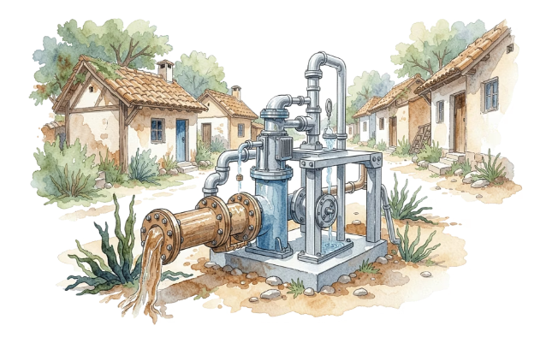
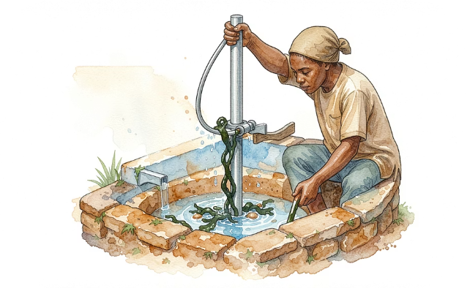
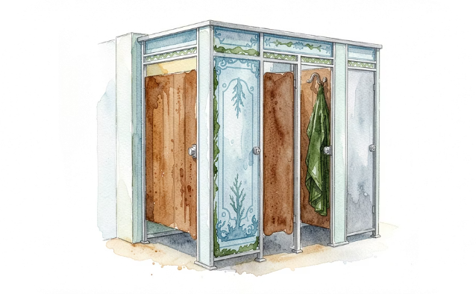
Leading Organizations
NGOs Driving Change on the Ground
WaterAid
Charity: Water
Sulabh International
Works in 28 countries to deliver clean water, decent toilets, and good hygiene — reaching the most marginalized communities.
Has funded over 100,000 water projects globally, bringing clean drinking water to more than 17 million people in developing nations.
Pioneered low-cost sanitation in India, constructing over 1.5 million household toilets and promoting dignity for sanitation workers.

Slide 9
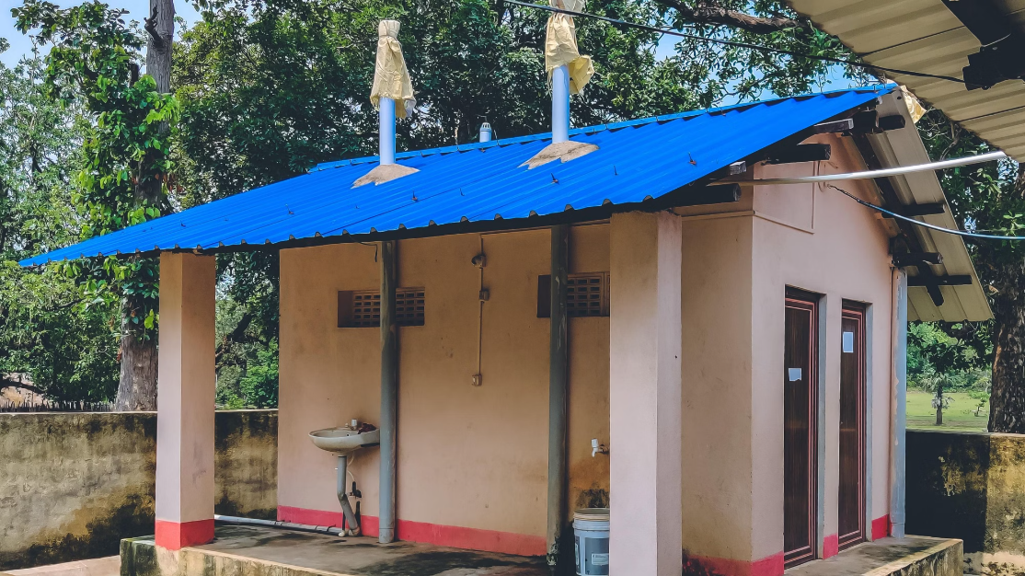
NGO Activities in Action
From Infrastructure to Awareness
Water filtration systems installed in homes, schools, and community centers
Toilet construction in underserved villages, prioritizing schools and women's access
Hygiene campaigns on handwashing, menstrual health, and safe food handling
Community training on wastewater management and rainwater harvesting

Slide 10
Champions of Change
Leaders Who Made a Difference
Bindeshwar Pathak
Scott Harrison
Founded Sulabh International and developed affordable two-pit pour-flush toilets, transforming sanitation access for millions across India.
Founded Charity: Water, pioneering transparent fundraising models that have funded clean water projects in 29 countries.
Bill Gates
Akshay Kumar
Through the Gates Foundation, invested hundreds of millions in reinventing the toilet and financing sanitation innovations for the developing world.
Used his platform and the film Toilet: Ek Prem Katha to spark a national conversation in India about sanitation dignity and open defecation.

Slide 11
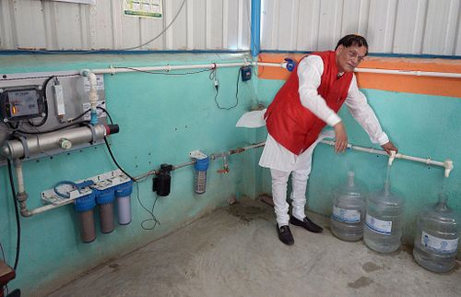
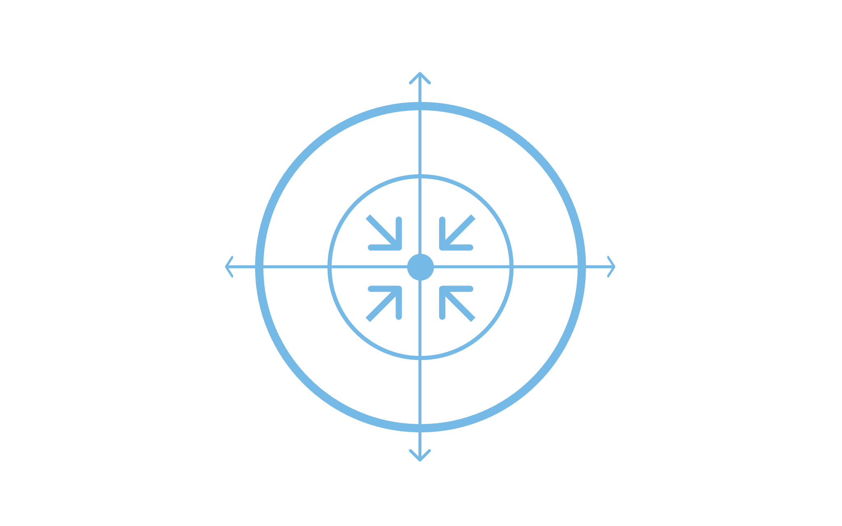
How We Achieve SDG 6 by 2030
Policy & Governance
Conservation
Technology
NGO & Community
Progress requires all four pathways working in parallel — no single sector can close the gap alone. Governments set the framework; technology scales solutions; NGOs build local trust; and conservation ensures long-term resilience.

Slide 12
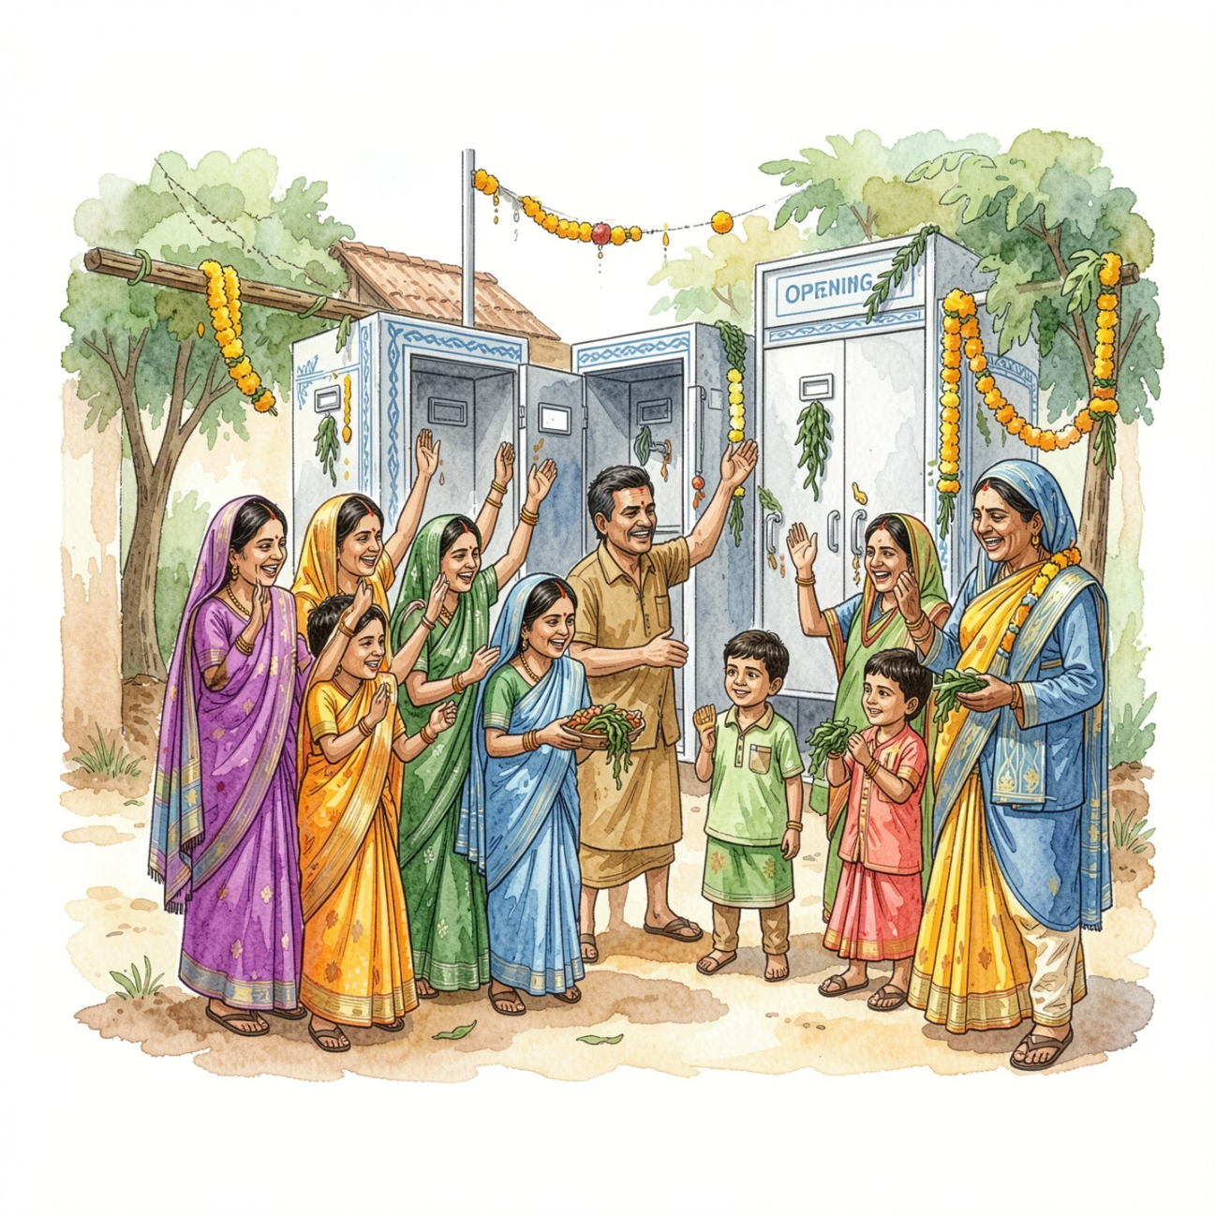
Case Study: India's Swachh Bharat Abhiyan
Launched in 2014, Swachh Bharat Abhiyan (SBM) – or Clean India Mission – is one of the world's largest sanitation initiatives. Its primary goal was to eliminate open defecation across India by October 2019, building millions of household and community toilets.
Massive Infrastructure Rollout: Over 100 million toilets constructed.
Behavioral Change Campaigns: Extensive public awareness campaigns promoted hygiene practices.
Community Participation: Local communities were engaged in planning and maintenance.
While achieving Open Defecation Free (ODF) status for many areas, the focus has now shifted to ODF Plus, emphasizing sustainability, usability, and solid and liquid waste management.

Slide 13



The Path Forward
CALL TO ACTION
Water is not a privilege.
Every Actor Has a Role
Policymakers
NGOs & Partners
Safe water and sanitation are the bedrock of every other development goal. When we secure SDG 6, we unlock health, education, equality, and resilience for all.
Fund, regulate, and prioritize WASH in national development plans.
Bridge gaps, mobilize communities, and deliver where governments cannot reach.
Citizens
Conserve water, demand accountability, and support awareness campaigns.

Slide 14
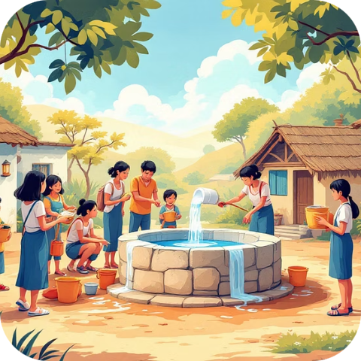
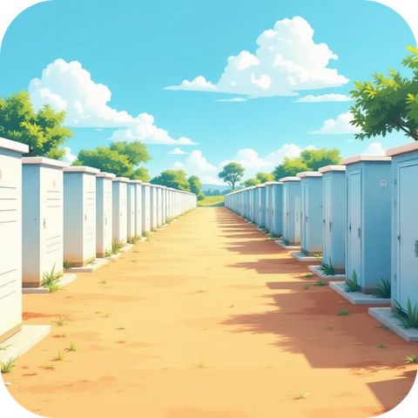
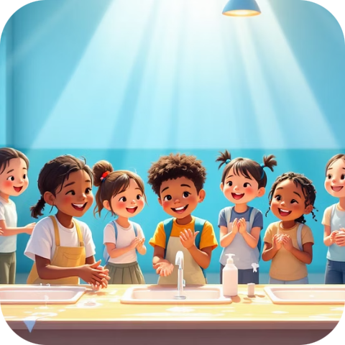
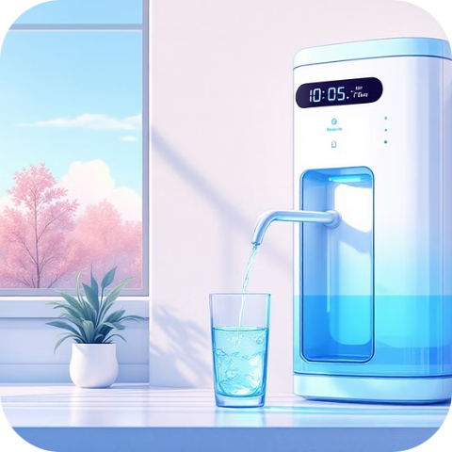
Expanding Our Reach: Activities & Impact
From local initiatives to national programs, a diverse range of activities are underway to achieve SDG 6. These efforts combine infrastructure development with crucial community engagement and education.
Community Water Management
Government Sanitation Schemes
Hygiene Education Initiatives
Advanced Water Purification
Empowering local populations to manage and maintain their water sources, ensuring long-term sustainability and ownership. These projects often lead to significant reductions in waterborne diseases in participating communities.
National programs like India's Swachh Bharat Abhiyan have supported the construction of over 100 million household toilets, drastically reducing open defecation and improving public health for hundreds of millions.
School-based and community-wide campaigns promote critical hygiene behaviors, such as handwashing and safe water storage, reaching an estimated 50 million individuals annually with vital health information.
Deployment of modern water filtration and purification technologies in high-risk areas, providing access to safe drinking water for over 5 million people previously exposed to contaminated sources.

Slide 15
Our Responsibility: Achieving SDG 6
Water. Sanitation. For All.
The journey to secure clean water and sanitation for everyone by 2030 is ongoing. It demands sustained collaboration, innovative solutions, and unwavering commitment from governments, organizations, and individuals worldwide. Together, we can turn this ambitious goal into a universal reality, transforming lives and safeguarding our planet for generations to come.

