Slide 1

Gold: The Enduring Store of Value
Thousands of years of trust. Decades of outperformance. A new era of demand.

Slide 2
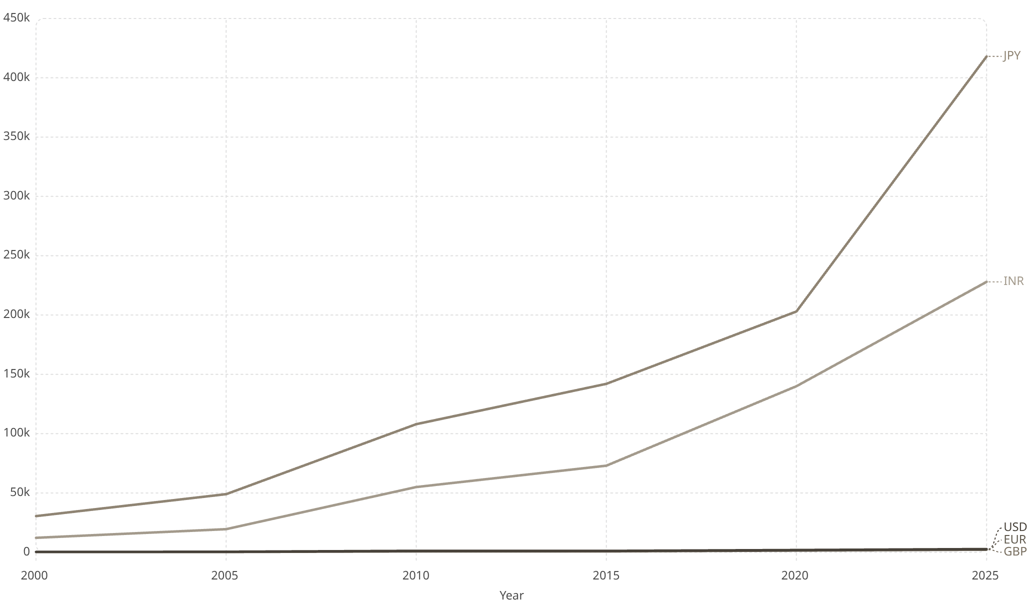
PERFORMANCE
Gold's Global Rise: 2000–2025
Across Every Currency
Gold has risen in all major currencies since 2000 — a universal hedge.
USD: +875%
EUR: +710%
GBP: +1,060%
INR: +1,770%

Slide 3
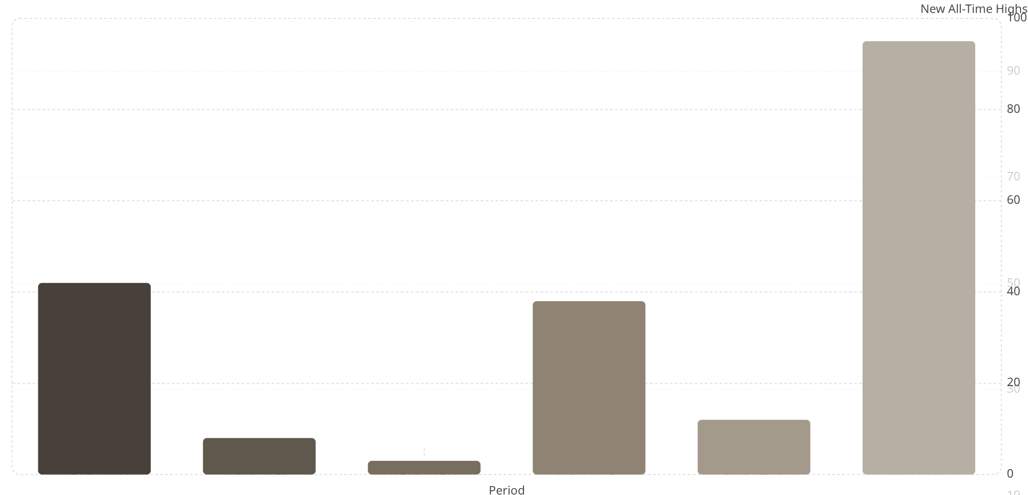
SECULAR BULL MARKET
The Big Long: New All-Time Highs
Accelerating Momentum
New all-time high closes are surging — reflecting a structural, not cyclical, bull market.
1970s
2000s
2020s
Gold standard ends
Post-crisis rally
Record acceleration

Slide 4
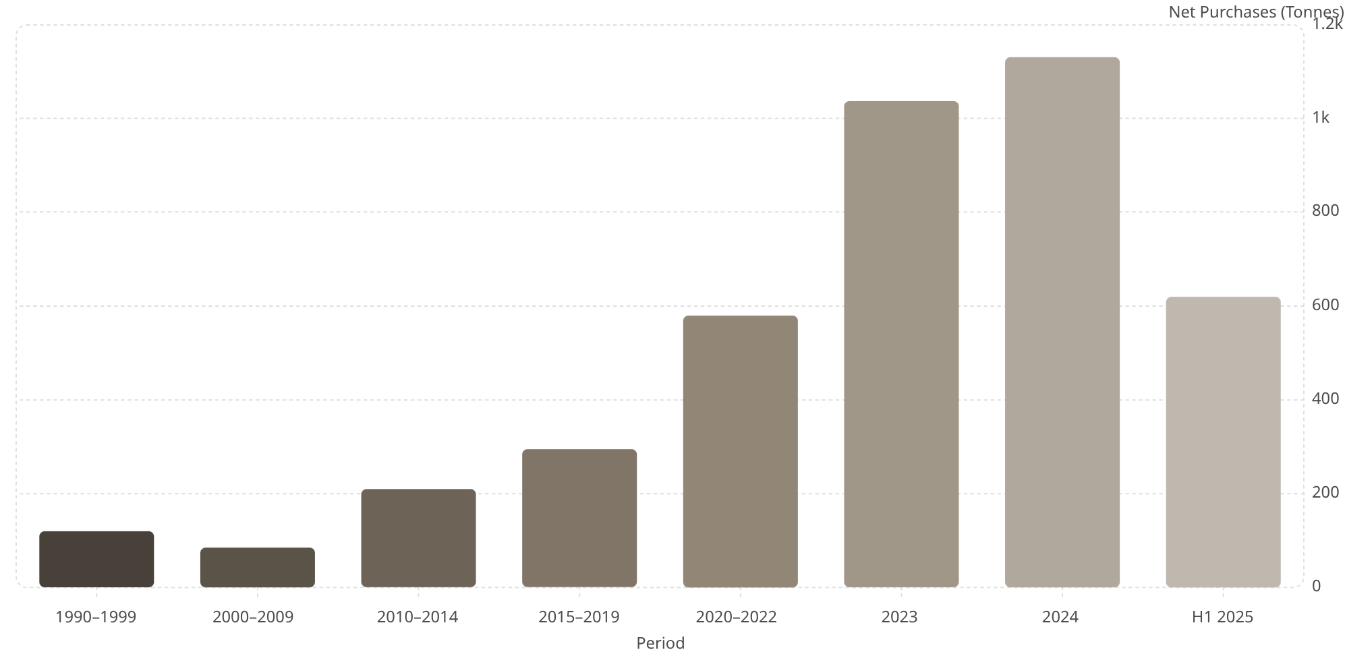
CENTRAL BANKS
A Strategic Shift to Gold
Record Buying
Central banks are accumulating gold at historic rates — diversifying away from the US dollar.
2022–2024
H1 2025
Key Buyers
3 consecutive record years
On pace for another record
China, India, Turkey, Poland

Slide 5
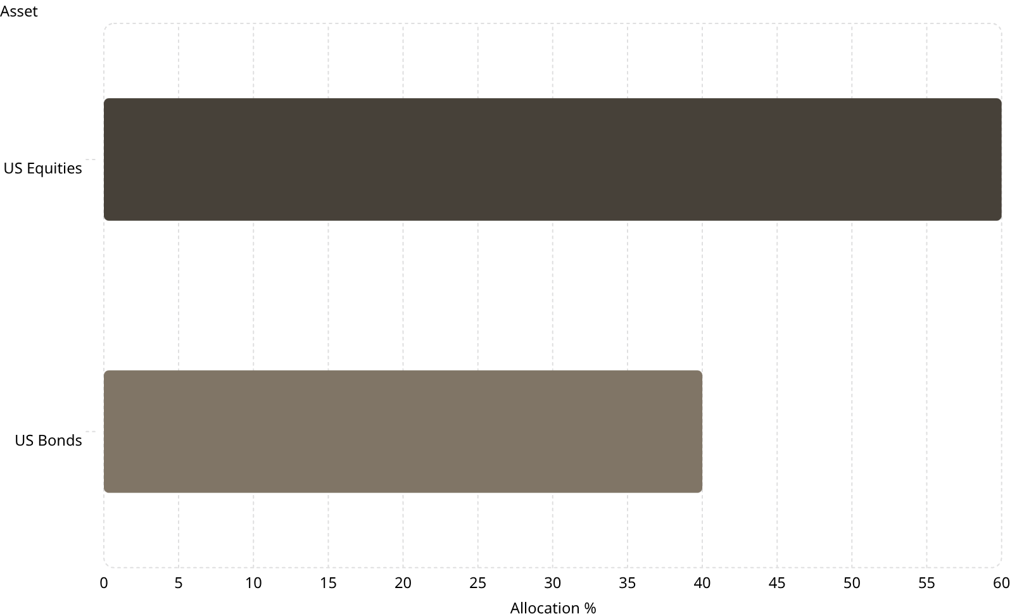
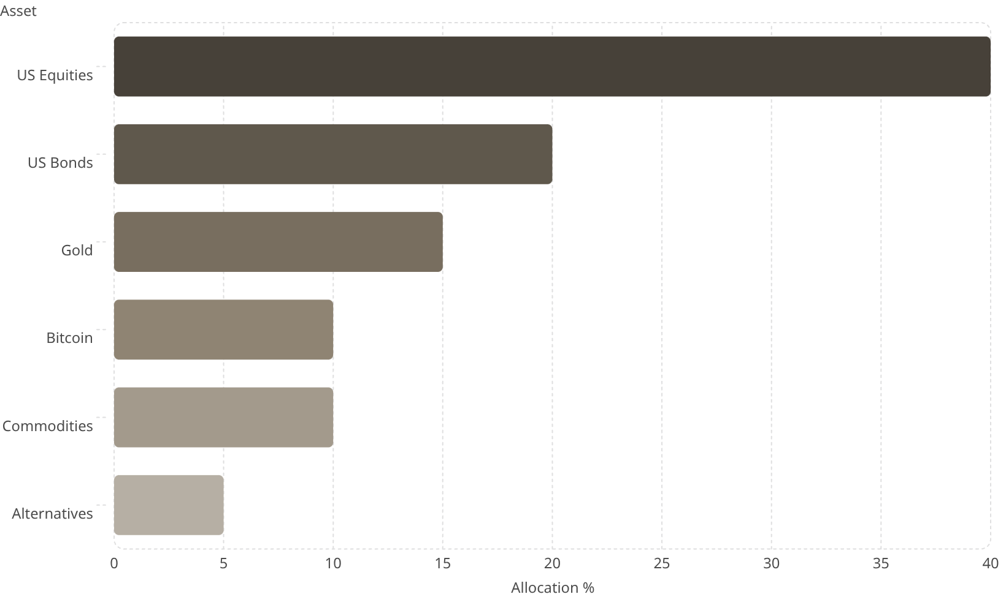
PORTFOLIO STRATEGY
A New Portfolio Paradigm
Old 60/40
New 60/40
Adding gold, Bitcoin & commodities improves diversification and inflation resilience.

