Slide 1
Decision Tree Induction for Heart Disease Prediction
Submitted By:
Narayan Das Nitol 15.02.04.025
Fahim Ahmed 15.02.04.039
Md Fazlay Rabbi 15.02.04.105
Abrar Jaheen Tahmid 15.02.04.112
Supervised By:
Dr. S. M. Abdullah Al-Mamun
Professor
Computer Science and Engineering
Ahsanullah University of Science & Technology

Slide 2
MOTIVATION
Decision tree : an important tool for machine learning
One of the fastest way to identify most significant variables
Can handle both numerical and categorical variables
Requires relatively little effort from users for data preparation
Very easy to understand the output

Slide 3
MOTIVATION(CONTINUED)
Heart Disease : one of the most fatal diseases
Causes many deaths annually
Can die people at anytime anywhere
Have may factors that can cause Heart Diseases like smoking, hyper tension, high blood pressure etc.
Fig 1: Prevalence of Heart Diseases by age for the years 2007-2018.

Slide 4
OBJECTIVE
To study and understand Decision Tree
To study and understand Random Forest
To study heart disease dataset
To implement Decision Tree and Random Forest algorithm with Built-in function and
from scratch
To analyze the results

Slide 5
GENERAL APPROACH FOR CLASSIFICATION
Raw Data
Data collection and preprocessing
Feature Selection
Classification
Preprocessed Data
Subset of Features
Output

Slide 6
DECISION TREE
Decision support tool that uses a tree-like graph or model of decisions
Flowchart like structure in which each internal node represents a “test” on an attribute
Considered to be one of the best and mostly used supervised learning methods
Empowers predictive models with high accuracy and stability

Slide 7
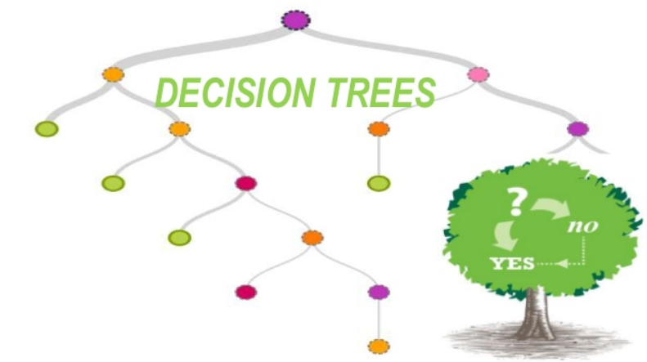
DECISION TREE(CONTINUED)
Figure 1 : Decision Tree

Slide 8
STRUCTURE OF A DECISION TREE
Each node is a test on one attribute
Outlook
sunny
Possible attribute values of the node
rain
overcast
Humidity
Yes
Windy
high
normal
true
false
Leaf is the decision
No
Yes
No
Yes

Slide 9
TYPES OF DECISION TREES
Categorical Variable Decision Trees
Continuous Variable Decision Trees

Slide 10
DECISION TREE ALGORITHMS
There are several algorithms for building decision trees. We mainly want to focus on two algorithms that are listed below-
ID3
CART

Slide 11
ID3 ALGORITHM
Uses entropy and information gain to build decision tree
Calculate entropy of parent node
Calculates entropy of each individual node of split and calculates weighted average of all sub-nodes available in split

Slide 12

ID3 ALGORITHM(CONTINUED)
Entropy:
Entropy 0 (Minimum): All the examples belong to same class.
Entropy 1(Maximum): Equal number of positive and negative examples.
Equation:
$$E\left(S\right)= \sum_{i=1}^{c}{−p_{i }log2 p_{i}}$$
E(S) = - p ₍₊₎ log2 p ₍₊₎ - p ₍₋₎ log2 p ₍₋₎

Slide 13
ID3 ALGORITHM(CONTINUED)
Information Gain:
Information gain is one criteria to decide on the attribute
Equation:
Gain(T, X) = Entropy(T) – Entropy(T, X)
Example:
G(Play Tennis, Outlook) = E(Play Tennis) – E(Play Tennis, Outlook)

Slide 14
CART ALGORITHM
Works with categorical target variable “Success” or “Failure”
Performs only Binary splits
Uses Gini method to create binary splits
Higher the value of Gini, higher the homogeneity

Slide 15

CART ALGORITHM(CONTINUED)
Equation:
1 — P^2(Target=0) — P^2(Target=1)
1- $\sum_{t=0}^{t=1}{P_{t}^{2}}$

Slide 16
RANDOM FORESTS
A large number of individual decision trees
Uses 2 key concepts:
Random sampling of training data points when building trees.
Random subsets of features considered when splitting nodes.
Spits out a class prediction and the class with the most votes becomes our model’s prediction
Has nearly the same hyperparameters as a decision tree or a bagging classifier

Slide 17
RANDOM FORESTS(CONTINUED)
Bagging:
Bagging or bootstrap aggregation a technique for reducing the variance of an estimated prediction function
For classification, a committee of trees each cast a vote for the predicted class
Bootstrap:
Randomly draw datasets with replacement from the training data, each sample the same size as the original training set

Slide 18
RANDOM FORESTS CLASSIFIER
Training Data:
M features
N examples

Slide 19
RANDOM FORESTS CLASSIFIER(CONTINUED)
Bagging:
Create bootstrap samples
from the training data
M features
N examples
....…

Slide 20
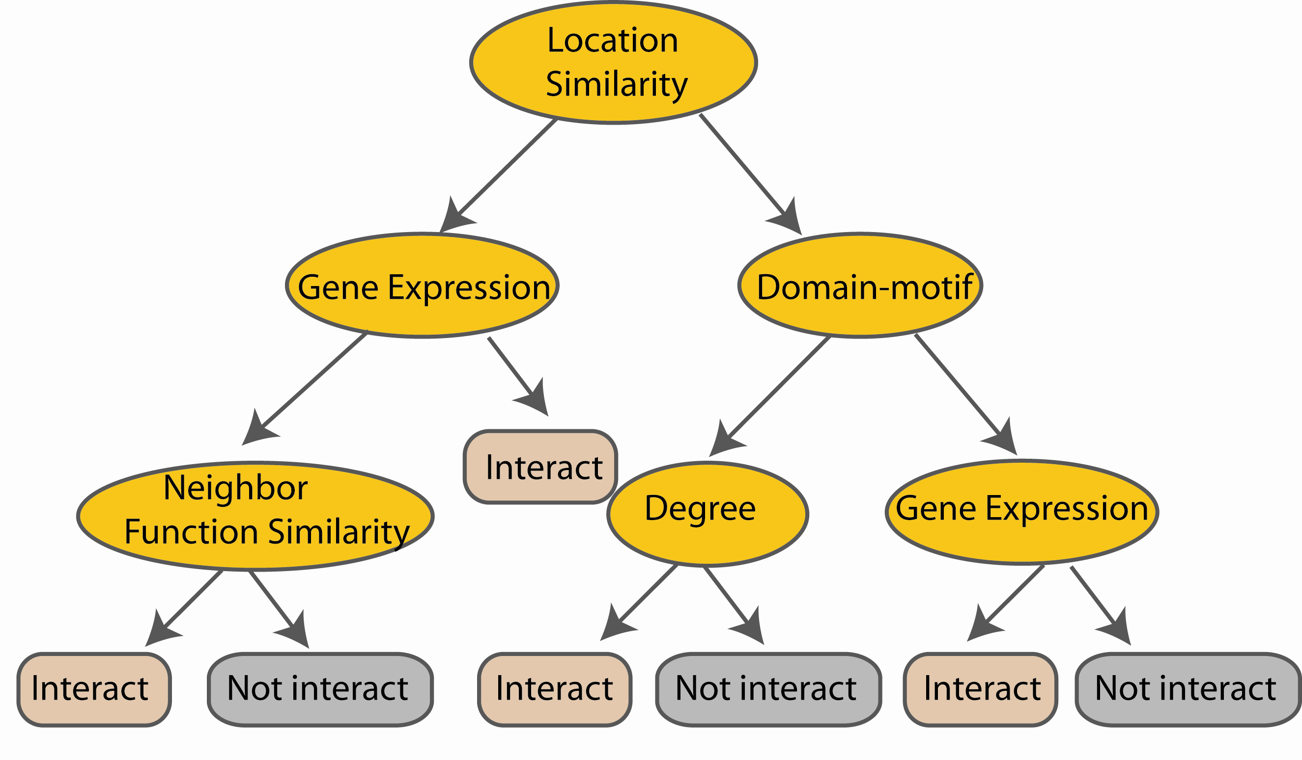
RANDOM FORESTS CLASSIFIER(CONTINUED)
Construct a decision tree
M features
N examples
....…

Slide 21

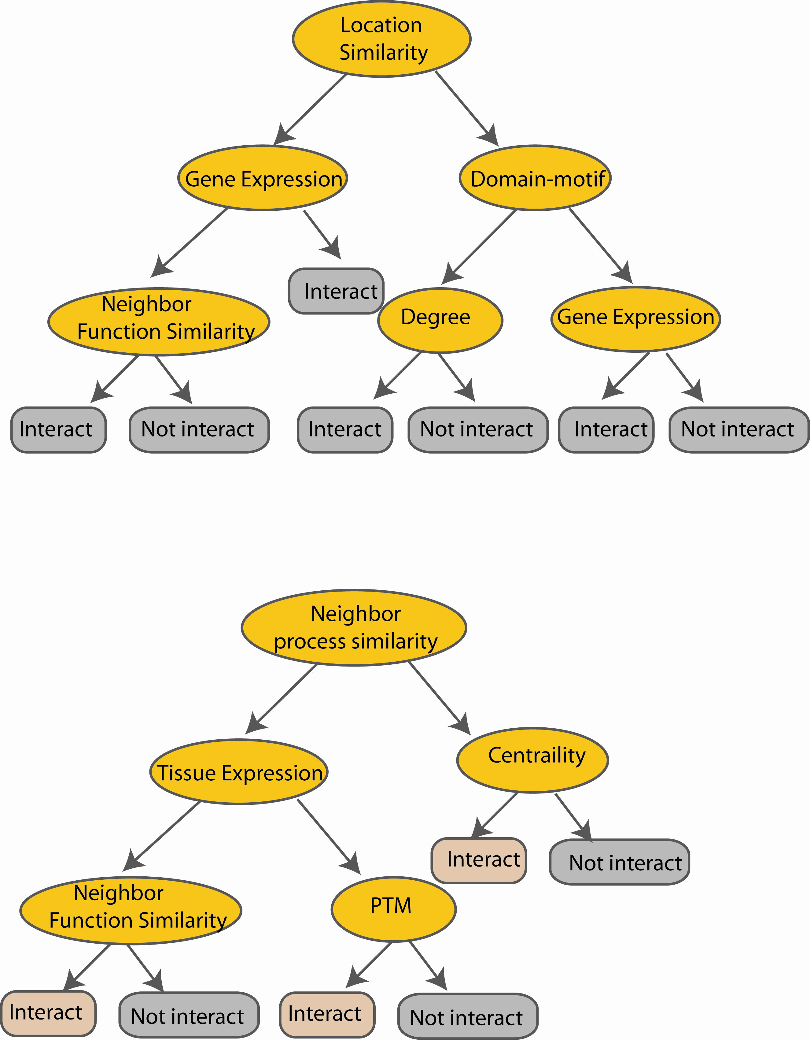
RANDOM FORESTS CLASSIFIER(CONTINUED)
M features
N examples
Take the majority vote
....…
....…

Slide 22
DATA COLLECTION & PREPROCESSING
Data is collected from different resources ( UCI , Kaggle).
Data preprocessing includes:
Importing the libraries
Importing the data-set
Checking out the missing values
Handling the continuous attributes
Renaming the feature column
Splitting the data-set into Training Set and Test Set

Slide 23
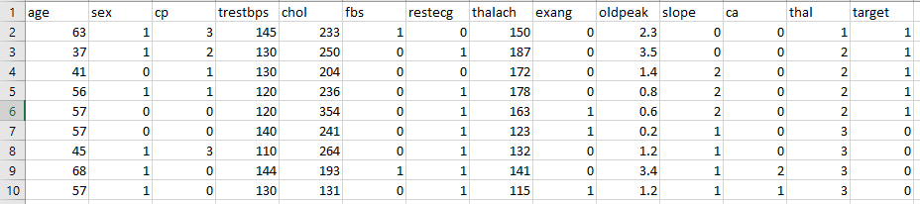
DATASET
In our dataset, there are 303 rows
Among them, 9 rows are given below:
Table 1: Top 9 rows of our dataset

Slide 24
IMPLIMENTATION
ID3 - Built-in functions:
import DecisionTreeClassifier from sklearn.tree
train_test_split(X, Y, test_size=0.1, random_state=1)
clf = DecisionTreeClassifier(criterion=“entropy”), clf = clf.fit(X_train, Y_train)
Y_pred = clf.predict(X_test)

Slide 25
IMPLIMENTATION(CONTINUED)
ID3 - Scratch functions:
train_test_split(df,test_size)
check_purity(data)
classify_data(data)
get_potential_splits(data)
split_data(data,split_column,split_value)
calculate_entropy(data)
calculate_overall_entropy(data_below,data_above)
determine_best_split(data,potential_splits)
decision_tree_algorithm(df,min_samples=2,max_depth)

Slide 26
IMPLIMENTATION(CONTINUED)
CART functions:
import DecisionTreeClassifier from sklearn.tree
train_test_split(X, Y, test_size=0.1, random_state=1)
clf = DecisionTreeClassifier(criterion = “gini”), clf = clf.fit(X_train, Y_train)
Y_pred = clf.predict(X_test)

Slide 27
IMPLIMENTATION(CONTINUED)
Random Forest - Built-in functions:
import RandomForestClassifier from sklearn.tree
clf = RandomForestClassifier(n_estimators=100)
clf.fit(y_train, y_train)
y_pred = clf.predict(x_test)

Slide 28
IMPLIMENTATION(CONTINUED)
Random Forest – Scratch functions:
bootstrapping(train_df, n_bootstrap)
random_forest_algorithm(train_df, n_trees, n_bootstrap, n_features, dt_max_depth)
random_forest_predictions(test_df, forest)

Slide 29
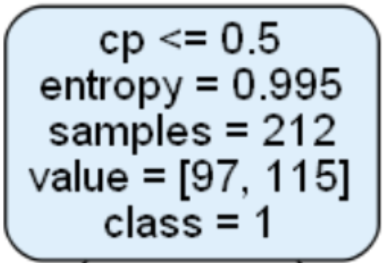
RESULT ANALYSIS
There are many factors related to Decision Tree when we generate a tree:
Figure 2: Tree factors

Slide 30
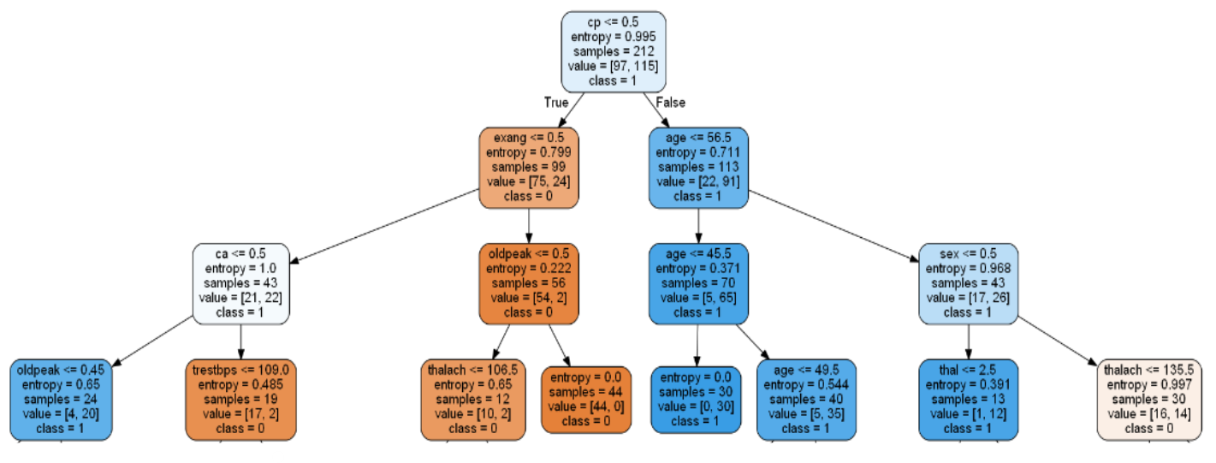
RESULT ANALYSIS(CONTINUED)
ID3 at max level 3
Figure 3: ID3 at Max Level 3

Slide 31
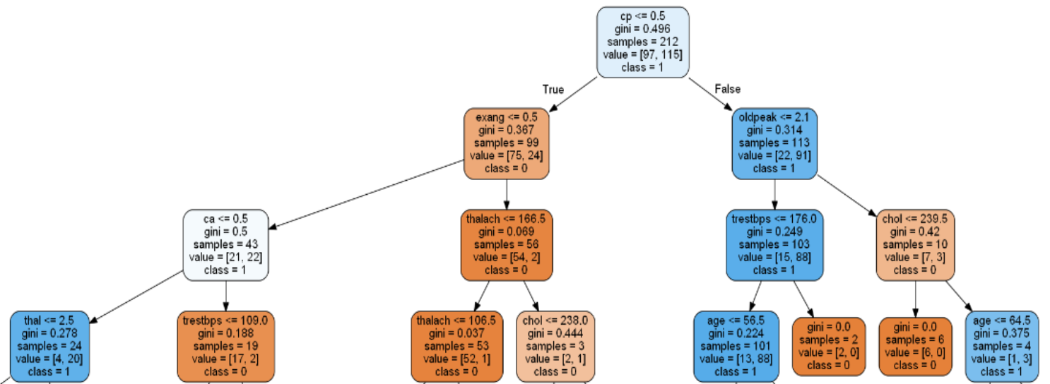
RESULT ANALYSIS(CONTINUED)
CART at max level 3
Figure 4: CART at Max Level 3

Slide 32
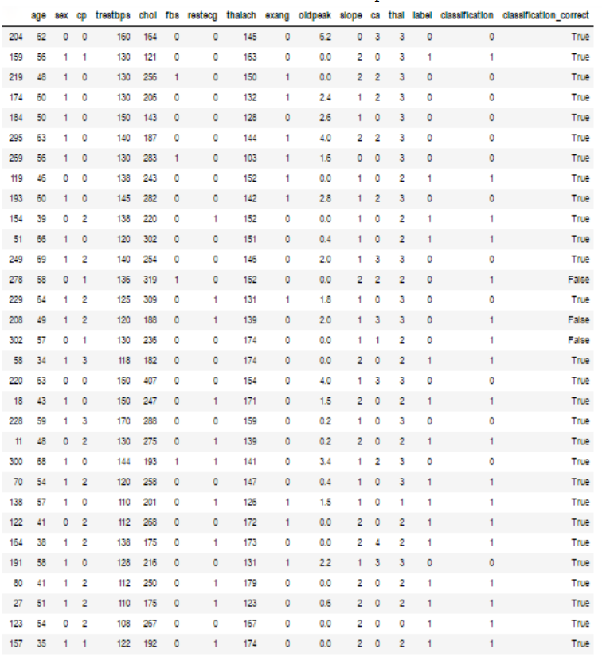
RESULT ANALYSIS(CONTINUED)
ID3 – Built-in classification result
Table 2: ID3 – Built-in final result

Slide 33
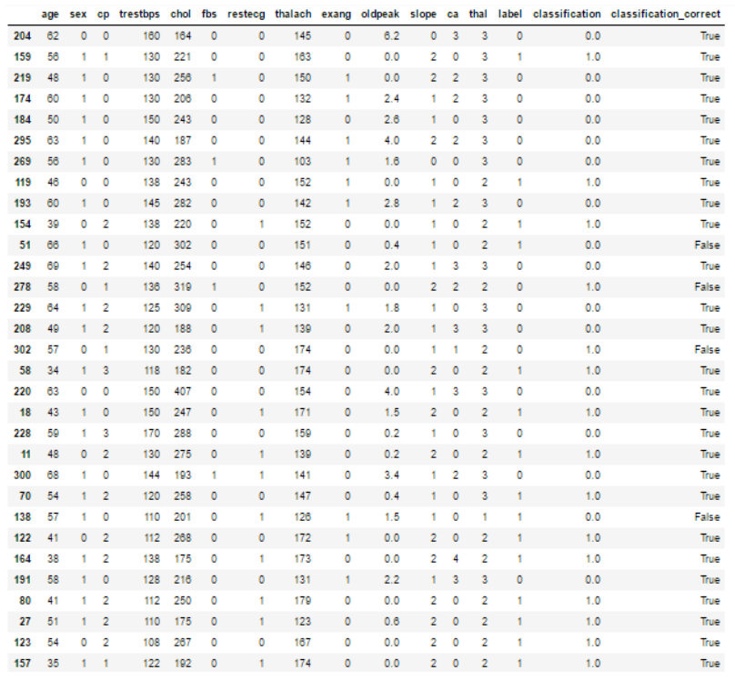
RESULT ANALYSIS(CONTINUED)
ID3 – Scratch classification result
Table 3: ID3 - Scratch final result

Slide 34
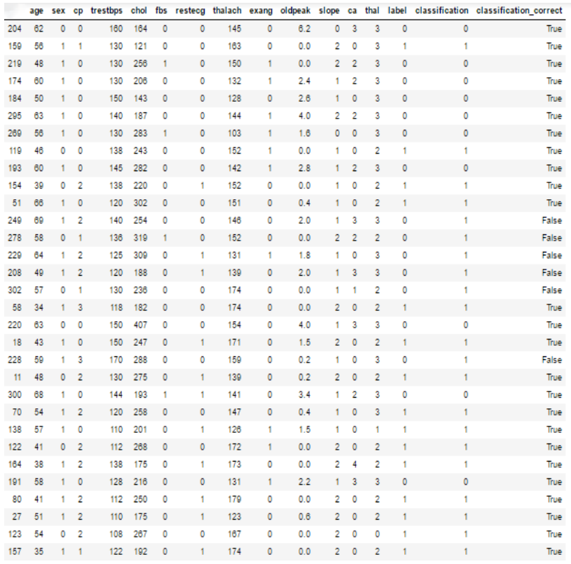
RESULT ANALYSIS(CONTINUED)
CART – Built-in classification result
Table 4: CART – Built-in final result

Slide 35
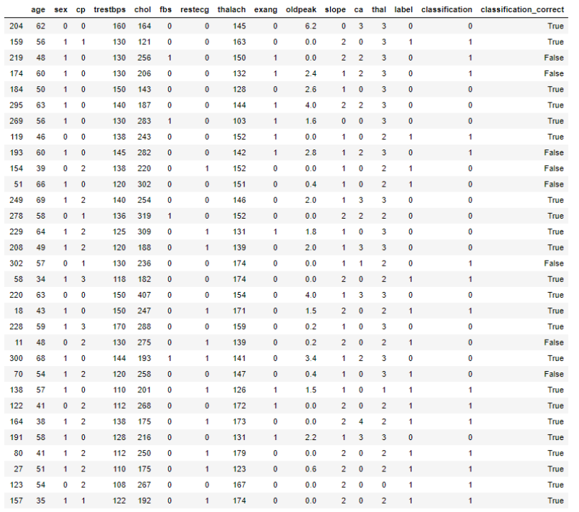
RESULT ANALYSIS(CONTINUED)
CART – Scratch classification result
Table 5: CART – Scratch final result

Slide 36
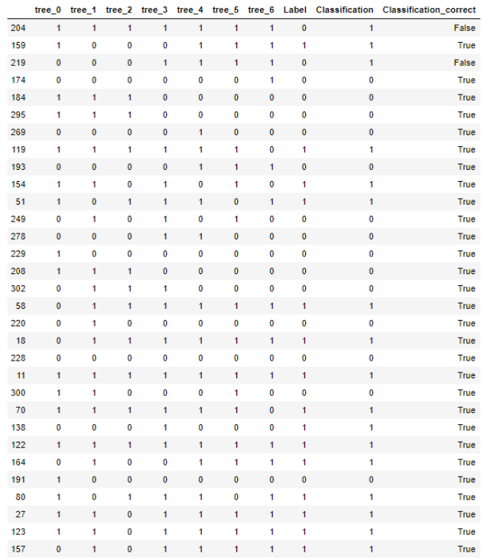
RESULT ANALYSIS(CONTINUED)
Random Forest – Built-in classification result
Table 6: Random Forest- Built-in final result

Slide 37
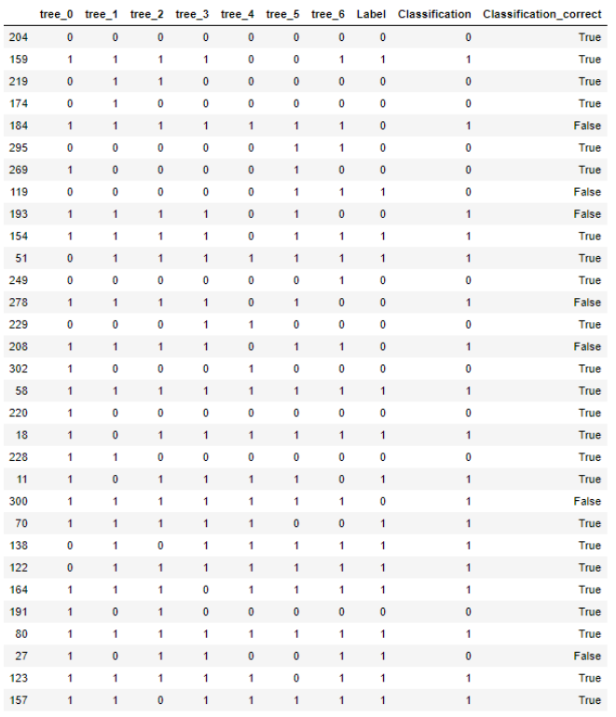
RESULT ANALYSIS(CONTINUED)
Random Forest – Scratch classification result
Table 7: Random Forest- Scratch final result

Slide 38
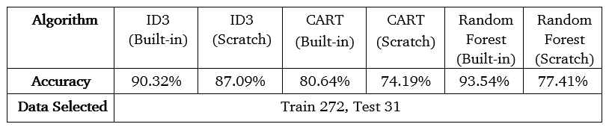
RESULT ANALYSIS(CONTINUED)
Accuracy Comparison of different algorithms
Table 8: Accuracy Comparison

Slide 39
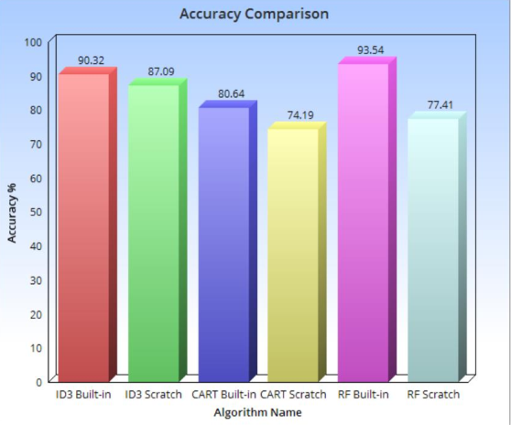
RESULT ANALYSIS(CONTINUED)
Performance graph of different algorithms
Figure 5: Performance Graph of Different Algorithms

Slide 40
CONCLUSION
Implemented Decision Tree for heart disease dataset by ID3 and CART algorithm using built-in library function and from scratch.
Implemented Random Forest algorithm using built-in library function and from scratch.
Compared and analyzed results between them.

Slide 41
FUTURE WORK
Real scenario large dataset of heart disease.
Convert continuous attributes into categorical attributes.
Apply these algorithms on different domains.
Cross-Validation method to increase the accuracy.

Slide 42
REFERENCES
[1] H. Sharma, S. Kumar: “A Survey on Decision Tree Algorithms of Classification in Data Mining”, International Journal of Science and Research(IJSR), 5(4): 2094-2097, April
2016.
[2] B. N. Patel, S. G. Prajapati and K. I. Lakhtaria, "Efficient Classification of Data Using Decision Tree",
Bonfring International Journal of Data Mining, 2(1): 6-12, March 2012.
[3] J. Han, M. Kamber, J. Pei, Data Mining: Concepts and Techniques, 3rd Edition, Morgan Kaufmann, 2011.
[4] M. Last and O. Maimon, “A Compact and Accurate Model for Classification”, IEEE Transactions on Knowledge and Data Engineering,16(2): 203-215, February 2004.
[5] C. S. Dangare, S. S. Apte, “Improved Study of Heart Disease Prediction System using Data
Mining Classification Techniques”, International Journal of Computer Applications, 47(10), June 2012
[6] Anbarasi M, Anupriya E, Iyengar N, “Enhanced prediction of heart Disease with feature subset selection using genetic algorithm”, International Journal of Engineering Science and Technology, 2(10), 2010.

Slide 43
REFERENCES(CONTINUED)
[7] https://medium.com/greyatom/decision-trees-a-simple-way-to-visualize-a-decision-
dc506a403aeb (Accessed: 7 December 2019)
[8] https://towardsdatascience.com/decision-trees-in-machine-learning-641b9c4e8052
(Accessed: 7 December 2019)
[9] https://hackernoon.com/what-is-a-decision-tree-in-machine-learning-15ce51dc445d
(Accessed: 7 December 2019)
[10] http://archive.ics.uci.edu/ml/datasets/Heart+Disease?fbclid=IwAR010
lnNu5IXtez05DPq1LN8rPTfZVMZ1uIsfwanhRZTakg (Accessed 7 August 2019)
[11] https://towardsdatascience.com/decision-trees-in-machine-learning- 641b9c4e8052 (Accessed: 7 December 2019)
[12] https://towardsdatascience.com/the-complete-guide-to-decision-trees-28a4e3c7be14 (Accessed: 21 December 2019)
[13] https://towardsdatascience.com/the-complete-guide-to-decision-trees-28a4e3c7be14 (Accessed: 24 December 2019)

Slide 44
REFERENCES(CONTINUED)
[14] https://sefiks.com/2018/08/27/a-step-by-step-cart-decision-tree-example/
(Accessed: 26 December 2019)
[15] https://sefiks.com/2017/11/20/a-step-by-step-id3-decision-tree-example/
(Accessed: 26 December 2019)
[16] https://towardsdatascience.com/an-implementation-and-explanation-of-the-random- forest-in-python-77bf308a9b76 (Accessed: 26 December 2019)
[17] https://dataaspirant.com/2017/05/22/random-forest-algorithm-machine-learning/ (Accessed: 21 December 2019)
[18] http://www.numpy.org/ (Accessed: 29 December 2019)
[19] http://pandas.pydata.org/ (Accessed: 29 February 2019)
[20] http://seaborn.pydata.org/introduction.html (Accessed: 29 December 2019)

Slide 45
Thank you!!!

