Slide 1
AgriConnect
10th April, 2023

Slide 2
Project objective:
Precision Agriculture
Precision agriculture is about managing variations in the field to increase crop yield, raise productivity and reduce consumption of agricultural inputs.

Slide 3
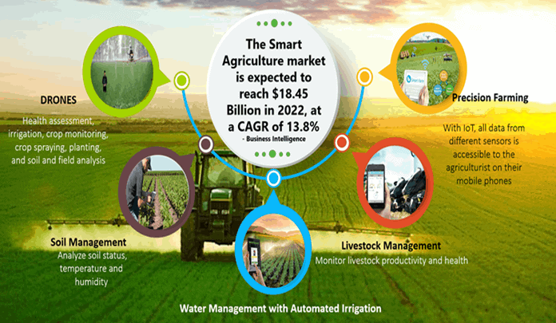

Slide 4
Overview
It is a hardware based implementation which allows the user to track all the changes happening in field over internet.
This includes various sensors like Soil-Moisture,Humidity, Temperature,etc.
This also includes farmer-friendly interface that will tell all-from weather forecasts to tips on current production. These all work on advanced AI-ML Based Design Layout which are currently being upgraded.

Slide 5
Understanding the problem
Accurate data collection:
Labor shortages:
Crop Production Management
Item 3
Irrigation
Targeted crop management
Efficiency
Profitability
Environmental Effects
Precision agriculture involves the use of various technologies, such as sensors and drones, to collect data on soil moisture, temperature, nutrient levels, and other environmental factors. This data can help farmers make informed decisions about crop management practices.
Labor shortages: Agriculture is a labor-intensive industry, and farmers may struggle to find enough workers, particularly during peak seasons.

Slide 6
Applications of IoT Technology for Agriculture
Product Quality Enhancing :
Monitoring soil moisture and trunk diameter in vineyards to control the amount of sugar in grapes and grapevine health.
Green Houses :
Control micro-climate conditions to maximize the production of fruits and vegetables and its quality.
Irrigation :
Selective irrigation in dry zones to reduce the water resources required.
Weather Forecast :
Analysis of weather conditions changes in fields to predict frost formation, rain, drought, snow or wind.
Compost :
Control of moisture levels and temperature in alfalfa, hay, straw, etc. to prevent fungi and other microbial contaminants.

Slide 7
Benefits of Smart Agriculture solution
Increases
Higher crop yield
Better quality
Understand which factors govern crop growth and yields
Guaranteeing food security
Reduces
Less transport costs: human interventions only when needed.
Less time spent
Reduce crop losses through disease or adverse weather
Cost savings reducing use of fertilizers, pesticides and consumables
Fight against droughts, scarcity and famine

Slide 8
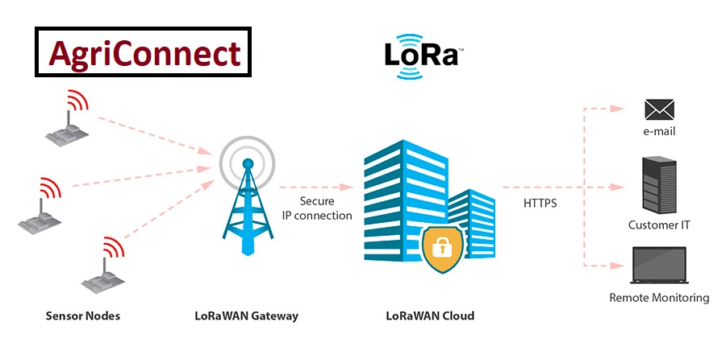
HOW THIS ALL WORKS

Slide 9
Benefits of LoRa
Long Range: A single LoRa base station enables deep penetration capability for dense urban environments and indoor coverage, while also providing the ability to connect to sensors more than 15-30 miles away in rural areas.
Low Cost: LoRa reduces upfront infrastructure investments and operating costs, as well as end-node sensor costs.
Standardized: LoRaWAN ensures interoperability among applications, IoT solution providers and telecom operators to speed adoption and deployment.
Low Power: The LoRaWAN protocol was developed specifically for low power and enables unprecedented multi-year battery lifetime.

Slide 10
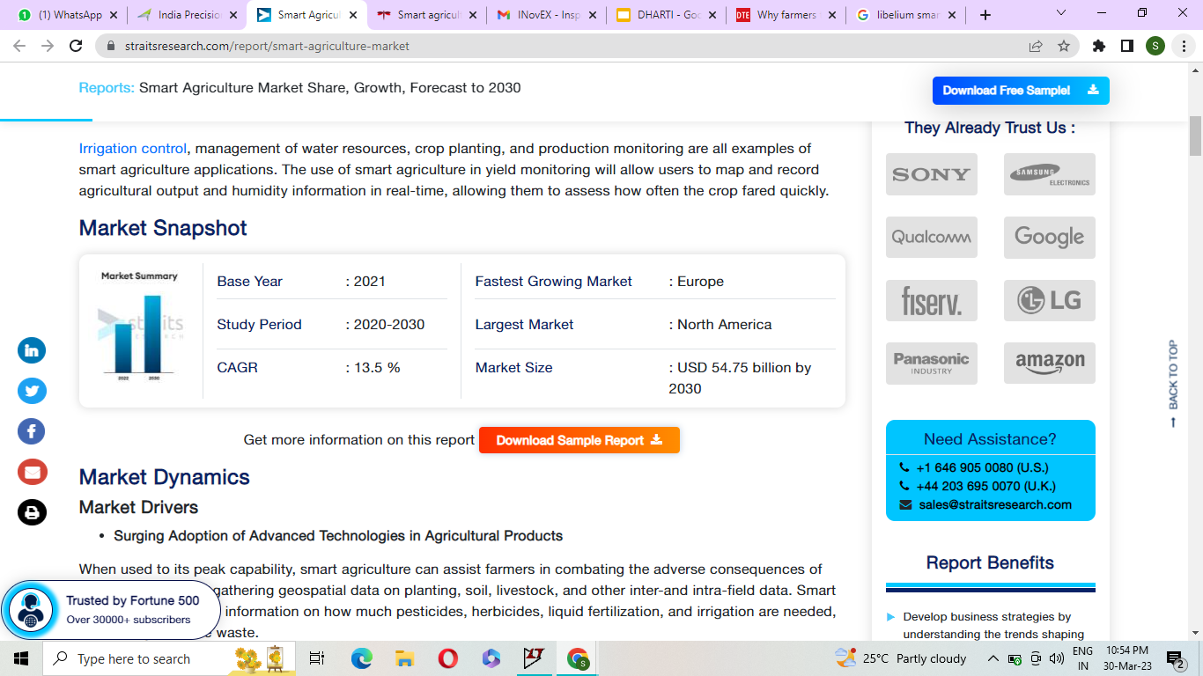
Market trends
Global Trend
The global smart agriculture market size is expected to reach a valuation of USD 54.75 billion by 2030, growing at a CAGR of 13.5% during the forecast period (2023-2030).
Local Trend
India precision agriculture market was valued at over $ 57 million in 2019 and is anticipated to grow at CAGR of over 10% to reach $ 99 million on account of increasing awareness related to the applications of precision agriculture and surging need to ensure maximum yield from limited sized farms.

Slide 11
Target Audience
Electronic hardware equipment manufacturers
Precision agriculture service providers, vendors and other stakeholders
Agricultural equipment manufacturers
Government bodies such as regulating authorities and policy makers
Organizations, forums and alliances related to precision agriculture
Market research and consulting firms

Slide 12
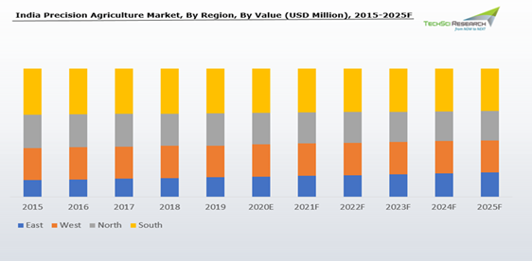
Analysis
Objective of the Analysis:
To analyze and forecast the market size of India precision agriculture market.
To classify and forecast India precision agriculture market based on technology, component, application and regional distribution.
To identify drivers and challenges for India precision agriculture market.
35
25
22
To examine competitive developments such as expansions, new product launches, mergers & acquisitions, etc., in India precision agriculture market.
To conduct pricing analysis for India precision agriculture market.
To identify and analyze the profile of leading players operating in India precision agriculture market.
15

Slide 13
Proposed deliverables
Deliverable 1
Sensor and LoRaWAN Integration
Deliverable 2
ML-DS based modelling and cloud based technology integration
Deliverable 3
Predictive analysis and Website/App based monitoring..
Deliverable 4
Optimisations

Slide 14
Timeline
Jan | Feb | Mar | Apr | May | Jun | Jul | Jul
In-Progress
In-production services
Testing Phases
Advanced projects
Versions For Every Field
Feature-Rich
Customisable by User

Slide 15
The Team
Jigishu Bhadviya
Electrical Team
S. Hari Rithanyaa
Adithya Narayan
AgriConnect
Ashutosh Singh
CS and Mechanical
Aneesh Bendale

