Slide 1

Keystroke Logging Demonstration
Harshitha GN

Slide 2

PROBLEM STATEMENT
With the increasing number of cyber security threats, traditional password-based authentication systems have proven insufficient in preventing unauthorized access. Static credentials can be easily compromised, leading to serious data breaches. This project proposes a keystroke dynamics-based authentication system that records and analyzes user typing behavior during login. By comparing real-time keystroke patterns with stored user profiles, the system aims to provide an additional layer of security that is non-intrusive, cost-effective, and difficult to replicate by attackers.

Slide 3
Project Description
The Keystroke Dynamics Login System is a security-based application that authenticates users not only by their credentials but also by their typing behavior
How it works:
The system records keystroke features such as:
Key press time
Key release time
Typing speed
Time interval between consecutive keys
During registration, the user’s typing pattern is stored.
During login, the system compares the current typing pattern with the stored pattern.
If both the password and typing pattern match within a threshold, access is granted.

Slide 4

WHO ARE THE END USERS?
Organizations & Companies
For secure employee login systems
Educational Institutions
Student portals and online exam authentication
Banking & Financial Systems
Extra security for sensitive accounts
Software Applications
Systems requiring multi-factor authentication
Individual Users
Personal systems needing enhanced login protection
The end users of the Keystroke Dynamics Login System include:

Slide 5

Technology Used
Python
Keyboard event handling
Time module
Basic pattern comparison (threshold-based)
Optional: Machine Learning for advanced matching

Slide 6
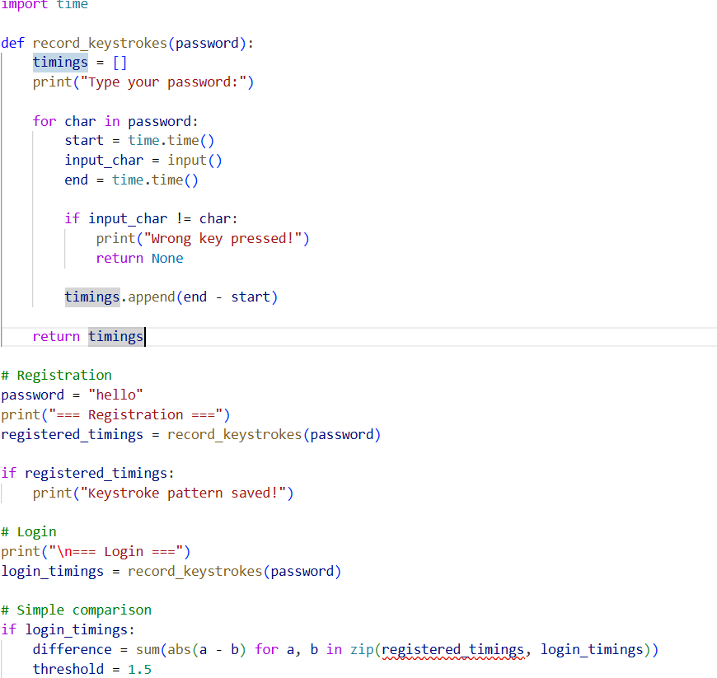
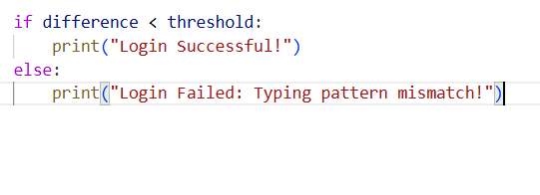
RESULTS
Demo Link

Slide 7
Thank you
.
.

