Slide 1

Notes:
Display this screen and play music before presentation starts.

Slide 2

Career Exploration for the College Student
Presenter: Dr. Brenda Edwards
Piedmont Technical College

Slide 3
Over 80% of students will change their major more than once while in college. And most of them will change more than two to three times.
Why?
Students find a new or different major which supports their interests, values, passion, or personality.
Students choose a career that is practical – something that will pay the bills.
No one asked the right questions at the initial admissions intake process.
Students may listen to outside influences on what career they should go into.
Reference: National Center for Education Statistics, 2013.

Slide 4

“Typical” Outside Influences Used to Choose a Career
TV = There is a big difference between TV drama and “real life”.
Friends = They’ll know what sounds “cool”, but unless they have proactively used the career /college tools available, they are probably not a knowledgeable source of information.
Life’s Interactions = OK, you have used the services of Dentists, Pharmacists, Teachers, etc. but… Do you really know what it is like to do their job?
Parent = A great source, if your parent’s career happens to be “the right one” out of several hundred possibilities for you.

Slide 5

What is Career Exploration?

Slide 6
3 Stages of Career Exploration
Stage 1 : Determine Your Interests
Stage 2: Discover Your Career
Stage 3: Plan your Goals

Slide 7

Stage 1: Determine Your Interests
Knowing about yourself is the basis of career decision-making. What are your interests, skills, and values? What is important to you about your work? What are your personal traits and characteristics? Ask yourself:
» What do I like to do?
» What do I value?
» What motivates me? What keeps my curiosity?
» What skills do I possess? What new ones can I develop?

Slide 8

Stage 2: Discover Your Career
Learning about the careers, types of jobs, educational requirements, and job functions are important in understanding the careers that fit your interests and goals. You may ask yourself:
» What are examples of careers in my chosen major or field of interest?
» What job titles interest me?
» What type of work environments do I like?
» Where can I go to research my chosen career or field of interest?

Slide 9

Stage 3: Plan your Goals
Take what you have learned about yourself and piece it together with the reality of the world of work. Begin to evaluate career options that are practical for you. Use decision-making and action planning skills to identify successful career and life plans. Some important questions include:
» Do I have the resources to pursue these options?
» What challenges might be presented during my educational pursuit? In the job market?
» What else do I need to know to identify my career objectives?
» Do I need to conduct more self-assessment or career research to make a career decision?

Slide 10

Why is Career Exploration Important?

Slide 11

Benefits of Career Planning
While in college:
Clarify short and long term goals
Fewer transfers and switching of major
Graduate on time
More motivated and goal focused
Higher academic achievement
After Graduation:
Better entry job with higher income
More satisfied with chosen career field
Less career change and faster career advancement

Slide 12

The consequences of NOT planning are costly…
Absence of Career Planning is a major cause of:
Switching majors
The feeling of being trapped in a major
College transfer
Dropout
Extended year(s) in school
Run out of Financial Aid

Slide 13

So… what is the answer?

Slide 14

What kind of Questions do you ask to determine if a student needs assistance in deciding on a major?

Slide 15

Open-ended questions
Closed-ended questions

Slide 16

So… if we know what kind of Questions to ask and the student is unsure or undecided about a career/major then what to do?

Slide 17
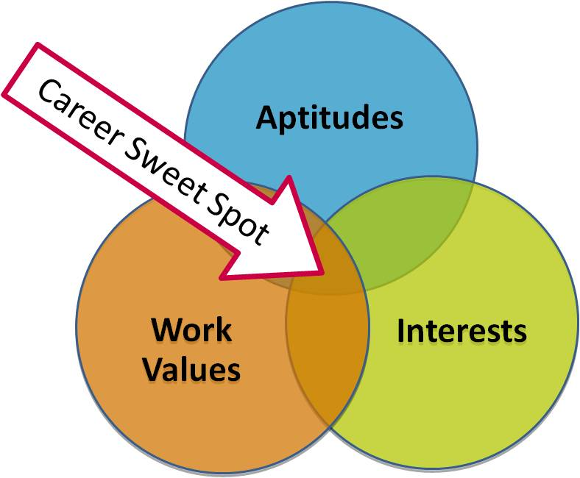
Refer student for Career Planning

Slide 18

Career Planning…Personality, Interest, & Values Assessments
Knowing yourself sets the stage for choosing careers that are right for you. It makes sense to choose a career that fits your personality strengths, values, interests, and skills.

Slide 19
There are many Personality and Interest Assessments…
TypeFocus
MBTI (Myers Briggs Type Indicator)
SDS (Self-Directed Search)
My Next Move O*NET Interests Profiler
Career Strengths Test
StrengthsQuest
Holland’s Personality

Slide 20
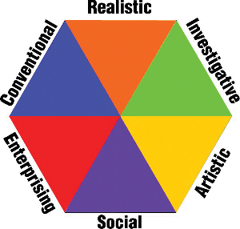
Holland’s Six Personality Types

Slide 21

Holland’s Six Personality Types
In our culture most people are stronger in one personality type than another.
All professions may require to some degree, all personality types.
People who work in a profession and environment that fits their “personality” tend to be successful and satisfied.

Slide 22

Theory of John Holland
John Holland, a psychologist who was drafted by the army in WW2, developed a classification system for jobs in the military based upon his theory describing six work environments and six vocational personalities.
Holland believed that career choice is an extension of a person's personality. People express themselves, their interests and values through their work choices and experience.
Holland assigns both people and work environments into specific types or themes.

Slide 23
What is your Holland’s personality type?

Slide 24

Activity: Walk around the room, read each poster, decide which Type best represents YOU and stand by that poster. Label this Type as your 1st Choice on your worksheet. Discussion: Why did you pick this type?

Slide 25
Activity: Move to your second favorite Type and write it on the worksheet as your 2nd choice.
Discussion:
Why did you choose this type?
Finally…
Move to your next choice and write it on the worksheet as your 3rd choice.

Slide 26
What is YOUR Holland Code?
RIS CSI
RCE CSE
RIC CES
RCI AES
REC AER
RIE ASC
CRS ESA
CIE ESC
CSR ECR
IRE ESR
IRC ISE
IRS SIR SRI SAE SRC SEC SAI SCE

Slide 27

How do you think the Hollands Personality codes relate to college majors?

Slide 28

People who choose a career or major that matches or is similar to their personality or interest type are more likely to be successful and satisfied.

Slide 29
In fact…
The Holland personality types are strong predictors of the majors students choose, and the impact of this choice lasts far beyond student learning and success in college -- job stability, salaries earned, job satisfaction, and career opportunities. (Porter & Umbach, 2006)
The more students choose a college major compatible with their “Holland personality type”, the more likely they are to:
Earn higher grades,
Persist in their choice of major,
Graduate on time, and
Be more satisfied and successful in their career (Kristof-Brown, et al., 2005).

Slide 30
College majors and personality….
The key to finding a satisfying career is to match your fundamental interests and personality type with occupations.
A Social person would go crazy sitting alone in an office all day.
An Artistic person would probably hate having to conform to a set of strict rules in a job.
That is why career and vocational test can be so helpful.
AND…
Assessments using Holland Personality Types provide information on the relationship between job personalities and key characteristics, college majors, hobbies, abilities, and related careers.
Reference: John Holland (1985) Making Vocational Choices (2nd ed.) Odessa, FL.: Psychological Assessment Resources, Inc.

Slide 31

Help our students take charge.
Our students are responsible for making their education and career decisions, managing their career and controlling their destiny.
Their career will affect their future lifestyle of fulfillment as well as where and how they live, their financial security, their leisure time activities, etc.

Slide 32

Career Exploration
Help each student reach their potential by seeking career guidance they need to start a career path that leads to a rewarding future.

Slide 33
Questions?
Thank you!
Dr. Brenda Edwards
Piedmont Technical College
864-941-8750
edwards.b@ptc.edu

