Slide 1
Technical Definition:
Object-Oriented Programming (OOP) is a programming methodology that organizes software design around objects, which are instances of classes. These objects encapsulate both data and the functions that operate on that data. It promotes concepts like abstraction, encapsulation, inheritance, and polymorphism to design reusable and maintainable software.

Slide 2
OOPS(power to depict the real world in a programming context)
Objects Mirror Reality: In the real world, we deal with "objects" like cars, people, animals, books, bank accounts, etc. Each of these objects has characteristics (like a car's color, make, model) and can perform actions (like a car driving, stopping). OOPS allows us to directly translate these real-world objects into "objects" in our code, giving them properties (data) and behaviors (methods).
Relationships between Objects: Just as real-world objects interact (e.g., a "person" drives a "car," a "customer" makes a "transaction" with a "bank account"), OOPS allows us to model these relationships through concepts like inheritance (a "sports car" is a "car") and composition (a "car" has an "engine").
Natural Problem Solving: When we think about solving a problem, we often naturally break it down into interacting entities. OOPS encourages this natural way of thinking, making the transition from a real-world problem description to a software solution more intuitive and less abstract.
So, in essence, OOPS provides a framework that allows programmers to model complex real-world systems in a way that is more understandable, maintainable, and extensible, by mapping real-world entities and their interactions directly into code.

Slide 3
Class
✅ how do you explain to you grandfather
A class is like a blueprint or design for creating things. Just like an architect’s plan for a house, it doesn’t build anything by itself, but it tells how something should be made.
✅ Actual Defination:
A class is a user-defined data type that acts as a template for creating objects. It defines the attributes (variables) and behaviors (methods) that the objects created from it will have.

Slide 4
Object
✅ how do you explain to you grandfather
An object is the actual thing you create from a blueprint. If a class is the house design, then an object is the real house built using that design.
✅ Actual Definition:
An object is an instance of a class. It is a real-world entity in memory that has state (data/attributes) and behavior (methods/functions)

Slide 5
.NET Framework
The .NET Framework, developed by Microsoft, is a software development platform for building and running applications on Windows. It provides a controlled programming model and a comprehensive set of tools and libraries that simplify application development. At its core, the .NET Framework aims to provide language interoperability, meaning you can write code in different programming languages that can work together seamlessly.

Slide 6
1. .NET Framework (Developed by Microsoft, First version: 2002)
Supports Multiple Programming Languages
🔹 Microsoft Languages (11) → Examples: C#, VB.Net
🔹 Non-Microsoft Languages (50+) → Supported but not developed by Microsoft
2. .NET Framework Application Development
Types of Applications
🖥 Form-based applications → Desktop software
🌐 Web-based applications → Websites & online platforms
🔄 Web services → APIs & backend services
Supported Platforms
🏢 Windows
📱 Phones
🌍 Web
3. Key Features of .NET Framework
✅ Rich functionalities
✅ Industry standard compliance
✅ Large ecosystem of tools & libraries

Slide 7
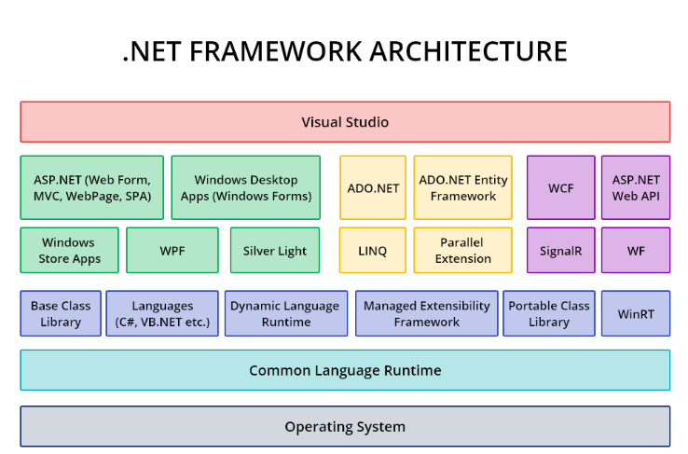

Slide 8
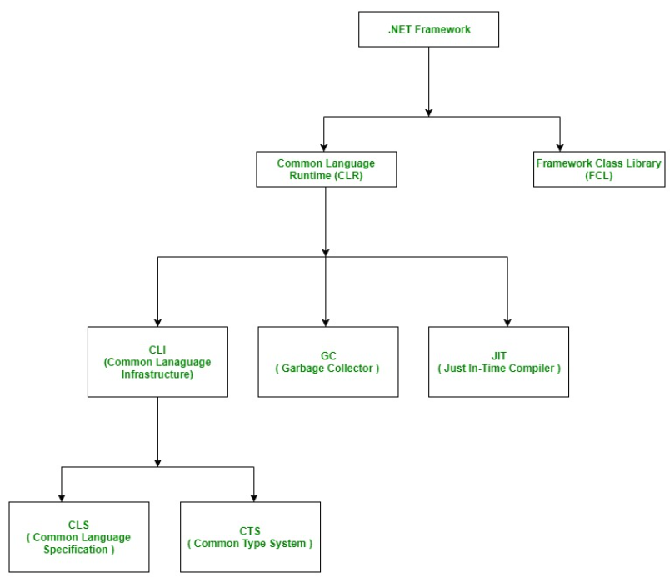
Components of .NET Framework

Slide 9
1. Common Language Runtime (CLR)
Acts as the execution engine for .NET applications.
Handles memory management, security, and exception handling.
Converts Intermediate Language (IL) code into machine code using Just-In-Time (JIT) compilation.
2. .NET Framework Class Library (FCL)
A vast collection of reusable classes, interfaces, and types.
Provides functionalities for file operations, network communication, data access, and more.
Includes namespaces like System.IO, System.Net, System.Data, etc.
3. Common Type System (CTS)
Defines a set of data types that all .NET languages must adhere to.
Ensures interoperability between different programming languages.

Slide 10
1. Common Language Infrastructure (CLI)
Definition: Standardized framework for application execution
Components of CLI:
📜 CTS (Common Type System) → Defines universal data types
🎯 CLS (Common Language Specification) → Ensures language interoperability
🔍 Metadata & Assembly → Stores type information
🚀 Virtual Execution System (VES) → Executes programs

Slide 11
Common Type System (CTS)
Purpose: Defines rules for data types across all languages
Main Categories:
Value Types → Stored directly in memory (e.g., int, float)
Reference Types → Stored as references (e.g., class, object)
Common Language Specification (CLS)
Purpose: Provides guidelines for language interoperability
Ensures Compatibility:
✅ Languages conforming to CLS can interact seamlessly
✅ Restricts language features that may cause conflicts

Slide 12
How They Work Together
CLI acts as the base and ensures that multiple languages can run within the .NET environment.
CTS standardizes the types used across languages, making sure every language in .NET understands fundamental data types.
CLS enforces rules to guarantee smooth interoperability, allowing applications built in different languages (like C# and VB.NET) to work together without issues.
So, CLI provides the framework, CTS ensures type consistency, and CLS sets language compatibility guidelines, making .NET a multi-language-friendly platform.

Slide 13
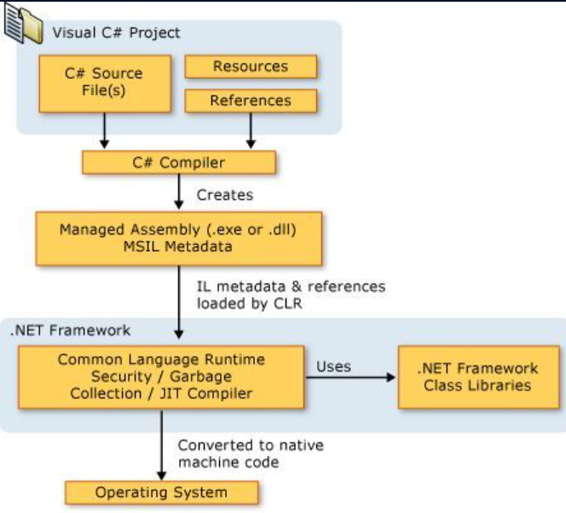

Slide 14
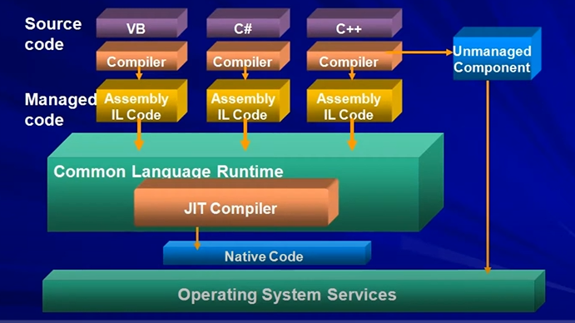

Slide 15
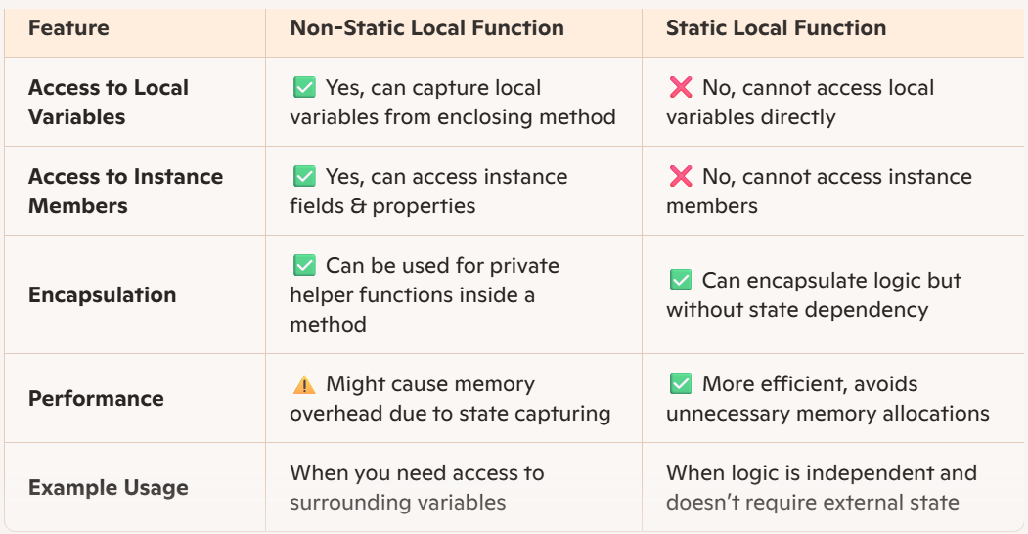

Slide 16
When to Use Each
✔ Use Non-Static Local Functions when you need to access variables from the enclosing method. ✔ Use Static Local Functions when the function is independent, improving performance by preventing unintended variable capturing.

Slide 17
An indexer in C# allows objects to be accessed using an array-like syntax. Instead of creating separate getter and setter methods, indexers provide a more intuitive way to retrieve and modify data within a class.
Indexer

Slide 18
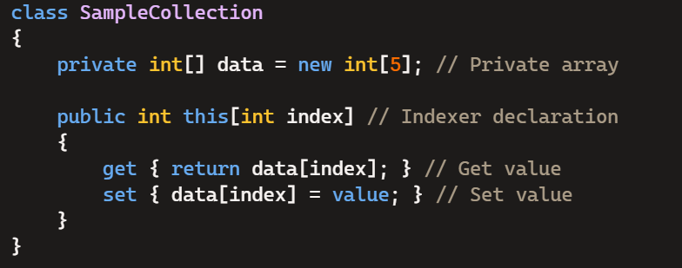

Slide 19
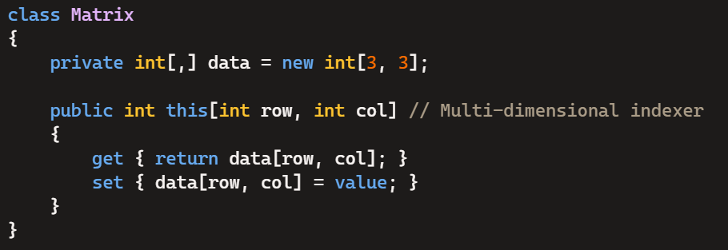
Database Row Representation
Imagine you have a class representing a database row. Indexers allow accessing columns dynamically:
Multi-Dimensional Data Access (Matrix)

Slide 20
Key Advantages of Indexers
✔ Simplifies object access (like an array) ✔ Enhances readability & usability ✔ Provides controlled access to collections

